Slide 1
A Study of Isaiah
Prophecy of the Fall of Babylon
August 21, 2019
Palm Beach Lakes
Class Seven
Dan Jenkins

Slide 2
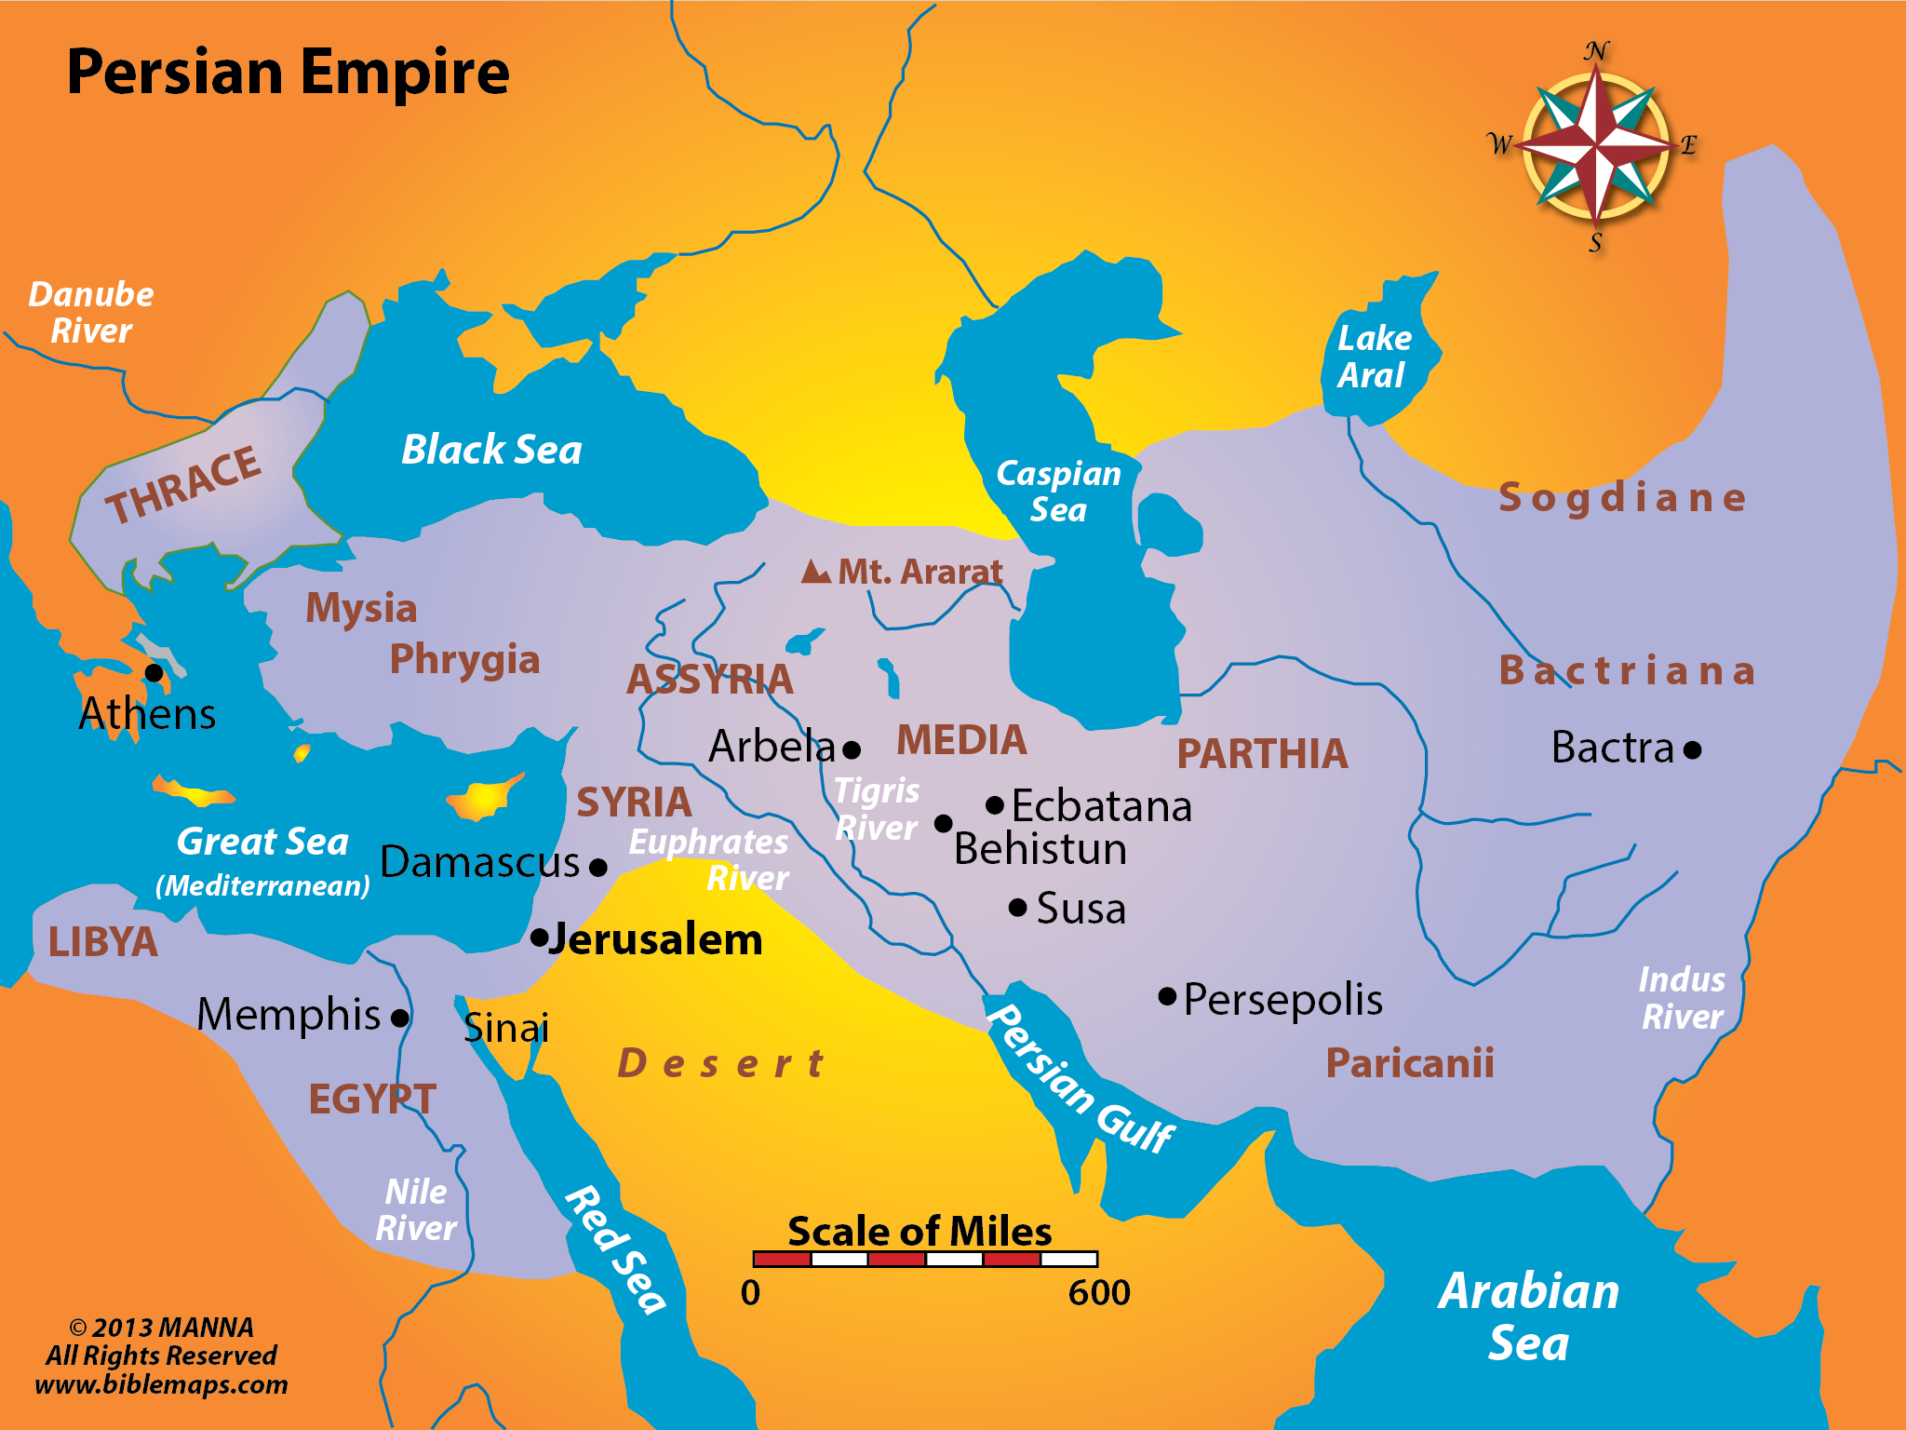
SYRIA
ASSYRIA
BABYLON
EGYPT
ETHIOPIA

Slide 3
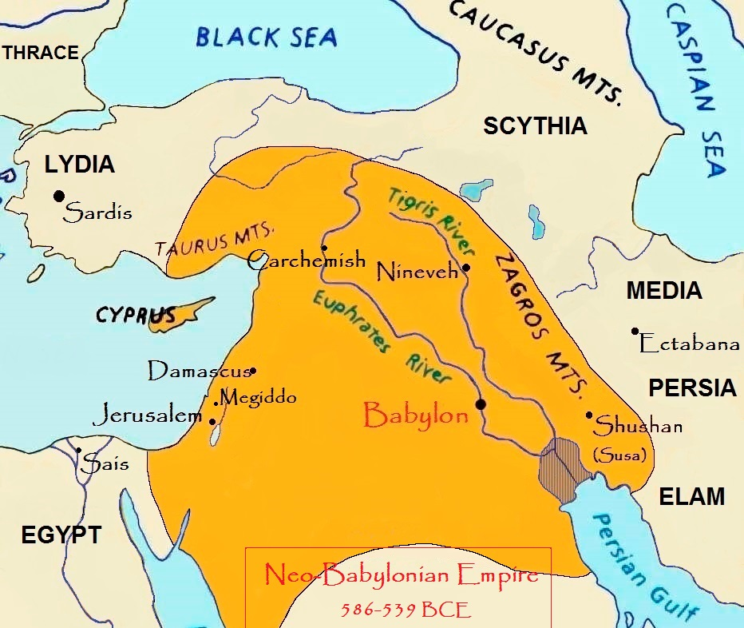

Slide 4
28
Babylon in Isaiah 13
Babylon, located about 80 km (50 miles) south of modern Baghdad in Iraq, was an ancient city with a history of settlement dating back to the 3rd millennium B.C. The greatest period in the city’s history was in the 6th century BCE during the reign of Nebuchadnezzar II when the city was the capital of the Neo-Babylonian Empire. The empire had been founded by Nebuchadnezzar’s father Nabopolassar (r. 625-605 B.C.) after his victories over the Assyrian Empire. Nebuchadnezzar II would go on to even greater things, including the capture of Jerusalem in 597 B.C. The Babylonian king then set about making his capital one of the most splendid cities in the world. The Istar Gate was built c. 575 B.C. with its fine towers and depictions in tiles of animals both real and imaginary, a 7-20 km brick double wall surrounded the city - the largest ever built - and then, possibly, he added the extensive pleasure gardens whose fame spread throughout the ancient world.
Brief History of Babylon

Slide 5
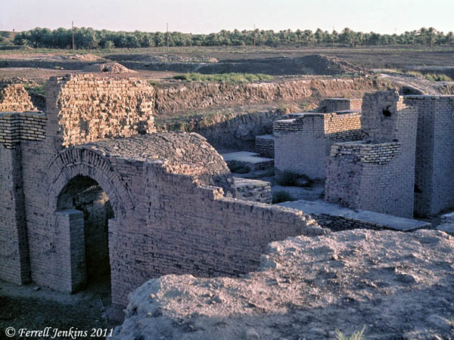
28
Ruins of Babylon

Slide 6
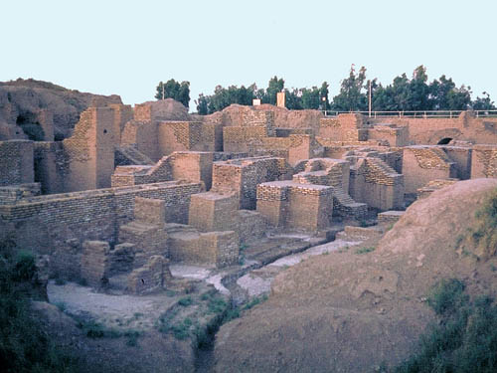
28
Ruins of Babylon

Slide 7
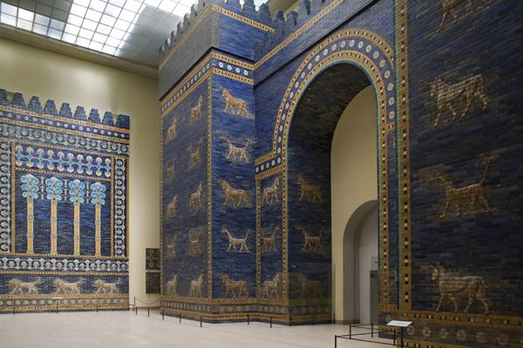
28
Babylon
Istar Gate

Slide 8
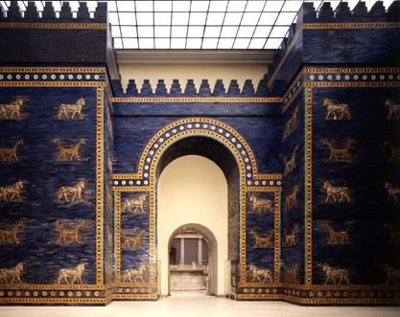
28
Babylon
Istar Gate

Slide 9
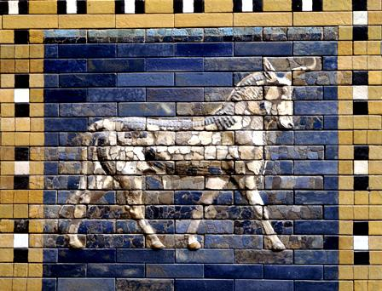
28
Babylon
Istar Gate

Slide 10
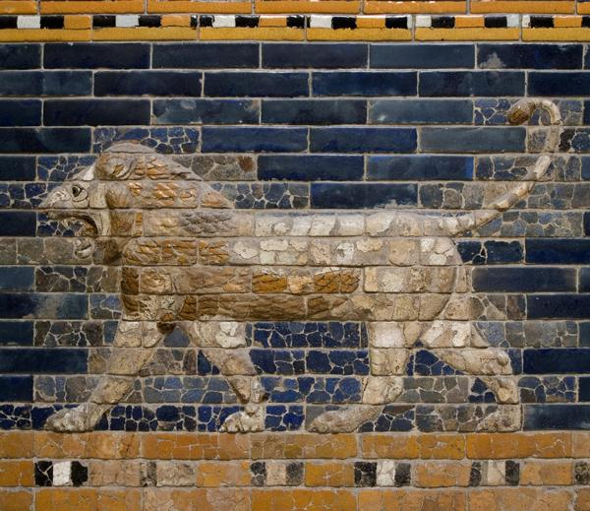
8
Babylon
Istar Gate

Slide 11
28
Babylon—Important City Throughout Bible
First mention—Tower of Babel (Confusion)
Babylon/Babylonia—295 times in Bible; 12 in N.T.
Last mention—Revelation, obviously figurative
Isaiah—“NOT a distant city far away” 2 Ki. 20:12ff
Impacted Jews, Nebuchadnezzar destroyed temple
Isaiah (200 years before it rose) told of its doom
God of Jews GREATER than gods of Babylon

Slide 12
28
Babylon in Isaiah 13
1 The burden against Babylon which Isaiah the son of Amoz saw. . . .
4 The noise of a multitude in the mountains, Like that of many people! A tumultuous noise of the kingdoms of nations gathered together! The LORD of hosts musters The army for battle.
5 They come from a far country, From the end of heaven—The LORD and His weapons of indignation, To destroy the whole land.
6 Wail, for the day of the LORD is at hand! It will come as destruction from the Almighty. . . .
9 Behold, the day of the LORD comes, Cruel, with both wrath and fierce anger, To lay the land desolate; And He will destroy its sinners from it.
Message to Babylon

Slide 13
28
Babylon in Isaiah 13
1 The burden against Babylon which Isaiah the son of Amoz saw. . . .
4 The noise of a multitude in the mountains, Like that of many people! A tumultuous noise of the kingdoms of nations gathered together! The LORD of hosts musters The army for battle.
5 They come from a far country, From the end of heaven—The LORD and His weapons of indignation, To destroy the whole land.
6 Wail, for the day of the LORD is at hand! It will come as destruction from the Almighty. . . .
9 Behold, the day of the LORD comes, Cruel, with both wrath and fierce anger, To lay the land desolate; And He will destroy its sinners from it.
Message to Babylon
It will fall to God’s army

Slide 14
28
Babylon in Isaiah 13
1 The burden against Babylon which Isaiah the son of Amoz saw. . . .
4 The noise of a multitude in the mountains, Like that of many people! A tumultuous noise of the kingdoms of nations gathered together! The LORD of hosts musters The army for battle.
5 They come from a far country, From the end of heaven—The LORD and His weapons of indignation, To destroy the whole land.
6 Wail, for the day of the LORD is at hand! It will come as destruction from the Almighty. . . .
9 Behold, the day of the LORD comes, Cruel, with both wrath and fierce anger, To lay the land desolate; And He will destroy its sinners from it.
Babylon is God’s army
It will fall to God’s army
Great destruction is coming

Slide 15
28
Babylon in Isaiah 13
1 The burden against Babylon which Isaiah the son of Amoz saw. . . .
4 The noise of a multitude in the mountains, Like that of many people! A tumultuous noise of the kingdoms of nations gathered together! The LORD of hosts musters The army for battle.
5 They come from a far country, From the end of heaven—The LORD and His weapons of indignation, To destroy the whole land.
6 Wail, for the day of the LORD is at hand! It will come as destruction from the Almighty. . . .
9 Behold, the day of the LORD comes, Cruel, with both wrath and fierce anger, To lay the land desolate; And He will destroy its sinners from it.
Babylon is God’s army
It will fall to God’s army
Great destruction is coming
It is the day of the Lord, the
Lord’s day

Slide 16
28
Babylon in Isaiah 13
1 The burden against Babylon which Isaiah the son of Amoz saw. . . .
4 The noise of a multitude in the mountains, Like that of many people! A tumultuous noise of the kingdoms of nations gathered together! The LORD of hosts musters The army for battle.
5 They come from a far country, From the end of heaven—The LORD and His weapons of indignation, To destroy the whole land.
6 Wail, for the day of the LORD is at hand! It will come as destruction from the Almighty. . . .
9 Behold, the day of the LORD comes, Cruel, with both wrath and fierce anger, To lay the land desolate; And He will destroy its sinners from it.
Babylon is God’s army
From a far country
Destruction coming to Jews
It is the day of the Lord, the
Lord’s day
His wrath & fierce anger

Slide 17
28
Babylon in Isaiah 13
1 The burden against Babylon which Isaiah the son of Amoz saw. . . .
4 The noise of a multitude in the mountains, Like that of many people! A tumultuous noise of the kingdoms of nations gathered together! The LORD of hosts musters The army for battle.
5 They come from a far country, From the end of heaven—The LORD and His weapons of indignation, To destroy the whole land.
6 Wail, for the day of the LORD is at hand! It will come as destruction from the Almighty. . . .
9 Behold, the day of the LORD comes, Cruel, with both wrath and fierce anger, To lay the land desolate; And He will destroy its sinners from it.
Babylon is God’s army
It will fall to God’s army
Great destruction is coming
It is the day of the Lord, the
Lord’s day
His wrath & fierce anger
His judgment against sin

Slide 18
28F
Babylon in Isaiah 13
10 For the stars of heaven and their constellations Will not give their light; The sun will be darkened in its going forth, And the moon will not cause its light to shine.
11 "I will punish the world for its evil, And the wicked for their iniquity; I will halt the arrogance of the proud, And will lay low the haughtiness of the terrible.
12 I will make a mortal more rare than fine gold, A man more than the golden wedge of Ophir.
13 Therefore I will shake the heavens, And the earth will move out of her place, In the wrath of the LORD of hosts And in the day of His fierce anger.
14 It shall be as the hunted gazelle, And as a sheep that no man takes up; Every man will turn to his own people, And everyone will flee to his own land.
Fall figuratively described

Slide 19
28F
Babylon in Isaiah 13
10 For the stars of heaven and their constellations Will not give their light; The sun will be darkened in its going forth, And the moon will not cause its light to shine.
11 "I will punish the world for its evil, And the wicked for their iniquity; I will halt the arrogance of the proud, And will lay low the haughtiness of the terrible.
12 I will make a mortal more rare than fine gold, A man more than the golden wedge of Ophir.
13 Therefore I will shake the heavens, And the earth will move out of her place, In the wrath of the LORD of hosts And in the day of His fierce anger.
14 It shall be as the hunted gazelle, And as a sheep that no man takes up; Every man will turn to his own people, And everyone will flee to his own land.
Fall figuratively described
God’s nature demands it

Slide 20
28F
Babylon in Isaiah 13
10 For the stars of heaven and their constellations Will not give their light; The sun will be darkened in its going forth, And the moon will not cause its light to shine.
11 "I will punish the world for its evil, And the wicked for their iniquity; I will halt the arrogance of the proud, And will lay low the haughtiness of the terrible.
12 I will make a mortal more rare than fine gold, A man more than the golden wedge of Ophir.
13 Therefore I will shake the heavens, And the earth will move out of her place, In the wrath of the LORD of hosts And in the day of His fierce anger.
14 It shall be as the hunted gazelle, And as a sheep that no man takes up; Every man will turn to his own people, And everyone will flee to his own land.
Fall figuratively described
God’s nature demands it
When God gets angry!

Slide 21
28F
Babylon in Isaiah 13
10 For the stars of heaven and their constellations Will not give their light; The sun will be darkened in its going forth, And the moon will not cause its light to shine.
11 "I will punish the world for its evil, And the wicked for their iniquity; I will halt the arrogance of the proud, And will lay low the haughtiness of the terrible.
12 I will make a mortal more rare than fine gold, A man more than the golden wedge of Ophir.
13 Therefore I will shake the heavens, And the earth will move out of her place, In the wrath of the LORD of hosts And in the day of His fierce anger.
14 It shall be as the hunted gazelle, And as a sheep that no man takes up; Every man will turn to his own people, And everyone will flee to his own land.
Fall figuratively described
God’s nature demands it
When God gets angry!
Desolation of Babylonians

Slide 22
28
Babylon in Isaiah 13
15 Everyone who is found will be thrust through, And everyone who is captured will fall by the sword.
16 Their children also will be dashed to pieces before their eyes; Their houses will be plundered And their wives ravished.
17 "Behold, I will stir up the Medes against them, Who will not regard silver; And as for gold, they will not delight in it. . . . .
19 And Babylon, the glory of kingdoms, The beauty of the Chaldeans' pride, Will be as when God overthrew Sodom and Gomorrah.
20 It will never be inhabited, Nor will it be settled from generation to generation; Nor will the Arabian pitch tents there, Nor will the shepherds make their sheepfolds there.
Total destruction

Slide 23
28
Babylon in Isaiah 13
15 Everyone who is found will be thrust through, And everyone who is captured will fall by the sword.
16 Their children also will be dashed to pieces before their eyes; Their houses will be plundered And their wives ravished.
17 "Behold, I will stir up the Medes against them, Who will not regard silver; And as for gold, they will not delight in it. . . . .
19 And Babylon, the glory of kingdoms, The beauty of the Chaldeans' pride, Will be as when God overthrew Sodom and Gomorrah.
20 It will never be inhabited, Nor will it be settled from generation to generation; Nor will the Arabian pitch tents there, Nor will the shepherds make their sheepfolds there.
Total destruction
Tells nation who He will use

Slide 24
28
Babylon in Isaiah 13
15 Everyone who is found will be thrust through, And everyone who is captured will fall by the sword.
16 Their children also will be dashed to pieces before their eyes; Their houses will be plundered And their wives ravished.
17 "Behold, I will stir up the Medes against them, Who will not regard silver; And as for gold, they will not delight in it. . . . .
19 And Babylon, the glory of kingdoms, The beauty of the Chaldeans' pride, Will be as when God overthrew Sodom and Gomorrah.
20 It will never be inhabited, Nor will it be settled from generation to generation; Nor will the Arabian pitch tents there, Nor will the shepherds make their sheepfolds there.
Total destruction
Tells nation who He will use

Slide 25
28
Babylon in Isaiah 13
15 Everyone who is found will be thrust through, And everyone who is captured will fall by the sword.
16 Their children also will be dashed to pieces before their eyes; Their houses will be plundered And their wives ravished.
17 "Behold, I will stir up the Medes against them, Who will not regard silver; And as for gold, they will not delight in it. . . . .
19 And Babylon, the glory of kingdoms, The beauty of the Chaldeans' pride, Will be as when God overthrew Sodom and Gomorrah.
20 It will never be inhabited, Nor will it be settled from generation to generation; Nor will the Arabian pitch tents there, Nor will the shepherds make their sheepfolds there.
Total destruction
Tells nation who He will use
Prophecy 200+ years before
Babylon destroyed

Slide 26
28
Babylon in Isaiah 13
15 Everyone who is found will be thrust through, And everyone who is captured will fall by the sword.
16 Their children also will be dashed to pieces before their eyes; Their houses will be plundered And their wives ravished.
17 "Behold, I will stir up the Medes against them, Who will not regard silver; And as for gold, they will not delight in it. . . . .
19 And Babylon, the glory of kingdoms, The beauty of the Chaldeans' pride, Will be as when God overthrew Sodom and Gomorrah.
20 It will never be inhabited, Nor will it be settled from generation to generation; Nor will the Arabian pitch tents there, Nor will the shepherds make their sheepfolds there.
Total destruction
Tells nation who He will use
Prophecy 200+ years before
Babylon destroyed
Destroyed like Sodom
It will NEVER be rebuilt

Slide 27
28
Babylon in Isaiah 13
15 Everyone who is found will be thrust through, And everyone who is captured will fall by the sword.
16 Their children also will be dashed to pieces before their eyes; Their houses will be plundered And their wives ravished.
17 "Behold, I will stir up the Medes against them, Who will not regard silver; And as for gold, they will not delight in it. . . . .
19 And Babylon, the glory of kingdoms, The beauty of the Chaldeans' pride, Will be as when God overthrew Sodom and Gomorrah.
20 It will never be inhabited, Nor will it be settled from generation to generation; Nor will the Arabian pitch tents there, Nor will the shepherds make their sheepfolds there.
Total destruction
Tells nation who He will use
Prophecy 200+ years before
Babylon destroyed
Destroyed like Sodom
It will NEVER be rebuilt

