Slide 1
A Study of Isaiah
Isaiah’s Messages to Gentile Nations
July 31, 2019
Palm Beach Lakes
Class Four
Dan Jenkins

Slide 2
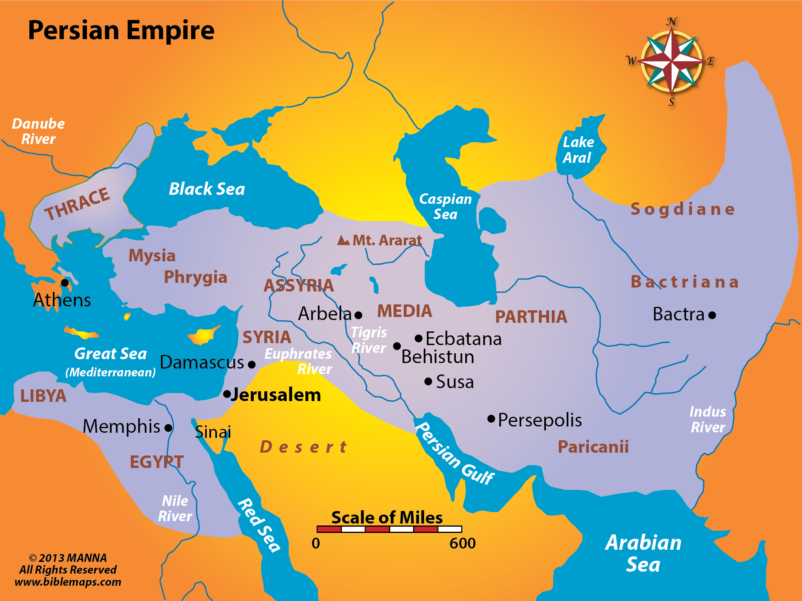
SYRIA
ASSYRIA
BABYLON
EGYPT
ETHIOPIA

Slide 3
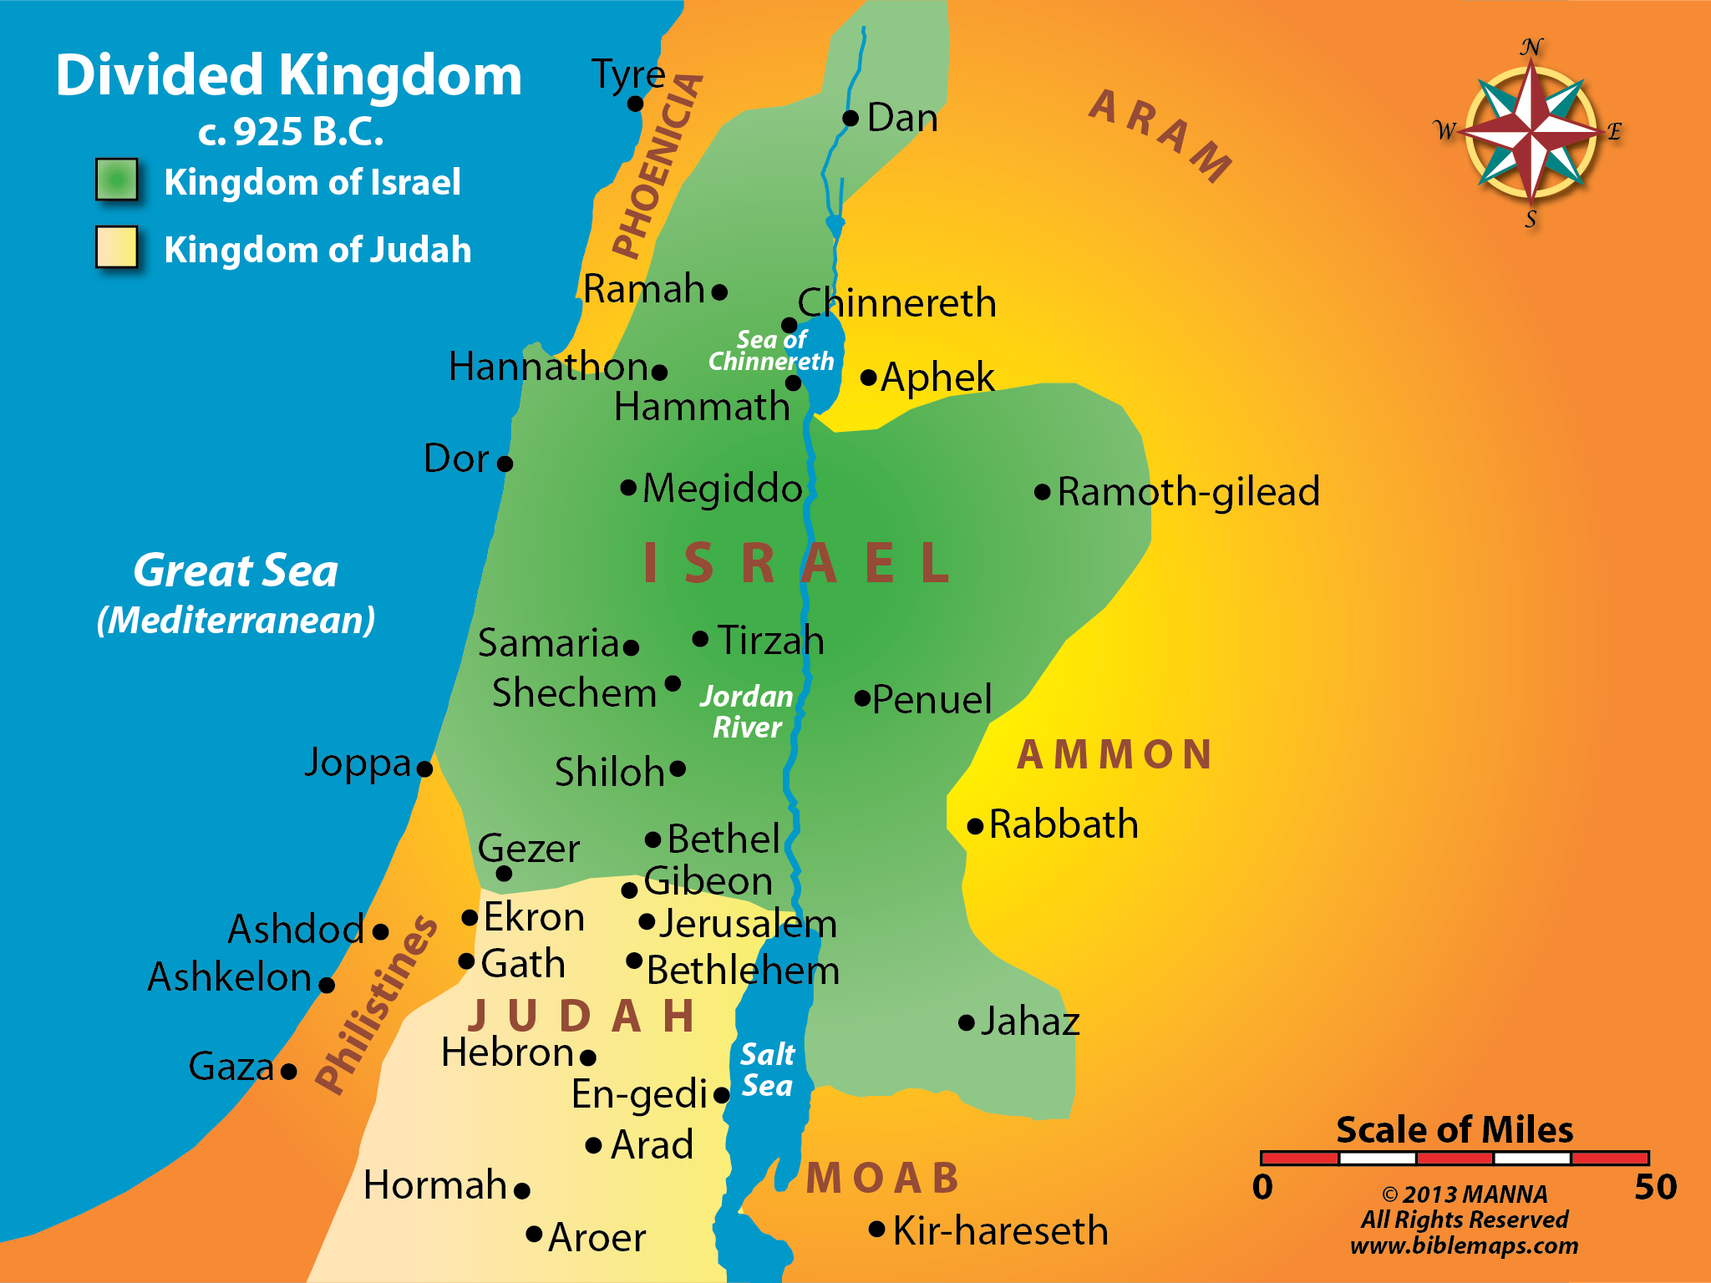
SYRIA
TYRE
ISRAEL
JUDAH
MOAB

Slide 4
28
Isaiah’s Message to the Nations (Isa. 13-39)
God made Israel His chosen people

Slide 5
28
Isaiah’s Message to the Nations (Isa. 13-39)
God made Israel His chosen people
God did not forget the Gentiles

Slide 6
28
Isaiah’s Message to the Nations (Isa. 13-39)
God made Israel His chosen people
God did not forget the Gentiles
Look at Isaiah chapter 13-39

Slide 7
28
Isaiah Messages to the Nations (Isa. 13-39)
sss
Isaiah 10 – Assyria
10:5 "Woe to Assyria, the rod of My anger And the staff in whose hand is My indignation.
Isa 13:1 The burden against Babylon which Isaiah the son of Amoz saw.
Isa 14:4 that you will take up this proverb against the king of Babylon, and say: "How the oppressor has ceased, The golden city ceased!
Isa 15:1 The burden against Moab. Because in the night Ar of Moab is laid waste And destroyed . . .
Isa 17:1 The burden against Damascus. "Behold, Damascus will cease from being a city, And it will be a ruinous heap.
Isa 18:1 Woe to the land shadowed with buzzing wings, Which is beyond the rivers of Ethiopia,
Isa 19:1 The burden against Egypt. Behold, the LORD rides on a swift cloud, And will come into Egypt;

Slide 8
28
Isaiah Messages to the Nations (Isa. 13-39)
sss
Isaiah 10 – Assyria
Isaiah 13-14 – Babylon
10:5 "Woe to Assyria, the rod of My anger And the staff in whose hand is My indignation.
Isa 13:1 The burden against Babylon which Isaiah the son of Amoz saw.
Isa 14:4 that you will take up this proverb against the king of Babylon, and say: "How the oppressor has ceased, The golden city ceased!
Isa 15:1 The burden against Moab. Because in the night Ar of Moab is laid waste And destroyed . . .
Isa 17:1 The burden against Damascus. "Behold, Damascus will cease from being a city, And it will be a ruinous heap.
Isa 18:1 Woe to the land shadowed with buzzing wings, Which is beyond the rivers of Ethiopia,
Isa 19:1 The burden against Egypt. Behold, the LORD rides on a swift cloud, And will come into Egypt;

Slide 9
28
Isaiah Messages to the Nations (Isa. 13-39)
sss
Isaiah 10 – Assyria
Isaiah 13-14 – Babylon
Isaiah 15-16 – Moab
10:5 "Woe to Assyria, the rod of My anger And the staff in whose hand is My indignation.
Isa 13:1 The burden against Babylon which Isaiah the son of Amoz saw.
Isa 14:4 that you will take up this proverb against the king of Babylon, and say: "How the oppressor has ceased, The golden city ceased!
Isa 15:1 The burden against Moab. Because in the night Ar of Moab is laid waste And destroyed . . .
Isa 17:1 The burden against Damascus. "Behold, Damascus will cease from being a city, And it will be a ruinous heap.
Isa 18:1 Woe to the land shadowed with buzzing wings, Which is beyond the rivers of Ethiopia,
Isa 19:1 The burden against Egypt. Behold, the LORD rides on a swift cloud, And will come into Egypt;

Slide 10
28
Isaiah Messages to the Nations (Isa. 13-39)
sss
Isaiah 10 – Assyria
Isaiah 13-14 – Babylon
Isaiah 15-16 – Moab
Isaiah 17 – Damascus
10:5 "Woe to Assyria, the rod of My anger And the staff in whose hand is My indignation.
Isa 13:1 The burden against Babylon which Isaiah the son of Amoz saw.
Isa 14:4 that you will take up this proverb against the king of Babylon, and say: "How the oppressor has ceased, The golden city ceased!
Isa 15:1 The burden against Moab. Because in the night Ar of Moab is laid waste And destroyed . . .
Isa 17:1 The burden against Damascus. "Behold, Damascus will cease from being a city, And it will be a ruinous heap.
Isa 18:1 Woe to the land shadowed with buzzing wings, Which is beyond the rivers of Ethiopia,
Isa 19:1 The burden against Egypt. Behold, the LORD rides on a swift cloud, And will come into Egypt;

Slide 11
28
Isaiah Messages to the Nations (Isa. 13-39)
sss
Isaiah 10 – Assyria
Isaiah 13-14 – Babylon
Isaiah 15-16 – Moab
Isaiah 17 – Damascus
Isaiah 18 – Beyond Ethiopian rivers
10:5 "Woe to Assyria, the rod of My anger And the staff in whose hand is My indignation.
Isa 13:1 The burden against Babylon which Isaiah the son of Amoz saw.
Isa 14:4 that you will take up this proverb against the king of Babylon, and say: "How the oppressor has ceased, The golden city ceased!
Isa 15:1 The burden against Moab. Because in the night Ar of Moab is laid waste And destroyed . . .
Isa 17:1 The burden against Damascus. "Behold, Damascus will cease from being a city, And it will be a ruinous heap.
Isa 18:1 Woe to the land shadowed with buzzing wings, Which is beyond the rivers of Ethiopia,
Isa 19:1 The burden against Egypt. Behold, the LORD rides on a swift cloud, And will come into Egypt;

Slide 12
28
Isaiah Messages to the Nations (Isa. 13-39)
sss
Isaiah 10 – Assyria
Isaiah 13-14 – Babylon
Isaiah 15-16 – Moab
Isaiah 17 – Damascus
Isaiah 18 – Beyond Ethiopian rivers
Isaiah 19 – Egypt
10:5 "Woe to Assyria, the rod of My anger And the staff in whose hand is My indignation.
Isa 13:1 The burden against Babylon which Isaiah the son of Amoz saw.
Isa 14:4 that you will take up this proverb against the king of Babylon, and say: "How the oppressor has ceased, The golden city ceased!
Isa 15:1 The burden against Moab. Because in the night Ar of Moab is laid waste And destroyed . . .
Isa 17:1 The burden against Damascus. "Behold, Damascus will cease from being a city, And it will be a ruinous heap.
Isa 18:1 Woe to the land shadowed with buzzing wings, Which is beyond the rivers of Ethiopia,
Isa 19:1 The burden against Egypt. Behold, the LORD rides on a swift cloud, And will come into Egypt;

Slide 13
28
Isaiah Messages to the Nations (Isa. 13-39)
sss
Isaiah 10 – Assyria
Isaiah 13-14 – Babylon
Isaiah 15-16 – Moab
Isaiah 17 – Damascus
Isaiah 18 – Beyond Ethiopian rivers
Isaiah 19 – Egypt
Isa 20:3 .. . as My servant Isaiah has walked naked and barefoot three years for a sign and a wonder against Egypt and Ethiopia, Isa 20:3 Then the LORD said, "Just as My servant Isaiah has walked naked and barefoot three years for a sign and a wonder against Egypt and Ethiopia,
Isa 22:9 You also saw the damage to the city of David, That it was great; And you gathered together the waters of the lower pool.
Isa 23:1 The burden against Tyre. Wail, you ships of Tarshish! For it is laid waste, So that there is no house, no harbor; From the land of Cyprus it is revealed to them.
Isa 24:1 Behold, the LORD makes the earth empty and makes it waste, Distorts its surface And scatters abroad its inhabitants.

Slide 14
28
Isaiah Messages to the Nations (Isa. 13-39)
sss
Isaiah 10 – Assyria
Isaiah 13-14 – Babylon
Isaiah 15-16 – Moab
Isaiah 17 – Damascus
Isaiah 18 – Beyond Ethiopian rivers
Isaiah 19 – Egypt
Isaiah 20 – Ethiopia and Egypt
Isa 20:3 .. . as My servant Isaiah has walked naked and barefoot three years for a sign and a wonder against Egypt and Ethiopia, Isa 20:3 Then the LORD said, "Just as My servant Isaiah has walked naked and barefoot three years for a sign and a wonder against Egypt and Ethiopia,
Isa 22:9 You also saw the damage to the city of David, That it was great; And you gathered together the waters of the lower pool.
Isa 23:1 The burden against Tyre. Wail, you ships of Tarshish! For it is laid waste, So that there is no house, no harbor; From the land of Cyprus it is revealed to them.
Isa 24:1 Behold, the LORD makes the earth empty and makes it waste, Distorts its surface And scatters abroad its inhabitants.

Slide 15
28
Isaiah Messages to the Nations (Isa. 13-39)
sss
Isaiah 10 – Assyria
Isaiah 13-14 – Babylon
Isaiah 15-16 – Moab
Isaiah 17 – Damascus
Isaiah 18 – Beyond Ethiopian rivers
Isaiah 19 – Egypt
Isaiah 20 – Ethiopia and Egypt
Isaiah 21 – Babylon ??
Isa 20:3 .. . as My servant Isaiah has walked naked and barefoot three years for a sign and a wonder against Egypt and Ethiopia, Isa 20:3 Then the LORD said, "Just as My servant Isaiah has walked naked and barefoot three years for a sign and a wonder against Egypt and Ethiopia,
Isa 22:9 You also saw the damage to the city of David, That it was great; And you gathered together the waters of the lower pool.
Isa 23:1 The burden against Tyre. Wail, you ships of Tarshish! For it is laid waste, So that there is no house, no harbor; From the land of Cyprus it is revealed to them.
Isa 24:1 Behold, the LORD makes the earth empty and makes it waste, Distorts its surface And scatters abroad its inhabitants.

Slide 16
28
Isaiah Messages to the Nations (Isa. 13-39)
sss
Isaiah 10 – Assyria
Isaiah 13-14 – Babylon
Isaiah 15-16 – Moab
Isaiah 17 – Damascus
Isaiah 18 – Beyond Ethiopian rivers
Isaiah 19 – Egypt
Isaiah 20 – Ethiopia and Egypt
Isaiah 21 – Babylon ??
Isaiah 22 – Jerusalem
Isa 20:3 .. . as My servant Isaiah has walked naked and barefoot three years for a sign and a wonder against Egypt and Ethiopia, Isa 20:3 Then the LORD said, "Just as My servant Isaiah has walked naked and barefoot three years for a sign and a wonder against Egypt and Ethiopia,
Isa 22:9 You also saw the damage to the city of David, That it was great; And you gathered together the waters of the lower pool.
Isa 23:1 The burden against Tyre. Wail, you ships of Tarshish! For it is laid waste, So that there is no house, no harbor; From the land of Cyprus it is revealed to them.
Isa 24:1 Behold, the LORD makes the earth empty and makes it waste, Distorts its surface And scatters abroad its inhabitants.

Slide 17
28
Isaiah Messages to the Nations (Isa. 13-39)
sss
Isaiah 10 – Assyria
Isaiah 13-14 – Babylon
Isaiah 15-16 – Moab
Isaiah 17 – Damascus
Isaiah 18 – Beyond Ethiopian rivers
Isaiah 19 – Egypt
Isaiah 20 – Ethiopia and Egypt
Isaiah 21 – Babylon ??
Isaiah 22 – Jerusalem
Isaiah 23 – Tyre
Isa 20:3 .. . as My servant Isaiah has walked naked and barefoot three years for a sign and a wonder against Egypt and Ethiopia, Isa 20:3 Then the LORD said, "Just as My servant Isaiah has walked naked and barefoot three years for a sign and a wonder against Egypt and Ethiopia,
Isa 22:9 You also saw the damage to the city of David, That it was great; And you gathered together the waters of the lower pool.
Isa 23:1 The burden against Tyre. Wail, you ships of Tarshish! For it is laid waste, So that there is no house, no harbor; From the land of Cyprus it is revealed to them.
Isa 24:1 Behold, the LORD makes the earth empty and makes it waste, Distorts its surface And scatters abroad its inhabitants.

Slide 18
28
Isaiah Messages to the Nations (Isa. 13-39)
sss
Isaiah 10 – Assyria
Isaiah 13-14 – Babylon
Isaiah 15-16 – Moab
Isaiah 17 – Damascus
Isaiah 18 – Beyond Ethiopian rivers
Isaiah 19 – Egypt
Isaiah 20 – Ethiopia and Egypt
Isaiah 21 – Babylon ??
Isaiah 22 – Jerusalem
Isaiah 23 – Tyre
Isaiah 24-25 – Whole earth
Isa 20:3 .. . as My servant Isaiah has walked naked and barefoot three years for a sign and a wonder against Egypt and Ethiopia, Isa 20:3 Then the LORD said, "Just as My servant Isaiah has walked naked and barefoot three years for a sign and a wonder against Egypt and Ethiopia,
Isa 22:9 You also saw the damage to the city of David, That it was great; And you gathered together the waters of the lower pool.
Isa 23:1 The burden against Tyre. Wail, you ships of Tarshish! For it is laid waste, So that there is no house, no harbor; From the land of Cyprus it is revealed to them.
Isa 24:1 Behold, the LORD makes the earth empty and makes it waste, Distorts its surface And scatters abroad its inhabitants.

Slide 19
28
Isaiah Messages to the Nations (Isa. 13-39)
sss
Isaiah 10 – Assyria Isaiah 13-14 – Babylon
Isaiah 15-16 – Moab Isaiah 17 – Damascus
Isaiah 18 – Beyond Ethiopian rivers
Isaiah 19 – Egypt 20 – Ethiopia & Egypt
Isaiah 21 – Babylon ?? Isaiah 22 – Jerusalem
Isaiah 23 – Tyre Isaiah 24-25 – Whole earth
Isa 25:8 He will swallow up death forever, And the Lord GOD will wipe away tears from all faces; The rebuke of His people He will take away from all the earth; For the LORD has spoken.
Isa 27:13 So it shall be in that day: The great trumpet will be blown; They will come, who are about to perish in the land of Assyria, And they who are outcasts in the land of Egypt, And shall worship the LORD in the holy mount at Jerusalem.
Isa 29:1 "Woe to Ariel, to Ariel, the city where David dwelt! Add year to year; Let feasts come around. Isa 34:2 For the indignation of the LORD is against all nations, And His fury against all their armies; He has utterly destroyed them, He has given them over to the slaughter.
Isa 35:5 Then the eyes of the blind shall be opened, And the ears of the deaf shall be unstopped.

Slide 20
28
Isaiah Messages to the Nations (Isa. 13-39)
sss
Isaiah 10 – Assyria Isaiah 13-14 – Babylon
Isaiah 15-16 – Moab Isaiah 17 – Damascus
Isaiah 18 – Beyond Ethiopian rivers
Isaiah 19 – Egypt 20 – Ethiopia & Egypt
Isaiah 21 – Babylon ?? Isaiah 22 – Jerusalem
Isaiah 23 – Tyre Isaiah 24-25 – Whole earth
Isaiah 25-26 – Future blessing on Judah
Isa 25:8 He will swallow up death forever, And the Lord GOD will wipe away tears from all faces; The rebuke of His people He will take away from all the earth; For the LORD has spoken.
Isa 27:13 So it shall be in that day: The great trumpet will be blown; They will come, who are about to perish in the land of Assyria, And they who are outcasts in the land of Egypt, And shall worship the LORD in the holy mount at Jerusalem.
Isa 29:1 "Woe to Ariel, to Ariel, the city where David dwelt! Add year to year; Let feasts come around. Isa 34:2 For the indignation of the LORD is against all nations, And His fury against all their armies; He has utterly destroyed them, He has given them over to the slaughter.
Isa 35:5 Then the eyes of the blind shall be opened, And the ears of the deaf shall be unstopped.

Slide 21
28
Isaiah Messages to the Nations (Isa. 13-39)
sss
Isaiah 10 – Assyria Isaiah 13-14 – Babylon
Isaiah 15-16 – Moab Isaiah 17 – Damascus
Isaiah 18 – Beyond Ethiopian rivers
Isaiah 19 – Egypt 20 – Ethiopia & Egypt
Isaiah 21 – Babylon ?? Isaiah 22 – Jerusalem
Isaiah 23 – Tyre Isaiah 24-25 – Whole earth
Isaiah 25-26 – Future blessing on Judah
Isaiah 27 – Northern Kingdom Redemption
Isa 25:8 He will swallow up death forever, And the Lord GOD will wipe away tears from all faces; The rebuke of His people He will take away from all the earth; For the LORD has spoken.
Isa 27:13 So it shall be in that day: The great trumpet will be blown; They will come, who are about to perish in the land of Assyria, And they who are outcasts in the land of Egypt, And shall worship the LORD in the holy mount at Jerusalem.
Isa 29:1 "Woe to Ariel, to Ariel, the city where David dwelt! Add year to year; Let feasts come around. Isa 34:2 For the indignation of the LORD is against all nations, And His fury against all their armies; He has utterly destroyed them, He has given them over to the slaughter.
Isa 35:5 Then the eyes of the blind shall be opened, And the ears of the deaf shall be unstopped.

Slide 22
28
Isaiah Messages to the Nations (Isa. 13-39)
sss
Isaiah 10 – Assyria Isaiah 13-14 – Babylon
Isaiah 15-16 – Moab Isaiah 17 – Damascus
Isaiah 18 – Beyond Ethiopian rivers
Isaiah 19 – Egypt 20 – Ethiopia & Egypt
Isaiah 21 – Babylon ?? Isaiah 22 – Jerusalem
Isaiah 23 – Tyre Isaiah 24-25 – Whole earth
Isaiah 25-26 – Future blessing on Judah
Isaiah 27 – Northern Kingdom Redemption
Isaiah 28 – Israel (Cornerstone in Jerusalem)
Isa 25:8 He will swallow up death forever, And the Lord GOD will wipe away tears from all faces; The rebuke of His people He will take away from all the earth; For the LORD has spoken.
Isa 27:13 So it shall be in that day: The great trumpet will be blown; They will come, who are about to perish in the land of Assyria, And they who are outcasts in the land of Egypt, And shall worship the LORD in the holy mount at Jerusalem.
Isa 29:1 "Woe to Ariel, to Ariel, the where David dwelt! Add year to year; Let feasts come around. Isa 34:2 For the indignation of the LORD is against all nations, And His fury against all their armies; He has utterly destroyed them, He has given them over to the slaughter.
Isa 35:5 Then the eyes of the blind shall be opened, And the ears of the deaf shall be unstopped.

Slide 23
28
Isaiah Messages to the Nations (Isa. 13-39)
sss
Isaiah 10 – Assyria Isaiah 13-14 – Babylon
Isaiah 15-16 – Moab Isaiah 17 – Damascus
Isaiah 18 – Beyond Ethiopian rivers
Isaiah 19 – Egypt 20 – Ethiopia & Egypt
Isaiah 21 – Babylon ?? Isaiah 22 – Jerusalem
Isaiah 23 – Tyre Isaiah 24-25 – Whole earth
Isaiah 25-26 – Future blessing on Judah
Isaiah 27 – Northern Kingdom Redemption
Isaiah 28 – Israel (Cornerstone in Jerusalem)
Isaiah 29-32 – Judgment against Jerusalem
Isa 25:8 He will swallow up death forever, And the Lord GOD will wipe away tears from all faces; The rebuke of His people He will take away from all the earth; For the LORD has spoken.
Isa 27:13 So it shall be in that day: The great trumpet will be blown; They will come, who are about to perish in the land of Assyria, And they who are outcasts in the land of Egypt, And shall worship the LORD in the holy mount at Jerusalem.
Isa 29:1 "Woe to Ariel, to Ariel, the city where David dwelt! Add year to year; Let feasts come around. Isa 34:2 For the indignation of the LORD is against all nations, And His fury against all their armies; He has utterly destroyed them, He has given them over to the slaughter.
Isa 35:5 Then the eyes of the blind shall be opened, And the ears of the deaf shall be unstopped.

Slide 24
28
Isaiah Messages to the Nations (Isa. 13-39)
sss
Isaiah 10 – Assyria Isaiah 13-14 – Babylon
Isaiah 15-16 – Moab Isaiah 17 – Damascus
Isaiah 18 – Beyond Ethiopian rivers
Isaiah 19 – Egypt 20 – Ethiopia & Egypt
Isaiah 21 – Babylon ?? Isaiah 22 – Jerusalem
Isaiah 23 – Tyre Isaiah 24-25 – Whole earth
Isaiah 25-26 – Future blessing on Judah
Isaiah 27 – Northern Kingdom Redemption
Isaiah 28 – Israel (Cornerstone in Jerusalem)
Isaiah 29-32 – Judgment against Jerusalem
Isaiah 34 – All Nations
Isa 25:8 He will swallow up death forever, And the Lord GOD will wipe away tears from all faces; The rebuke of His people He will take away from all the earth; For the LORD has spoken.
Isa 27:13 So it shall be in that day: The great trumpet will be blown; They will come, who are about to perish in the land of Assyria, And they who are outcasts in the land of Egypt, And shall worship the LORD in the holy mount at Jerusalem.
Isa 29:1 "Woe to Ariel, to Ariel, the city where David dwelt! Add year to year; Let feasts come around. Isa 34:2 For the indignation of the LORD is against all nations, And His fury against all their armies; He has utterly destroyed them, He has given them over to the slaughter.
Isa 35:5 Then the eyes of the blind shall be opened, And the ears of the deaf shall be unstopped.

Slide 25
28
Isaiah Messages to the Nations (Isa. 13-39)
sss
Isaiah 10 – Assyria Isaiah 13-14 – Babylon
Isaiah 15-16 – Moab Isaiah 17 – Damascus
Isaiah 18 – Beyond Ethiopian rivers
Isaiah 19 – Egypt 20 – Ethiopia & Egypt
Isaiah 21 – Babylon ?? Isaiah 22 – Jerusalem
Isaiah 23 – Tyre Isaiah 24-25 – Whole earth
Isaiah 25-26 – Future blessing on Judah
Isaiah 27 – Northern Kingdom Redemption
Isaiah 28 – Israel (Cornerstone in Jerusalem)
Isaiah 29-32 – Judgment against Jerusalem
Isaiah 34 – All Nations
Isaiah 35 – Messianic Psalm
Isa 25:8 He will swallow up death forever, And the Lord GOD will wipe away tears from all faces; The rebuke of His people He will take away from all the earth; For the LORD has spoken.
Isa 27:13 So it shall be in that day: The great trumpet will be blown; They will come, who are about to perish in the land of Assyria, And they who are outcasts in the land of Egypt, And shall worship the LORD in the holy mount at Jerusalem.
Isa 29:1 "Woe to Ariel, to Ariel, the city where David dwelt! Add year to year; Let feasts come around. Isa 34:2 For the indignation of the LORD is against all nations, And His fury against all their armies; He has utterly destroyed them, He has given them over to the slaughter.
Isa 35:5 Then the eyes of the blind shall be opened, And the ears of the deaf shall be unstopped.

Slide 26
28
Isaiah Messages to the Nations (Isa. 13-39)
sss
Isaiah 10 – Assyria Isaiah 13-14 – Babylon
Isaiah 15-16 – Moab Isaiah 17 – Damascus
Isaiah 18 – Beyond Ethiopian rivers
Isaiah 19 – Egypt 20 – Ethiopia & Egypt
Isaiah 21 – Babylon ?? Isaiah 22 – Jerusalem
Isaiah 23 – Tyre Isaiah 24-25 – Whole earth
Isaiah 25-26 – Future blessing on Judah
Isaiah 27 – Northern Kingdom Redemption
Isaiah 28 – Israel (Cornerstone in Jerusalem)
Isaiah 29-32 – Judgment against Jerusalem
Isaiah 34–All Nations Isaiah 35–Messianic Psalm
-
Isa 36:1 Now it came to pass in the fourteenth year of King Hezekiah that Sennacherib king of Assyria came up against all the fortified cities of Judah and took them.
Isa 37:2 Then he sent Eliakim, who was over the household, Shebna the scribe, and the elders of the priests, covered with sackcloth, to Isaiah the prophet, the son of Amoz.
Isa 38:1 In those days Hezekiah was sick and near death. And Isaiah the prophet, the son of Amoz, went to him and said to him, "Thus says the LORD: 'Set your house in order, for you shall die and not live.' "
Isa 39:3 Then Isaiah the prophet went to King Hezekiah, and said to him, "What did these men say, and from where did they come to you?" So Hezekiah said, "They came to me from a far country, from Babylon.

Slide 27
28
Isaiah Messages to the Nations (Isa. 13-39)
sss
Isaiah 10 – Assyria Isaiah 13-14 – Babylon
Isaiah 15-16 – Moab Isaiah 17 – Damascus
Isaiah 18 – Beyond Ethiopian rivers
Isaiah 19 – Egypt 20 – Ethiopia & Egypt
Isaiah 21 – Babylon ?? Isaiah 22 – Jerusalem
Isaiah 23 – Tyre Isaiah 24-25 – Whole earth
Isaiah 25-26 – Future blessing on Judah
Isaiah 27 – Northern Kingdom Redemption
Isaiah 28 – Israel (Cornerstone in Jerusalem)
Isaiah 29-32 – Judgment against Jerusalem
Isaiah 34–All Nations Isaiah 35–Messianic psalm
Isaiah 36-37 – Hezekiah, Isaiah and Assyria
Isa 36:1 Now it came to pass in the fourteenth year of King Hezekiah that Sennacherib king of Assyria came up against all the fortified cities of Judah and took them.
Isa 37:2 Then he sent Eliakim, who was over the household, Shebna the scribe, and the elders of the priests, covered with sackcloth, to Isaiah the prophet, the son of Amoz.
Isa 38:1 In those days Hezekiah was sick and near death. And Isaiah the prophet, the son of Amoz, went to him and said to him, "Thus says the LORD: 'Set your house in order, for you shall die and not live.' "
Isa 39:3 Then Isaiah the prophet went to King Hezekiah, and said to him, "What did these men say, and from where did they come to you?" So Hezekiah said, "They came to me from a far country, from Babylon.

Slide 28
28
Isaiah Messages to the Nations (Isa. 13-39)
sss
Isaiah 10 – Assyria Isaiah 13-14 – Babylon
Isaiah 15-16 – Moab Isaiah 17 – Damascus
Isaiah 18 – Beyond Ethiopian rivers
Isaiah 19 – Egypt 20 – Ethiopia & Egypt
Isaiah 21 – Babylon ?? Isaiah 22 – Jerusalem
Isaiah 23 – Tyre Isaiah 24-25 – Whole earth
Isaiah 25-26 – Future blessing on Judah
Isaiah 27 – Northern Kingdom Redemption
Isaiah 28 – Israel (Cornerstone in Jerusalem)
Isaiah 29-32 – Judgment against Jerusalem
Isaiah 34–All Nations Isaiah 35–Messianic psalm
Isaiah 36-37 – Hezekiah, Isaiah and Assyria
Isaiah 38 – Hezekiah and Death
Isa 36:1 Now it came to pass in the fourteenth year of King Hezekiah that Sennacherib king of Assyria came up against all the fortified cities of Judah and took them.
Isa 37:2 Then he sent Eliakim, who was over the household, Shebna the scribe, and the elders of the priests, covered with sackcloth, to Isaiah the prophet, the son of Amoz.
Isa 38:1 In those days Hezekiah was sick and near death. And Isaiah the prophet, the son of Amoz, went to him and said to him, "Thus says the LORD: 'Set your house in order, for you shall die and not live.' "
Isa 39:3 Then Isaiah the prophet went to King Hezekiah, and said to him, "What did these men say, and from where did they come to you?" So Hezekiah said, "They came to me from a far country, from Babylon.

Slide 29
28
Isaiah Messages to the Nations (Isa. 13-39)
sss
Isaiah 10 – Assyria Isaiah 13-14 – Babylon
Isaiah 15-16 – Moab Isaiah 17 – Damascus
Isaiah 18 – Beyond Ethiopian rivers
Isaiah 19 – Egypt 20 – Ethiopia & Egypt
Isaiah 21 – Babylon ?? Isaiah 22 – Jerusalem
Isaiah 23 – Tyre Isaiah 24-25 – Whole earth
Isaiah 25-26 – Future blessing on Judah
Isaiah 27 – Northern Kingdom Redemption
Isaiah 28 – Israel (Cornerstone in Jerusalem)
Isaiah 29-32 – Judgment against Jerusalem
Isaiah 34–All Nations Isaiah 35–Messianic psalm
Isaiah 36-37 – Hezekiah, Isaiah and Assyria
Isaiah 38 – Hezekiah and Death
Isaiah 39 – Hezekiah and envoy from Babylon
-
Isa 36:1 Now it came to pass in the fourteenth year of King Hezekiah that Sennacherib king of Assyria came up against all the fortified cities of Judah and took them.
Isa 37:2 Then he sent Eliakim, who was over the household, Shebna the scribe, and the elders of the priests, covered with sackcloth, to Isaiah the prophet, the son of Amoz.
Isa 38:1 In those days Hezekiah was sick and near death. And Isaiah the prophet, the son of Amoz, went to him and said to him, "Thus says the LORD: 'Set your house in order, for you shall die and not live.' "
Isa 39:3 Then Isaiah the prophet went to King Hezekiah, and said to him, "What did these men say, and from where did they come to you?" So Hezekiah said, "They came to me from a far country, from Babylon.

