Slide 1
A Study of Isaiah
The Threat to Judah & King Ahaz
The Promise of the Virgin Birth
July 24, 2019
Palm Beach Lakes
Class Three
Dan Jenkins

Slide 2
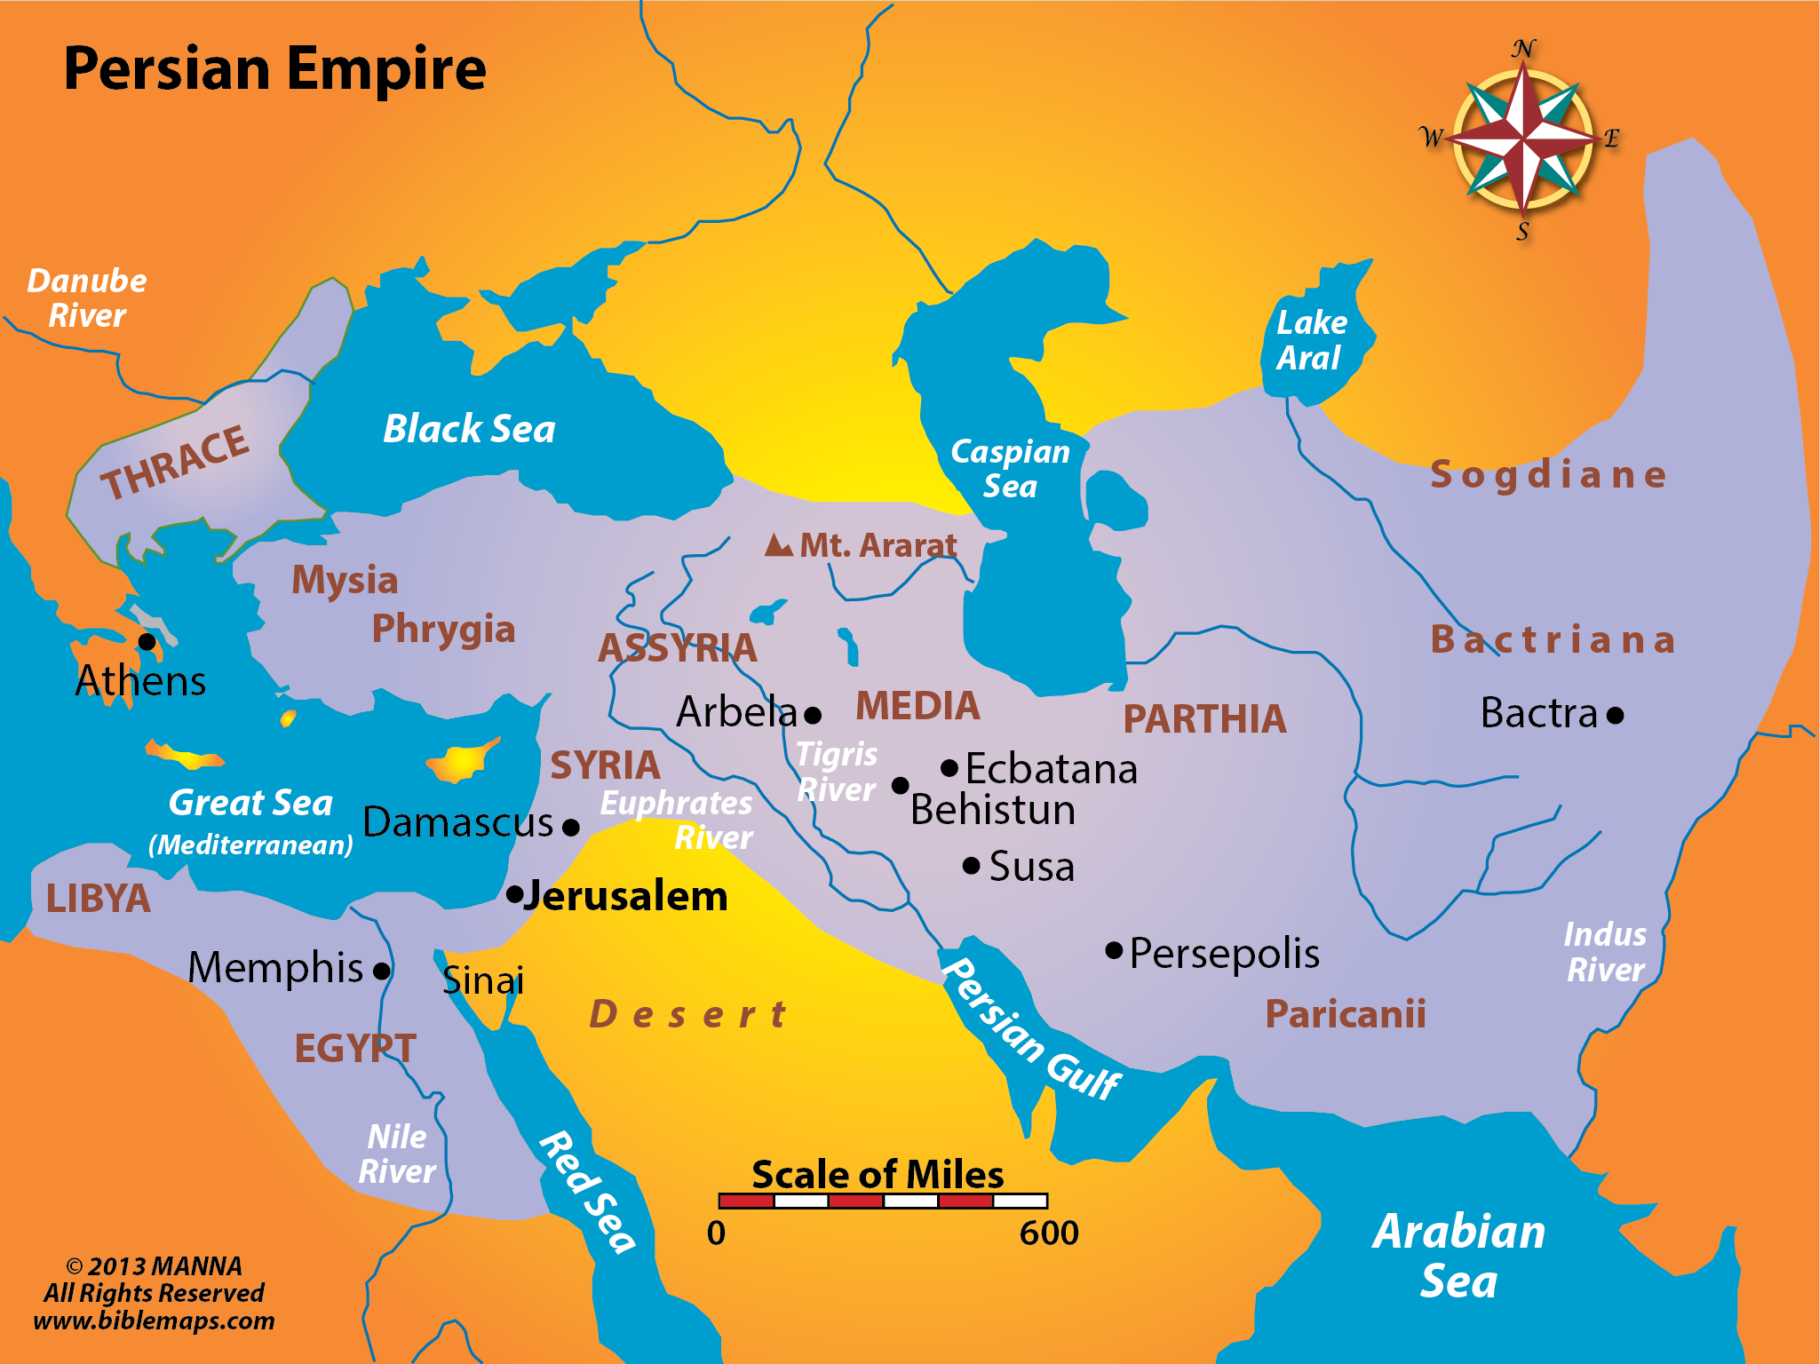
SYRIA
ASSYRIA

Slide 3
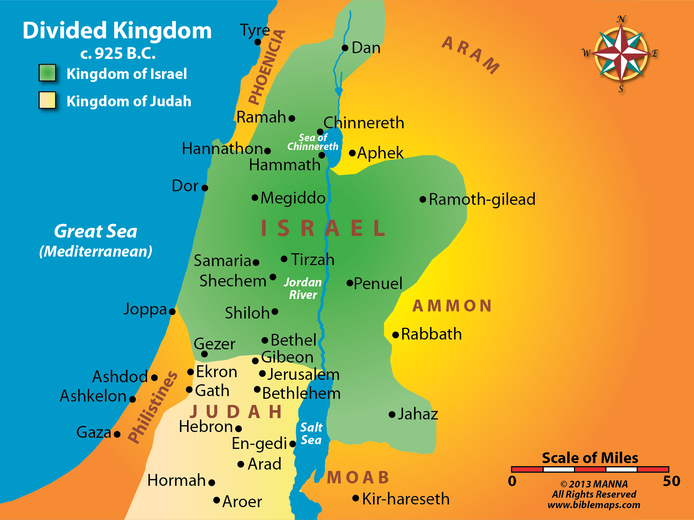
SYRIA
ISRAEL
JUDAH

Slide 4
28
The Background of the Virgin Birth Promise
sss
Isa 7:1 Now it came to pass in the days of Ahaz the son of Jotham, the son of Uzziah, king of Judah, that Rezin king of Syria and Pekah the son of Remaliah, king of Israel, went up to Jerusalem to make war against it, but could not prevail against it.
Isa 7:2 And it was told to the house of David, saying, "Syria's forces are deployed in Ephraim." So his heart and the heart of his people were moved as the trees of the woods are moved with the wind.
Isa 7:3 Then the LORD said to Isaiah, "Go out now to meet Ahaz, you and Shear-Jashub your son, at the end of the aqueduct from the upper pool, on the highway to the Fuller's Field,

Slide 5
28
The Background of the Virgin Birth Promise
sss
King Ahaz
Begin reign at age 20—2 Chr. 28:1
Isa 7:1 Now it came to pass in the days of Ahaz the son of Jotham, the son of Uzziah, king of Judah, that Rezin king of Syria and Pekah the son of Remaliah, king of Israel, went up to Jerusalem to make war against it, but could not prevail against it.
Isa 7:2 And it was told to the house of David, saying, "Syria's forces are deployed in Ephraim." So his heart and the heart of his people were moved as the trees of the woods are moved with the wind.
Isa 7:3 Then the LORD said to Isaiah, "Go out now to meet Ahaz, you and Shear-Jashub your son, at the end of the aqueduct from the upper pool, on the highway to the Fuller's Field,

Slide 6
28
The Background of the Virgin Birth Promise
sss
King Ahaz
Begin reign at age 20—2 Chr. 28:1
Threat from Israel (King Pekah)
Isa 7:1 Now it came to pass in the days of Ahaz the son of Jotham, the son of Uzziah, king of Judah, that Rezin king of Syria and Pekah the son of Remaliah, king of Israel, went up to Jerusalem to make war against it, but could not prevail against it.
Isa 7:2 And it was told to the house of David, saying, "Syria's forces are deployed in Ephraim." So his heart and the heart of his people were moved as the trees of the woods are moved with the wind.
Isa 7:3 Then the LORD said to Isaiah, "Go out now to meet Ahaz, you and Shear-Jashub your son, at the end of the aqueduct from the upper pool, on the highway to the Fuller's Field,

Slide 7
28
The Background of the Virgin Birth Promise
sss
King Ahaz
Begin reign at age 20—2 Chr. 28:1
Threat from Israel (King Pekah)
Threat from Damascus Syria (Rezin)
Isa 7:1 Now it came to pass in the days of Ahaz the son of Jotham, the son of Uzziah, king of Judah, that Rezin king of Syria and Pekah the son of Remaliah, king of Israel, went up to Jerusalem to make war against it, but could not prevail against it.
Isa 7:2 And it was told to the house of David, saying, "Syria's forces are deployed in Ephraim." So his heart and the heart of his people were moved as the trees of the woods are moved with the wind.
Isa 7:3 Then the LORD said to Isaiah, "Go out now to meet Ahaz, you and Shear-Jashub your son, at the end of the aqueduct from the upper pool, on the highway to the Fuller's Field,

Slide 8
28
The Background of the Virgin Birth Promise
sss
King Ahaz
Begin reign at age 20—2 Chr. 28:1
Threat from Israel (King Pekah)
Threat from Damascus Syria (Rezin)
Situation seems hopeless
Isa 7:1 Now it came to pass in the days of Ahaz the son of Jotham, the son of Uzziah, king of Judah, that Rezin king of Syria and Pekah the son of Remaliah, king of Israel, went up to Jerusalem to make war against it, but could not prevail against it.
Isa 7:2 And it was told to the house of David, saying, "Syria's forces are deployed in Ephraim." So his heart and the heart of his people were moved as the trees of the woods are moved with the wind.
Isa 7:3 Then the LORD said to Isaiah, "Go out now to meet Ahaz, you and Shear-Jashub your son, at the end of the aqueduct from the upper pool, on the highway to the Fuller's Field,

Slide 9
28
The Background of the Virgin Birth Promise
sss
King Ahaz
Begin reign at age 20—2 Chr. 28:1
Threat from Israel (King Pekah)
Threat from Damascus Syria (Rezin)
Situation seems hopeless
Sought help from Nineveh, Assyria
Did NOT seek help from God
Isa 7:1 Now it came to pass in the days of Ahaz the son of Jotham, the son of Uzziah, king of Judah, that Rezin king of Syria and Pekah the son of Remaliah, king of Israel, went up to Jerusalem to make war against it, but could not prevail against it.
Isa 7:2 And it was told to the house of David, saying, "Syria's forces are deployed in Ephraim." So his heart and the heart of his people were moved as the trees of the woods are moved with the wind.
Isa 7:3 Then the LORD said to Isaiah, "Go out now to meet Ahaz, you and Shear-Jashub your son, at the end of the aqueduct from the upper pool, on the highway to the Fuller's Field,

Slide 10
28
The Background of the Virgin Birth Promise
sss
King Ahaz
Begin reign at age 20—2 Chr. 28:1
Threat from Israel (King Pekah)
Threat from Damascus Syria (Rezin)
Situation seems hopeless
Sought help from Nineveh, Assyria
Did NOT seek help from God
God sends Isaiah to King Ahaz
Isa 7:1 Now it came to pass in the days of Ahaz the son of Jotham, the son of Uzziah, king of Judah, that Rezin king of Syria and Pekah the son of Remaliah, king of Israel, went up to Jerusalem to make war against it, but could not prevail against it.
Isa 7:2 And it was told to the house of David, saying, "Syria's forces are deployed in Ephraim." So his heart and the heart of his people were moved as the trees of the woods are moved with the wind.
Isa 7:3 Then the LORD said to Isaiah, "Go out now to meet Ahaz, you and Shear-Jashub your son, at the end of the aqueduct from the upper pool, on the highway to the Fuller's Field,

Slide 11
28
The Background of the Virgin Birth Promise
sss
King Ahaz
Begin reign at age 20—2 Chr. 28:1
Threat from Israel (King Pekah)
Threat from Damascus Syria (Rezin)
Situation seems hopeless
Sought help from Nineveh, Assyria
Did NOT seek help from God
God sends Isaiah to King Ahaz
Later sought help from Syrian god
Later copied pagan Assyrian altar
Built Assyrian altar in temple
Isa 7:1 Now it came to pass in the days of Ahaz the son of Jotham, the son of Uzziah, king of Judah, that Rezin king of Syria and Pekah the son of Remaliah, king of Israel, went up to Jerusalem to make war against it, but could not prevail against it.
Isa 7:2 And it was told to the house of David, saying, "Syria's forces are deployed in Ephraim." So his heart and the heart of his people were moved as the trees of the woods are moved with the wind.
Isa 7:3 Then the LORD said to Isaiah, "Go out now to meet Ahaz, you and Shear-Jashub your son, at the end of the aqueduct from the upper pool, on the highway to the Fuller's Field,

Slide 12
The Background of the Virgin Birth Promise
Isaiah’s Message
Isa 7:7 thus says the Lord GOD: "It shall not stand, Nor shall it come to pass.
Isa 7:8 For the head of Syria is Damascus, And the head of Damascus is Rezin. Within sixty-five years Ephraim will be broken, So that it will not be a people.
Isa 7:9 The head of Ephraim is Samaria, And the head of Samaria is Remaliah's son. If you will not believe, Surely you shall not be established." ' "
Isa 7:10 Moreover the LORD spoke again to Ahaz, saying,
Isa 7:11 "Ask a sign for yourself from the LORD your God; ask it either in the depth or in the height above."
Isa 7:12 But Ahaz said, "I will not ask, nor will I test the LORD!"

Slide 13
The Background of the Virgin Birth Promise
Isaiah’s Message
Wait 65 years
Isa 7:7 thus says the Lord GOD: "It shall not stand, Nor shall it come to pass.
Isa 7:8 For the head of Syria is Damascus, And the head of Damascus is Rezin. Within sixty-five years Ephraim will be broken, So that it will not be a people.
Isa 7:9 The head of Ephraim is Samaria, And the head of Samaria is Remaliah's son. If you will not believe, Surely you shall not be established." ' "
Isa 7:10 Moreover the LORD spoke again to Ahaz, saying,
Isa 7:11 "Ask a sign for yourself from the LORD your God; ask it either in the depth or in the height above."
Isa 7:12 But Ahaz said, "I will not ask, nor will I test the LORD!"

Slide 14
The Background of the Virgin Birth Promise
Isaiah’s Message
Wait 65 years
Israel (Samaria) will end
Isa 7:7 thus says the Lord GOD: "It shall not stand, Nor shall it come to pass.
Isa 7:8 For the head of Syria is Damascus, And the head of Damascus is Rezin. Within sixty-five years Ephraim will be broken, So that it will not be a people.
Isa 7:9 The head of Ephraim is Samaria, And the head of Samaria is Remaliah's son. If you will not believe, Surely you shall not be established." ' "
Isa 7:10 Moreover the LORD spoke again to Ahaz, saying,
Isa 7:11 "Ask a sign for yourself from the LORD your God; ask it either in the depth or in the height above."
Isa 7:12 But Ahaz said, "I will not ask, nor will I test the LORD!"
Isa 7:7 thus says the Lord GOD: "It shall not stand, Nor shall it come to pass.
Isa 7:8 For the head of Syria is Damascus, And the head of Damascus is Rezin. Within sixty-five years Ephraim will be broken, So that it will not be a people.
Isa 7:9 The head of Ephraim is Samaria, And the head of Samaria is Remaliah's son. If you will not believe, Surely you shall not be established." ' "
Isa 7:10 Moreover the LORD spoke again to Ahaz, saying,
Isa 7:11 "Ask a sign for yourself from the LORD your God; ask it either in the depth or in the height above."
Isa 7:12 But Ahaz said, "I will not ask, nor will I test the LORD!"

Slide 15
The Background of the Virgin Birth Promise
Isaiah’s Message
Wait 65 years
Israel (Samaria) will end
Ahaz, ask for a sign
Isa 7:7 thus says the Lord GOD: "It shall not stand, Nor shall it come to pass.
Isa 7:8 For the head of Syria is Damascus, And the head of Damascus is Rezin. Within sixty-five years Ephraim will be broken, So that it will not be a people.
Isa 7:9 The head of Ephraim is Samaria, And the head of Samaria is Remaliah's son. If you will not believe, Surely you shall not be established." ' "
Isa 7:10 Moreover the LORD spoke again to Ahaz, saying,
Isa 7:11 "Ask a sign for yourself from the LORD your God; ask it either in the depth or in the height above."
Isa 7:12 But Ahaz said, "I will not ask, nor will I test the LORD!"

Slide 16
The Background of the Virgin Birth Promise
Isaiah’s Message
Wait 65 years
Israel (Samaria) will end
Ahaz, ask for a sign
“I will not ask”
Isa 7:7 thus says the Lord GOD: "It shall not stand, Nor shall it come to pass.
Isa 7:8 For the head of Syria is Damascus, And the head of Damascus is Rezin. Within sixty-five years Ephraim will be broken, So that it will not be a people.
Isa 7:9 The head of Ephraim is Samaria, And the head of Samaria is Remaliah's son. If you will not believe, Surely you shall not be established." ' "
Isa 7:10 Moreover the LORD spoke again to Ahaz, saying,
Isa 7:11 "Ask a sign for yourself from the LORD your God; ask it either in the depth or in the height above."
Isa 7:12 But Ahaz said, "I will not ask, nor will I test the LORD!"

Slide 17
The Background of the Virgin Birth Promise
The Sign Given
Isa 7:11 "Ask a sign for yourself from the LORD your God; ask it either in the depth or in the height above."
Isa 7:12 But Ahaz said, "I will not ask, nor will I test the LORD!"
Isa 7:13 Then he said, "Hear now, O house of David! Is it a small thing for you to weary men, but will you weary my God also?
Isa 7:14 Therefore the Lord Himself will give you a sign: Behold, the virgin shall conceive and bear a Son, and shall call His name Immanuel.
Isa 7:15 Curds and honey He shall eat, that He may know to refuse the evil and choose the good.
Isa 7:16 For before the Child shall know to refuse the evil and choose the good, the land that you dread will be forsaken by both her kings.

Slide 18
The Background of the Virgin Birth Promise
The Sign Given
To the house of David
Isa 7:11 "Ask a sign for yourself from the LORD your God; ask it either in the depth or in the height above."
Isa 7:12 But Ahaz said, "I will not ask, nor will I test the LORD!"
Isa 7:13 Then he said, "Hear now, O house of David! Is it a small thing for you to weary men, but will you weary my God also?
Isa 7:14 Therefore the Lord Himself will give you a sign: Behold, the virgin shall conceive and bear a Son, and shall call His name Immanuel.
Isa 7:15 Curds and honey He shall eat, that He may know to refuse the evil and choose the good.
Isa 7:16 For before the Child shall know to refuse the evil and choose the good, the land that you dread will be forsaken by both her kings.

Slide 19
The Background of the Virgin Birth Promise
The Sign Given
To the house of David
A virgin will conceive
Isa 7:11 "Ask a sign for yourself from the LORD your God; ask it either in the depth or in the height above."
Isa 7:12 But Ahaz said, "I will not ask, nor will I test the LORD!"
Isa 7:13 Then he said, "Hear now, O house of David! Is it a small thing for you to weary men, but will you weary my God also?
Isa 7:14 Therefore the Lord Himself will give you a sign: Behold, the virgin shall conceive and bear a Son, and shall call His name Immanuel.
Isa 7:15 Curds and honey He shall eat, that He may know to refuse the evil and choose the good.
Isa 7:16 For before the Child shall know to refuse the evil and choose the good, the land that you dread will be forsaken by both her kings.

Slide 20
The Background of the Virgin Birth Promise
The Sign Given
To the house of David
A virgin will conceive
Son will be God living among us
Isa 7:11 "Ask a sign for yourself from the LORD your God; ask it either in the depth or in the height above."
Isa 7:12 But Ahaz said, "I will not ask, nor will I test the LORD!"
Isa 7:13 Then he said, "Hear now, O house of David! Is it a small thing for you to weary men, but will you weary my God also?
Isa 7:14 Therefore the Lord Himself will give you a sign: Behold, the virgin shall conceive and bear a Son, and shall call His name Immanuel.
Isa 7:15 Curds and honey He shall eat, that He may know to refuse the evil and choose the good.
Isa 7:16 For before the Child shall know to refuse the evil and choose the good, the land that you dread will be forsaken by both her kings.

Slide 21
The Background of the Virgin Birth Promise
The Sign Given
To the house of David
A virgin will conceive
Son will be God living among us
Problem is verse 16
Isa 7:11 "Ask a sign for yourself from the LORD your God; ask it either in the depth or in the height above."
Isa 7:12 But Ahaz said, "I will not ask, nor will I test the LORD!"
Isa 7:13 Then he said, "Hear now, O house of David! Is it a small thing for you to weary men, but will you weary my God also?
Isa 7:14 Therefore the Lord Himself will give you a sign: Behold, the virgin shall conceive and bear a Son, and shall call His name Immanuel.
Isa 7:15 Curds and honey He shall eat, that He may know to refuse the evil and choose the good.
Isa 7:16 For before the Child shall know to refuse the evil and choose the good, the land that you dread will be forsaken by both her kings.

Slide 22
The Background of the Virgin Birth Promise
The Sign Given
To the house of David
A virgin will conceive
Son will be God living among us
Problem is verse 16
Before child is able to choose good and evil, Israel and Syria’s king will die—yet Jesus was not born for 700 years—how could the virgin birth be a sign to Ahaz
Isa 7:11 "Ask a sign for yourself from the LORD your God; ask it either in the depth or in the height above."
Isa 7:12 But Ahaz said, "I will not ask, nor will I test the LORD!"
Isa 7:13 Then he said, "Hear now, O house of David! Is it a small thing for you to weary men, but will you weary my God also?
Isa 7:14 Therefore the Lord Himself will give you a sign: Behold, the virgin shall conceive and bear a Son, and shall call His name Immanuel.
Isa 7:15 Curds and honey He shall eat, that He may know to refuse the evil and choose the good.
Isa 7:16 For before the Child shall know to refuse the evil and choose the good, the land that you dread will be forsaken by both her kings.

Slide 23
Solution to Problem of Virgin Birth Promise
The Solution
Isa 7:11 "Ask a sign for yourself from the LORD your God; ask it either in the depth or in the height above."
Isa 7:12 But Ahaz said, "I will not ask, nor will I test the LORD!"
Isa 7:13 Then he said, "Hear now, O house of David! Is it a small thing for you to weary men, but will you weary my God also?
Isa 7:14 Therefore the Lord Himself will give you a sign: Behold, the virgin shall conceive and bear a Son, and shall call His name Immanuel.
Isa 7:15 Curds and honey He shall eat, that He may know to refuse the evil and choose the good.
Isa 7:16 For before the Child shall know to refuse the evil and choose the good, the land that you dread will be forsaken by both her kings.

Slide 24
Solution to Problem of Virgin Birth Promise
The Solution
How many children in Isaiah 7?
Isa 7:11 "Ask a sign for yourself from the LORD your God; ask it either in the depth or in the height above."
Isa 7:12 But Ahaz said, "I will not ask, nor will I test the LORD!"
Isa 7:13 Then he said, "Hear now, O house of David! Is it a small thing for you to weary men, but will you weary my God also?
Isa 7:14 Therefore the Lord Himself will give you a sign: Behold, the virgin shall conceive and bear a Son, and shall call His name Immanuel.
Isa 7:15 Curds and honey He shall eat, that He may know to refuse the evil and choose the good.
Isa 7:16 For before the Child shall know to refuse the evil and choose the good, the land that you dread will be forsaken by both her kings.

Slide 25
Solution to Problem of Virgin Birth Promise
The Solution
How many children in Isaiah 7?
Not just the one in verse 14
Isa 7:11 "Ask a sign for yourself from the LORD your God; ask it either in the depth or in the height above."
Isa 7:12 But Ahaz said, "I will not ask, nor will I test the LORD!"
Isa 7:13 Then he said, "Hear now, O house of David! Is it a small thing for you to weary men, but will you weary my God also?
Isa 7:14 Therefore the Lord Himself will give you a sign: Behold, the virgin shall conceive and bear a Son, and shall call His name Immanuel.
Isa 7:15 Curds and honey He shall eat, that He may know to refuse the evil and choose the good.
Isa 7:16 For before the Child shall know to refuse the evil and choose the good, the land that you dread will be forsaken by both her kings.

Slide 26
Solution to Problem of Virgin Birth Promise
The Solution
How many children in Isaiah 7?
Not just the one in verse 14
Look at verse seven
Isa 7:11 "Ask a sign for yourself from the LORD your God; ask it either in the depth or in the height above."
Isa 7:12 But Ahaz said, "I will not ask, nor will I test the LORD!"
Isa 7:13 Then he said, "Hear now, O house of David! Is it a small thing for you to weary men, but will you weary my God also?
Isa 7:14 Therefore the Lord Himself will give you a sign: Behold, the virgin shall conceive and bear a Son, and shall call His name Immanuel.
Isa 7:15 Curds and honey He shall eat, that He may know to refuse the evil and choose the good.
Isa 7:16 For before the Child shall know to refuse the evil and choose the good, the land that you dread will be forsaken by both her kings.

Slide 27
Solution to Problem of Virgin Birth Promise
The Solution
How many children in Isaiah 7?
Not just the one in verse 14
Look at verse seven
Look at Isaiah 8:18
Isa 7:11 "Ask a sign for yourself from the LORD your God; ask it either in the depth or in the height above."
Isa 7:12 But Ahaz said, "I will not ask, nor will I test the LORD!"
Isa 7:13 Then he said, "Hear now, O house of David! Is it a small thing for you to weary men, but will you weary my God also?
Isa 7:14 Therefore the Lord Himself will give you a sign: Behold, the virgin shall conceive and bear a Son, and shall call His name Immanuel.
Isa 7:15 Curds and honey He shall eat, that He may know to refuse the evil and choose the good.
Isa 7:16 For before the Child shall know to refuse the evil and choose the good, the land that you dread will be forsaken by both her kings.

Slide 28
Solution to Problem of Virgin Birth Promise
The Solution
How many children in Isaiah 7?
Not just the one in verse 14
Look at verse seven
Look at Isaiah 8:18
The child verse 14 = Jesus
Isa 7:11 "Ask a sign for yourself from the LORD your God; ask it either in the depth or in the height above."
Isa 7:12 But Ahaz said, "I will not ask, nor will I test the LORD!"
Isa 7:13 Then he said, "Hear now, O house of David! Is it a small thing for you to weary men, but will you weary my God also?
Isa 7:14 Therefore the Lord Himself will give you a sign: Behold, the virgin shall conceive and bear a Son, and shall call His name Immanuel.
Isa 7:15 Curds and honey He shall eat, that He may know to refuse the evil and choose the good.
Isa 7:16 For before the Child shall know to refuse the evil and choose the good, the land that you dread will be forsaken by both her kings.

Slide 29
Solution to Problem of Virgin Birth Promise
The Solution
How many children in Isaiah 7?
Not just the one in verse 14
Look at verse seven
Look at Isaiah 8:18
The child verse 14 = Jesus
The child in vs. 15-16 = Isaiah’s son
Isa 7:11 "Ask a sign for yourself from the LORD your God; ask it either in the depth or in the height above."
Isa 7:12 But Ahaz said, "I will not ask, nor will I test the LORD!"
Isa 7:13 Then he said, "Hear now, O house of David! Is it a small thing for you to weary men, but will you weary my God also?
Isa 7:14 Therefore the Lord Himself will give you a sign: Behold, the virgin shall conceive and bear a Son, and shall call His name Immanuel.
Isa 7:15 Curds and honey He shall eat, that He may know to refuse the evil and choose the good.
Isa 7:16 For before the Child shall know to refuse the evil and choose the good, the land that you dread will be forsaken by both her kings.

