Slide 1
A Study of Isaiah
THE CALL OF ISAIAH AND THE
COMING KING AND HIS KINGDOM
July 17, 2019
Palm Beach Lakes
Dan Jenkins

Slide 2
Background Events in Biblical History
Creation-Adam, Eve, Sin—Separation from God
The Flood—Noah, The Ark—God’s Judgment against Sin
Beginning of the “Nation”—Abram, Isaac, Jacob (Israel)—3 Promises
The “Nation” into Egypt—Joseph, Famine—ISRAEL-ites to Egypt
The Exodus—Moses—Nation heads toward the promised land
Promised Land—Joshua—Land taken and divided to ISRAEL-itles
First Government—Judges (15), 350 years—Nation adopts idols

Slide 3
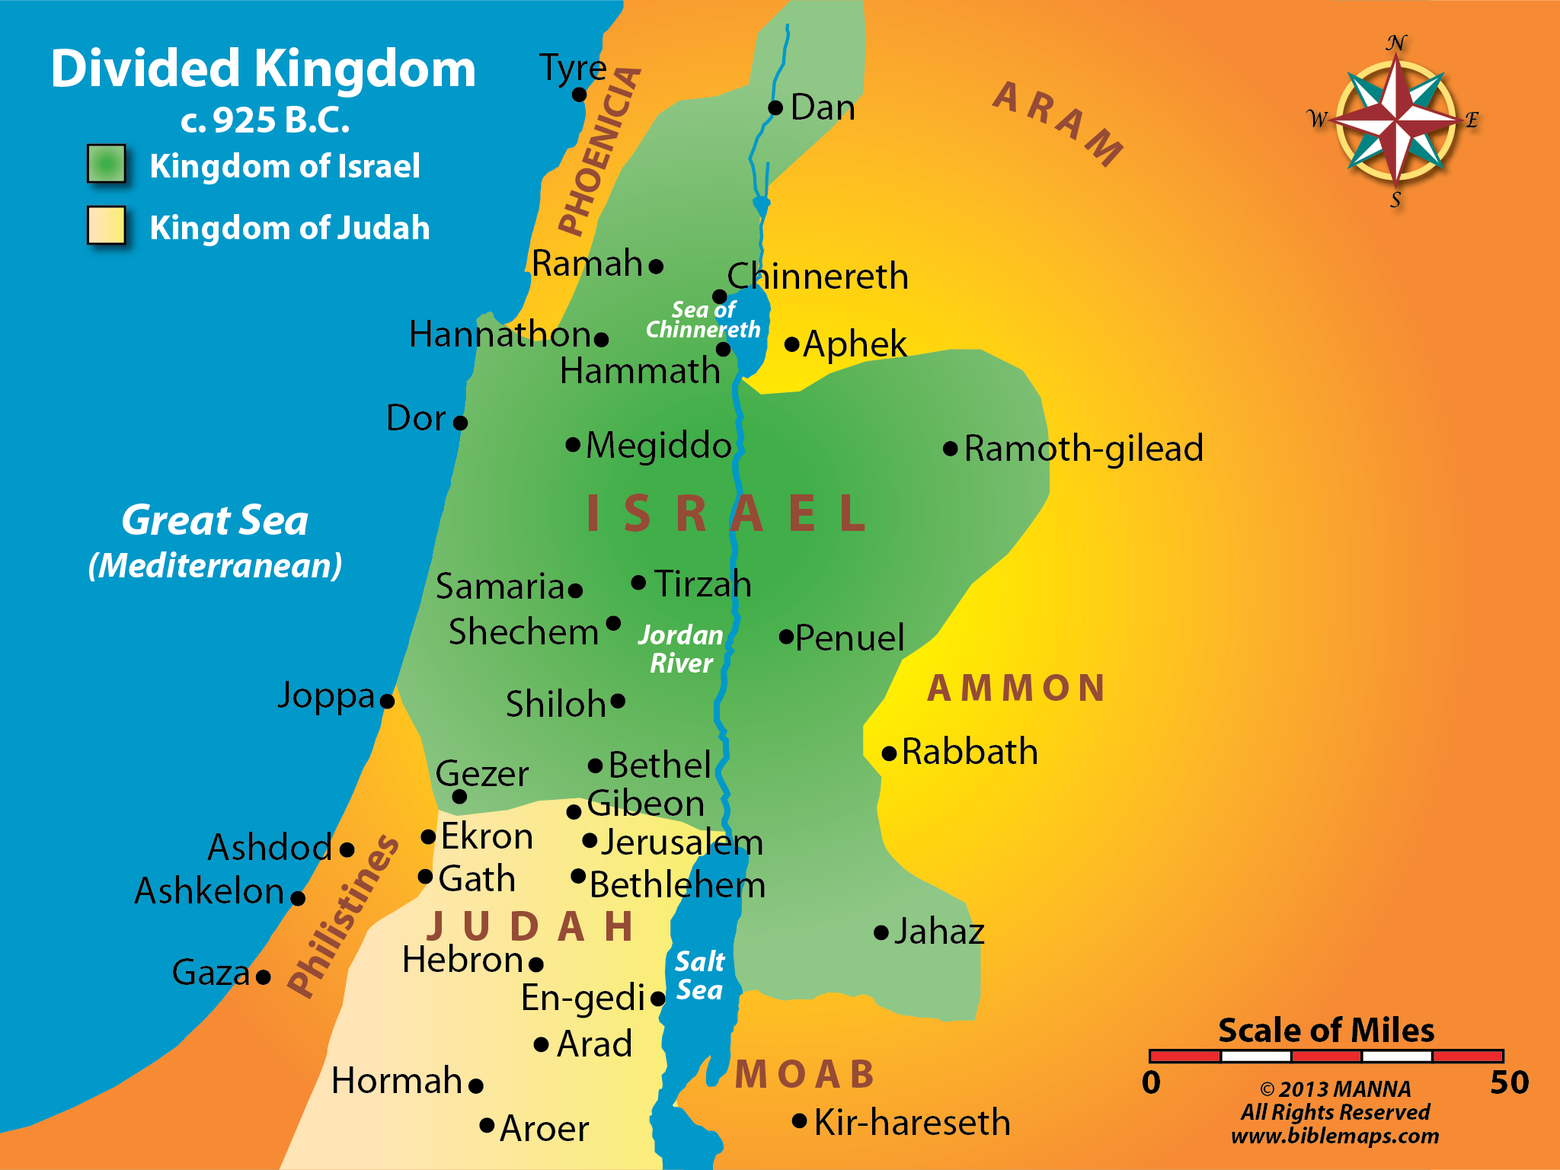

Slide 4
Background Events in Biblical History
Creation-Adam, Eve, Sin—Separation from God
The Flood—Noah, The Ark—God’s Judgment against Sin
Beginning of the “Nation”—Abram, Isaac, Jacob (Israel)—3 Promises
The “Nation” into Egypt—Joseph, Famine—ISRAEL-ites to Egypt
The Exodus—Moses—Nation heads toward the promised land
Promised Land—Joshua—Land taken and divided to ISRAEL-itles
First Government—Judges (15), 350 years—Nation adopts idols
Second Government—Saul, David, Solomon (120 yr)—Tribes united
Division of the Nation—North=Israel (10 tribes); South=Judah (2)
Captivity of the “Northern” Nation—Israel to Assyria (931 B.C.)
Captivity of the “Southern” Nation—Judah to Babylon (606 B.C.)
Return from Captivity—All tribes, primarily Judah (536. B.C.)

Slide 5
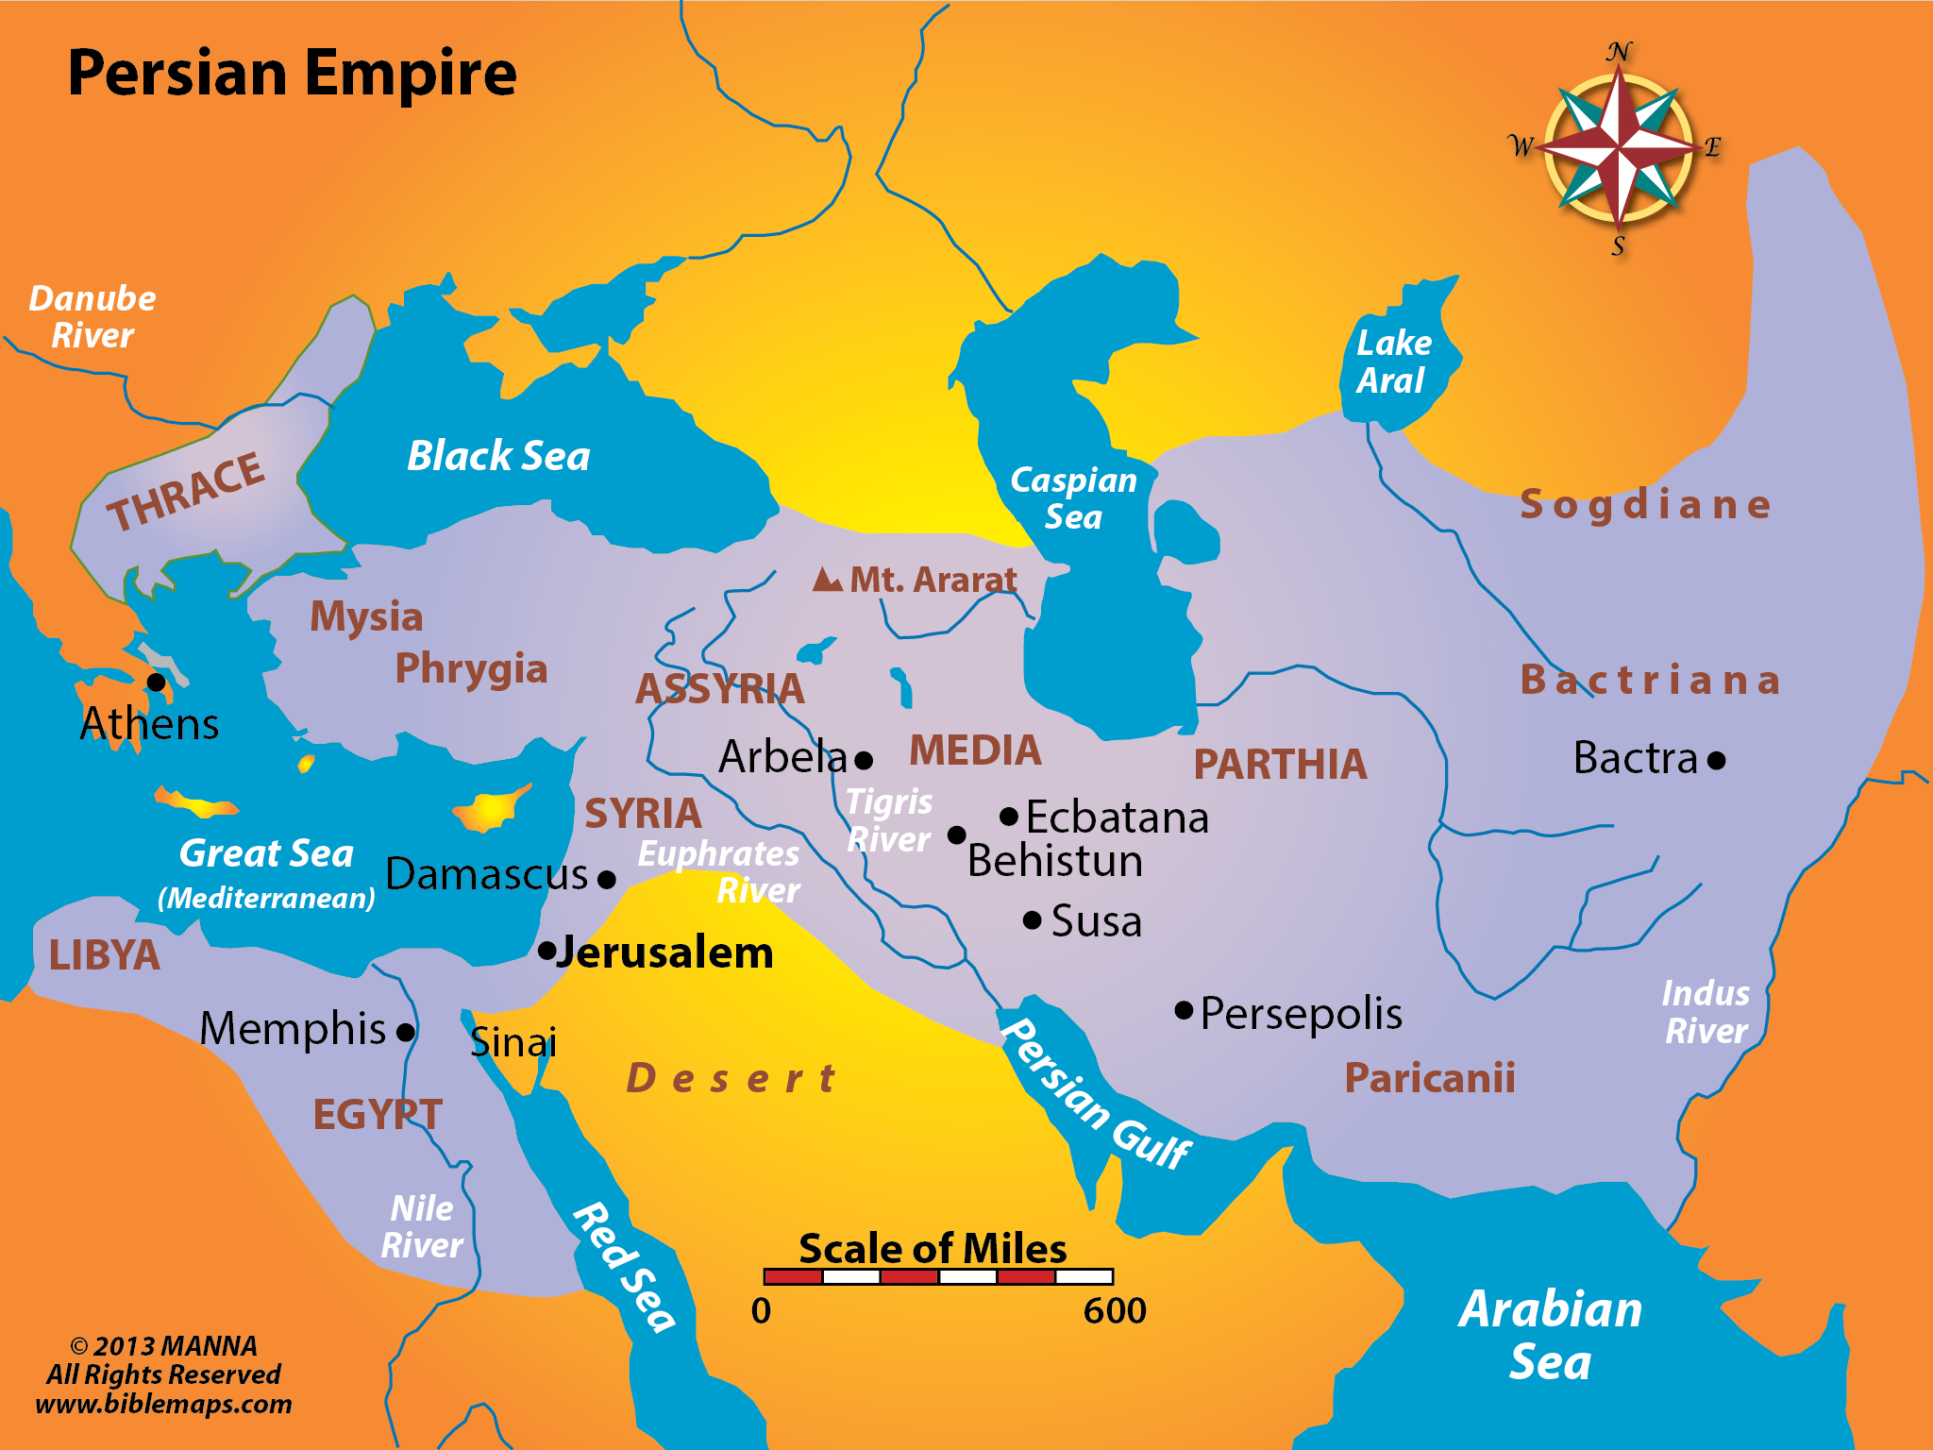
SYRIA
ASSYRIA

Slide 6
The Call of Isaiah – Isaiah 6

Slide 7
The Call of Isaiah – Isaiah 6

Slide 8
The Call of Isaiah – Isaiah 6
What did he see?

Slide 9
The Call of Isaiah – Isaiah 6
What did he see?
What did he hear?

Slide 10
The Call of Isaiah – Isaiah 6
What did he see?
What did he hear?
How did he feel?

Slide 11
The Call of Isaiah – Isaiah 6
What did he see?
What did he hear?
How did he feel?
God’s question

Slide 12
The Call of Isaiah – Isaiah 6
What did he see?
What did he hear?
How did he feel?
God’s question
Isaiah’s question

Slide 13
The Kingdom Prophecies
Isaiah 2:1-4
When? Last Days
2 Now it shall come to pass in the latter days That the mountain of the LORD's house Shall be established on the top of the mountains, And shall be exalted above the hills; And all nations shall flow to it.
3 Many people shall come and say, "Come, and let us go up to the mountain of the LORD, To the house of the God of Jacob; He will teach us His ways, And we shall walk in His paths." For out of Zion shall go forth the law, And the word of the LORD from Jerusalem.
4 He shall judge between the nations, And rebuke many people; They shall beat their swords into plowshares, And their spears into pruning hooks; Nation shall not lift up sword against nation, Neither shall they learn war anymore.

Slide 14
The Kingdom Prophecies
Isaiah 2:1-4
When? Last Days
What? Lord’s house
2 Now it shall come to pass in the latter days That the mountain of the LORD's house Shall be established on the top of the mountains, And shall be exalted above the hills; And all nations shall flow to it.
3 Many people shall come and say, "Come, and let us go up to the mountain of the LORD, To the house of the God of Jacob; He will teach us His ways, And we shall walk in His paths." For out of Zion shall go forth the law, And the word of the LORD from Jerusalem.
4 He shall judge between the nations, And rebuke many people; They shall beat their swords into plowshares, And their spears into pruning hooks; Nation shall not lift up sword against nation, Neither shall they learn war anymore.

Slide 15
The Kingdom Prophecies
Isaiah 2:1-4
When? Last Days
What? Lord’s house
Who? All nations
2 Now it shall come to pass in the latter days That the mountain of the LORD's house Shall be established on the top of the mountains, And shall be exalted above the hills; And all nations shall flow to it.
3 Many people shall come and say, "Come, and let us go up to the mountain of the LORD, To the house of the God of Jacob; He will teach us His ways, And we shall walk in His paths." For out of Zion shall go forth the law, And the word of the LORD from Jerusalem.
4 He shall judge between the nations, And rebuke many people; They shall beat their swords into plowshares, And their spears into pruning hooks; Nation shall not lift up sword against nation, Neither shall they learn war anymore.

Slide 16
The Kingdom Prophecies
Isaiah 2:1-4
When? Last Days
What? Lord’s house
Who? All nations
Where? Zion, Jerusalem
2 Now it shall come to pass in the latter days That the mountain of the LORD's house Shall be established on the top of the mountains, And shall be exalted above the hills; And all nations shall flow to it.
3 Many people shall come and say, "Come, and let us go up to the mountain of the LORD, To the house of the God of Jacob; He will teach us His ways, And we shall walk in His paths." For out of Zion shall go forth the law, And the word of the LORD from Jerusalem.
4 He shall judge between the nations, And rebuke many people; They shall beat their swords into plowshares, And their spears into pruning hooks; Nation shall not lift up sword against nation, Neither shall they learn war anymore.

Slide 17
The Kingdom Prophecies
Isaiah 9:6-7
Names of the Child
Wonderful Counselor
Mighty God
Everlasting Father
Prince of Peace
6 For unto us a Child is born, Unto us a Son is given; And the government will be upon His shoulder. And His name will be called Wonderful, Counselor, Mighty God, Everlasting Father, Prince of Peace.
7 Of the increase of His government and peace There will be no end, Upon the throne of David and over His kingdom, To order it and establish it with judgment and justice From that time forward, even forever. The zeal of the Lord of hosts will perform this.

Slide 18
The Kingdom Prophecies
Isaiah 9:6-7
Names of the Child
Wonderful Counselor
Mighty God
Everlasting Father
Prince of Peace
His Regal Nature
Government on His shoulder
Increasing government & peace
Will sit on David’s throne
Established with judgment & justice
Kingdom to last forever
Zeal of God will make it happen
6 For unto us a Child is born, Unto us a Son is given; And the government will be upon His shoulder. And His name will be called Wonderful, Counselor, Mighty God, Everlasting Father, Prince of Peace.
7 Of the increase of His government and peace There will be no end, Upon the throne of David and over His kingdom, To order it and establish it with judgment and justice From that time forward, even forever. The zeal of the Lord of hosts will perform this.

Slide 19
The Kingdom Prophecies
Isaiah 56:1-5ff
The coming salvation
isa 56:1 Thus says the LORD: "Keep justice, and do righteousness, For My salvation is about to come, And My righteousness to be revealed. . . .
Isa 56:3 Do not let the son of the foreigner Who has joined himself to the LORD Speak, saying, "The LORD has utterly separated me from His people"; Nor let the eunuch say, "Here I am, a dry tree."
Isa 56:4 For thus says the LORD: "To the eunuchs who keep My Sabbaths, And choose what pleases Me, And hold fast My covenant,
Isa 56:5 Even to them I will give in My house And within My walls a place and a name Better than that of sons and daughters; I will give them an everlasting name That shall not be cut off.

Slide 20
The Kingdom Prophecies
Isaiah 56:1-5ff
The coming salvation
To include foreigners
isa 56:1 Thus says the LORD: "Keep justice, and do righteousness, For My salvation is about to come, And My righteousness to be revealed. . . .
Isa 56:3 Do not let the son of the foreigner Who has joined himself to the LORD Speak, saying, "The LORD has utterly separated me from His people"; Nor let the eunuch say, "Here I am, a dry tree."
Isa 56:4 For thus says the LORD: "To the eunuchs who keep My Sabbaths, And choose what pleases Me, And hold fast My covenant,
Isa 56:5 Even to them I will give in My house And within My walls a place and a name Better than that of sons and daughters; I will give them an everlasting name That shall not be cut off.

Slide 21
The Kingdom Prophecies
Isaiah 56:1-5ff
The coming salvation
To include foreigners
To include eunuchs
isa 56:1 Thus says the LORD: "Keep justice, and do righteousness, For My salvation is about to come, And My righteousness to be revealed. . . .
Isa 56:3 Do not let the son of the foreigner Who has joined himself to the LORD Speak, saying, "The LORD has utterly separated me from His people"; Nor let the eunuch say, "Here I am, a dry tree."
Isa 56:4 For thus says the LORD: "To the eunuchs who keep My Sabbaths, And choose what pleases Me, And hold fast My covenant,
Isa 56:5 Even to them I will give in My house And within My walls a place and a name Better than that of sons and daughters; I will give them an everlasting name That shall not be cut off.

Slide 22
The Kingdom Prophecies
Isaiah 56:1-5ff
The coming salvation
To include foreigners
To include eunuchs
To receive an everlasting name
isa 56:1 Thus says the LORD: "Keep justice, and do righteousness, For My salvation is about to come, And My righteousness to be revealed. . . .
Isa 56:3 Do not let the son of the foreigner Who has joined himself to the LORD Speak, saying, "The LORD has utterly separated me from His people"; Nor let the eunuch say, "Here I am, a dry tree."
Isa 56:4 For thus says the LORD: "To the eunuchs who keep My Sabbaths, And choose what pleases Me, And hold fast My covenant,
Isa 56:5 Even to them I will give in My house And within My walls a place and a name Better than that of sons and daughters; I will give them an everlasting name That shall not be cut off.

Slide 23
The Kingdom Prophecies
Isaiah 62:1-3; 65:17
Righteousness & Salvation
Isa 62:1 For Zion's sake I will not hold My peace, And for Jerusalem's sake I will not rest, Until her righteousness goes forth as brightness, And her salvation as a lamp that burns.
Isa 62:2 The Gentiles shall see your righteousness, And all kings your glory. You shall be called by a new name, Which the mouth of the LORD will name.
Isa 62:3 You shall also be a crown of glory In the hand of the LORD, And a royal diadem In the hand of your God. Isa. 62:1-3
Isa 65:17 "For behold, I create new heavens and a new earth; And the former shall not be remembered or come to mind. Isa. 65:17

Slide 24
The Kingdom Prophecies
Isaiah 62:1-3; 65:17
Righteousness & Salvation
Gentiles shall see it
Isa 62:1 For Zion's sake I will not hold My peace, And for Jerusalem's sake I will not rest, Until her righteousness goes forth as brightness, And her salvation as a lamp that burns.
Isa 62:2 The Gentiles shall see your righteousness, And all kings your glory. You shall be called by a new name, Which the mouth of the LORD will name.
Isa 62:3 You shall also be a crown of glory In the hand of the LORD, And a royal diadem In the hand of your God. Isa. 62:1-3
Isa 65:17 "For behold, I create new heavens and a new earth; And the former shall not be remembered or come to mind. Isa. 65:17

Slide 25
The Kingdom Prophecies
Isaiah 62:1-3; 65:17
Righteousness & Salvation
Gentiles shall see it
A New name given by God
Isa 62:1 For Zion's sake I will not hold My peace, And for Jerusalem's sake I will not rest, Until her righteousness goes forth as brightness, And her salvation as a lamp that burns.
Isa 62:2 The Gentiles shall see your righteousness, And all kings your glory. You shall be called by a new name, Which the mouth of the LORD will name.
Isa 62:3 You shall also be a crown of glory In the hand of the LORD, And a royal diadem In the hand of your God. Isa. 62:1-3
Isa 65:17 "For behold, I create new heavens and a new earth; And the former shall not be remembered or come to mind. Isa. 65:17

Slide 26
The Kingdom Prophecies
Isaiah 62:1-3; 65:17
Righteousness & Salvation
Gentiles shall see it
A New name given by God
End of former things and the
beginning new things
Isa 62:1 For Zion's sake I will not hold My peace, And for Jerusalem's sake I will not rest, Until her righteousness goes forth as brightness, And her salvation as a lamp that burns.
Isa 62:2 The Gentiles shall see your righteousness, And all kings your glory. You shall be called by a new name, Which the mouth of the LORD will name.
Isa 62:3 You shall also be a crown of glory In the hand of the LORD, And a royal diadem In the hand of your God. Isa. 62:1-3
Isa 65:17 "For behold, I create new heavens and a new earth; And the former shall not be remembered or come to mind. Isa. 65:17

