Slide 1
A Study of Isaiah
Introduction of Isaiah
July 10, 2019
Palm Beach Lakes
Dan Jenkins
July-September, 2019

Slide 2
A Study of Isaiah
Introduction of Isaiah
CLASS ONE
Palm Beach Lakes
Dan Jenkins
July-September, 2019

Slide 3
Introduction – Class 1
Historical Background
PLACE THE FOLLOWING PEOPLE IN CHRONOLOGICAL ORDER
Adam Saul Joshua Moses Abraham
Deborah David Samson Noah Moses

Slide 4
Introduction – Class 1
Historical Background
PLACE THE FOLLOWING PEOPLE IN CHRONOLOGICAL ORDER
Adam Noah Abraham Moses
Joshua Deborah Samson Saul David

Slide 5
Introduction – Class 1
Historical Background
PLACE THE FOLLOWING EVENTS IN CHRONOLOGICAL ORDER
Second Government in the Promised Land = Kings
Babylonian Captivity and Return
Entering of the Promised Land
Fall of Northern Kingdom
First Government in the Promised Land = Judges
Divided Kingdom After Solomon’s Death
United Kingdom under the first three kings = Saul, David, Solomon
Fall of Southern Kingdom

Slide 6
Introduction – Class 1
Historical Background
PLACE THE FOLLOWING EVENTS IN CHRONOLOGICAL ORDER
Entering of the Promised Land
First Government in the Promised Land = Judges
Second Government in the Promised Land = Kings
United Kingdom under the first three kings = Saul, David, Solomon
Divided Kingdom After Solomon’s Death
Fall of Northern Kingdom
Fall of Southern Kingdom
Babylonian Captivity and Return

Slide 7
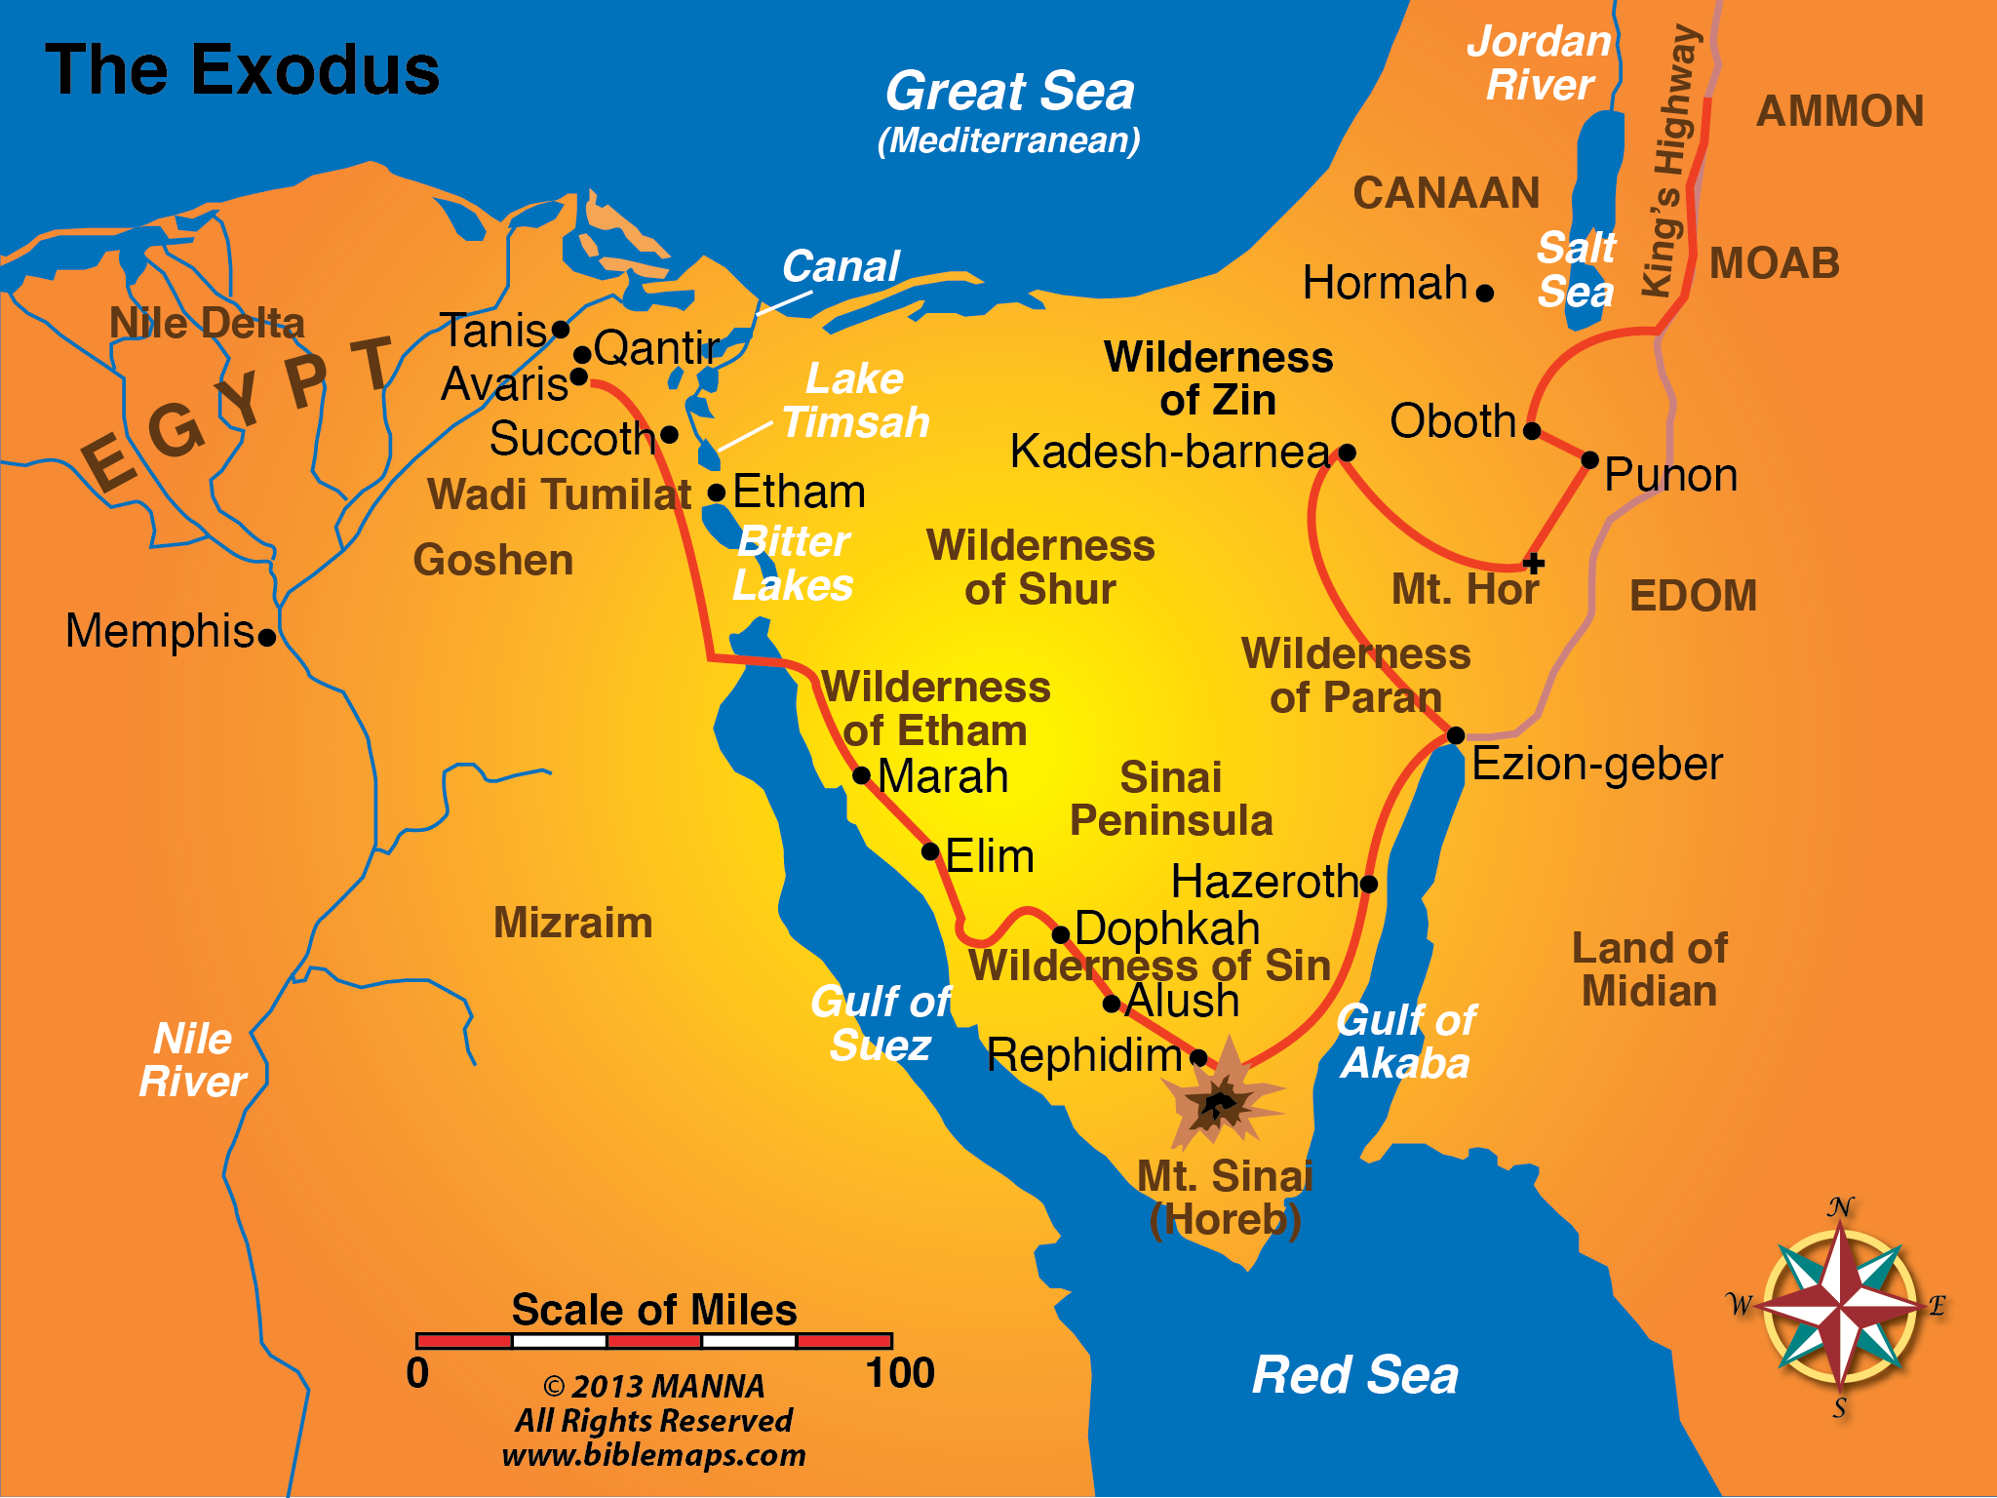

Slide 8
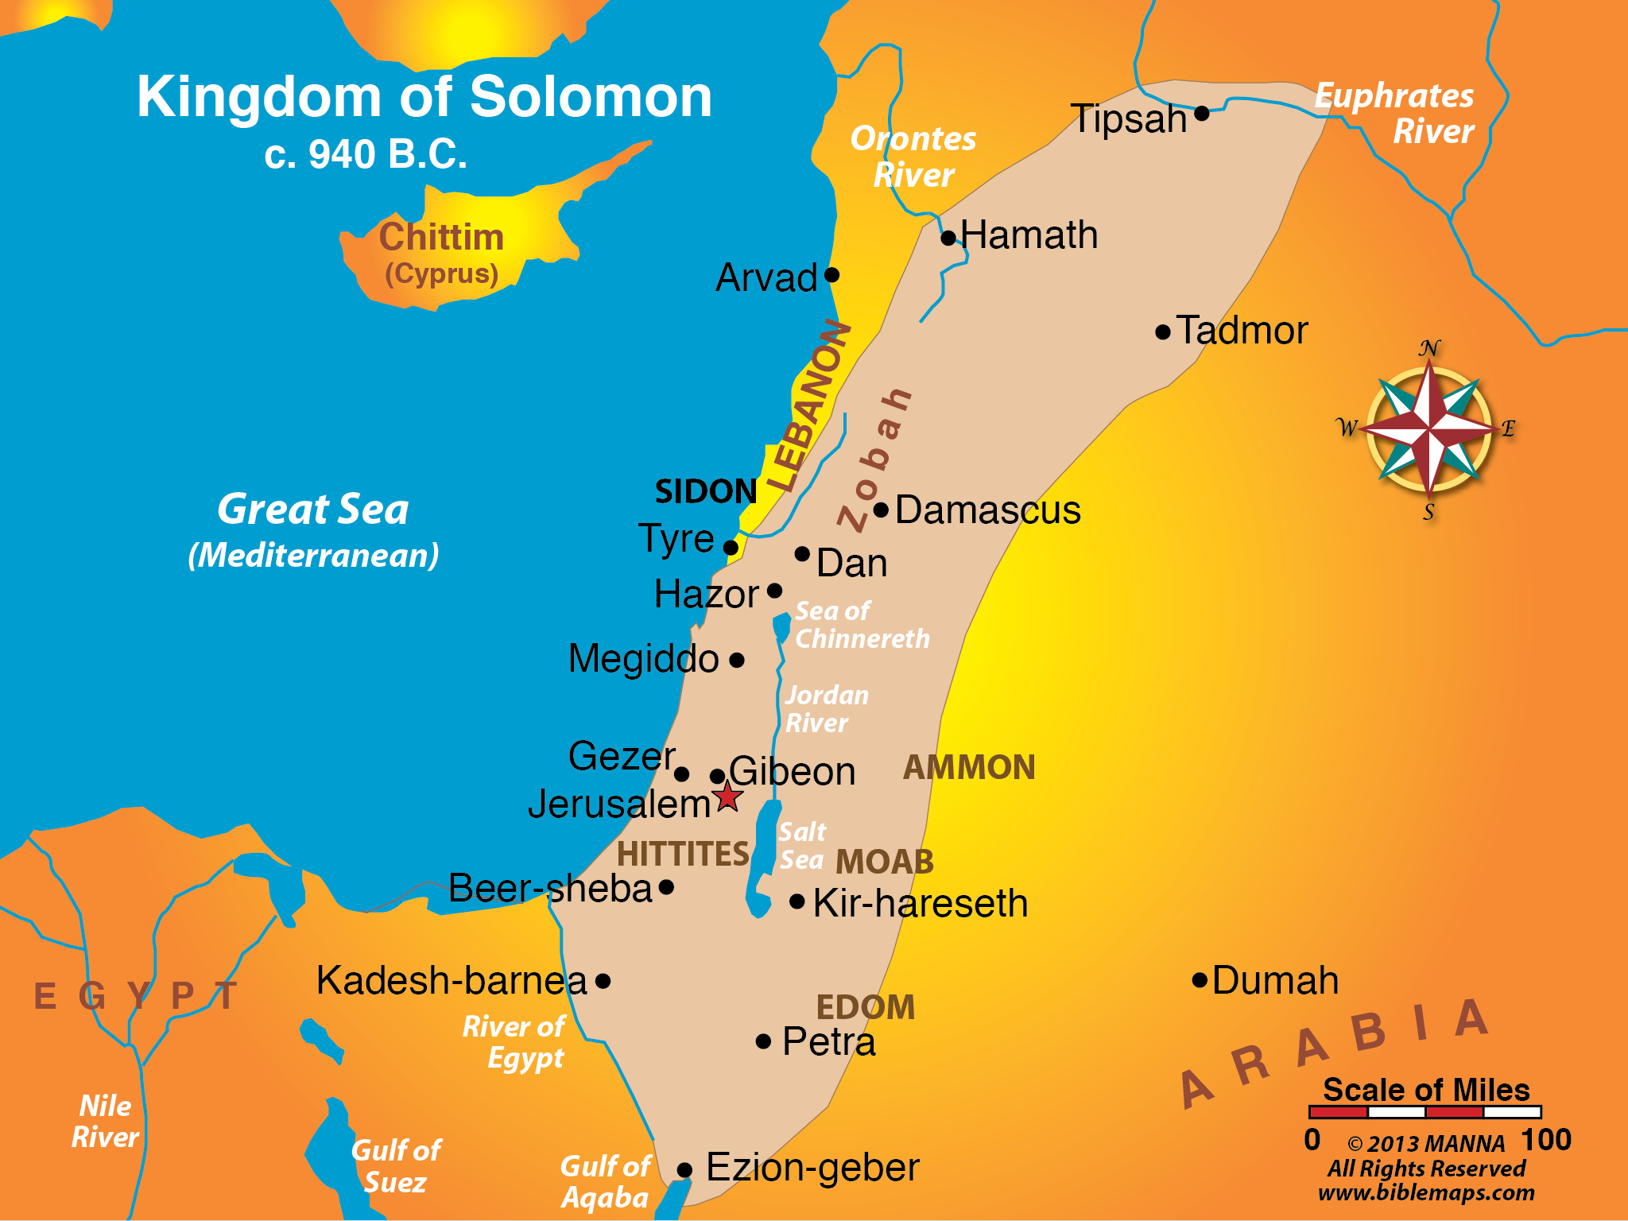
Land Divided
Judges Rule
King Appointed
One Kingdom
Divided Kingdom
Fall of Kingdoms

Slide 9
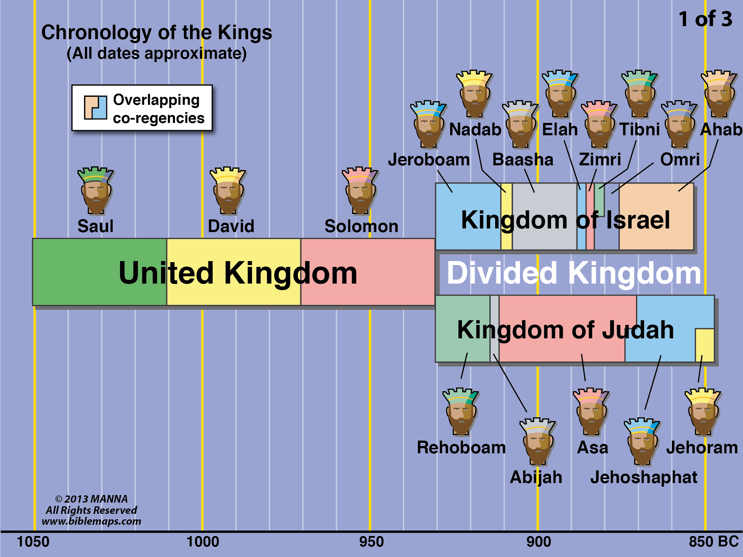
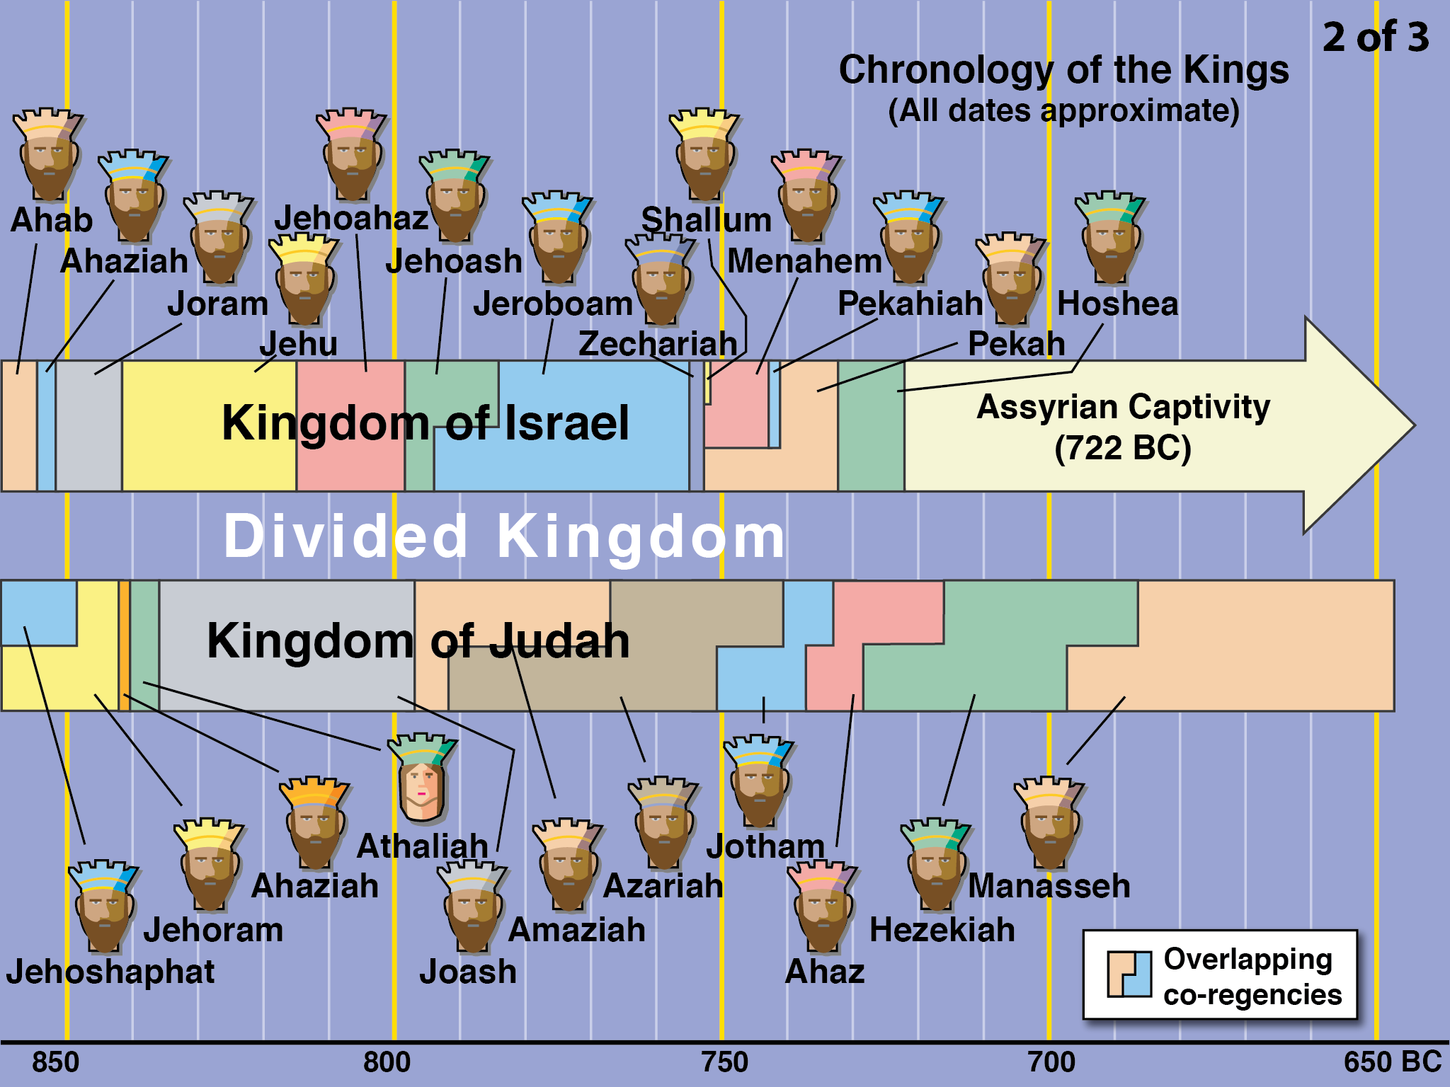

Slide 10
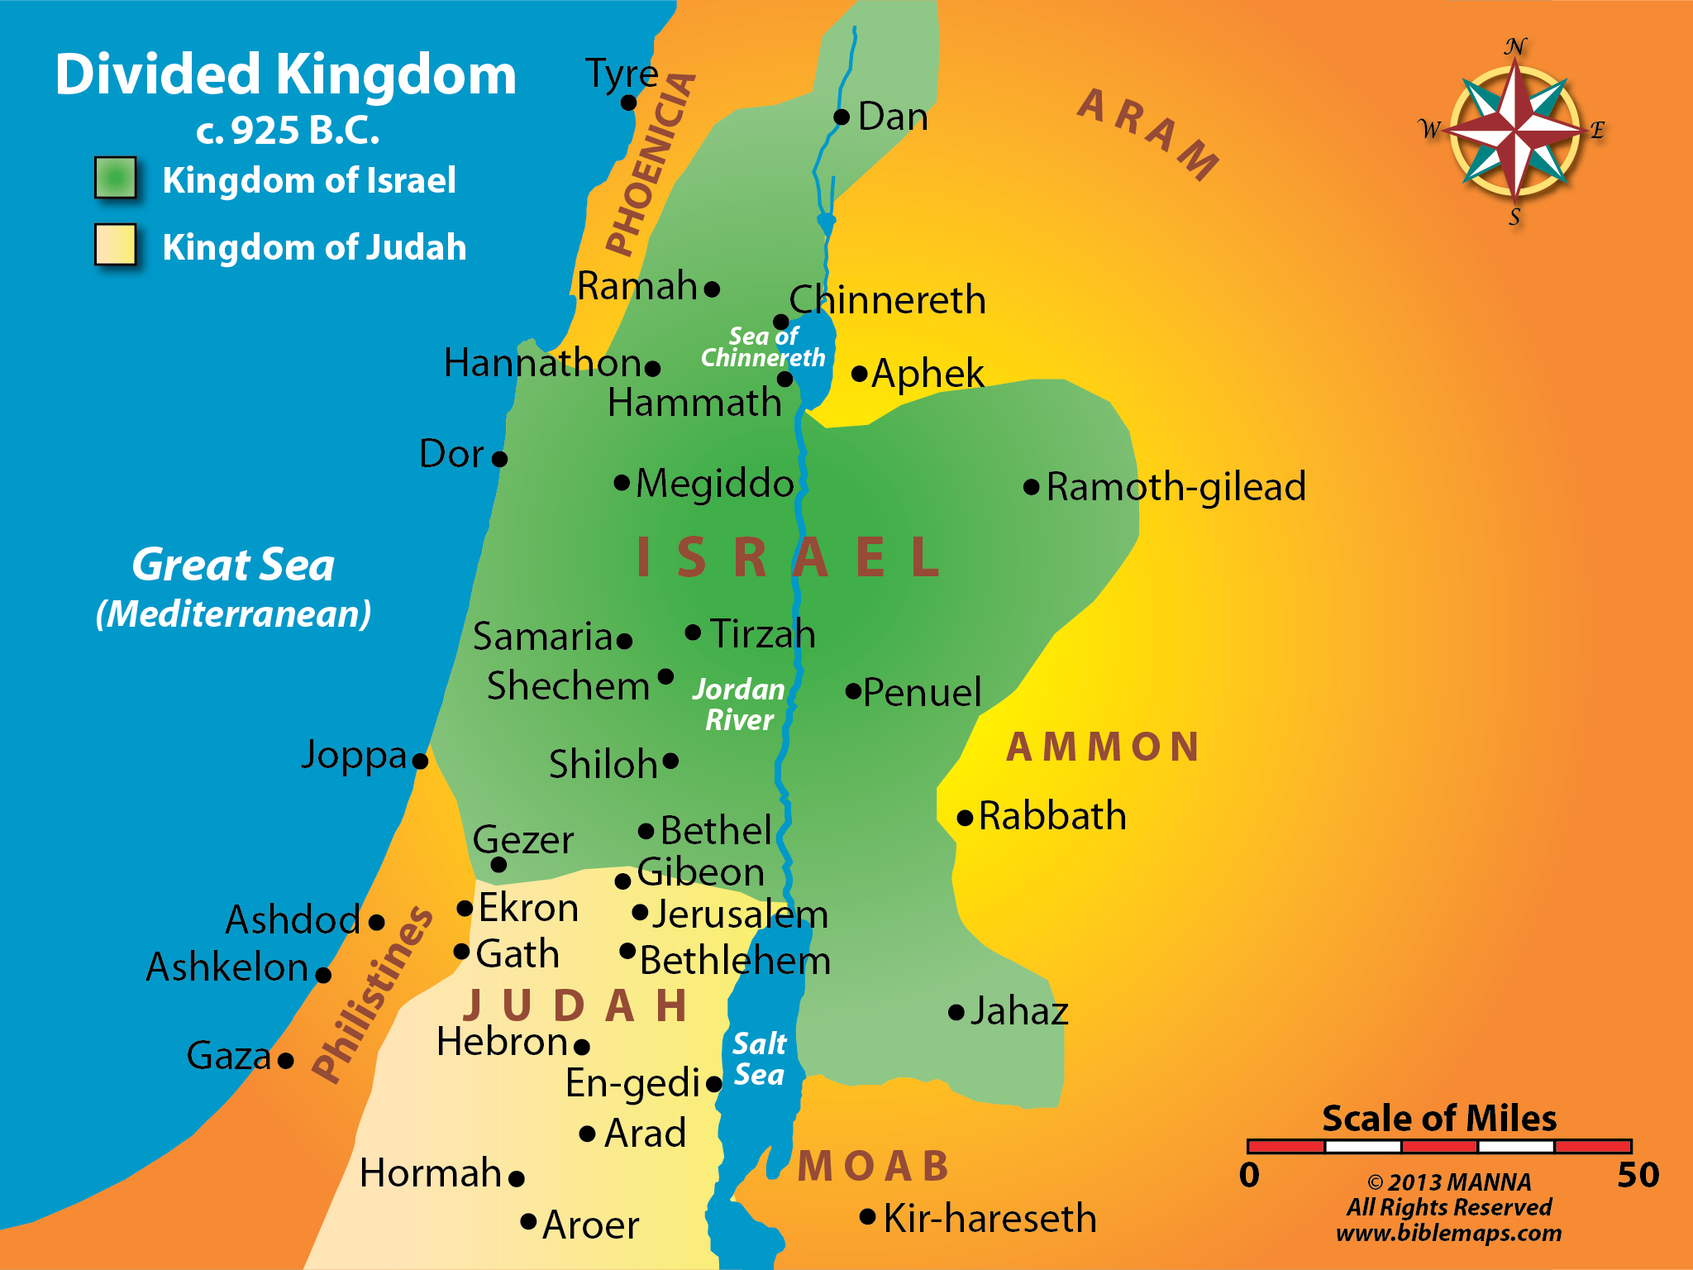

Slide 11
Northern Kingdom

Slide 12
Northern Kingdom
Capital City – Samaria
Largest Tribe – Ephraim
First King – Jeroboam
Kings – 19 – None righteous
Captivity – Assyria –722 B.C.

Slide 13
Southern Kingdom

Slide 14
NORTHERN KINGDOM
Capital City – Samaria
Largest Tribe – Ephraim
First King – Jeroboam
Kings – 19 – None righteous
Captivity – Assyria –722 B.C.
SOUTHERN KINGDOM – JUDAH
Capital City – Jerusalem
Largest Tribe – Judah
First King – Rehoboam
Kings – 19 – Four righteous
Captivity – Babylon – 606 B.C.

Slide 16
Introduction – Class 1
Historical Background
Spiritual Condition
Isa. 1:1-6
Isa. 1:21-23
Isa. 3:16-26
Isa. 4:8-12
Etc.

Slide 17
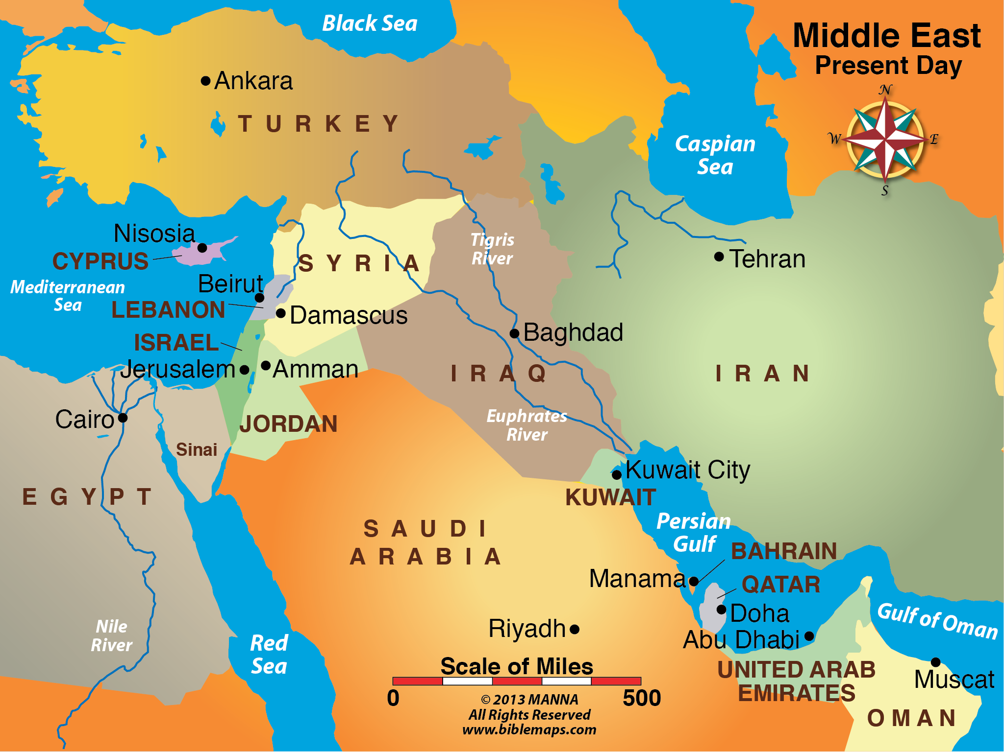

Slide 18
