Slide 2
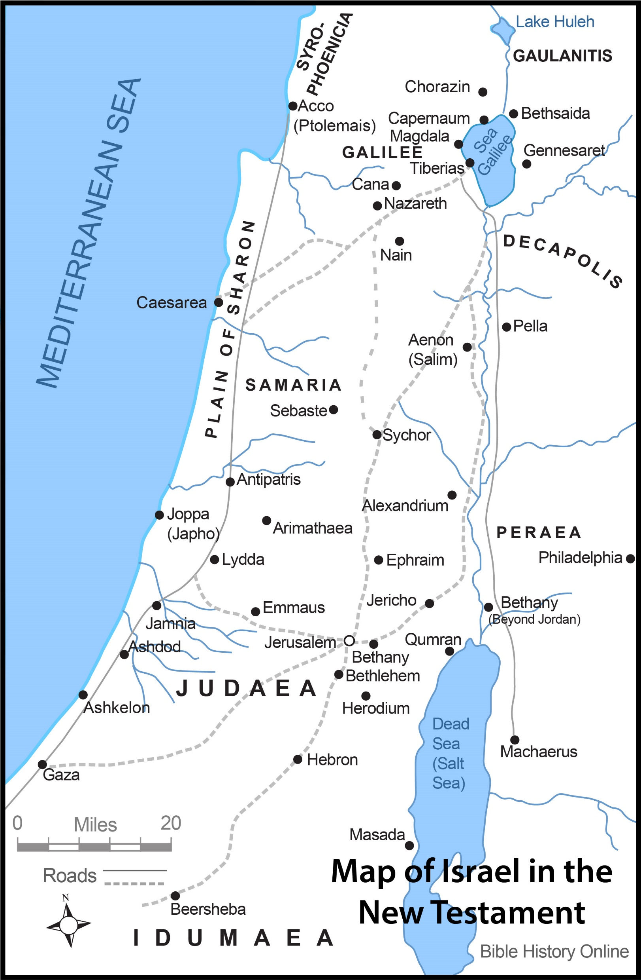

Slide 3
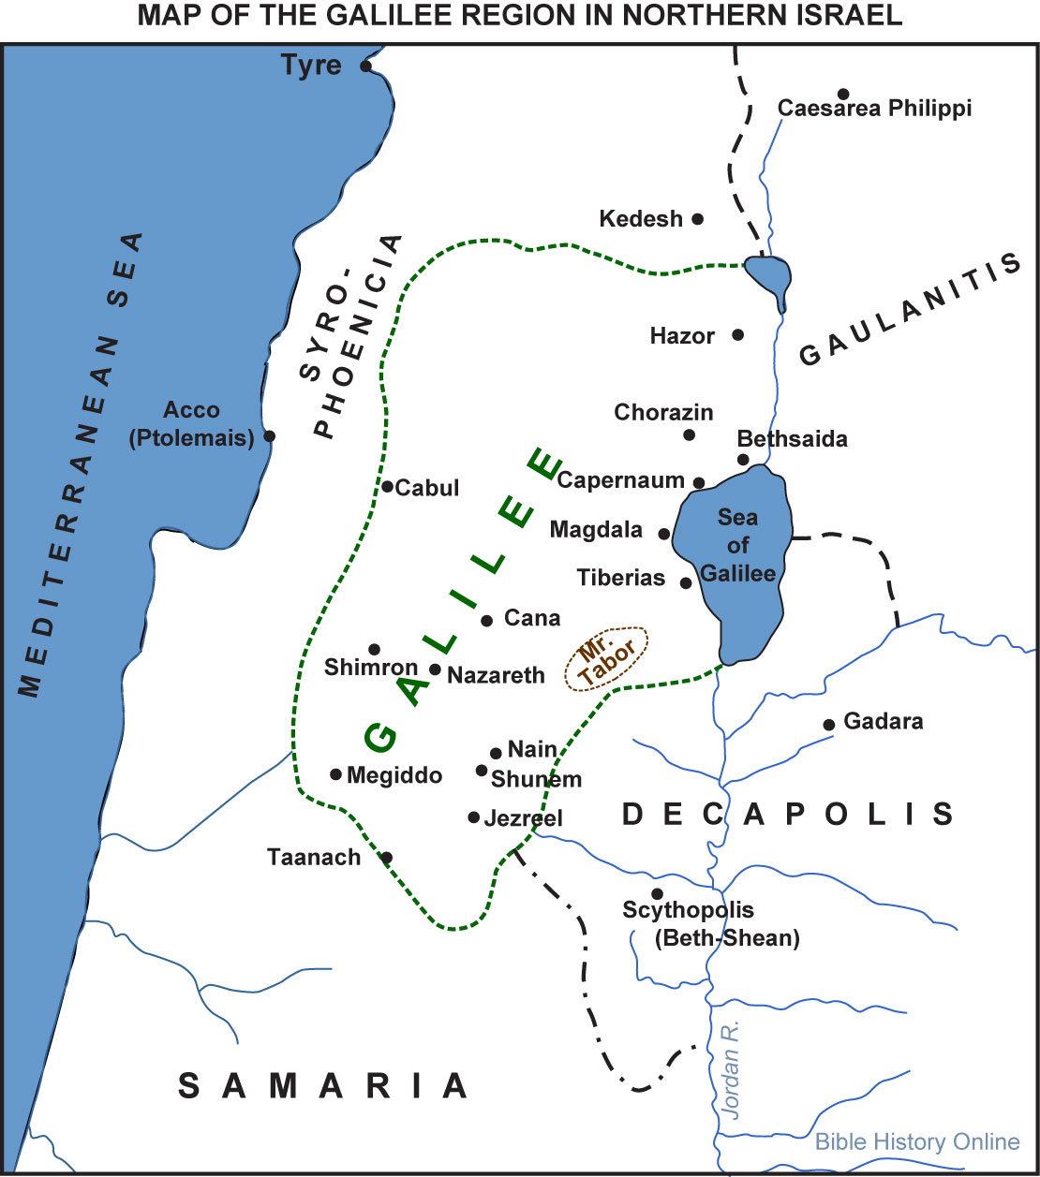

Slide 4
Worry Leads to “Little Faith” OR “Little Faith” Leads to Worry (Matt. 6:30)
Fear Leads to “Little Faith” OR “Little Faith” Leads to Fear (Matt. 8:26)

Slide 5
Doubt Leads to “Little Faith” OR “Little Faith” Leads to Doubt (Matt. 14:31)
The Greek word for “doubt” in this verse (distazo) means “to pull two ways,” implying one who is of a divided mind/trust
Doubt is forbidden (Jas. 1:6)
Doubt will cause us to fail to reach our destination (Matt. 14:29)
Doubt will cause us to focus on problems instead of Jesus (14:30)
Doubt will cause us to be tossed about by cares of life (Jas. 1:6)
Doubt will cause us to be “unstable” in all of our ways (Jas. 1:8)
Doubt may cause us to not “receive anything from the Lord” (1:7)

Slide 6
Doubt Leads to “Little Faith” OR “Little Faith” Leads to Doubt (Matt. 14:31)
To have faith that overcomes doubt:
Expect God/Jesus to know your troubles (Matt. 14:23-25)
Expect that God/Jesus will help you anytime and anywhere (14:24-25)
Expect that there is nothing too hard for the Lord (14:25)
Take comfort, delight and assurance in the presence of Jesus (14:27)
Expect that with God’s help great things can be done (14:29)
KEEP YOUR EYES on Jesus and not your troubles or circumstances (14:30)
Know that the Lord is near (nearer than you think) (14:30-31)

Slide 7
Doubt Leads to “Little Faith” OR “Little Faith” Leads to Doubt (Matt. 14:31)
To have faith that overcomes doubt:
Pray for wisdom (Jas. 1:5)
Pray in faith, with no doubting (Jas. 1:6)
Do all you can to increase your faith and trust in: - God (Heb. 11:6), - His power (Eph. 3:20-21), - His providence (Rom. 8:28), - His presence (Psa. 139:7-12; Heb. 13:5) and - His precepts (1 Thess. 2:13)
DO NOT DOUBT—God Is There No Matter What!
Therefore, keep your eyes on the Lord!

Slide 8
Forgetting Leads to “Little Faith” OR “Little Faith” Leads to Forgetting (Matt. 16:8)
Forgetting what God has done is forbidden (Deut. 4:23; 8:11; 9:7; 25:19; 2 Kgs. 17:38; Psa. 78:7; 103:2; Prov. 4:5)
Forgetting what God has done will cause us:
To get confused and not understand the will of the Lord (16:8)
To minimize the great things God has done for us (16:9-11)
To overlook the abundance of God’s blessings (16:9-11)
To follow down a path that will lead us astray (16:12)

Slide 9
Forgetting Leads to “Little Faith” OR “Little Faith” Leads to Forgetting (Matt. 16:8)
To have faith that overcomes forgetting:
We must “keep His commandments” (Deut. 8:11; 4:23)
We must stop “rebelling against” and “provoking” Him (Deut. 9:7)
We must not become complacent in what God gives us (Deut. 25:19)
We must “fear” God and keep His “commandments” (2 Kgs. 17:35-39)
We must remember “all His benefits” toward us (Psa. 103)
We must desire, respect, learn & obey His Word (119: 16, 109, 176)
We must “get wisdom” and “get understanding” (Prov. 4:4-7)
DO NOT FORGET—God Wants You to Grow in Faith!
Therefore, remember what the Lord has done!

Slide 10
Humility and Confidence Lead to “Great Faith” (Matt. 8:5-13)
Believed Jesus could solve problems we cannot (8:5-8) = Great faith
Felt unworthy before the Lord (8:7-8) = Great faith
Acknowledged the supreme authority of Jesus (8:9) = Great faith
Jesus said, “I have not found such great faith, not even in Israel!” (8:10)

Slide 11
Persistence and Reverence Lead to “Great Faith” (Matt. 15:21-28)
Repeatedly cried out to Jesus for mercy (15:21-23) = Great faith
Fell down at His feet and begged for help (15:25) = Great faith
Humbly accepted the place of a “dog” for her daughter to be healed (15:27) = Great faith
Had absolute confidence that Jesus was her only hope = Great faith
Jesus said, “O woman, great is your faith!” (Matt. 15:28)

