Slide 2
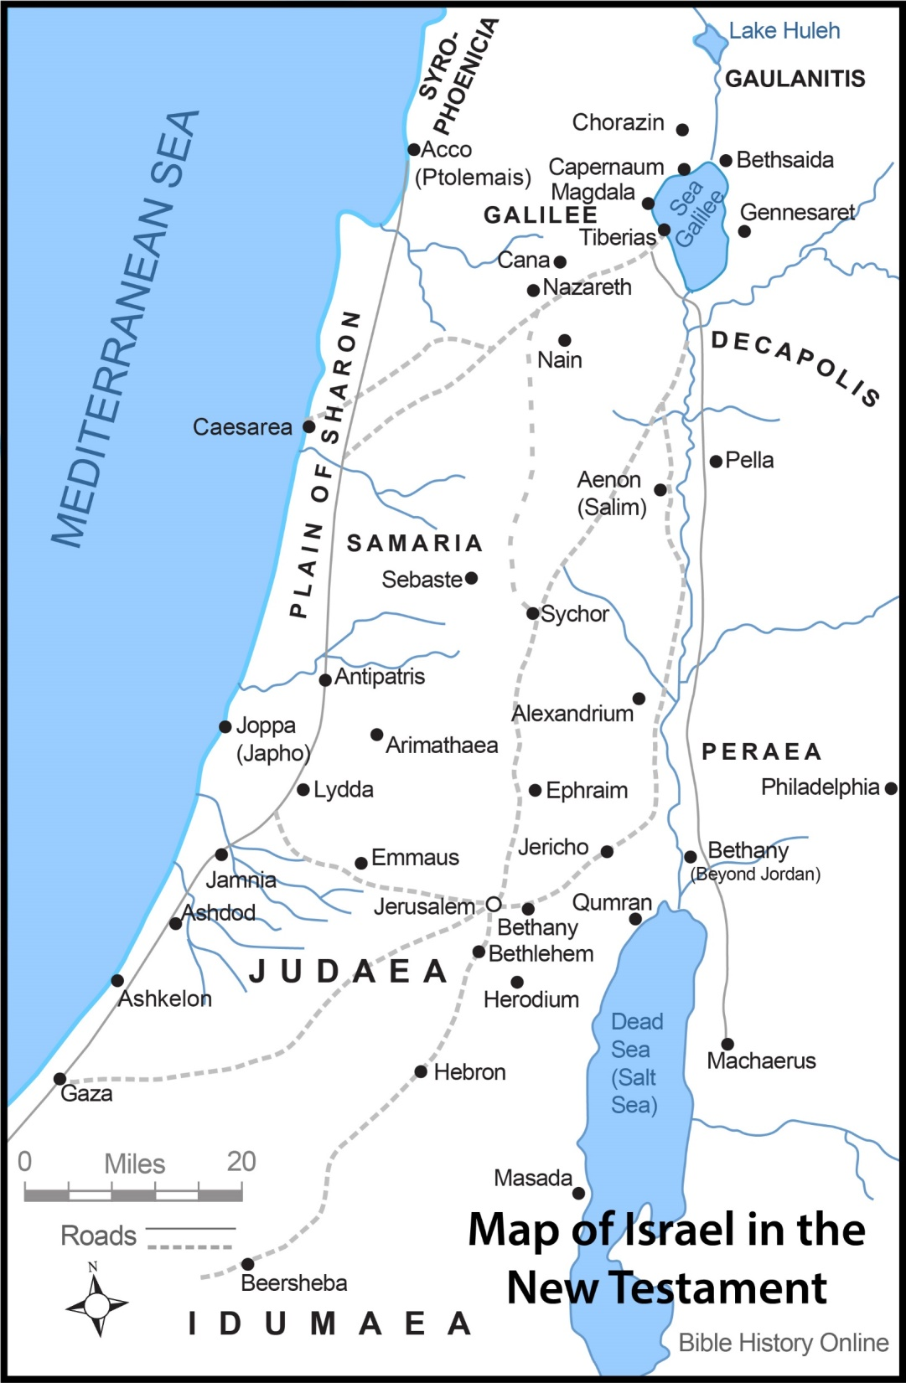

Slide 3
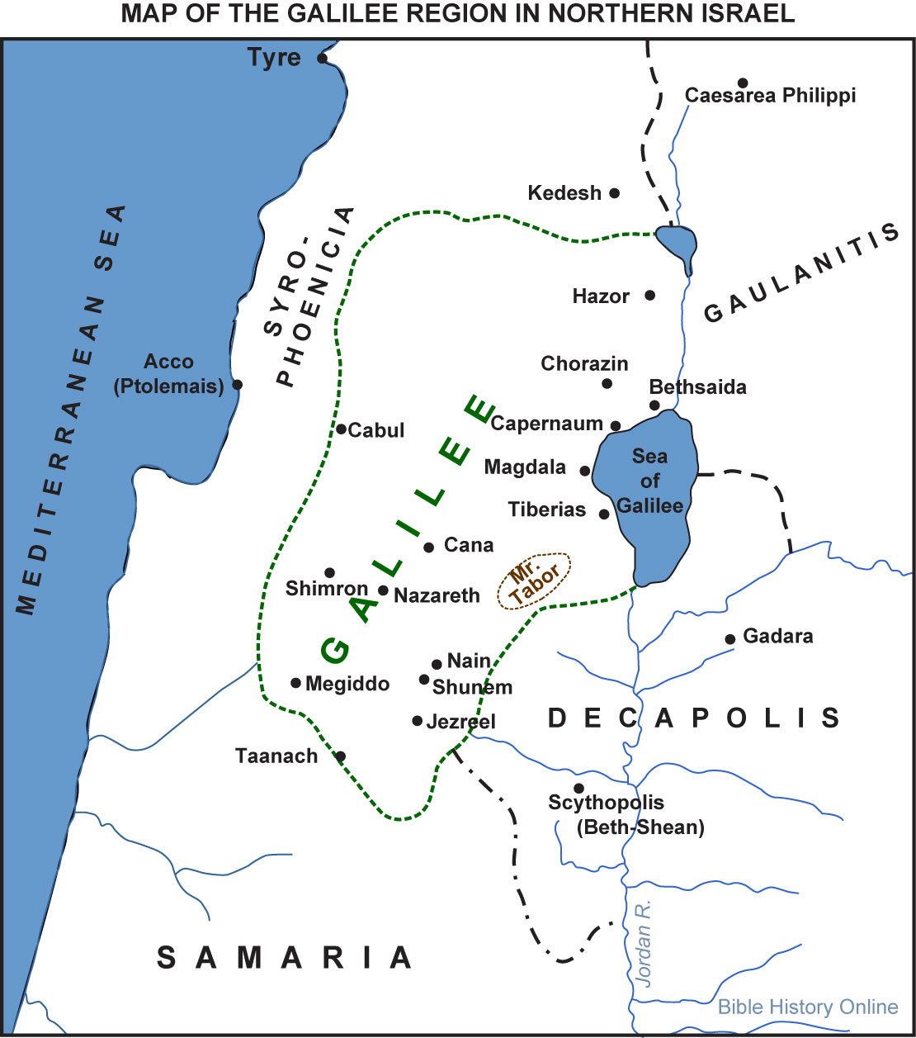

Slide 4
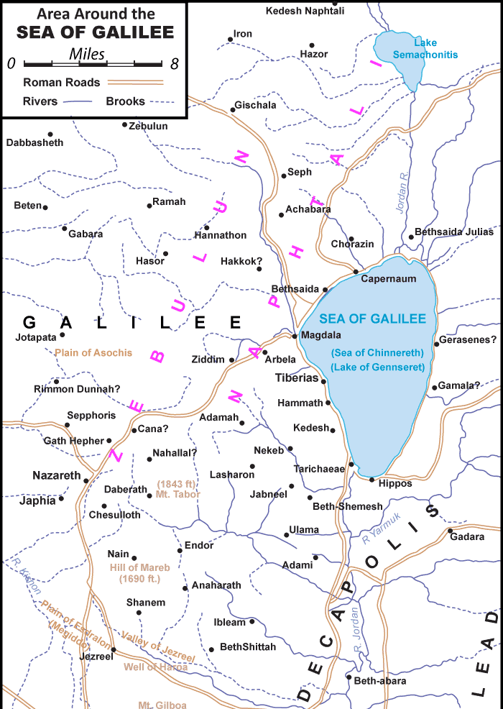

Slide 5
Worry Leads to “Little Faith” OR “Little Faith” Leads to Worry (Matt. 6:30)
The Greek word for “worry” (merimnao) means, “draw in different directions, distract”
Jesus said that worry is forbidden (6:25, 31, 34)
Jesus said that worry is futile (6:27)
Jesus said that worry is foolish (6:26, 30)
Jesus said that worry is faithless (6:30, 32a)

Slide 6
Worry Leads to “Little Faith” OR “Little Faith” Leads to Worry (Matt. 6:30)
To have a faith that overcomes worry:
Focus on the things of life that really matter (6:25, 33)
Fix your mind and heart on God’s goodness (6:26-32)
Feed and further your faith by feasting on God’s Word regularly (6:30, 33)
Fill your day with prayer (6:6-9)
Function one day at a time (6:34, 11)
DO NOT WORRY—God Takes Care of Our Needs!!!
Therefore, set your priorities on Him and not on the worries of this life!

Slide 7
Fear Leads to “Little Faith” OR “Little Faith” Leads to Fear (Matt. 8:26)
The Greek word for “fearful” in this verse (deilos) means, “cowardly, timid, without courage”
Fear is forbidden (John 14:27; Isa. 41:10)
Fear prevents us from doing God’s will (Matt. 25:25-30)
Fear is contrary to the “power, love and discipline” that a Christian should have (2 Tim. 1:7)
Fear puts the focus on us instead of on the Lord (Matt. 10:30-31)
“The cowardly/fearful…shall have their part in the lake which burns with fire and brimstone” (Rev. 21:8)

Slide 8
Fear Leads to “Little Faith” OR “Little Faith” Leads to Fear (Matt. 8:26)
To have a faith that overcomes fear:
Realize that JESUS is in the boat with you (Matt. 8:23)
Realize that focusing on “us” and “we” misses the boat (8:25)
Realize that the Lord of the wind & waves is your Lord (8:26-27)
Recount all that the Lord has already done (8:3, 13, 15, 16)
Remember that the Lord is on your side (Psa. 118:6; 46:1-3)
Regularly and repeatedly pray to God (Psa. 55:4-5, 16-17, 22)
DO NOT FEAR—God is Able!
Therefore, trust the Lord and not yourself!

