Slide 2
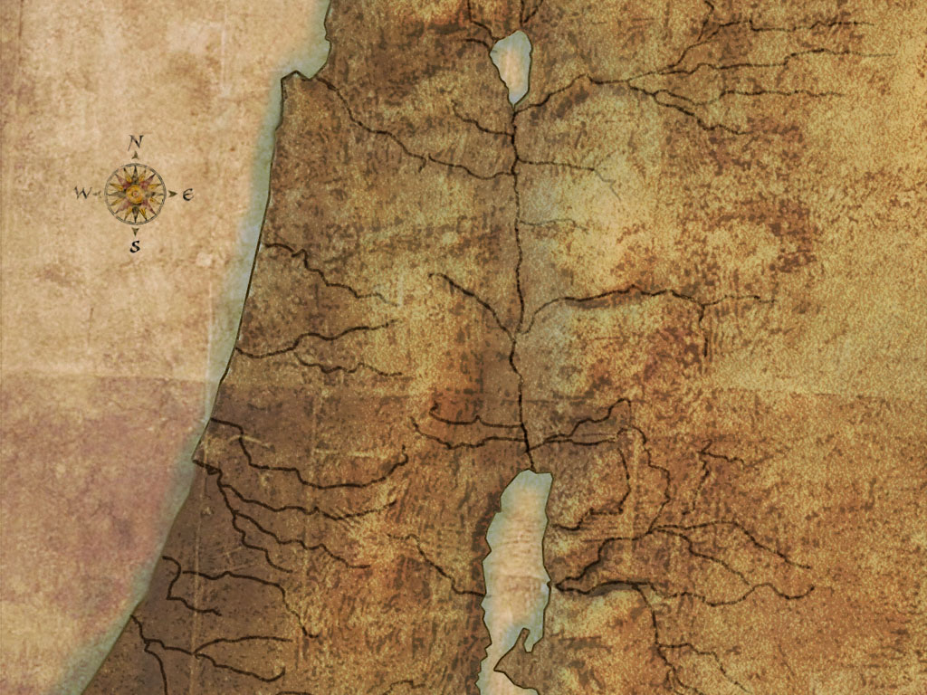
Jericho

Slide 3
We Learn What Biblical GRACE Is
BEFORE giving the instructions about what to DO, God told Joshua that it was a GIFT (Josh. 6:2)
The city was a GIFT of God—by His GRACE they would possess it (Ex. 6:8; Deut. 6:10-11)
The possession of His GIFT was conditional & required OBEDIENCE to His instructions
Can a GIFT from God actually require ACTION/WORK on our part to receive?
  Our DAILY BREAD is a GIFT of God (Matt. 6:11) that requires work (2 Thess. 3:10)
  Our SALVATION is a GIFT of God (Eph. 2:5, 8-10) that requires work (Mark 16:16; Luke 13:3; John 3:5; Heb. 5:9; James 2:14-26)
Biblical grace is a gift from God which requires action on man’s part to secure

Slide 4
We Learn What Biblical FAITH Is
The events at Jericho are summarized in Hebrews 11:30
Biblical faith is wholeheartedly accepting what God says because God says it (cf. Isa. 55:8-9)
  Israelites saving their firstborn during the Passover may have been non-sensical to man (Ex. 12:1-14)
  Israelites being saved during the plague of fiery serpents may have been non-sensical to man (Num. 21:4-9)
  Naaman being saved from leprosy may have been non-sensical to man (2 Kgs. 5:1-14)
  Modern man being saved from sins through baptism may seem non-sensical to man
  Marching around city walls for seven days to win a battle may have been non-sensical to man (Josh. 6:1-25)

Slide 5
We Learn What Biblical FAITH Is
Biblical faith has three equally essential components:
  Firm conviction (Rom. 4:21),
  Trustful surrender (Luke 9:23),
  And obedience (Heb. 11; John 3:36)
Biblical faith includes & involves personal obedience
  The first generation of Israelites did not enter the Promised Land due to “unbelief” or being “disobedient” (Heb. 3:18-19)
  The second generation entered the Promised Land by obeying the commands at Jericho (Heb. 11:30)
  Biblical faith is confident and complete trust in God that prompts immediate action/response

Slide 6
We Learn What Biblical OBEDIENCE Is
Biblical Obedience Requires STEPPING OUT FROM THE CROWD (Josh. 2:1-24; 6:17, 22-23, 25; Heb. 11:31; Jas. 2:25)
Biblical Obedience Requires LISTENING (6:2, 6, 7, 10; Rom. 10:17)
Biblical Obedience Requires ATTENTION TO DETAIL (Josh. 6:1-16)
Biblical Obedience Requires PROPER ORDER
  The order in which they marched (6:4, 9, 13)
  The order in which they shouted (6:5 + 6:10, 16, 20)
Biblical Obedience Requires CONSISTENT & REPEATED PRACTICE (6:14)
Biblical Obedience Cannot Tolerate DISOBEDIENCE (6:18-19 + 7:11, 15, 20-21)
Do EXACTLY what God commands & EVERYTHING God commands

