Slide 1
An Introduction

Slide 3
Egypt
Egypt was first mentioned in connection with Abraham. (Genesis 12:10)
Egypt would be the place of the birth of the Hebrew nation. (Genesis 15:13-18)
Joseph in Egypt (Genesis 37:28)
Exodus
Put Egypt away (Joshua 24:14-15)
Remember (Deuteronomy 15:15; 16:12; 24:17-22)

Slide 5
Jericho
One of the oldest cities dates back 10,000 years.
The Israelites camped opposite it in Moab (Numbers 22:1)
Very affluent and large walled city.
Spies (Joshua 2:1-24)
Conquest (Joshua 6:1-27)
Bestowed to the tribe of Benjamin.
Hiel the Bethelite (1 Kings 16:34)
Herod the Great built a fortress there, and died in it.
Jesus gave sight to the blind men (Matthew 20:30)
Descendant of Rahab ate with Zacchaeus (Luke 19:1-10)

Slide 6
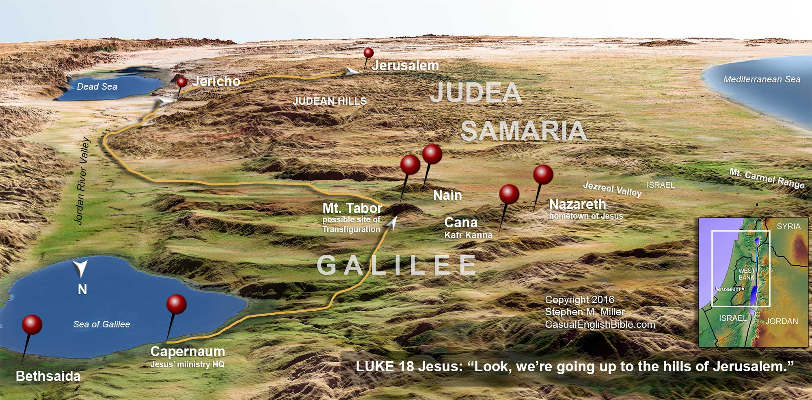

Slide 7
Galilee
Solomon gave 20 cities from this region to the king of Tyer for payment for cedar, juniper and gold Lebanon (1 Kings 9:11)
In the time of Jesus Israel was divided into 3 sectors (Judea, Samaria and Galilee).
Prophecy (Isaiah 9:1; Matthew 4:12-17)
Jesus’ early ministry was centered in this area and around the lake. (Sea of Chinnereth, Lake Gennesaret, Lake Tiberius, Sea of Galilee)
“I will go ahead of you to Galilee” (Matthew 26:32; 28:6-10)

Slide 8
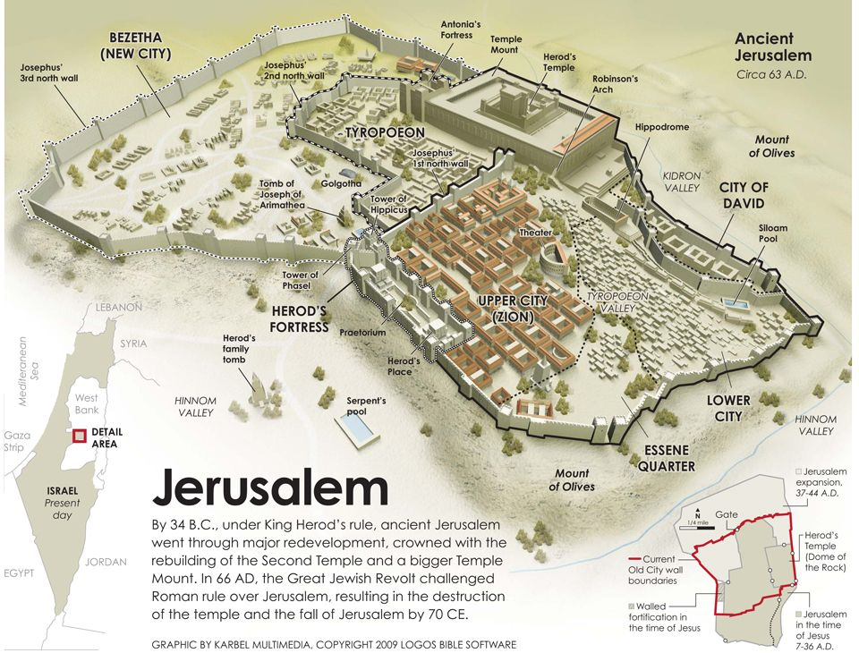

Slide 9
Jerusalem
Its ancient name was Salem. (Genesis 14:18; Psalm 76:2)
Abraham made an offering there. (Genesis 22:1-24)
The temple was built by Solomon there (2 Chronicles 3:1)
Israelites were never able to completely drive out the Jebusites until David (2 Samuel 5:7)
During the life of Jesus Jerusalem looked very different.
Events of Jesus’ life.
Prophecy (Micah 4:1-3; Acts 2)

Slide 10
Vacation Bible School
Summer time opportunity for Bible instruction.
An opportunity to invite friends and kids for an event.
An opportunity to get involved with the congregation.

