Slide 1
Bind Us Together The Heart of Binding: Impartial Humility
Ron Brackett
Central Florida Bible Camp

Slide 2
Humility/Humble
Dictionary.com
The quality or condition of being humble; modest opinion or estimate of one's own importance, rank, etc.
Humble: Adjective:
not proud or arrogant; modest -- to be humble although successful.
having a feeling of insignificance, inferiority, subservience, etc. – In the presence of so many world-famous writers I felt very humble.
low in rank, importance, status, quality, etc.; lowly – of humble origin; a humble home.
courteously respectful -- In my humble opinion you are wrong.
low in height, level, etc.; small in size – a humble member of the galaxy.

Slide 3
Humility
Wikipedia.org
Humility is the quality of being humble.
Dictionary definitions accentuate humility as a low self-regard and sense of unworthiness.
In a religious context humility can mean a recognition of self in relation to a deity (i.e. God) or deities, and self-debasement with subsequent submission to said deity as a member of that religion.
Humility is an outward expression of an appropriate inner, or self regard, and is contrasted with humiliation which is an imposition, often external, of shame upon a person.

Slide 4
Humility
Wikipedia.org
Humility may be misappropriated as ability to suffer humiliation through self-denouncements which in itself remains focus on self rather than low self-focus.
Humility, in various interpretations, is widely seen as a virtue which centers on low self-preoccupation, or unwillingness to put oneself forward, so it is in many religious and philosophical traditions, it contrasts with narcissism, hubris and other forms of pride and is an idealistic and rare intrinsic construct that has an extrinsic side.

Slide 5
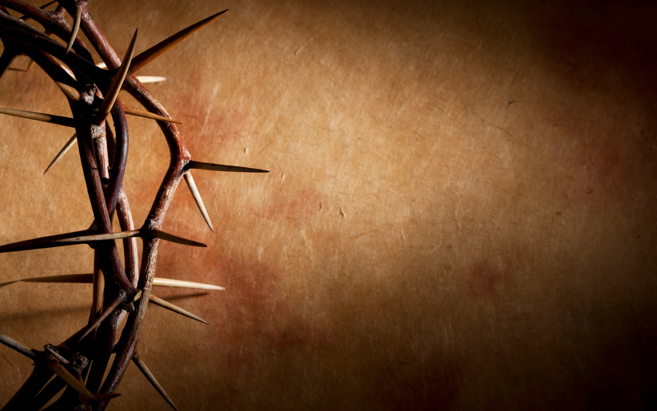
Humility
“a personal quality in which an individual shows dependence on God and respect for other persons”

Slide 6
Psychology Today
June 27, 2012
Recent studies show that humility is connected with many forms of prosocial behavior. While some misunderstand humility as low self-esteem or self-denigration, a proper conception of this virtue has both self-regarding and other-regarding components. The humble person keeps her accomplishments, gifts, and talents in a proper perspective. She has self-knowledge, and is aware of her limitations as an individual and as a human being. But humble individuals are also oriented towards others, they value the welfare of other people and have the ability to "forget themselves" as well, when appropriate.

Slide 7
Psychology Today
June 27, 2012
Interestingly, the empirical research on humility shows that this trait has great value. Humility has been linked with better academic performance, job performance, and excellence in leadership. Humble people have better social relationships, avoid deception in their social interactions, and they tend to be forgiving, grateful, and cooperative. A recent set of studies also shows that humility is a consistent predictor of generosity. People who are humble tend to be more generous with both their time and their money.

Slide 9
What the Bible Says…
2 Chronicles 7:14 if My people who are called by My name will humble themselves, and pray and seek My face, and turn from their wicked ways, then I will hear from heaven, and will forgive their sin and heal their land.
Psalm 147:6 The Lord lifts up the humble; He casts the wicked down to the ground.
Matthew 18:4 Therefore whoever humbles himself as this little child is the greatest in the kingdom of heaven.

Slide 10
What the Bible Says…
Luke 18:14 I tell you, this man went down to his house justified rather than the other; for everyone who exalts himself will be humbled, and he who humbles himself will be exalted.
James 4:6 But He gives more grace. Therefore He says: “God resists the proud, But gives grace to the humble.”
James 4:10 Humble yourselves in the sight of the Lord, and He will lift you up.

Slide 11
What the Bible Says…
1 Peter 5:5-6 Likewise you younger people, submit yourselves to your elders. Yes, all of you be submissive to one another, and be clothed with humility, for “God resists the proud, But gives grace to the humble.” ⁶ Therefore humble yourselves under the mighty hand of God, that He may exalt you in due time,

Slide 12
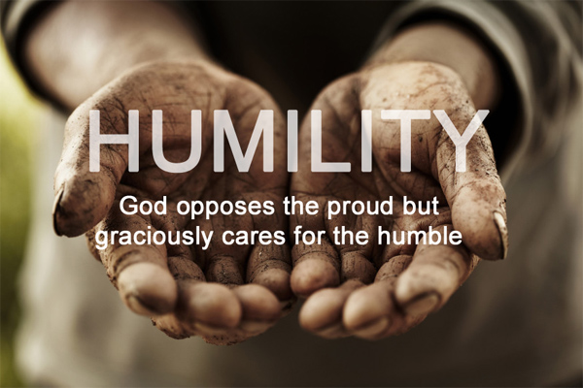

Slide 13
The Example of Moses
Numbers 12:3 Now the man Moses was very humble, more than all men who were on the face of the earth. (NKJV)
“meek” (KJV)
“Meek” (humble) does not equal “weak”
Moses intercedes for Israel (Exod. 32:10-14)
Moses punishes wrong-doing (Exod. 32:19-20, 25-28)

Slide 15
The Example of Paul
Acts 8:1, 3 At that time a great persecution arose against the church which was at Jerusalem; and they were all scattered throughout the regions of Judea and Samaria, except the apostles. ³ As for Saul, he made havoc of the church, entering every house, and dragging off men and women, committing them to prison.
Acts 9:1-2 Then Saul, still breathing threats and murder against the disciples of the Lord, went to the high priest ² and asked letters from him to the synagogues of Damascus, so that if he found any who were of the Way, whether men or women, he might bring them bound to Jerusalem.
Notes:
-- One of the brightest & most gifted Jewish leaders
-- Our first introduction

Slide 16
The Example of Paul
Philippians 3:4-6 though I also might have confidence in the flesh. If anyone else thinks he may have confidence in the flesh, I more so: ⁵ circumcised the eighth day, of the stock of Israel, of the tribe of Benjamin, a Hebrew of the Hebrews; concerning the law, a Pharisee; ⁶ concerning zeal, persecuting the church; concerning the righteousness which is in the law, blameless.

Slide 17
The Example of Paul
Philippians 3:7-11 But what things were gain to me, these I have counted loss for Christ. ⁸ Yet indeed I also count all things loss for the excellence of the knowledge of Christ Jesus my Lord, for whom I have suffered the loss of all things, and count them as rubbish, that I may gain Christ ⁹ and be found in Him, not having my own righteousness, which is from the law, but that which is through faith in Christ, the righteousness which is from God by faith; ¹⁰ that I may know Him and the power of His resurrection, and the fellowship of His sufferings, being conformed to His death, ¹¹ if, by any means, I may attain to the resurrection from the dead.
Notes:
Kept proper perspective

Slide 18
The Example of Paul
1 Corinthians 15:8-9 Then last of all He was seen by me also, as by one born out of due time. ⁹ For I am the least of the apostles, who am not worthy to be called an apostle, because I persecuted the church of God.
Notes:
His humility is on display

Slide 19
The Example of Paul
1 Timothy 1:12-15 And I thank Christ Jesus our Lord who has enabled me, because He counted me faithful, putting me into the ministry, ¹³ although I was formerly a blasphemer, a persecutor, and an insolent man; but I obtained mercy because I did it ignorantly in unbelief. ¹⁴ And the grace of our Lord was exceedingly abundant, with faith and love which are in Christ Jesus. ¹⁵ This is a faithful saying and worthy of all acceptance, that Christ Jesus came into the world to save sinners, of whom I am chief.
Notes:
His humility is on display

Slide 20
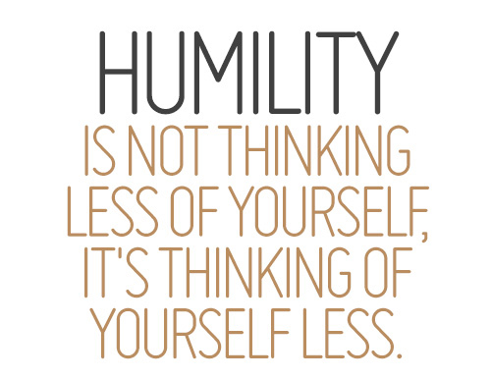

Slide 21
The Example of Jesus
Philippians 2:3-4 Let nothing be done through selfish ambition or conceit, but in lowliness of mind let each esteem others better than himself. ⁴ Let each of you look out not only for his own interests, but also for the interests of others.
Philippians 2:5-8 Let this mind be in you which was also in Christ Jesus, ⁶ who, being in the form of God, did not consider it robbery to be equal with God, ⁷ but made Himself of no reputation, taking the form of a bondservant, and coming in the likeness of men. ⁸ And being found in appearance as a man, He humbled Himself and became obedient to the point of death, even the death of the cross.
Notes:
His humility is on display

Slide 22
The Example of Jesus
Mark 10:42-45 ⁴² But Jesus called them to Himself and said to them, “You know that those who are considered rulers over the Gentiles lord it over them, and their great ones exercise authority over them. ⁴³ Yet it shall not be so among you; but whoever desires to become great among you shall be your servant. ⁴⁴ And whoever of you desires to be first shall be slave of all. ⁴⁵ For even the Son of Man did not come to be served, but to serve, and to give His life a ransom for many.”
Notes:
His humility is on display

Slide 23
The Example of Jesus
John 13:12-17 ¹² So when He had washed their feet, taken His garments, and sat down again, He said to them, “Do you know what I have done to you? ¹³ You call Me Teacher and Lord, and you say well, for so I am. ¹⁴ If I then, your Lord and Teacher, have washed your feet, you also ought to wash one another’s feet. ¹⁵ For I have given you an example, that you should do as I have done to you. ¹⁶ Most assuredly, I say to you, a servant is not greater than his master; nor is he who is sent greater than he who sent him. ¹⁷ If you know these things, blessed are you if you do them.
Notes:
His humility is on display

Slide 24
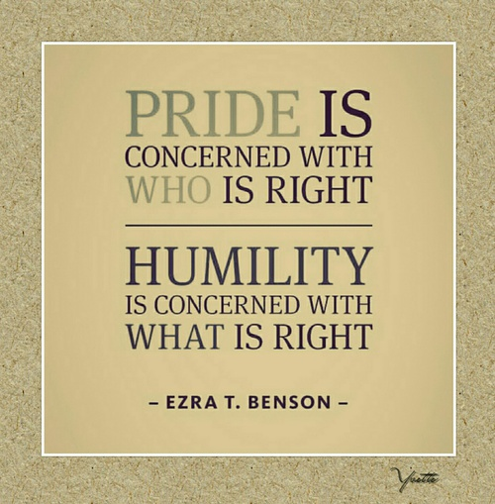

Slide 25
Bind Us Together: Humility…
…affirms the worth of all people
Romans 5:6-8 For when we were still without strength, in due time Christ died for the ungodly. ⁷ For scarcely for a righteous man will one die; yet perhaps for a good man someone would even dare to die. ⁸ But God demonstrates His own love toward us, in that while we were still sinners, Christ died for us.

Slide 26
Bind Us Together: Humility…
…affirms the worth of all people
…deflates pride & arrogance
Proverbs 27:1-2 Do not boast about tomorrow, For you do not know what a day may bring forth. ² Let another man praise you, and not your own mouth; A stranger, and not your own lips.

Slide 27
Bind Us Together: Humility…
…affirms the worth of all people
…deflates pride & arrogance
…elevates God & others above ourselves
J O Y
Jesus first
Others next
Yourself last of all

Slide 28
Bind Us Together: Humility…
…affirms the worth of all people
…deflates pride & arrogance
…elevates God & others above ourselves
…silences gossip & hateful talk
Ephesians 4:22 Let no corrupt word proceed out of your mouth, but what is good for necessary edification, that it may impart grace to the hearers.

Slide 29
Bind Us Together: Humility…
…affirms the worth of all people
…deflates pride & arrogance
…elevates God & others above ourselves
…silences gossip & hateful talk
…eliminates self-righteous criticism & judging
Matthew 7:1-2 “Judge not, that you be not judged. ² For with what judgment you judge, you will be judged; and with the measure you use, it will be measured back to you.

Slide 30
Bind Us Together: Humility…
…affirms the worth of all people
…deflates pride & arrogance
…elevates God & others above ourselves
…silences gossip & hateful talk
…eliminates self-righteous criticism & judging
…quells anger & revenge
Ephesians 4:26-27 Be angry, and do not sin”: do not let the sun go down on your wrath, ²⁷ nor give place to the devil.

Slide 31
Bind Us Together: Humility…
…affirms the worth of all people
…deflates pride & arrogance
…elevates God & others above ourselves
…silences gossip & hateful talk
…eliminates self-righteous criticism & judging
…quells anger & revenge
…projects the Golden Rule
Matthew 7:7-12 “Ask, and it will be given to you; seek, and you will find; knock, and it will be opened to you. ⁸ For everyone who asks receives, and he who seeks finds, and to him who knocks it will be opened. ⁹ Or what man is there among you who, if his son asks for bread, will give him a stone? ¹⁰ Or if he asks for a fish, will he give him a serpent? ¹¹ If you then, being evil, know how to give good gifts to your children, how much more will your Father who is in heaven give good things to those who ask Him!¹² Therefore, whatever you want men to do to you, do also to them, for this is the Law and the Prophets.

Slide 32
Bind Us Together: Humility…
…affirms the worth of all people
…deflates pride & arrogance
…elevates God & others above ourselves
…silences gossip & hateful talk
…eliminates self-righteous criticism & judging
…quells anger & revenge
…projects the Golden Rule
…forgives quickly
Ephesians 4:32 And be kind to one another, tenderhearted, forgiving one another, even as God in Christ forgave you.

Slide 33
Behave Humbly
Romans 12:9-21 ⁹ Let love be without hypocrisy. Abhor what is evil. Cling to what is good. ¹⁰ Be kindly affectionate to one another with brotherly love, in honor giving preference to one another; ¹¹ not lagging in diligence, fervent in spirit, serving the Lord; ¹² rejoicing in hope, patient in tribulation, continuing steadfastly in prayer; ¹³ distributing to the needs of the saints, given to hospitality.
¹⁴ Bless those who persecute you; bless and do not curse. ¹⁵ Rejoice with those who rejoice, and weep with those who weep. ¹⁶ Be of the same mind toward one another. Do not set your mind on high things, but associate with the humble. Do not be wise in your own opinion.
Notes:
His humility is on display

Slide 34
Behave Humbly
Romans 12:9-21 ¹⁷ Repay no one evil for evil. Have regard for good things in the sight of all men. ¹⁸ If it is possible, as much as depends on you, live peaceably with all men. ¹⁹ Beloved, do not avenge yourselves, but rather give place to wrath; for it is written, “Vengeance is Mine, I will repay,” says the Lord. ²⁰ Therefore
“If your enemy is hungry, feed him; If he is thirsty, give him a drink; For in so doing you will heap coals of fire on his head.”
²¹ Do not be overcome by evil, but overcome evil with good.
Notes:
His humility is on display

