Slide 1
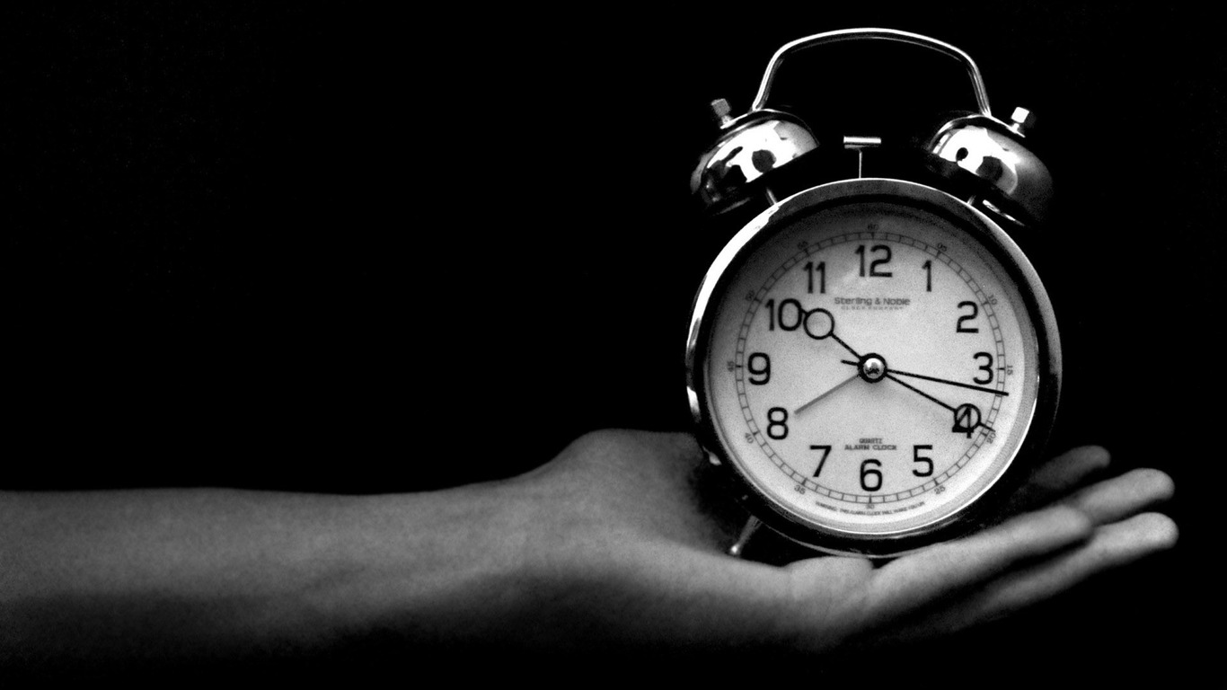
TIME
Our Greatest Commodity

Slide 2


Slide 3
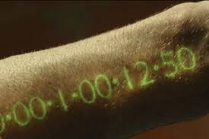

Slide 4

Time Is Short
“My days are swifter than a weaver's shuttle” Job 7:6
“Man, who is born of woman, is short-lived and full of turmoil. Like a flower he comes forth and withers. He also flees like a shadow and does not remain.” Job 14:1-2
“Yet you do not know what your life will be like tomorrow. You are just a vapor that appears for a little while and then vanishes away.” James 4:14
“But this I say, brethren, the time has been shortened, so that from now on those who have wives should be as though they had none” 1 Corinthians 7:29

Slide 5
Time Is Different
“While the earth remains, seedtime and harvest, and cold and heat, and summer and winter, and day and night shall not cease.” Genesis 8:22
You can’t create, borrow, buy or destroy time.
You can’t be stored, brought back, hurried up or slowed down.
There is only wise and unwise use of it.

Slide 6
Time Is Different
God is the source of time.
“For in Him we live and move and exist” Acts 17:28
No portion of time can be recalled.
“For we will surely die and are like water spilled on the ground which cannot be gathered up again.”
2 Samuel 14:14

Slide 7
Time Is Opportune
We are given time to reap what we have sown.
Do not be deceived, God is not mocked; for whatever a man sows, this he will also reap. For the one who sows to his own flesh will from the flesh reap corruption, but the one who sows to the Spirit will from the Spirit reap eternal life. Let us not lose heart in doing good, for in due time we will reap if we do not grow weary. So then, while we have opportunity, let us do good to all people, and especially to those who are of the household of the faith.
Galatians 6:7-10

Slide 8
Time Is Opportune
We are given time to prepare ourselves.
For though by this time you ought to be teachers, you have need again for someone to teach you the elementary principles of the oracles of God, and you have come to need milk and not solid food.
Hebrews 5:12

Slide 9
Time Is Opportune
We are given time to prepare ourselves.
Do this, knowing the time, that it is already the hour for you to awaken from sleep; for now salvation is nearer to us than when we believed. The night is almost gone, and the day is near. Therefore let us lay aside the deeds of darkness and put on the armor of light. Let us behave properly as in the day, not in carousing and drunkenness, not in sexual promiscuity and sensuality, not in strife and jealousy. But put on the Lord Jesus Christ, and make no provision for the flesh in regard to its lusts.
Romans 13:11-14

Slide 10
Time Is Opportune
We are given time to prepare ourselves.
Therefore be careful how you walk, not as unwise men but as wise, making the most of your time, because the days are evil. So then do not be foolish, but understand what the will of the Lord is.
Ephesians 5:15-17

Slide 11
Time Is Opportune
We are given time to teach.
These words, which I am commanding you today, shall be on your heart. "You shall teach them diligently to your sons and shall talk of them when you sit in your house and when you walk by the way and when you lie down and when you rise up.
Deuteronomy 6:6-7

Slide 12
Time Is Opportune
We are given time to teach.
Conduct yourselves with wisdom toward outsiders, making the most of the opportunity. Let your speech always be with grace, as though seasoned with salt, so that you will know how you should respond to each person.
Colossians 4:5-6

Slide 13
Time Is Opportune
We are given time to teach.
The Lord's bond-servant must not be quarrelsome, but be kind to all, able to teach, patient when wronged, with gentleness correcting those who are in opposition, if perhaps God may grant them repentance leading to the knowledge of the truth, and they may come to their senses and escape from the snare of the devil, having been held captive by him to do his will.
2 Timothy 2:24-26

Slide 14
Time Is Opportune
We are given time to glorify God.
Now may the God who gives perseverance and encouragement grant you to be of the same mind with one another according to Christ Jesus, so that with one accord you may with one voice glorify the God and Father of our Lord Jesus Christ.
Romans 15:5-6

Slide 15
Time Is Opportune
We are given time to glorify God.
Let your light shine before men in such a way that they may see your good works, and glorify your Father who is in heaven.
Matthew 5:16

Slide 16
Time Is Opportune
We are given time to glorify God.
For the one who desires life, to love and see good days, must keep his tongue from evil and his lips from speaking deceit. He must turn away from evil and do good; he must seek peace and pursue it. For the eyes of the lord are toward the righteous, and his ears attend to their prayer, but the face of the lord is against those who do evil.
1 Peter 3:10-12

Slide 17
Time Is To Be Used Wisely
So teach us to number our days, That we may present to You a heart of wisdom.
Psalm 90:12

Slide 18
Time Is To Be Used Wisely
LORD, make me to know my end And what is the extent of my days; Let me know how transient I am. Behold, You have made my days as handbreadths, And my lifetime as nothing in Your sight; Surely every man at his best is a mere breath. Selah. Surely every man walks about as a phantom; Surely they make an uproar for nothing; He amasses riches and does not know who will gather them. And now, Lord, for what do I wait? My hope is in You.
Psalm 39:4-7

Slide 19
Time Is To Be Used Wisely
“We must work the works of Him who sent Me as long as it is day; night is coming when no one can work.”
John 9:4

Slide 20
Time Is To Be Used Wisely
It is not about how much time you have.
Methuselah (969) vs Christ (33)

Slide 21
Time Is To Be Used Wisely
Deciding How I Use My Time:
Am I seeking first the kingdom of God?
Is this best for the church?
Does this use of time better those around me?
Does this use of my time rob time from something more important?
Have I grown or matured more by this use of time?

