Slide 2
“A Journey of a thousand miles…”
The church in Antioch (Acts 13:1)
The call to service (Acts 13:2)
The sending off (Acts 13:3)
Notes:
Num 27:18-20 (18) So the LORD said to Moses, "Take Joshua the son of Nun, a man in whom is the Spirit, and lay your hand on him;(19) and have him stand before Eleazar the priest and before all the congregation, and commission him in their sight.(20) "You shall put some of your authority on him, in order that all the congregation of the sons of Israel may obey him.
1Ti 5:22 (22) Do not lay hands upon anyone too hastily and thereby share responsibility for the sins of others; keep yourself free from sin.

Slide 3
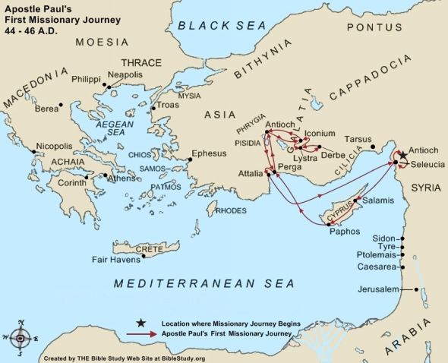

Slide 4
Cyprus: Acts 13:4-12
Salamis (Acts 13:4-5)
Paphos (Acts 13:6-12)

Slide 6
Antioch of Pisidia: Acts 13:13-52
Travel and John Mark leaves 13:13-14
Teaching in the synagogue 13:15-41
The reception of the message 13:42-52

Slide 8
Iconium: Acts 14:1-7
Initial reception 14:1
Opposition 14:2-4
Resolve 14:5-7

Slide 10
Lystra: Acts 14:8-23
Paul heals the man with lame feet 14:8-10
“The gods have come down to us” 14:11-18
Paul was stoned 14:19
Resolve 14:20-23

Slide 12
Return home: Acts 14:24-28
The return 14:24-26
The report 14:27-28

