Slide 1
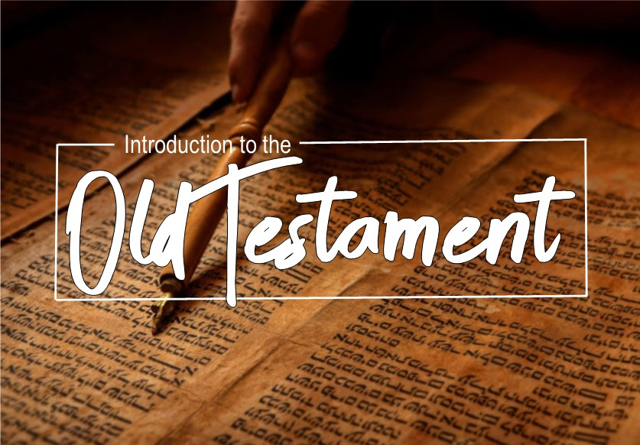

Slide 2

Books of Prophecy
Prophetic books:
Covers a period of about 400 years
There are 17 books and 16 writers.
They compliment the historical books with their information.

Slide 3
Books of Prophecy
Main Theme of Prophetic books:
The justice, sovereignty and mercy of God.
Relevant message;
  To the people in their day (Jerimiah 1:9-10)
  For our learning (Romans 15:4)
Main message; Christ.
"Of Him all the prophets bear witness that through His name everyone who believes in Him receives forgiveness of sins."(Acts 10:43)

Slide 4
Books of Prophecy
Being a Prophet:
Primarily they were God’s spokesman
They were called for a special purpose
They were inspired (2 Peter 1:21)
They were reformers (Ezekiel 22:26)
Proof of their message (Deut. 18:20-22)

Slide 5
Books of Prophecy
Who they addressed:
Israel – Amos and Hosea
Nineveh – Jonah and Nahum
Babylon – Daniel
Captives in Babylon – Ezekiel
Edom – Obadiah
Judah – Joel, Isaiah, Micah, Jeremiah, Habakkuk, Zephaniah, Haggai, Zechariah, Malachai

Slide 6
Daniel
Summary:
In chapters 1-6, Daniel writes about his own life in captivity. He was selected to work for the Babylonian King Nebuchadnezzar. Daniel (or his Babylonian name Belteshazzar), and his friends bold integrity to stand for Godliness instead of culture. They rejecting the king’s food, prayed when it was illegal to do so, and refused to bow to the king’s idol, for which they were thrown into a scorching furnace. Daniel interpreted the king’s dreams twice then was promoted as chief over all the wise men in Babylon. Yet, through all the great things that Daniel did He claimed it was God that did it through him and he gave all the glory to God, “It is He who reveals the profound and hidden things; He knows what is in the darkness, and the light dwells with Him” (2:22).

Slide 7
Daniel
Summary:
Chapters 7-12 contain the visions that Daniel received from God and the events that are involved in his prophetic ministry. A portion of these includes the results of the earthly kingdoms that he lived in. They also mention the coming Messiah and the kingdom to come. “As for me, I heard but could not understand; so I said, “My lord, what will be the outcome of these events?” He said, “Go your way, Daniel, for these words are concealed and sealed up until the end time” (12:8-9).

Slide 8
Hosea
Summary:
Chapters 1-3: The Adulterous Wife and Faithful Husband.
1:3 – Gomer - The Unfaithful Bride
1:4 – Jezreel – God Scatters
1:6 – Lo-Ruhamah – Unpitied
1:9 – Lo-Ammi – Not My People
2:4-5 – Children of harlotry
3 – Restoration of Wife and Children

Slide 9
Hosea
Summary:
Chapters 4-14: The Adulterous Israel and Faithful Lord.
Unfaithful Ephraim-Israel (Northern Kingdom)
11 – God’s love for Israel
14 – God’s promise to restore Israel

Slide 10
Joel
Summary:
The Prophet Joel is only known by this book. Prophecy aimed at Judah. Time of book may have been during Persian captivity. No mention of kings, but refers to priests (2:17). Also refers to the Greeks (3:6).

Slide 11
Joel
Summary:
Day of the Locust (1:2-12)
Day of the Drought (1:13-20)
Invasion of Judah (2:1-27)
Prophecy of Christ (2:28-32) (Acts 2:16-21)

Slide 12
Amos
Summary:
The Prophet Amos is only known by this book. Prophecy aimed at Israel. Time is set in 1:1. Message to Israel is the coming doom to the northern kingdom.

Slide 13
Amos
Summary:
1:1-2:16 – Eight prophecies
3:1-6:14 – Three Sermons
7:1-9:10 – Five visions
9:11-15 – Five promises

Slide 14
Obadiah
Summary:
Shortest book in the Old Testament (21v)
Book of Judgement on Edom (descendants of Esau)
Time is difficult to be exact

