Slide 1
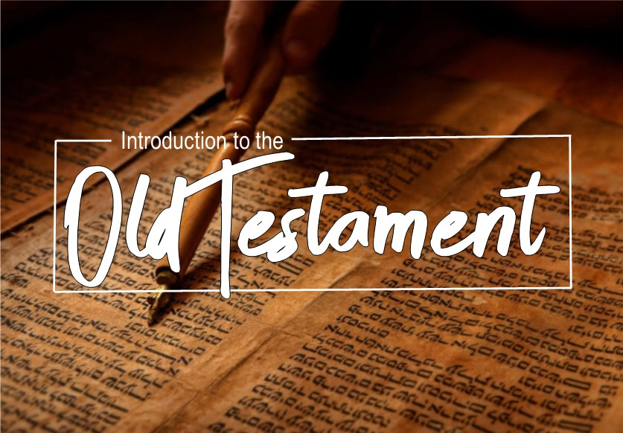

Slide 2

Books of Prophecy
Prophetic books:
Covers a period of about 400 years
There are 17 books and 16 writers.
They compliment the historical books with their information.

Slide 3
Books of Prophecy
Main Theme of Prophetic books:
The justice, sovereignty and mercy of God.
Relevant message;
  To the people in their day (Jerimiah 1:9-10)
  For our learning (Romans 15:4)
Main message; Christ.
"Of Him all the prophets bear witness that through His name everyone who believes in Him receives forgiveness of sins."(Acts 10:43)

Slide 4
Books of Prophecy
Being a Prophet:
Primarily they were God’s spokesman
They were called for a special purpose
They were inspired (2 Peter 1:21)
They were reformers (Ezekiel 22:26)
Proof of their message (Deut. 18:20-22)

Slide 5
Books of Prophecy
Who they addressed:
Israel – Amos and Hosea
Nineveh – Jonah and Nahum
Babylon – Daniel
Captives in Babylon – Ezekiel
Edom – Obadiah
Judah – Joel, Isaiah, Micah, Jeremiah, Habakkuk, Zephaniah, Haggai, Zechariah, Malachai

Slide 6
Ezekiel
Purpose: The book of Ezekiel is Narrative History, Prophetic and Apocalyptic in genre and even contains Parables. The prophet Ezekiel wrote it approximately 571 B.C. (this date is accurately precise because this book contains more defined dates than any other book in the Bible.) Key personalities include Ezekiel, Israel’s leaders, Ezekiel’s wife, King Nebuchadnezzar, and “the prince”.

Slide 7
Ezekiel
Purpose: It was written to announce judgment upon Judah, to allow them one last chance to repent. It also foretells of the coming deliverance of God’s nation from captivity in Babylon. It mainly discusses the events during the Babylonian captivity. Ezekiel is a priest who is called by God to deliver His messages.

Slide 8
Ezekiel
Summary:
In chapters 1-3, God commissions his servant Ezekiel. He receives visions, and his message is to confront God’s sinful nation, “I am sending you to the sons of Israel, to a rebellious people who have rebelled against Me; they and their fathers have transgressed against Me to this very day ” (2:3).

Slide 9
Ezekiel
Summary:
Chapters 4-24, Ezekiel delivered the message of doom to the captives. He told several parables, one that compared Israel to an adulterous woman (16:1-63). He taught them that God was cleansing His chosen nation, “You have borne the penalty of your lewdness and abominations’, the LORD declares” (16:58).

Slide 10
Ezekiel
Summary:
From chapters 25-32, Ezekiel condemns judgment upon seven particular nations who mocked YHWH, the God of Israel because of the captivity; they too would soon see their fate. These nations are Ammon, Moab, Edom, Philistia, Tyre, Sidon, and Egypt.

Slide 11
Ezekiel
Summary:
In chapters 33-48, a message of deliverance and restoration is written. This includes not only the current nation of Israel but also the future of the coming Messiah, the Temple, and the Kingdom of God in the End age. In chapter 37, he writes the famous vision of the valley of bones, “He said to me, “Son of man, can these bones live?” And I answered, “O Lord God, You know” (37:3)

Slide 12
Ezekiel
Important passages:
3:1-4, 16-21/33:1-9
16:49
18:1-4, 19-20
33:10-20
37:26-28/ 2 Cor. 6:16

Slide 13
Daniel
Purpose:
The genre of the book of Daniel is Narrative History and Prophetic Oracle. The prophet Daniel wrote it around 530 B.C. and his writings records the events of the Babylonian captivity in 560-536 B.C. to which Daniel was a servant. It also describes the visions given by God, and reveals the events and plans for everyone’s future. Key personalities of this book include Daniel, Nebuchadnezzar, Shadrach, Meshach, Abednego, Belshazzar, and Darius.

Slide 14
Daniel
Purpose:
The purpose of this book is to provide a historical account how the Lord God protected and provided for His faithful followers while in captivity. It also includes a vision of future redemption and hope.

Slide 15
Daniel
Summary:
In chapters 1-6, Daniel writes about his own life in captivity. He was selected to work for the Babylonian King Nebuchadnezzar. Daniel (or his Babylonian name Belteshazzar), and his friends bold integrity to stand for Godliness instead of culture. They rejecting the king’s food, prayed when it was illegal to do so, and refused to bow to the king’s idol, for which they were thrown into a scorching furnace. Daniel interpreted the king’s dreams twice then was promoted as chief over all the wise men in Babylon. Yet, through all the great things that Daniel did He claimed it was God that did it through him and he gave all the glory to God, “It is He who reveals the profound and hidden things; He knows what is in the darkness, and the light dwells with Him” (2:22).

Slide 16
Daniel
Summary:
Chapters 7-12 contain the visions that Daniel received from God and the events that are involved in his prophetic ministry. A portion of these includes the results of the earthly kingdoms that he lived in. They also mention the coming Messiah and the kingdom to come. “As for me, I heard but could not understand; so I said, “My lord, what will be the outcome of these events?” He said, “Go your way, Daniel, for these words are concealed and sealed up until the end time” (12:8-9).

Slide 17
Daniel
Important passages:
1:8
2:44-45
3:16-18
5:1,13-14, 24-31
9:1-2
9:23; 10:11,12

