Slide 1
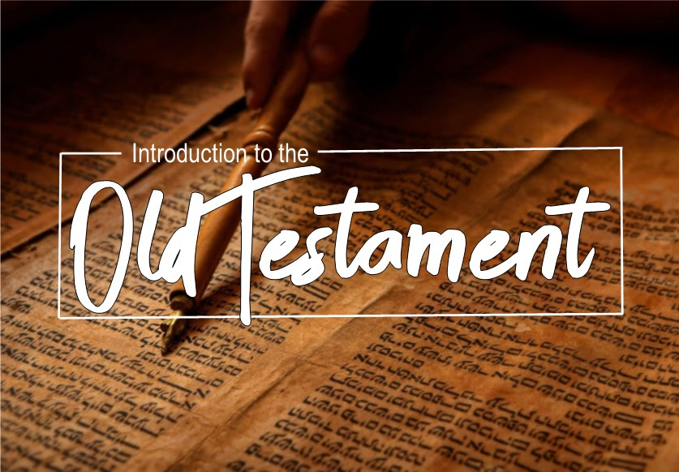

Slide 2

Jeremiah
Purpose: To cry out to a backsliding Judah to amend her ways and return to God.
“Then Jeremiah spoke to all the officials and to all the people, saying, ‘The LORD sent me to prophesy against this house and against this city all the words that you have heard. ‘Now therefore amend your ways and your deeds and obey the voice of the LORD your God; and the LORD will change His mind about the misfortune which He has pronounced against you.’”
26:12-13

Slide 3
Jeremiah
Contents: Jeremiah calls for repentance but the people choose to rebel after the death of Josiah. There is no hope and the prophet declares the judgement of the Lord because of their apostacy.

Slide 4
Jeremiah
Historical Setting:
Jeremiah began prophesied in Judah through the reign of:
639-609 B.C. – Josiah
609 B.C. (3 months) – Jehoahaz
609-597 B.C. – Jehoiakim
597 B.C. (3 months) – Jehoiachin
597-586 B.C. – Zedekiah
586 B.C. – the fall of Jerusalem
586 (?) B.C. – the assassination of Gedaliah

Slide 5
Jeremiah
Historical Setting:
626 B.C. – the call of Jeremiah
612 B.C. – the fall of Nineveh
609 B.C. – the death of Josiah at Megiddo
605 B.C. – the Battle of Carchemish and the fall of the Assyrian Empire
605 B.C. – the first siege of Jerusalem by Nebuchadnezzar (Daniel exiled to Babylon)
597 B.C. – the second siege of Jerusalem
588-586 B.C. – the final siege of Jerusalem, beginning the Babylonian captivity

Slide 6
Jeremiah
Important passages:
God’s call of Jeremiah 1:4-10
Broken cisterns 2:11-13; 17:13
No peace 6:13-14
Neither could they blush 6:15; 8:12
Amend your ways 7:3-5; 18:11; 26:13
Trusting in lying words 7:4-8

Slide 7
Jeremiah
Important passages:
The potter and the clay 18:1-11
False shepherds 23:1-4; 50:6
The Branch 23:5-8
The promise of return 29:10-14
New covenant 31:31-34 Heb. 8:8-13; 10:15-18

Slide 8
Jeremiah
Important passages:
Jehoiakim’s knife 36:21-24, 27-32
The people of God 24:7; 31:33; 1 Pet. 2:9-10

Slide 9
Lamentations
Purpose: This is a collection of poems of lament over the destruction of Jerusalem and the captivity of her people.
Contents:
Chapter 1 – The Way of Wickedness
Chapter 2 – The Wrath of God
Chapter 3 – The Weight of Sorrow
Chapter 4 – The Want of Help
Chapter 5 – The Wreck of Iniquity

Slide 10
Lamentations
Important passages:
1:16-19
2:5-7
2:17
3:21-25
3:39-40
5:21

