Slide 1
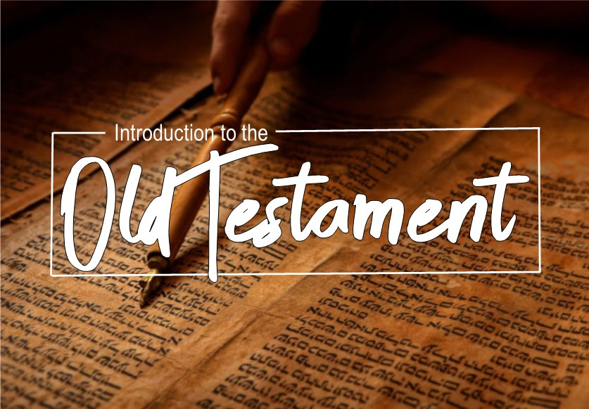

Slide 2

Job
Purpose: God’s policies are in trial. Satan says men are righteous because of God’s blessing. Job wonders how God could cause the righteous to suffer.
Contents: 1-2 Prologue. 3-31 Job’s discussion with his friends. 32-37 Elihu’s monologue 38-42:6 God speaks. 42:7-17 epilogue.

Slide 3
Job
Important passages:
The LORD said to Satan, "Have you considered My servant Job? For there is no one like him on the earth, a blameless and upright man, fearing God and turning away from evil.“
(Job 1:8)

Slide 4
Job
Important passages:
Then his wife said to him, "Do you still hold fast your integrity? Curse God and die!" But he said to her, "You speak as one of the foolish women speaks. Shall we indeed accept good from God and not accept adversity?" In all this Job did not sin with his lips.
(Job 2:9-10)

Slide 5
Job
Important passages:
"I have heard many such things; Sorry comforters are you all. "Is there no limit to windy words? Or what plagues you that you answer?
(Job 16:2-3)

Slide 6
Job
Important passages:
“There is no umpire between us, Who may lay his hand upon us both.”
(Job 9:33)
Mediator theme (5:1; 16:18-22; 33:23)
“As for me, I know that my Redeemer lives, And at the last He will take His stand on the earth”
(Job 19:25)

Slide 7
Job
Important passages:
“Who is this that darkens counsel By words without knowledge? Now gird up your loins like a man, And I will ask you, and you instruct Me!”
(Job 38:2-3)

Slide 8
Job
Important passages:
“Will the faultfinder contend with the Almighty? Let him who reproves God answer it.”
(Job 40:2)

Slide 9
Psalms
Purpose: The heart of the righteous as they react to the struggles of living righteous lives.
Contents: Book 1 (1-41) Book 2 (42-72)
Book 3 (73-89) Book 4 (90-106) Book 5 (107-150)

Slide 10
Psalms
Important passages:
Psalm 1
Psalm 18
Psalm 22
Psalm 23
Psalm 37
Psalm 119

Slide 11
Proverbs
Purpose: To give wisdom to the hearer and understanding to the prudent.
Contents: Importance of wisdom (1-9) Proverbs of Solomon (10-22:16) Anonymous sayings (22:17-24:34) Proverbs of Solomon (25-29) Appendices (30-31)

Slide 12
Proverbs
Important passages:
The name of the LORD is a strong tower; The righteous runs into it and is safe.
(Pro 18:10)

Slide 13
Proverbs
Important passages:
A wise man will hear and increase in learning, And a man of understanding will acquire wise counsel
(Pro 1:5)

Slide 14
Proverbs
Important passages:
Do not let kindness and truth leave you; Bind them around your neck, Write them on the tablet of your heart. So you will find favor and good repute In the sight of God and man.
(Pro 3:3-4)

Slide 15
Proverbs
Important passages:
Train up a child in the way he should go, Even when he is old he will not depart from it.
(Pro 22:6)

Slide 16
Proverbs
Important passages:
How long will you lie down, O sluggard? When will you arise from your sleep? "A little sleep, a little slumber, A little folding of the hands to rest“ Your poverty will come in like a vagabond And your need like an armed man.
(Pro 6:9-11)

Slide 17
Proverbs
Important passages:
Better is a little with righteousness Than great income with injustice.
(Pro 16:8)

Slide 18
Proverbs
Important passages:
Better is a dry morsel and quietness with it Than a house full of feasting with strife.
(Pro 17:1)

Slide 19
Proverbs
Important passages:
It is better to live in a corner of a roof Than in a house shared with a contentious woman.
(Pro 21:9)

Slide 20
Proverbs
Important passages:
There are six things which the LORD hates, Yes, seven which are an abomination to Him: Haughty eyes, a lying tongue, And hands that shed innocent blood, A heart that devises wicked plans, Feet that run rapidly to evil, A false witness who utters lies, And one who spreads strife among brothers.
(Pro 6:16-19)

Slide 21
Ecclesiastes
Purpose: To show that there is nothing “under the sun” that would give life as much purpose and meaning like what we find in relationship with God.
Contents: Intro (1:1-11) Fulfillment: Problem and solution (1:12-3:15) Frustrations: problem and solution 3:16-7:29 Guidelines for life (8-12)

Slide 22
Ecclesiastes
Important passages:
That which has been is that which will be, And that which has been done is that which will be done. So there is nothing new under the sun. Is there anything of which one might say, "See this, it is new"? Already it has existed for ages Which were before us. There is no remembrance of earlier things; And also of the later things which will occur, There will be for them no remembrance Among those who will come later still.
(Ecc 1:9-11)

Slide 23
Ecclesiastes
Important passages:
There is an appointed time for everything. And there is a time for every event under heaven
(Ecc 3:1)

Slide 24
Ecclesiastes
Important passages:
I know that there is nothing better for them than to rejoice and to do good in one's lifetime; moreover, that every man who eats and drinks sees good in all his labor—it is the gift of God.
(Ecc 3:12-13)

Slide 25
Ecclesiastes
Important passages:
Two are better than one because they have a good return for their labor. For if either of them falls, the one will lift up his companion. But woe to the one who falls when there is not another to lift him up. Furthermore, if two lie down together they keep warm, but how can one be warm alone? And if one can overpower him who is alone, two can resist him. A cord of three strands is not quickly torn apart.
(Ecc 4:9-12)

Slide 26
Ecclesiastes
Important passages:
The conclusion, when all has been heard, is: fear God and keep His commandments, because this applies to every person. For God will bring every act to judgment, everything which is hidden, whether it is good or evil.
(Ecc 12:13-14)

Slide 27
Song of Solomon
Purpose: Extol the goodness of the love between man and woman united in matrimony.
Contents: Shulammite maiden in Solomon’s harem (1:1-3:5) Solomon attempts to woo said maiden (3:6-7:9) The maiden rejects the king (7:10-8:4) Maiden reunited with her love (8:5-14)

Slide 28
Song of Solomon
Important passages:
“Like a lily among the thorns, So is my darling among the maidens." "Like an apple tree among the trees of the forest, So is my beloved among the young men. In his shade I took great delight and sat down, And his fruit was sweet to my taste.”
(Son 2:2-3)

Slide 29
Song of Solomon
Important passages:
“My beloved is mine, and I am his; He pastures his flock among the lilies.”
(Son 2:16)

Slide 30
Song of Solomon
Important passages:
“The watchmen who make the rounds in the city found me, And I said, 'Have you seen him whom my soul loves?' "Scarcely had I left them When I found him whom my soul loves; I held on to him and would not let him go Until I had brought him to my mother's house, And into the room of her who conceived me.”
(Son 3:3-4)

Slide 31
Song of Solomon
Important passages:
“A garden locked is my sister, my bride, A rock garden locked, a spring sealed up.”
(Son 4:12)

Slide 32
Song of Solomon
Important passages:
“His mouth is full of sweetness. And he is wholly desirable. This is my beloved and this is my friend, O daughters of Jerusalem.”
(Son 5:16)

Slide 33
Song of Solomon
Important passages:
“How beautiful are your feet in sandals, O prince's daughter! The curves of your hips are like jewels, The work of the hands of an artist.”
(Son 7:1)

