Slide 1
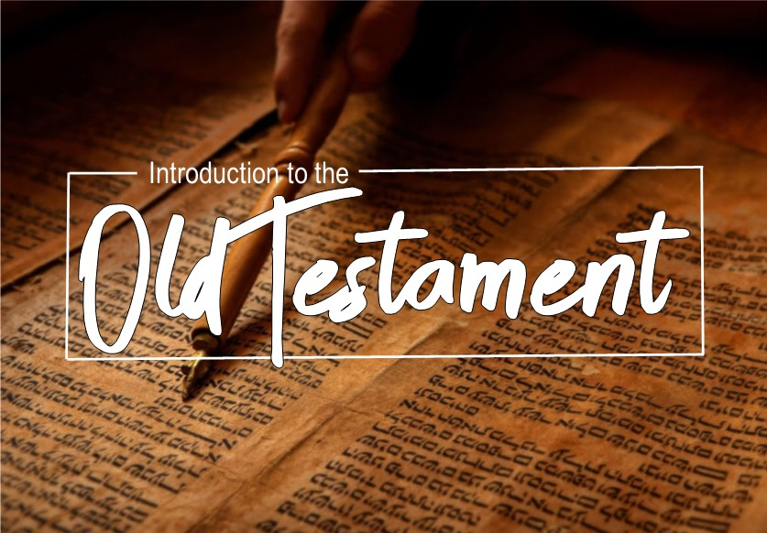

Slide 2

1 & 2 Samuel
Purpose: In these two books we see the fulfillment of God’s promise of kings. (Gen. 17:6; Deu. 17:14-17).
Contents: 1 Samuel tells of the prophet Samuel (ch1-7) and King Saul (8-31)
2 Samuel tells of the reign of King David

Slide 3
1 & 2 Samuel
Important passages:
Thereafter Samuel called the people together to the LORD at Mizpah; and he said to the sons of Israel, "Thus says the LORD, the God of Israel, 'I brought Israel up from Egypt, and I delivered you from the hand of the Egyptians and from the power of all the kingdoms that were oppressing you.' "But you have today rejected your God, who delivers you from all your calamities and your distresses; yet you have said, 'No, but set a king over us!’”
(1Sa 10:17-19)

Slide 4
1 & 2 Samuel
Important passages:
Samuel said, "Has the LORD as much delight in burnt offerings and sacrifices As in obeying the voice of the LORD? Behold, to obey is better than sacrifice, And to heed than the fat of rams.
(1Sa 15:22)

Slide 5
1 & 2 Samuel
Important passages:
Then David said to the Philistine, "You come to me with a sword, a spear, and a javelin, but I come to you in the name of the LORD of hosts, the God of the armies of Israel, whom you have taunted.
(1Sa 17:45)

Slide 6
1 & 2 Samuel
Important passages:
"When your days are complete and you lie down with your fathers, I will raise up your descendant after you, who will come forth from you, and I will establish his kingdom. "He shall build a house for My name, and I will establish the throne of his kingdom forever.
(2Sa 7:12-13)

Slide 7
1 & 2 Samuel
Important passages:
Nathan then said to David, "You are the man! Thus says the LORD God of Israel, 'It is I who anointed you king over Israel and it is I who delivered you from the hand of Saul.
(2Sa 12:7)

Slide 8
1 & 2 Kings
Purpose: In these two books we see the cost of sin in God’s people.
Contents: 1 Kings tells of the reign of Solomon (1-11). The kings of Judah and Israel (1 Kings 12 – 2 Kings 17). The kings of Judah until captivity (18-25)

Slide 9
1 & 2 Kings
Important passages:
As David's time to die drew near, he charged Solomon his son, saying, "I am going the way of all the earth. Be strong, therefore, and show yourself a man. "Keep the charge of the LORD your God, to walk in His ways, to keep His statutes, His commandments, His ordinances, and His testimonies, according to what is written in the Law of Moses, that you may succeed in all that you do and wherever you turn,(1Ki 2:1-3)

Slide 10
1 & 2 Kings
Important passages:
It happened that when the priests came from the holy place, the cloud filled the house of the LORD, so that the priests could not stand to minister because of the cloud, for the glory of the LORD filled the house of the LORD.
(1Ki 8:10-11)

Slide 11
1 & 2 Kings
Important passages:
Now Naaman, captain of the army of the king of Aram, was a great man with his master, and highly respected, because by him the LORD had given victory to Aram. The man was also a valiant warrior, but he was a leper.
(2Ki 5:1)

Slide 12
1 & 2 Kings
Important passages:
So the LORD was very angry with Israel and removed them from His sight; none was left except the tribe of Judah.
(2Ki 17:18)

Slide 13
1 & 2 Kings
Important passages:
Then Isaiah the son of Amoz sent to Hezekiah saying, "Thus says the LORD, the God of Israel, 'Because you have prayed to Me about Sennacherib king of Assyria, I have heard you.’
(2Ki 19:20)

Slide 14
1 & 2 Chronicles
Purpose: These two books are a condensed version of 1&2 Samuel and 1&2 Kings.
Contents: 1 Chronicles lists the genealogies of Adam to the return from Babylon (1-9). History of King David (10-29) 2 Chronicles History of king Solomon (1-9) History of the kings of Judah (10-36)

Slide 15
1 & 2 Chronicles
Important passages:
But King David said to Ornan, "No, but I will surely buy it for the full price; for I will not take what is yours for the LORD, or offer a burnt offering which costs me nothing.“
(1Ch 21:24)

Slide 16
1 & 2 Chronicles
Important passages:
"Now it was in the heart of my father David to build a house for the name of the LORD, the God of Israel. "But the LORD said to my father David, 'Because it was in your heart to build a house for My name, you did well that it was in your heart.
(2Ch 6:7-8)

Slide 17
1 & 2 Chronicles
Important passages:
and My people who are called by My name humble themselves and pray and seek My face and turn from their wicked ways, then I will hear from heaven, will forgive their sin and will heal their land.
(2Ch 7:14)

Slide 18
Ezra
Purpose: This begins the time of restoration and building of the temple.
Contents: Restoration under Zerubbabel (1-6) Reforms under Ezra (7-10)

Slide 19
Ezra
Important passages:
Now in the first year of Cyrus king of Persia, in order to fulfill the word of the LORD by the mouth of Jeremiah, the LORD stirred up the spirit of Cyrus king of Persia, so that he sent a proclamation throughout all his kingdom, and also put it in writing, saying: "Thus says Cyrus king of Persia, 'The LORD, the God of heaven, has given me all the kingdoms of the earth and He has appointed me to build Him a house in Jerusalem, which is in Judah.
(Ezr 1:1-2)

Slide 20
Ezra
Important passages:
Yet many of the priests and Levites and heads of fathers' households, the old men who had seen the first temple, wept with a loud voice when the foundation of this house was laid before their eyes, while many shouted aloud for joy, so that the people could not distinguish the sound of the shout of joy from the sound of the weeping of the people, for the people shouted with a loud shout, and the sound was heard far away.(Ezr 3:12-13)

Slide 21
Ezra
Important passages:
Then Ezra the priest stood up and said to them, "You have been unfaithful and have married foreign wives adding to the guilt of Israel. "Now therefore, make confession to the LORD God of your fathers and do His will; and separate yourselves from the peoples of the land and from the foreign wives." Then all the assembly replied with a loud voice, "That's right! As you have said, so it is our duty to do.(Ezr 10:10-12)

Slide 22
Nehemiah
Purpose: More return from captivity with Nehemiah to rebuild the wall around Jeruselam.
Contents: Rebuilding of the walls (1-7) Reforms by Ezra and Nehemiah (8-13)

Slide 23
Nehemiah
Important passages:
When I heard these words, I sat down and wept and mourned for days; and I was fasting and praying before the God of heaven.
(Neh 1:4)

Slide 24
Nehemiah
Important passages:
So the king said to me, "Why is your face sad though you are not sick? This is nothing but sadness of heart." Then I was very much afraid.
(Neh 2:2)

Slide 25
Nehemiah
Important passages:
So we built the wall and the whole wall was joined together to half its height, for the people had a mind to work.
(Neh 4:6)

Slide 26
Nehemiah
Important passages:
When I saw their fear, I rose and spoke to the nobles, the officials and the rest of the people: "Do not be afraid of them; remember the Lord who is great and awesome, and fight for your brothers, your sons, your daughters, your wives and your houses.“
(Neh 4:14)

Slide 27
Nehemiah
Important passages:
So the wall was completed on the twenty-fifth of the month Elul, in fifty-two days. When all our enemies heard of it, and all the nations surrounding us saw it, they lost their confidence; for they recognized that this work had been accomplished with the help of our God.
(Neh 6:15-16)

Slide 28
Esther
Purpose: Shows God’s continued protection of His people even in their captivity.
Contents: Danger of the jews (1-3) deliverance of the Jews (4-10).

Slide 29
Esther
Important passages:
But Queen Vashti refused to come at the king's command delivered by the eunuchs. Then the king became very angry and his wrath burned within him.
(Est 1:12)

Slide 30
Esther
Important passages:
"For if you remain silent at this time, relief and deliverance will arise for the Jews from another place and you and your father's house will perish. And who knows whether you have not attained royalty for such a time as this?“
(Est 4:14)

