Slide 1
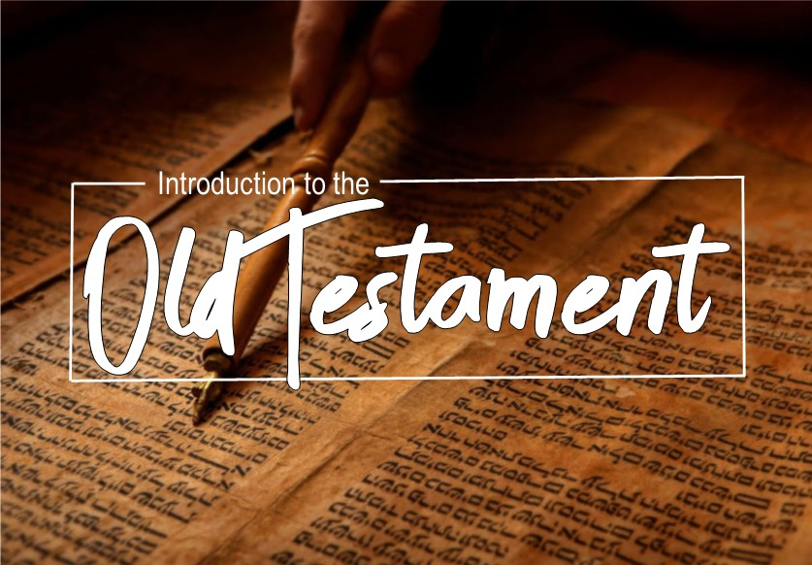

Slide 2

Numbers
  The book of numbers is largely narrative of the children of Israel that covers 38 year and nine month span.
  It was written by Moses.
  Key personalities include Moses, Aaron, Miriam, Joshua, Caleb, Eleazar, Korah, and Balaam.

Slide 3
Numbers
  The purpose of the book of Numbers is to tell about how Israel prepared to enter the promise land.
  However, they sinned and were punished.
  It describes Moses taking two population censuses, hence the name Numbers.

Slide 4
Numbers
  Outline:
  From chapters 1-9 the Israelites are preparing for their journey and entry into the promise land.
    Moses begins by taking a census of all the tribes, primarily to see how many men are available and in shape for military service.
    Moses dedicates the Levites and instructs the Nazirite vows and laws.
    During this time, the Israelites celebrate the 2nd Passover one year after their exit from bondage.

Slide 5
Numbers
  Outline:
  In chapters 10-12, the Israelites travel from the wilderness in Sinai to approach the promise land.
    The people complain about their food, God gives them quail.
    Because of their greed, He also sends them a plague.
    Miriam and Aaron learn a lesson about whom God places in leadership.

Slide 6
Numbers
  Outline:
  In chapters 13-19, we see severe punishment for disobedience and unfaithfulness to God.
    Moses sends out 12 spies to perform reconnaissance on the promise land.
    The 12 spies return and only two of them bring good news.
    The people fear the occupants and rebel against taking the land.
    For this God punishes them and sends them into the wilderness for forty years to roam.

Slide 7
Numbers
  Outline:
  The last chapters of Numbers, from 20-36, the new generation of Israelites again attempt to enter the land to take it as God promised.
    This time they easily destroy two nations that confront them as they are entering.
    Balak uses his prophet Balaam to learn to seduce the Israelites to worship Baal.
    Because of this disobedience, about 24,000 people die, including Balaam.
    Before the book of Numbers ends, Moses again conducts a census, and Joshua assumes the leadership of Israel in place of Moses who is banned from the promise land, due to his disobedience.

Slide 8
Deuteronomy
This is book includes narrative, history, law, and a song from Moses just after he commissions Joshua.
This song describes the History that the Israelites had experienced.
The key personalities are Moses and Joshua.

Slide 9
Deuteronomy
Moses wrote this book to remind the Israelites of what God had done and to remind them of what God expects of them.
The name literally means “Second Law” as Moses gives “the Law” for the second time.
The covenant is re-established.

Slide 10
Deuteronomy
Outline:
In chapters 1-4, Moses reviews some of the details of the past history of Israel.
  The Exodus
  The wandering in the wilderness.
  He then urges that they obey the Laws of God.

Slide 11
Deuteronomy
Outline:
Then, in chapters 5-28 Moses restates the Ten Commandments to the Israelites.
  Moses explains the principles and instructions for living a Godly life as God’s chosen nation.
  These include how to love the Lord, laws of worship, laws regarding relationships.
  Also the consequences and penalties if these laws are broken.

Slide 12
Deuteronomy
Outline:
Chapters 29-30 there is a move to commit themselves, as a nation, and to stand apart unto God.
  This consists of not only knowing the many laws that God has commanded.
  Also obeying them and placing God first.

Slide 13
Deuteronomy
Outline:
Finally, in chapter 31 through 34, we see the first change in leadership in Israel.
  Moses, the one who has been leading them the entire time, hands over his authority to Joshua, and commissions him.
  Moses blesses the tribes, which reminds us of Jacob blessing his sons almost 450 years earlier.
  In the last chapter, God shows Moses the promise land, although he cannot enter it, after this, Moses the servant of the Lord dies on Mt. Nebo.

Slide 14
Joshua
The genre of the book of Joshua is Narrative History.
The key personalities are Joshua, Rahab, Achan, Phinehas, and Eleazar.
It was written to assure the Israelites the Living God will reward obedience, and also to record the entrance and conquest of the promise land.

Slide 15
Joshua
Joshua demonstrates his faith in God as he follows the orders given to him and takes leadership of the nation. Joshua truly was “strong and courageous” (1:7).

Slide 16
Joshua
Outline:
In chapters 1-4, Joshua and the Israelites enter the promise land and in doing so we read of an amazing entry.
  As they arrive at the Jordan River, we find details of an incredible, miraculous crossing.
  God shows His incredible grace to a prostitute named Rahab, the ancestress of King David.

Slide 17
Joshua
Outline:
Then in chapters 5-12, Joshua follows God’s orders and first conquers the central of the promise land.
  This includes the unlikely manner in which they conquer the grand fortress of Jericho.
  Ai was the next town and although it took two tries, the first due to sin in the camp, on the second attempt God again moved and dominated.
  Next, the Israelites occupied the southern land and then the northern land to complete the occupancy; however, although they controlled the region, they never did completely conquer it.

Slide 18
Joshua
Outline:
Finally, in chapters 13-24, the land is divided up and distributed among the tribes of Israel.
  Some of the larger cities are placed aside for the Levitical priests who did not receive a portion of land, due to their duties.
  Lastly, Joshua dies but before he passes he gives one of the greatest challenges that lasts for all generations including our own, “Choose for yourselves today whom you will serve...as for me and my house, we will serve the LORD” (24:15).

Slide 19
Judges
The book of Judges includes several interesting genres; Poetry, Riddles, and mainly Narrative History.
Its author is anonymous but it is usually assumed that Samuel, the prophet wrote it.
Key personalities include Othniel, Ehud, Deborah, Gideon, Abimelech, Jephthah, Samson, and Delilah.

Slide 20
Judges
Its purpose was to teach Israel that God is faithful and certain to punish sin therefore each person must remain loyal and devoted to Him.
This book shows the immediate generations after the conquest of the promise land and unfortunately, the results of unfaithfulness are similar to what we have seen in the past, not good.

Slide 21
Judges
Outline:
In chapters 1:1-3:6, we find that the Israelites have failed to keep their part of the covenant.
  They did not entirely conquer and take control of all the land that they were promised.
  This problem unfortunately grows wildly out of control as time goes on.

Slide 22
Judges
Outline:
From 3:7-16, God raises up judges to rescue Israel several times.
  A cycle of sin-rescue-worship-sin continues constantly.
  These rescues were temporary because we find that the nation’s obedience only lasted as long as the life of that particular judge.
  Out of the 14 judges mentioned, the major judges that stand out are famous stories of Deborah, Gideon, and Samson.

Slide 23
Judges
Outline:
In chapters 17-31, we see Israel slumping into a horrid state of moral demise and ruin.
  Predominantly in the tribes of Dan and Benjamin, we see how far man has really turned from the God of Abraham.
  The tribe of Dan had almost completely given in to the worship of idols made by a man named Micah, even to the point that they practically defend it.
  Later, the entire tribe of Benjamin is wiped out down to 600 men in a violent and vicious civil war. It is here we read the sad passage of truth, "In those days Israel had no king; everyone did as he saw fit" (Judges 21:25).

Slide 24
Ruth
The book of Ruth is the Narrative of a love story, yet also has some important Genealogy.
The timeline of this book is intertwined during the period of the Judges.
The author was anonymous but tradition says it was written by Samuel the prophet.
Key personalities include Ruth, Naomi, and Boaz.

Slide 25
Ruth
Its purpose was to demonstrate the kind of love, and faithfulness that God desires for us.
It shows the difference between what happens when a nation does not follow in obedience to the covenant of God (Judges), and when God’s people follow in faithfulness within the covenant (Ruth).

Slide 26
Ruth
Outline:
In chapter 1, Ruth remains loyal to her mother-in-law Naomi after the death of her husband and in-laws.
  Naomi decides to return to her home land of Bethlehem alone, however, Ruth insists on staying.
  She adopts Naomi’s God as her own. “But Ruth said, "Do not urge me to leave you or turn back from following you; for where you go, I will go, and where you lodge, I will lodge. Your people shall be my people, and your God, my God” (1:16).
Chapter 2 we see Ruth gleaning in the fields of Naomi’s relative Boaz.
  Boaz out of compassion and obedience to the law allows Ruth to glean
  He also leaves extra grain for her purposely.

Slide 27
Ruth
Outline:
In chapter 1, Ruth remains loyal to her mother-in-law Naomi after the death of her husband and in-laws.
  Naomi decides to return to her home land of Bethlehem alone, however, Ruth insists on staying.
  She adopts Naomi’s God as her own. “But Ruth said, "Do not urge me to leave you or turn back from following you; for where you go, I will go, and where you lodge, I will lodge. Your people shall be my people, and your God, my God” (1:16).
Chapter 2 we see Ruth gleaning in the fields of Naomi’s relative Boaz.
  Boaz out of compassion and obedience to the law allows Ruth to glean
  He also leaves extra grain for her purposely.

Slide 28
Ruth
Outline:
In chapter 3, Naomi encourages Ruth to seek marriage with Boaz as a kinsman redeemer.
  Ruth obeys Naomi and asks for her rights.
  Boaz agrees but mentions that he must first be sure there are no others with first rights.
Chapter 4 Boaz and Ruth are married and Ruth conceives a son named Obed, the grandfather of the great King David, in the lineage of Christ our Messiah.

