Slide 1
Introduction to Ezra, Nehemiah and Esther
History and Geography

Slide 2
Studying the Bible by Canon
Order of books in the Bible
Not completely Chronological
It follows the order of the Latin Vulgate translated by Jerome in the 4th century AD
Historical Reference Bible

Slide 3
Fertile Crescent

Slide 4
Fertile Crescent
Cradle of Civilization
Birthplace of agriculture, urbanization, writing, trade, science, history and organized religion
Place associated with Garden of Eden in Jewish, Christian and Muslim faiths

Slide 5
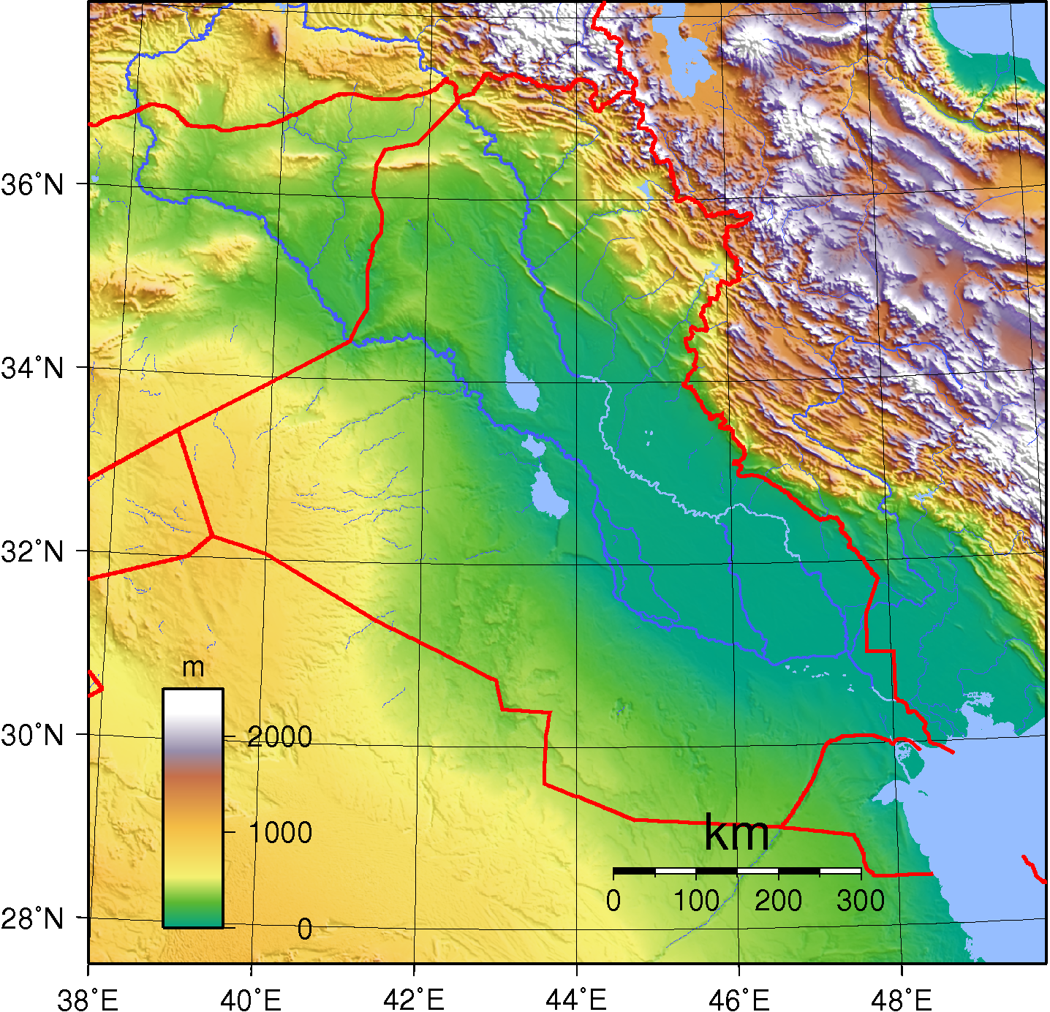
???

Slide 6
IRAQ

Slide 7
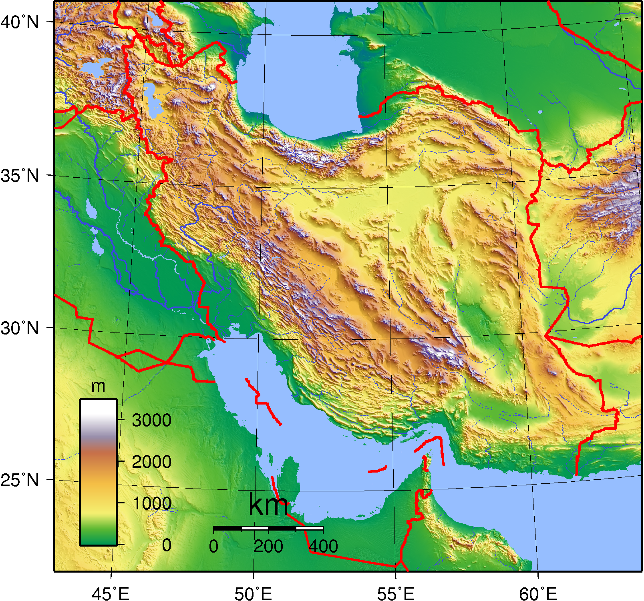
???

Slide 8
IRAN

Slide 9
Babylonian Captivity
Daniel 1:1-2; 2 Kings 25; 2 Chron 36
King Nebuchadnezzar
Some sources show 4 deportations
605 BC – Dan 1:1-2
597 BC – 2 Kings 24:10-16; 2 Chr 36:10; Jer 52:28
588-586 BC – 2 Kings 25:1-21; 2 Chr 36:17-20
581 BC – Jer 50:30

Slide 10
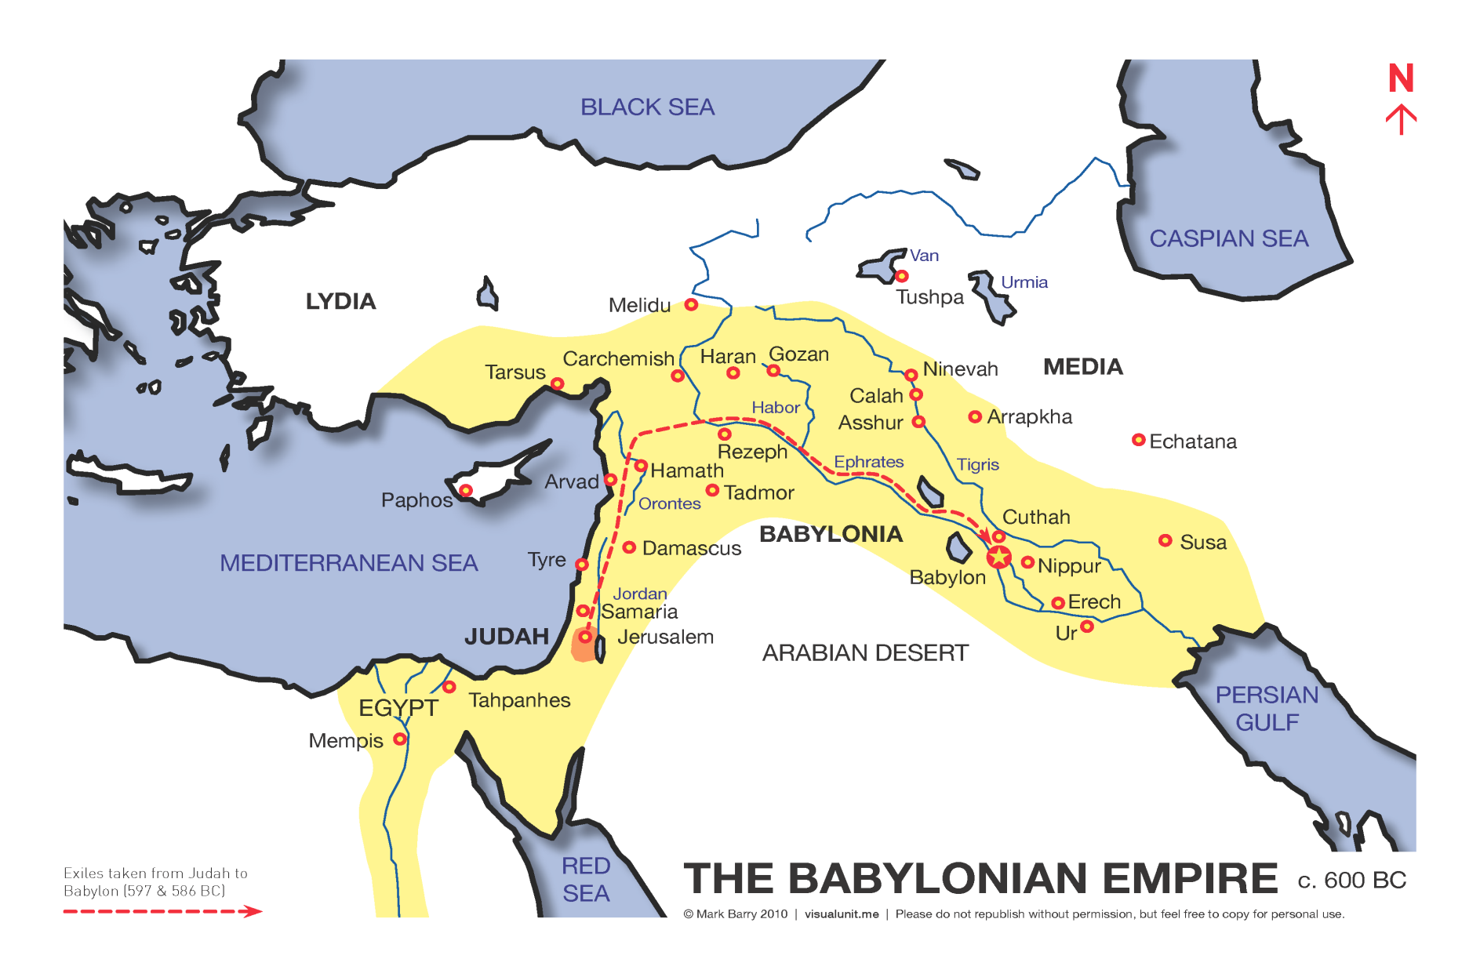
Babylonian Empire

Slide 11
Persian Empire
King Nabonidus and coregent Belshazzar were overthrown by Cyrus the Persian in 539 BC
Dan 5:30

Slide 12
Cyrus the Great
Isaiah 45:1-7
1 "Thus says the Lord to His anointed, To Cyrus, whose right hand I have held-- To subdue nations before him And loose the armor of kings, To open before him the double doors, So that the gates will not be shut:
2 'I will go before you And make the crooked places straight; I will break in pieces the gates of bronze And cut the bars of iron.
3 I will give you the treasures of darkness And hidden riches of secret places, That you may know that I, the Lord, Who call you by your name, Am the God of Israel.
4 For Jacob My servant's sake, And Israel My elect, I have even called you by your name; I have named you, though you have not known Me.
5 I am the Lord, and there is no other; There is no God besides Me. I will gird you, though you have not known Me,
6 That they may know from the rising of the sun to its setting That there is none besides Me. I am the Lord, and there is no other;
7 I form the light and create darkness, I make peace and create calamity; I, the Lord, do all these things.'

Slide 13
Cyrus the Great
City was locked up and they had plenty of supplies to outlast a long siege.
Cyrus walked into the city through open gates inside the city that were left open
People of Babylon welcomed him to city
Cyrus Cylinder

Slide 14
Cyrus the Great
Interesting Facts
The capital city of his empire was the city of Pasargadae in modern day Iran. His tomb and monument can be found there.
The Cyrus Cylinder describes how Cyrus improved the lives of Babylonians. The United Nations declared it a “declaration of human rights.”
Cyrus developed an elite group of 10,000 army troops that were later called the Immortals.
To send messages quickly around his large empire Cyrus formed a postal system.

Slide 15
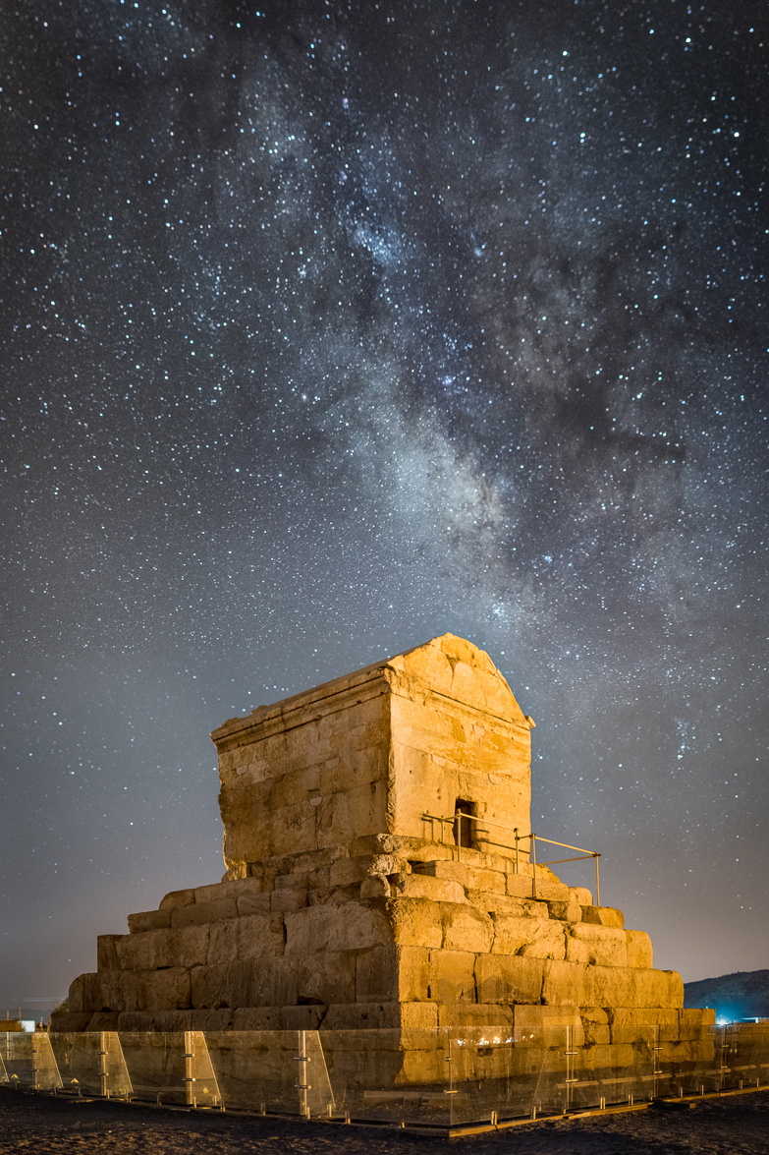
Tomb of Cyrus the Great

Slide 16
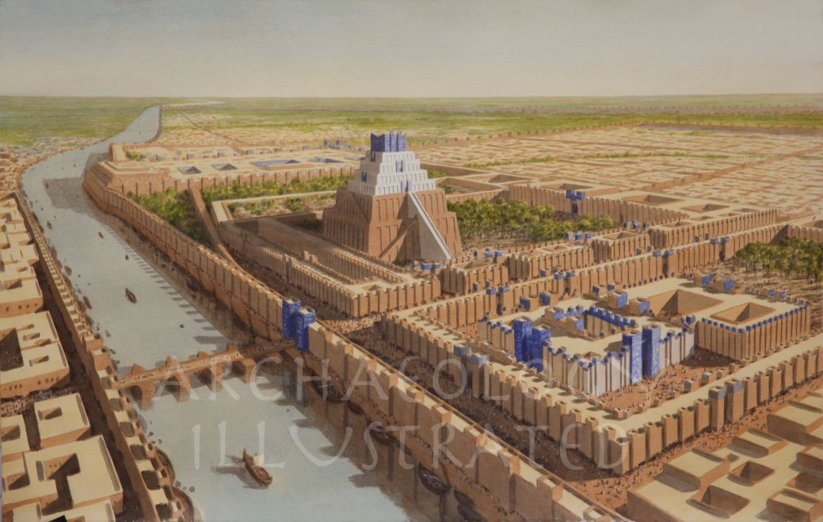
Babylon

Slide 17
Babylonian Empire

Slide 18
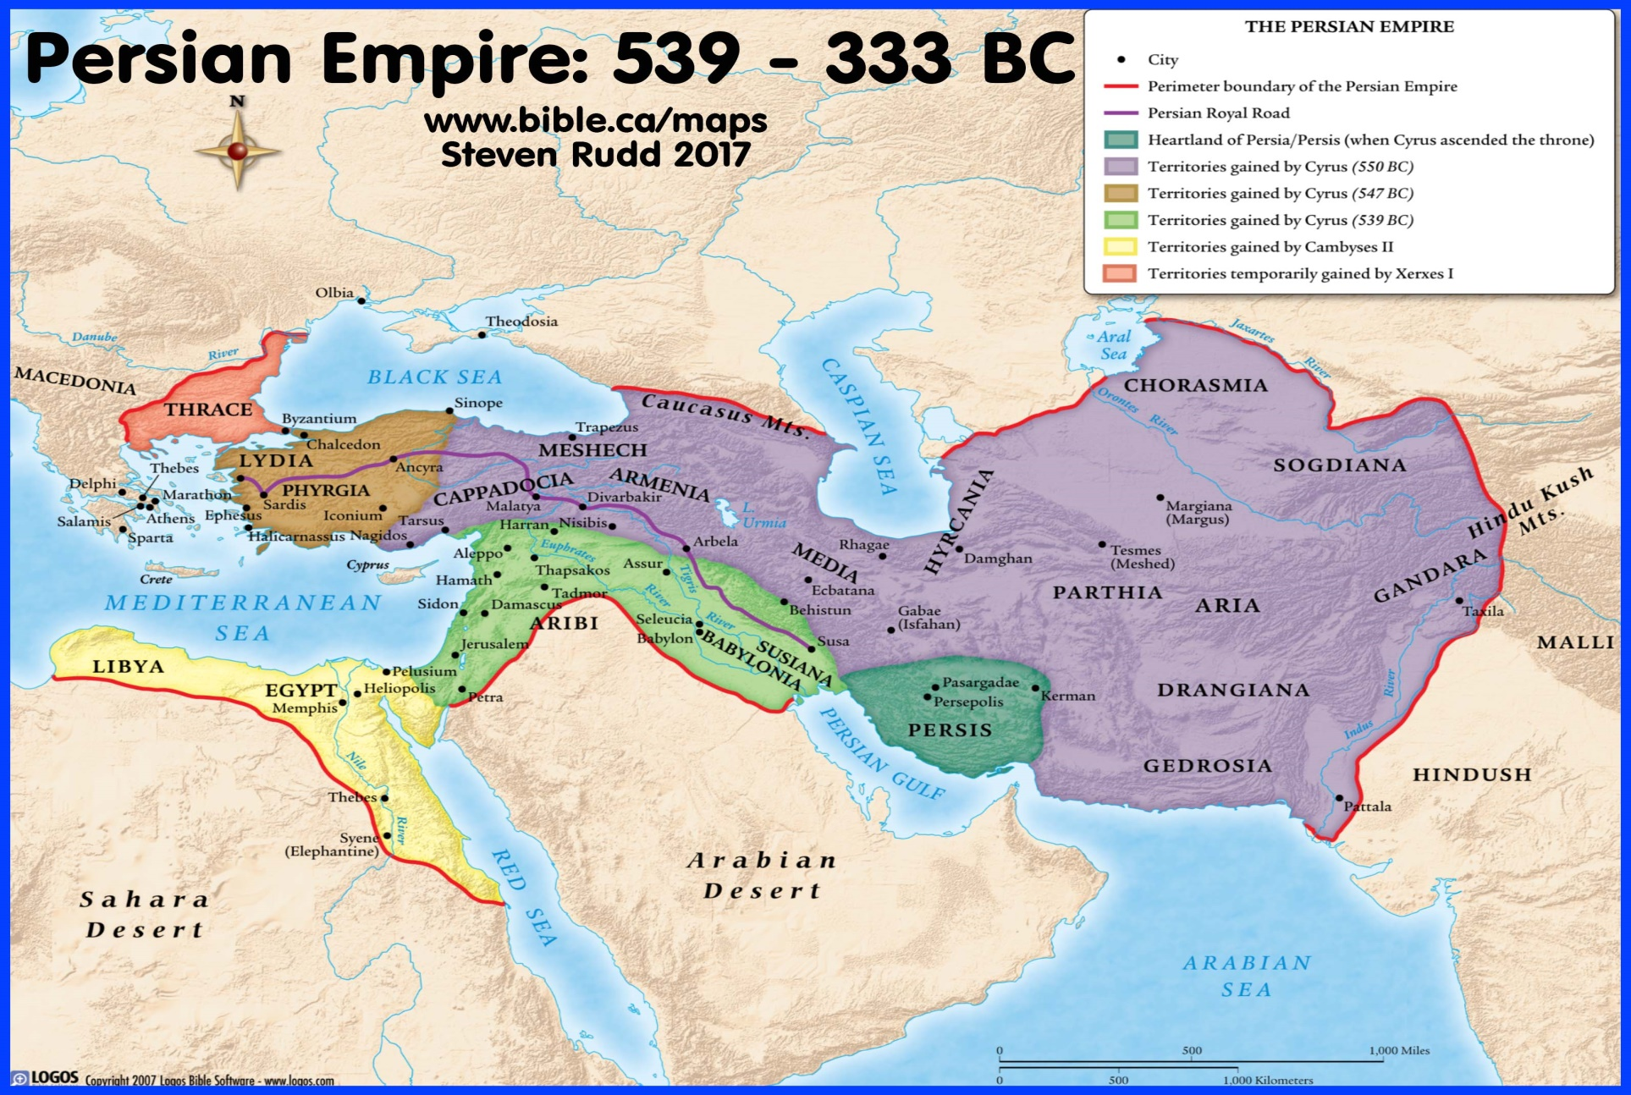
Persian Empire

Slide 19
Persian Empire
Cyrus’ son Cambyses succeeded him
Was considered unstable
Only reigned 530 – 522 BC
Darius, an officer of Cambyses, took over next
Increased the size of the empire 522-486 BC
Son Xerxes 486-465 BC
Artaxerxes 465-424 BC

Slide 20
Bible Ties to Leaders
Cyrus – Ezra 1
Darius – Daniel
Xerxes – Esther 1:1 (also known as Ahasuerus)
Artaxerxes – Ezra 7:1; Nehemiah 2:1

