Slide 1
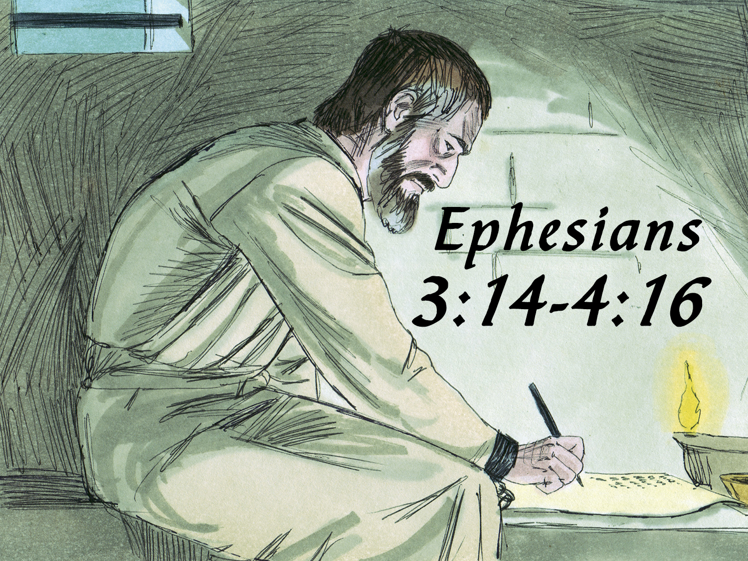

Slide 2
A Divine explanation of God’s eternal purpose…
To redeem all mankind…
And bring them together…
Into one spiritual body (the church)…
In Christ…
And how to live in Christ.

Slide 3
Chapters 1-3
The Church As God’s Eternal Plan
The Glorious Nature of His Church (1:1-23)
The Human Composition of His Church (2:1-22)
The Eternal Purpose of His Church (3:1-21)
Chapters 4-6
Living in the Church As God Planned

Slide 4
God’s Eternal Purpose Fulfilled in the Church (3:1-13)
The Revelation of God’s Mystery = The Universal Church (3:1-7)
The Purpose of God’s Church = Preaching Christ (3:8-13)
Paul’s Prayer of Confidence for the Church (3:14-21)
The Address (3:14-15)
The Five Requests (3:16-19)
The Doxology (3:20-21)

Slide 6
Chapters 1-3
The Church As God’s Eternal Plan
The Glorious Nature of His Church (1:1-23)
The Human Composition of His Church (2:1-22)
The Eternal Purpose of His Church (3:1-21)
Chapters 4-6
Living in the Church As God Planned
Strive for Unity in the Congregation (4:1-16)

Slide 7
United in Its Walk (4:1-3)
United in Its Doctrine (4:4-6)
United in Its Work (4:7-13)

