Slide 2
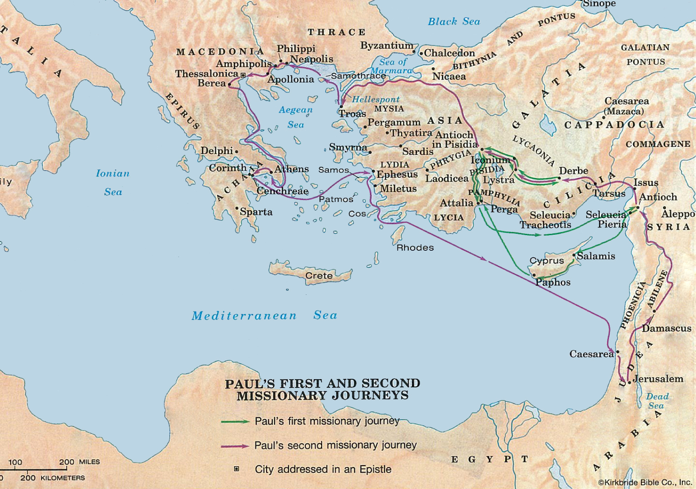

Slide 3
Ephesus – Major City in Asia Minor
All major roads and trade routes converged in Ephesus
Commercial and religious center of Asia Minor
Courts of Asia Minor assembled there; proconsul lived there
Temple of Diana, one of the “Seven Wonders of the Ancient World”

Slide 4
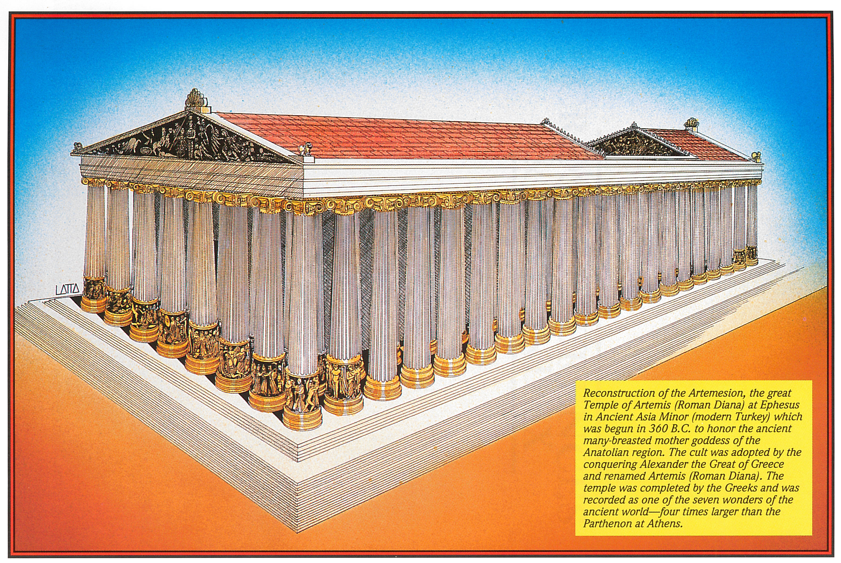

Slide 5
Ephesus – Major City in Asia Minor
All major roads and trade routes converged in Ephesus
Commercial and religious center of Asia Minor
Courts of Asia Minor assembled there; proconsul lived there
Temple of Diana, one of the “Seven Wonders of the Ancient World”
Shining marble with 120 columns that stood 60 feet high
The temple was a “place of worship”
The temple was a “place of banking and commerce”
The temple was a “place of asylum”
The gospel was preached & flourished in this pagan city

Slide 6
Paul Was Close to the Church in Ephesus
The church may have been established in Ephesus during Paul’s Second Missionary Journey (Acts 18:19-28) – circa 52 A.D.
Paul returned to the church on his third missionary journey and labored there for three years (Acts 19) – circa 53-56 A.D.
On his way to Jerusalem, Paul met with the elders from Ephesus in Miletus (Acts 20:17-38) – circa 57 A.D.
Paul wrote the Ephesian letter from Roman prison – circa 62 A.D.
Paul later sent Timothy to Ephesus because false teachers had infiltrated and impacted the church (1 Tim. 1:3; cf. Acts 20:28-31)
When John wrote to the seven churches of Asia, more than 30 years later, the church at Ephesus had left her first love and was called upon (by the Lord) to repent and return (Rev. 2:1-7)

Slide 7
Introduction to the Book and Its Key Elements
Written by the apostle Paul (1:1)
Written to “the saints who are in Ephesus” (1:1)
Written around 60-62 A.D. (almost 30 years after Acts 2)
Written from Roman prison (3:1; 4:1; 6:20)
Paul imprisoned for two years at the end of the book of Acts (28:30-31)
One of the “Prison Epistles” (Ephesians, Philippians, Colossians, Philemon)
Paul’s companions while in prison: Tychicus, Onesimus, Aristarchus, John Mark, Jesus Justus, Epaphras, Luke, Demas, Epaphroditus, Timothy
Tychicus probably carried/delivered the letter (6:21-22)
May have been intended as a “circular letter” thru Asia Minor
“Twin epistle” of Colossians – similar theme and phraseology
Ephesians emphasizes the church as the body of Christ
Colossians emphasizes Christ as the head of the church

Slide 8
Introduction to the Book and Its Key Elements
Theme: God’s eternal purpose is fulfilled in the church of Christ
Key words (in its 155 verses):
“in Christ” (or equivalent) – 35 times, 12 times in first 13 verses
“in” – 107 times
“Christ” – 46 times
“church” – 9 times
“body” – 9 times
“walk” – 8 times
Divides naturally in half
Chapters 1-3: Doctrinal
Chapters 4-6: Practical

Slide 9
A Divine explanation of God’s eternal purpose…
1:1 Paul, an apostle of Jesus Christ by the will of God…
1:4 just as He chose us in Him before the foundation of the world…
1:5 having predestined us to adoption as sons by Jesus Christ to Himself, according to the good pleasure of His will,
1:9 having made known to us the mystery of His will, according to His good pleasure which He purposed in Himself,
1:11 In Him also we have obtained an inheritance, being predestined according to the purpose of Him who works all things according to the counsel of His will,

Slide 10
A Divine explanation of God’s eternal purpose…
3:3 how that by revelation He made known to me the mystery…
3:4 when you read, you may understand my knowledge in the mystery of Christ),
3:6 that the Gentiles should be fellow heirs, of the same body, and partakers of His promise in Christ through the gospel,
3:9 and to make all see what is the fellowship of the mystery, which from the beginning of the ages has been hidden in God who created all things through Jesus Christ;
3:11 according to the eternal purpose which He accomplished in Christ Jesus our Lord,
5:17 Therefore do not be unwise, but understand what the will of the Lord is.

Slide 11
A Divine explanation of God’s eternal purpose…
To redeem all mankind…
1:5 having predestined us to adoption as sons by Jesus Christ to Himself, according to the good pleasure of His will,
1:6 to the praise of the glory of His grace, by which He has made us accepted in the Beloved.
1:7 In Him we have redemption through His blood, the forgiveness of sins, according to the riches of His grace
1:11 In Him also we have obtained an inheritance, being predestined according to the purpose of Him who works all things according to the counsel of His will,
1:13 In Him you also trusted, after you heard the word of truth, the gospel of your salvation…
1:14 who is the guarantee of our inheritance until the redemption of the purchased possession…

Slide 12
A Divine explanation of God’s eternal purpose…
To redeem all mankind…
1:18 the eyes of your understanding being enlightened; that you may know what is the hope of His calling, what are the riches of the glory of His inheritance in the saints,
2:1 And you He made alive, who were dead in trespasses and sins,
2:4 But God, who is rich in mercy, because of His great love with which He loved us,
2:5 even when we were dead in trespasses, made us alive together with Christ (by grace you have been saved),
2:6 and raised us up together, and made us sit together in the heavenly places in Christ Jesus,
2:7 that in the ages to come He might show the exceeding riches of His grace in His kindness toward us in Christ Jesus.

Slide 13
A Divine explanation of God’s eternal purpose…
To redeem all mankind…
2:8 For by grace you have been saved through faith, and that not of yourselves; it is the gift of God,
2:13 But now in Christ Jesus you who once were far off have been brought near by the blood of Christ.
2:16 and that He might reconcile them both to God in one body through the cross, thereby putting to death the enmity.
4:32 …just as God in Christ forgave you.
5:2 And walk in love, as Christ also has loved us and given Himself for us, an offering and a sacrifice to God for a sweet-smelling aroma.
5:25 Husbands, love your wives, just as Christ also loved the church and gave Himself for her,
5:27 that He might present her to Himself a glorious church…

Slide 14
A Divine explanation of God’s eternal purpose…
To redeem all mankind…
And bring them together…
1:10 that in the dispensation of the fullness of the times He might gather together in one all things in Christ, both which are in heaven and which are on earth--in Him.
2:14 For He Himself is our peace, who has made both one, and has broken down the middle wall of separation,
2:15 having abolished in His flesh the enmity, that is, the law of commandments contained in ordinances, so as to create in Himself one new man from the two, thus making peace,
2:16 and that He might reconcile them both to God in one body through the cross, thereby putting to death the enmity.
2:18 For through Him we both have access by one Spirit to the Father.

Slide 15
A Divine explanation of God’s eternal purpose…
To redeem all mankind…
And bring them together…
2:21 in whom the whole building, being joined together, grows into a holy temple in the Lord,
2:22 in whom you also are being built together for a dwelling place of God in the Spirit.
4:3 endeavoring to keep the unity of the Spirit in the bond of peace.
4:4 There is one body and one Spirit, just as you were called in one hope of your calling;
4:5 one Lord, one faith, one baptism;
4:6 one God and Father of all, who is above all, and through all, and in you all.

Slide 16
A Divine explanation of God’s eternal purpose…
To redeem all mankind…
And bring them together…
4:16 from whom the whole body, joined and knit together by what every joint supplies, according to the effective working by which every part does its share, causes growth of the body for the edifying of itself in love.
4:25 Therefore, putting away lying, "Let each one of you speak truth with his neighbor," for we are members of one another.
4:32 And be kind to one another, tenderhearted, forgiving one another, just as God in Christ forgave you.

Slide 17
A Divine explanation of God’s eternal purpose…
To redeem all mankind…
And bring them together…
Into one spiritual body (the church)…
1:1 Paul, an apostle of Jesus Christ by the will of God, To the saints who are in Ephesus, and faithful in Christ Jesus:
1:15 Therefore I also, after I heard of your faith in the Lord Jesus and your love for all the saints,
1:18 that you may know what is the hope of His calling, what are the riches of the glory of His inheritance in the saints,
1:22 And He put all things under His feet, and gave Him to be head over all things to the church,
1:23 which is His body, the fullness of Him who fills all in all.

Slide 18
A Divine explanation of God’s eternal purpose…
To redeem all mankind…
And bring them together…
Into one spiritual body (the church)…
2:16 and that He might reconcile them both to God in one body through the cross, thereby putting to death the enmity.
2:19 Now, therefore, you are no longer strangers and foreigners, but fellow citizens with the saints and members of the household of God,
2:21 in whom the whole building, being joined together, grows into a holy temple in the Lord,
2:22 in whom you also are being built together for a dwelling place of God in the Spirit.

Slide 19
A Divine explanation of God’s eternal purpose…
To redeem all mankind…
And bring them together…
Into one spiritual body (the church)…
3:6 that the Gentiles should be fellow heirs, of the same body, and partakers of His promise in Christ through the gospel,
3:8 To me, who am less than the least of all the saints, this grace was given…
3:10 to the intent that now the manifold wisdom of God might be made known by the church…
3:15 from whom the whole family in heaven and earth is named,
3:18 may be able to comprehend with all the saints what is the width and length and depth and height--

Slide 20
A Divine explanation of God’s eternal purpose…
To redeem all mankind…
And bring them together…
Into one spiritual body (the church)…
3:21 to Him be glory in the church by Christ Jesus to all generations, forever and ever. Amen.
4:4 There is one body and one Spirit, just as you were called in one hope of your calling;
4:12 for the equipping of the saints for the work of ministry, for the edifying of the body of Christ,
4:16 from whom the whole body, joined and knit together by what every joint supplies, according to the effective working by which every part does its share, causes growth of the body for the edifying of itself in love.

Slide 21
A Divine explanation of God’s eternal purpose…
To redeem all mankind…
And bring them together…
Into one spiritual body (the church)…
4:25 Therefore, putting away lying, "Let each one of you speak truth with his neighbor," for we are members of one another.
5:3 But fornication and all uncleanness or covetousness, let it not even be named among you, as is fitting for saints;
5:5 For this you know, that no fornicator, unclean person, nor covetous man, who is an idolater, has any inheritance in the kingdom of Christ and God.
5:19 speaking to one another in psalms and hymns and spiritual songs, singing and making melody in your heart to the Lord,
5:21 submitting to one another in the fear of God.

Slide 22
A Divine explanation of God’s eternal purpose…
To redeem all mankind…
And bring them together…
Into one spiritual body (the church)…
5:23 For the husband is head of the wife, as also Christ is head of the church; and He is the Savior of the body.
5:24 Therefore, just as the church is subject to Christ, so let the wives be to their own husbands in everything.
5:25 Husbands, love your wives, just as Christ also loved the church and gave Himself for her,
5:26 that He might sanctify and cleanse her with the washing of water by the word,

Slide 23
A Divine explanation of God’s eternal purpose…
To redeem all mankind…
And bring them together…
Into one spiritual body (the church)…
5:27 that He might present her to Himself a glorious church, not having spot or wrinkle or any such thing, but that she should be holy and without blemish.
5:29 …nourishes and cherishes it, just as the Lord does the church.
5:30 For we are members of His body…
5:32 …I speak concerning Christ and the church.
6:10 Finally, my brethren…
6:18 …with all perseverance and supplication for all the saints—
6:23 Peace to the brethren…

Slide 24
A Divine explanation of God’s eternal purpose…
To redeem all mankind…
And bring them together…
Into one spiritual body (the church)…
In Christ…
1:1 Paul, an apostle of Jesus Christ by the will of God, To the saints who are in Ephesus, and faithful in Christ Jesus:
1:3 Blessed be the God and Father of our Lord Jesus Christ, who has blessed us with every spiritual blessing in the heavenly places in Christ,
1:4 just as He chose us in Him before the foundation of the world, that we should be holy and without blame before Him in love,

Slide 25
A Divine explanation of God’s eternal purpose…
To redeem all mankind…
And bring them together…
Into one spiritual body (the church)…
In Christ…
1:6 to the praise of the glory of His grace, by which He has made us accepted in the Beloved.
1:7 In Him we have redemption through His blood, the forgiveness of sins, according to the riches of His grace
1:10 that in the dispensation of the fullness of the times He might gather together in one all things in Christ, both which are in heaven and which are on earth--in Him.
1:11 In Him also we have obtained an inheritance…

Slide 26
A Divine explanation of God’s eternal purpose…
To redeem all mankind…
And bring them together…
Into one spiritual body (the church)…
In Christ…
1:12 that we who first trusted in Christ should be to the praise of His glory.
1:13 In Him you also trusted, after you heard the word of truth, the gospel of your salvation; in whom also, having believed…,
1:20 which He worked in Christ when He raised Him from the dead and seated Him at His right hand in the heavenly places,
2:6 and raised us up together, and made us sit together in the heavenly places in Christ Jesus,

Slide 27
A Divine explanation of God’s eternal purpose…
To redeem all mankind…
And bring them together…
Into one spiritual body (the church)…
In Christ…
2:7 that in the ages to come He might show the exceeding riches of His grace in His kindness toward us in Christ Jesus.
2:10 For we are His workmanship, created in Christ Jesus for good works, which God prepared beforehand that we should walk in them.
2:13 But now in Christ Jesus you who once were far off have been brought near by the blood of Christ.

Slide 28
A Divine explanation of God’s eternal purpose…
To redeem all mankind…
And bring them together…
Into one spiritual body (the church)…
In Christ…
2:15 having abolished in His flesh the enmity, that is, the law of commandments contained in ordinances, so as to create in Himself one new man from the two, thus making peace,
2:21 in whom the whole building, being joined together, grows into a holy temple in the Lord,
2:22 in whom you also are being built together for a dwelling place of God in the Spirit.

Slide 29
A Divine explanation of God’s eternal purpose…
To redeem all mankind…
And bring them together…
Into one spiritual body (the church)…
In Christ…
3:6 that the Gentiles should be fellow heirs, of the same body, and partakers of His promise in Christ through the gospel,
3:11 according to the eternal purpose which He accomplished in Christ Jesus our Lord,
3:12 in whom we have boldness and access with confidence through faith in Him.
4:21 if indeed you have heard Him and have been taught by Him, as the truth is in Jesus:

Slide 30
A Divine explanation of God’s eternal purpose…
To redeem all mankind…
And bring them together…
Into one spiritual body (the church)…
In Christ…
4:32 And be kind to one another, tenderhearted, forgiving one another, just as God in Christ forgave you.
5:8 For you were once darkness, but now you are light in the Lord.
6:10 Finally, my brethren, be strong in the Lord and in the power of His might.
6:21 But that you also may know my affairs and how I am doing, Tychicus, a beloved brother and faithful minister in the Lord, will make all things known to you;

Slide 31
A Divine explanation of God’s eternal purpose…
To redeem all mankind…
And bring them together…
Into one spiritual body (the church)…
In Christ…
And how to live in Christ.
2:10 For we are His workmanship, created in Christ Jesus for good works, which God prepared beforehand that we should walk in them.
4:1 I, therefore, the prisoner of the Lord, beseech you to walk worthy of the calling with which you were called,

Slide 32
A Divine explanation of God’s eternal purpose…
To redeem all mankind…
And bring them together…
Into one spiritual body (the church)…
In Christ…
And how to live in Christ.
4:16 from whom the whole body, joined and knit together by what every joint supplies, according to the effective working by which every part does its share, causes growth of the body for the edifying of itself in love.
4:22 that you put off, concerning your former conduct, the old man which grows corrupt according to the deceitful lusts,

Slide 33
A Divine explanation of God’s eternal purpose…
To redeem all mankind…
And bring them together…
Into one spiritual body (the church)…
In Christ…
And how to live in Christ.
4:24 and that you put on the new man which was created according to God, in true righteousness and holiness.
5:2 And walk in love, as Christ also has loved us and given Himself for us, an offering and a sacrifice to God for a sweet-smelling aroma.
5:8 For you were once darkness, but now you are light in the Lord. Walk as children of light

Slide 34
A Divine explanation of God’s eternal purpose…
To redeem all mankind…
And bring them together…
Into one spiritual body (the church)…
In Christ…
And how to live in Christ.
5:15 See then that you walk circumspectly, not as fools but as wise,
6:11 Put on the whole armor of God, that you may be able to stand against the wiles of the devil.
6:13 Therefore take up the whole armor of God, that you may be able to withstand in the evil day, and having done all, to stand.
6:14 Stand therefore, having girded your waist with truth…

