Slide 1
“I Am the Light of the World”

Slide 2
The Setting (John 7:1-8:20)
Jesus was in the city of Jerusalem (7:3, 10, 14).
Jesus went to Jerusalem for the Feast of Tabernacles (7:2).
Jesus was in the temple and teaching (7:14-15; 8:2, 20).
Jesus was in the treasury of the temple, which was a part of the Court of Women (8:20).
There were golden lampstands on massive tower-like structures in the Court of Women.

Slide 3
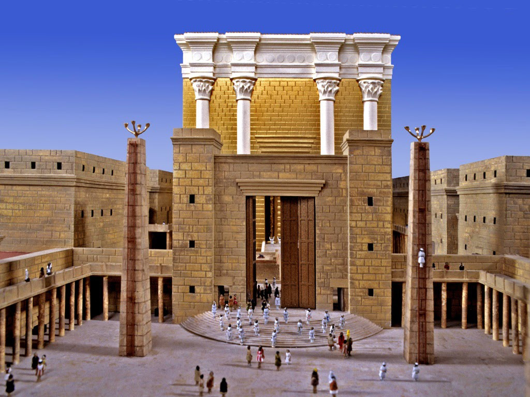

Slide 4
The Setting (John 7:1-8:20)
Jesus was in the city of Jerusalem (7:3, 10, 14).
Jesus went to Jerusalem for the Feast of Tabernacles (7:2).
Jesus was in the temple and teaching (7:14-15; 8:2, 20).
Jesus was in the treasury of the temple, which was a part of the Court of Women (8:20).
There were golden lampstands on massive tower-like structures in the Court of Women.
It was “early in the morning” on the day after the Feast (8:2), perhaps as the sun was rising
While He was teaching, “the scribes and Pharisees brought to Him a woman caught in adultery” (8:3).

Slide 5
The Saying (8:12; cf. 9:5)
Light and darkness are frequently contrasted in Scripture for special emphasis.
Light has a different meaning and importance to different people.
Darkness is a spiritual condition that has long plagued our world, characterized by (Eph. 4:17-32):
Futility of mind
Darkened understanding
Alienated from the life of God
Ignorance because of the blindness of heart
Past feeling, given over to lewdness
Working all uncleanness with greediness
Deceitful lusts
Giving place to the devil

Slide 6
The Saying (8:12; cf. 9:5)
Jesus calling Himself “the light of the world” is in harmony with Scripture.
Jesus was prophesied to be “the light.”
Isaiah: people would see “a great light,” when “upon them a light has shined” (Isa. 9:2 + 60:1-3; cf. Matt. 4:15-16)
Malachi: “The Sun of Righteousness” (Mal. 4:2)
Zacharias: “the Dayspring from on high,” who was coming “to give light to those who sit in darkness” (Luke 1:78-79)
Simeon: “a light to bring revelation to the Gentiles” (Luke 2:32)
Jesus is often called “the light” in the New Testament.
John the Baptist bore witness “of the Light” (John 1:6-9).
The apostle John called Him “the light of men. And the light shines in darkness” (John 1:4-5).
He is “the Bright and Morning Star” (Rev. 22:16).

Slide 7
The Saying (8:12; cf. 9:5)
Jesus is “THE LIGHT of the WORLD.”
He is THE light – not A light.
He is the only true light. There is no other.
He is the LIGHT:
That man hates and rejects (John 3:19-21).
That keeps man from stumbling (John 11:9-10).
Which keeps man from being overtaken by darkness (12:35-36).
Which keeps man from abiding in darkness (12:46).
He is the light of the WORLD.
Not for a select few, not for the Jews only.
For rich and poor, wise and unwise, of every nation.
For “whoever believes” in Him (John 12:46).

Slide 8
The Significance
As “The Light of the World,” Jesus:
Shows the way – “He who follows Me”
Provides safety – “Shall not walk in darkness”
In darkness, one “does not know where he is going” (John 12:35)
Gives life – “Have the light of life”
Where there is no light, there is no life.
Jesus is the source of abundant life (cf. John 10:10)
Jesus is the source of eternal life (cf. John 17:2)

Slide 9
The Significance
Since Jesus is “The Light of the World,” I must:
Follow Him (John 8:12), wherever He leads (cf. 1 Pet. 2:21)
Requires complete trust (John 3:16, 36)
Requires strict obedience (Heb. 5:8-9; Matt. 7:21)
Requires walking in and abiding in the “light” of His Word (1 John 1:7; John 8:31; Psa. 119:105)
Reflect Him (Matt. 5:14-16 + Phil. 2:15)
Requires letting my light shine
Requires not letting the crooked and perverse affect my light
Requires remembering who I am (1 Pet. 2:9)
Be wary of “false lights” reflecting Satan’s “light” (2 Cor. 11:13-15)
Avoid the darkness of the world (1 Th. 5:5; 1 Jn. 1:5-7; 5:19)

