Slide 2
Introduction
The name:
Hebrews called the books Samuel and Kings. Two books placed with the prophets as they are works of prophets.
In Greek they are 1, 2, 3 and 4 Kingdoms.
In Latin 1, 2, 3 and 4 Kings.
In English 1 & 2 Samuel, 1 & 2 Kings

Slide 3
Introduction
1 & 2 Kings:
Coincide with 2 Chronicles.
Covers a period of 386 years.
Solomon’s reign: 40 years
Divided kingdom: 210 years
Judah alone: 136 years
Jeremiah is the author of Kings writing between 560 and 539 BC.

Slide 4
Outline
Solomon’s Reign
1 Kings 1-11
Divided Kingdom 1 Kings 12 – 2 Kings 17
Judah Alone 2 Kings 18-25

Slide 5
I. Solomon’s Reign 1-11
The Beginning of Rule 1:1 – 3:3
Solomon’s Coronation 1:1-53
The conspiracy of Adonijah 1:1-10
The countermeasures of Nathan 1:11-27
The coronation of Solomon 1:28-53
Solomon’s Rule Established 2:1-3:3
David’s last council 2:1-12
Adonijah’s second conspiracy 2:13-35
Shimei’s death 2:36-46
Intro to Solomon’s reign 3:1-3

Slide 6
I. Solomon’s Reign 1-11
Solomon’s Wisdom 3:4-4:34
Explanation of Solomon’s wisdom 3:4-15
Demonstration of Wisdom 3:16-28
Wisdom in Administration 4:1-34
The officials 4:1-6
Taxation system 4:7-20
The extent of his power and rule 4:21-34

Slide 7
I. Solomon’s Reign 1-11
Solomon’s Work 5:1-7:51
Preparations for building the temple 5:1-18
Building and description of the temple 6:1-38
Construction of the Palace complex 7:1-12
Metal work for the temple 7:13-51

Slide 8
First Temple

Slide 9
I. Solomon’s Reign 1-11
Solomon’s Wealth 8:1-10:29
The dedication of the temple 8:1-66
The revelation to Solomon 9:1-9
The glory of Solomon’s kingdom 9:10-28
The fame of Solomon 10:1-13
The wealth of Solomon 10:14-29

Slide 10
I. Solomon’s Reign 1-11
Solomon’s Sin 11:1-43
Solomon’s transgressions 11:1-13
Solomon’s troubles 11:14-40
The death of Solomon 11:41-43

Slide 11
II. Divided Kingdom
1 Kings 12
to
2 Kings 17
The division of the kingdom 1 Kings 12:1-33
The request of Israel 12:1-5
The recommendations of the counselors 12:6-11
The reply of Rehoboam 12:12-15
The rebellion of Israel 12:16-20
The response of Rehohboam 12:21-24
The apostasy of Israel 12:25-33

Slide 12
II. Divided Kingdom
1 Kings 12
to
2 Kings 17
Jeroboam and the Prophets 2 Kings 13-14:20
The man of God to Jeroboam 13:1-32
Jeroboam does not turn from evil 13:33-34
Prophecy against Jeroboam 14:1-20

Slide 13
II. Divided Kingdom
1 Kings 12
to
2 Kings 17
History of Succession 1 Kings 14:21-16:34
The first three kings of Judah 14:21-15:24
Rehoboam 14:21-31
Abijam 15:1-8
Asa 15:9-24

Slide 14
II. Divided Kingdom
1 Kings 12
to
2 Kings 17
Six kings of Israel 15:25-16:34
Nadab’s short rule and succession 15:25-31
War between Israel and Judah 15:32
Baasha 15:33-16:5
Elah 16:6-14
Zimri 16:15-20
Omri 16:21-28
Ahab made king 16:29-34

Slide 15
II. Divided Kingdom
1 Kings 12
to
2 Kings 17
The work of Elijah 17:1 – 2 Kings 2:14
Elijah Fed by the ravens 17:1-6
The widow at Zeraphath 17:7-24
Elijah and Obadiah 18:1-16
Elijah on Mt Carmel 18:17-46
Elijah flees to Horeb 19:1-9a
The Lord appears to Elijah 19:9b-18
The call of Elisha 19:19-21

Slide 16
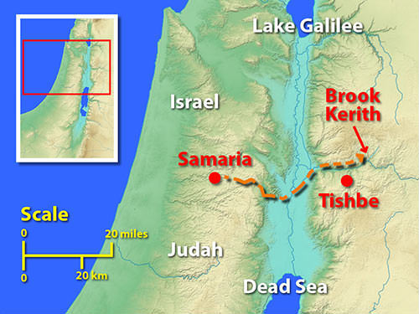

Slide 17
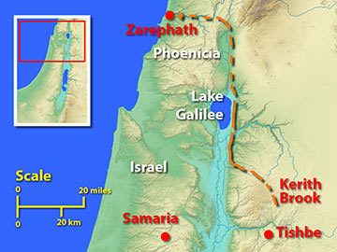

Slide 18
II. Divided Kingdom
1 Kings 12
to
2 Kings 17
Ben-Hadad Attacks Samaria 20:1-12
Ahab defeats Ben-Hadad 20:13-34
A prophet condemns Ahab 20:35-43
Naboth’s vineyard 21:1-29
Micaiah prophesies against Ahab 22:1-28
Ahab killed in Ramoth Gilead 22:29-40
Jehosaphat king of Judah 22:41-50
Ahaziah king of Israel 22:51-53

