Slide 1
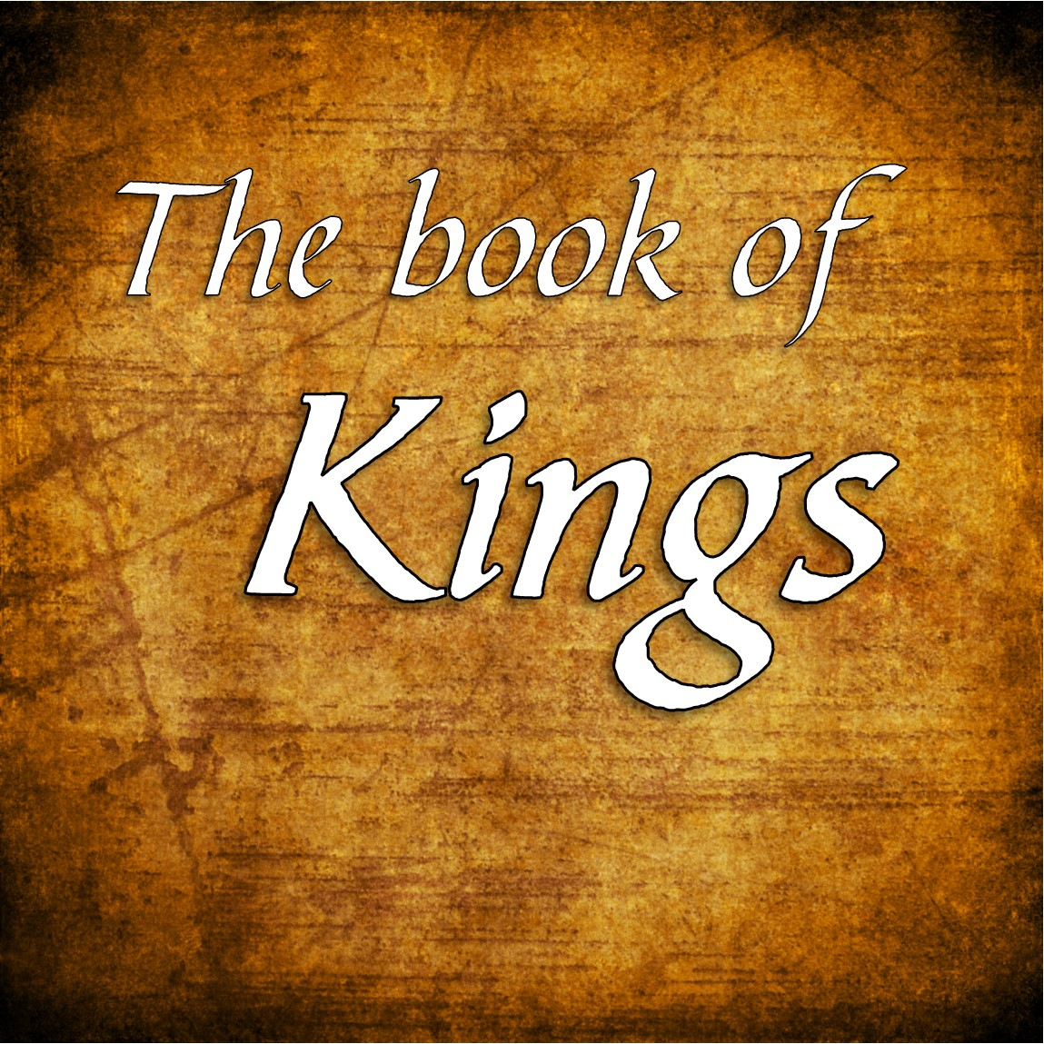

Slide 2

Introduction
The name:
Hebrews called the books Samuel and Kings. Two books placed with the prophets as they are works of prophets.
In Greek they are 1, 2, 3 and 4 Kingdoms.
In Latin 1, 2, 3 and 4 Kings.
In English 1 & 2 Samuel, 1 & 2 Kings

Slide 3
Introduction
1 & 2 Kings:
Coincide with 2 Chronicles.
Covers a period of 386 years.
  Solomon’s reign: 40 years
  Divided kingdom: 210 years
  Judah alone: 136 years
Jeremiah is the author of Kings writing between 560 and 539 BC.

Slide 4

Outline
Solomon’s Reign
1 Kings 1-11
Divided Kingdom 1 Kings 12 – 2 Kings 17
Judah Alone 2 Kings 18-25

Slide 5

I. Solomon’s Reign 1-11
The Beginning of Rule 1:1 – 3:3
  Solomon’s Coronation 1:1-53
    The conspiracy of Adonijah 1:1-10
    The countermeasures of Nathan 1:11-27
    The coronation of Solomon 1:28-53
  Solomon’s Rule Established 2:1-3:3
    David’s last council 2:1-12
    Adonijah’s second conspiracy 2:13-35
    Shimei’s death 2:36-46
    Intro to Solomon’s reign 3:1-3

Slide 6
I. Solomon’s Reign 1-11
Solomon’s Wisdom 3:4-4:34
  Explanation of Solomon’s wisdom 3:4-15
  Demonstration of Wisdom 3:16-28
  Wisdom in Administration 4:1-34
    The officials 4:1-6
    Taxation system 4:7-20
    The extent of his power and rule 4:21-34

Slide 7
I. Solomon’s Reign 1-11
Solomon’s Work 5:1-7:51
  Preparations for building the temple 5:1-18
  Building and description of the temple 6:1-38
  Construction of the Palace complex 7:1-12
  Metal work for the temple 7:13-51

Slide 8

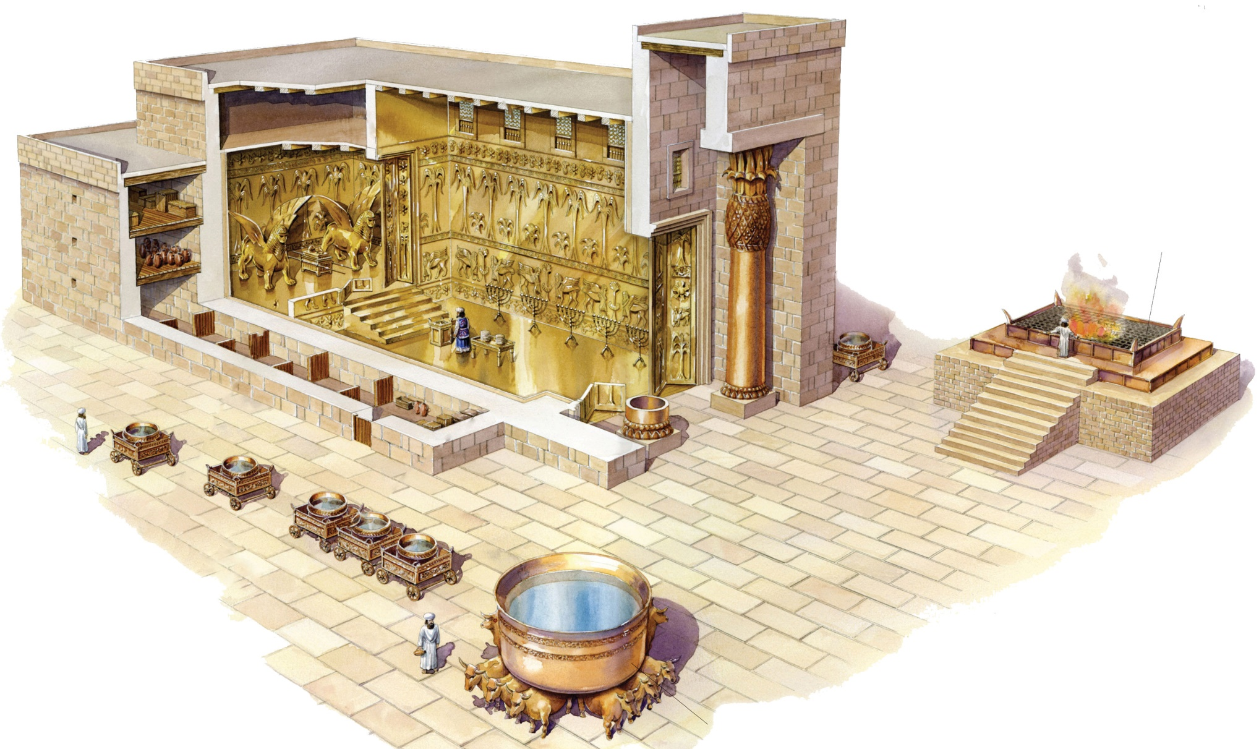
First Temple

Slide 9
I. Solomon’s Reign 1-11
Solomon’s Wealth 8:1-10:29
  The dedication of the temple 8:1-66
  The revelation to Solomon 9:1-9
  The glory of Solomon’s kingdom 9:10-28
  The fame of Solomon 10:1-13
  The wealth of Solomon 10:14-29

Slide 10
I. Solomon’s Reign 1-11
Solomon’s Sin 11:1-43
  Solomon’s transgressions 11:1-13
  Solomon’s troubles 11:14-40
  The death of Solomon 11:41-43

Slide 11
II. Divided Kingdom
1 Kings 12
to
2 Kings 17
The division of the kingdom 1 Kings 12:1-33
  The request of Israel 12:1-5
  The recommendations of the counselors 12:6-11
  The reply of Rehoboam 12:12-15
  The rebellion of Israel 12:16-20
  The response of Rehohboam 12:21-24
  The apostasy of Israel 12:25-33

Slide 12
II. Divided Kingdom
1 Kings 12
to
2 Kings 17
Jeroboam and the Prophets 2 Kings 13-14:20
  The man of God to Jeroboam 13:1-32
  Jeroboam does not turn from evil 13:33-34
  Prophecy against Jeroboam 14:1-20

Slide 13
II. Divided Kingdom
1 Kings 12
to
2 Kings 17
History of Succession 1 Kings 14:21-16:34
  The first three kings of Judah 14:21-15:24
    Rehoboam 14:21-31
    Abijam 15:1-7
    Asa 15:8-24

Slide 14
II. Divided Kingdom
1 Kings 12
to
2 Kings 17
  Six kings of Israel 15:25-16:34
    Nadab’s short rule and succession 15:25-31
    War between Israel and Judah 15:32-34
    Prophecy against Baasha 16:1-5
    Elah 16:6-14
    Zimri 16:15-20
    Omri 16:21-28
    Ahab made king 16:29-34

Slide 15
III. Judah Alone 2 Kings 18-25
The Beginning of Rule 1:1 – 3:3
  Solomon’s Coronation 1:1-53
    The conspiracy of Adonijah 1:1-10
    The countermeasures of Nathan 1:11-27
    The coronation of Solomon 1:28-53
  Solomon’s Rule Established 2:1-3:3
    David’s last council 2:1-12
    Adonijah’s second conspiracy 2:13-35
    Shimei’s death 2:36-46
    Intro to Solomon’s reign 3:1-3

