Slide 2
Introduction to the Book
Authorship: the Apostle Paul (1:1)
The writer’s description of himself could only be Paul (11:13; 15:15-20 + Acts 9, 26)
The date is around 57-58 A.D.
A key for the dating is the collection for the poor saints (15:25-28)
In 1 Cor. 16:1-3 and 2 Cor. 8-9, the funds were being collected
By the time Romans was written, the task had been completed
The place of writing is Corinth
Paul spent 3 months in Corinth in Acts 20:3, on his 3rd missionary journey
Romans was written just before his visit to Jerusalem recorded in Acts 20
Gaius and Erastus were from Corinth (16:23; cf. 1 Cor. 1:14; 2 Tim. 4:20)
Phoebe (maybe carried the letter) lived near Corinth in Cenchrea (16:1-2)
The Recipients of the Letter
The letter was written to the “saints” in Rome (1:7)

Slide 3
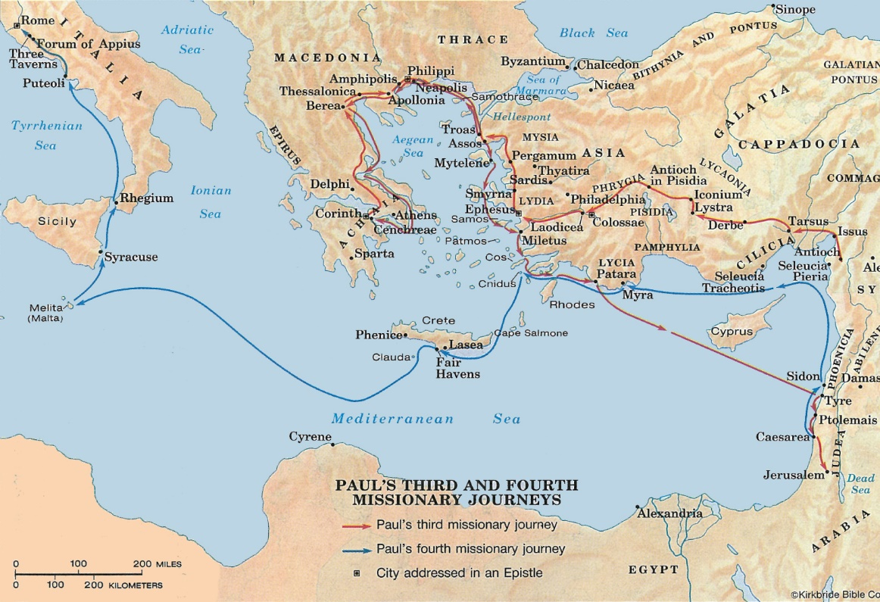

Slide 4
Introduction to the Book
The Church in Rome: Its Origin & Composition
Paul had never been to Rome and did not establish the church in Rome
There is no evidence that Peter or any other apostle had ever been to Rome (cf. 1:11; 15:20)
The exact origin of the church in Rome is unknown
It appears to have existed for many years (1:8, 13; 15:23; 16:19)
The first converts in Rome could have been:
Present in Jerusalem on Pentecost in Acts 2 (Acts 2:10)
Among those scattered after the death of Stephen (Acts 8:1-4)
Converts of Paul from other regions, who had moved to Rome (ch. 16)
Some converts had been in presence of an apostle (12:3-8)
Both Gentiles & Jews were in the church (with more Gentiles)

Slide 5
Introduction to the Book
Characteristics of the Letter
Very didactic, like a theological treatise
Lengthy introduction (17 verses)
Tremendously personal conclusion (26 members by name)
Heavy use of the Old Testament
Rich with theological terms like: sin, wrath, death, law, righteousness, justification, etc.
Intentions to visit Rome and then to visit Spain (15:22-33)
The book can be divided “in half”:
Chapters 1-11: Doctrinal/Theological – How to be “just”
Chapters 12-16: Practical – How to “live by faith”

Slide 6
Introduction to the Book
The Primary Theme of the Letter
Justification is available to man only through obedient faith in Jesus Christ. The gospel of Christ is God’s plan (and only plan) for all men to obtain salvation from sins and to be accounted righteous in the eyes of God.
The theme is surveyed at the beginning of the book (1:16-17) and then developed throughout the book
Obedient faith is emphasized:
At the beginning & end of the book (1:5 + 16:26)
Throughout the book (2:8; 5:19; 6:16, 17; 10:16; 16:19)
Romans is a book that emphasizes:
Faith, but not faith alone
Obedience, but not rote obedience
Faith that obeys and emphasizes obedience through faith

Slide 7
General Outline to the Book
Introduction (1:1-17)
Sin: The Need for God’s Righteousness (1:18-3:20)
Gentiles (1:18-32)
Jews (2:1-3:8)
Universal (3:9-20)
Justification: The Provision of God’s Righteousness (3:21-4:25)
God’s Righteousness Revealed in Christ’s Cross (3:21-26)
God’s Righteousness Defended Against Criticism (3:27-31)
God’s Righteousness Illustrated in Abraham (4:1-25)
Sanctification: The Effect of God’s Righteousness (5:1-8:39)
Free from Wrath (5:1-21)
Free from Sin (6:1-23)
Free from Law (7:1-25)
Free from Death (8:1-39)
- from David Lipe

Slide 8
General Outline to the Book
Jew & Gentile: The Scope of God’s Righteousness (9:1-11:36)
Rejection of Israel: Not a Breach of Faith (9:1-29)
Rejection of Israel: Not Arbitrary (9:30-10:21)
Rejection of Israel: Not Total (11:1-10)
Rejection of Israel: Not Irrevocable (11:11-24)
Rejection of Israel: Not Permanent (11:25-36)
Service: The Fruit of God’s Righteousness (12:1-15:13)
Our Relationship to God (12:1-2)
Our Relationship to Ourselves (12:3-8)
Our Relationship to One Another (12:9-16)
Our Relationship to Our Enemies (12:17-21)
Our Relationship to the State (13:1-7)
Our Relationship to the Law (13:8-10)
Our Relationship to the Day (13:11-14)
Our Relationship to the Weak (14:1-15:13)
- from David Lipe

Slide 9
General Outline to the Book
Conclusion: The Providence of God in the Ministry of Paul (15:14-16:27)
Paul’s Apostolic Service (15:14-22)
Paul’s Travel Plans (15:23-33)
Paul’s Commendation and Greetings (16:1-16)
Paul’s Warnings, Messages and Doxology (16:17-27)
- from David Lipe

