Slide 1
Judges
Palm Beach Lakes
July-August 2016
Dan Jenkins

Slide 2
List of the Judges
Othniel
Ehud
Shamgar
Deborah
Gideon, Abimelech
Tola, Jair, Jephthah
Ibzan, Elon, Abdon
Samson, Eli, Samuel

Slide 3
Faithful
“Clock”
of the Judges
Repentance
Judge/Deliverer
Idolatry
Oppressed

Slide 4
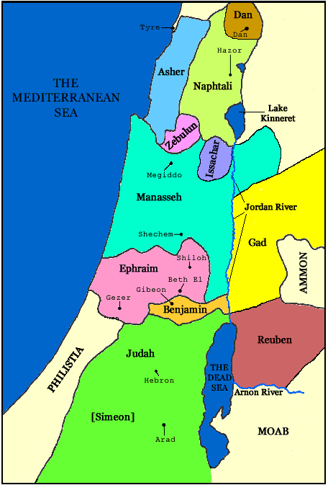
Division of Land
Among the
Tribes of Israel

Slide 5
Closing Chapters
Not chronologically placed
Events not after Samson’s death
During days of Phinehas, the son of Aaron (20:28)
There was no king…right in own eyes
Deut. 12:8
Judges 17:6
Judges 18:1
Judges 19:1
Judges 21:25

Slide 6
Closing Chapters
Micah gets his own god/priest (ch. 17)
Lived in mountains of Ephraim
Stole 1,100 shekels from mom, confessed
Idol made and placed in Micah’s house
Hires and adopts a Levitical priest
Micah loses his own god/priest (ch. 18)
Danites failed to get “southern” area
Five men find new land in north Israel
“Steal” Levitical priest and idols
Capture northern land and settle there
They have their own god/priest

Slide 7
Closing Chapters
Levite gets & kills his concubine (19)
Another Levite from Ephraim
Get a “wife” from Bethlehem
Wife becomes harlot—returns home
Levite reclaims her
Journey home—shelters in Gibeah
Gibeahans (Benjaminites) abuse wife
Wife dies, Levite butchers his wife into 12 pieces, sends piece to each tribe
The tribes respond

Slide 8
Closing Chapters
Levite gets & kills his concubine (19)
Tribe of Benjamin destroyed (20)
Israel’s army of 400,000 assemble
Ask Benjamin to give Gibeahans
Benjamin refuses
Jews ask God, “Who should go first”
Jews loses first battle 22,000 slain
Jews ask, “Shall we go again?”
Jews loses 18,000; Jews weep & worship
God says, “Go tomorrow and win
Army of Gibean/Benjamin (26,700) killed

Slide 9
Closing Chapters
Levite gets & kills his concubine (19)
Tribe of Benjamin destroyed (20)
Wives for 600 Benjaminites (21)
Six hundred Benjaminites escape
Jews realize only 11 tribes left
Yet Jews had vowed not to marry Benja.
“Who did not become part of army?”
Jabesh-Gilead had not fought/vowed
All except virgins from Jabesh slain
Four hundred virgins for 600 Benja.
Two hundred more from Shiloh taken

