Slide 1
Judges
Palm Beach Lakes
July-August 2016
Dan Jenkins

Slide 2
List of the Judges
Othniel
Ehud
Shamgar
Deborah
Gideon, Abimelech
Tola, Jair, Jephthah
Ibzan, Elon, Abdon
Samson, Eli, Samuel

Slide 3
Tola-Jair-Jephthah
1 After Abimelech there arose to save Israel Tola the son of Puah, the son of Dodo, a man of Issachar; and he dwelt in Shamir in the mountains of Ephraim.
2 He judged Israel twenty-three years; and he died and was buried in Shamir.
Judges 10:1-2
O
Faithful
Repent
judge
Idols
Oppressed

Slide 4
Tola-Jair-Jephthah
3 After him arose Jair, a Gileadite; and he judged Israel twenty-two years.
4 Now he had thirty sons who rode on thirty donkeys; they also had thirty towns, which are called "Havoth Jair" to this day, which are in the land of Gilead.
5 And Jair died and was buried in Camon.
6 Then the children of Israel again did evil in the sight of the LORD, and served the Baals and the Ashtoreths . . . Judges 10:3-6 . . . (Read the rest of this verse!! )
O
Faithful
Repent
judge
Idols
Oppressed

Slide 5
Tola-Jair-Jephthah
Son of a harlot—driven away by family
Lived among pagans, was a great “raider”
Jews were threatened by Ammon
Jews asked Jephthah to return & lead them
“What will you give me to do this?
O
Faithful
Repent
judge
Idols
Oppressed

Slide 6
Tola-Jair-Jephthah
Son of a harlot—driven away by family
Lived among pagans, was a great “raider”
Jews were threatened by Ammon
Jews asked Jephthah to return & lead them
“What will you give me to do this?
Jephthah’s appeal to Ammonites
Setting history straight
“Why have you waited 300 years?”
O
Faithful
Repent
judge
Idols
Oppressed

Slide 7
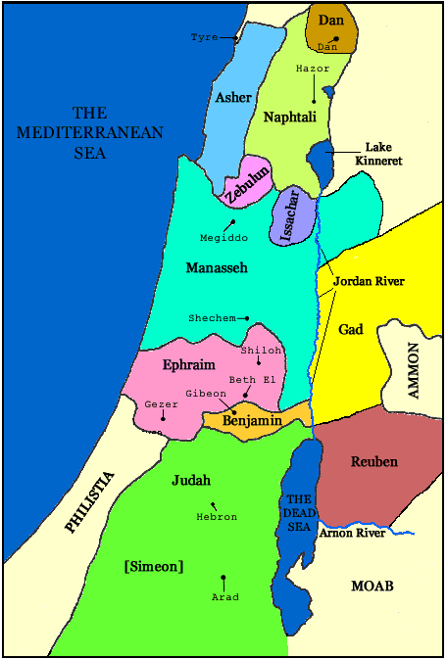
Jephthah—Review of History

Slide 8
Tola-Jair-Jephthah
Son of a harlot—driven away by family
Lived among pagans, was a great “raider”
Jews were threatened by Ammon
Jews asked Jephthah to return & lead them
“What will you give me to do this?
Jephthah’s appeal to Ammonites
Setting history straight
“Why have you waited 300 years?”
Jephthah’s vow
O
Faithful
Repent
judge
Idols
Oppressed

Slide 9
Jephthah’s Vow
If You will indeed deliver . . . 11:30
“Whatever comes out of the door . . .”
“I will offer it up as a burnt offering” 11:3
Jephthah’s victory . . . greeted by daughter
“. . . And he carried out his vow with her which he had vowed” 10:39
No need to “soften” this story, just because we have trouble understanding it”
Trouble then came from “tongued-tied” Ephraimites
O
Faithful
Repent
judge
Idols
Oppressed

