Slide 1
DEBORAH
JUDGES 4 & 5

Slide 3
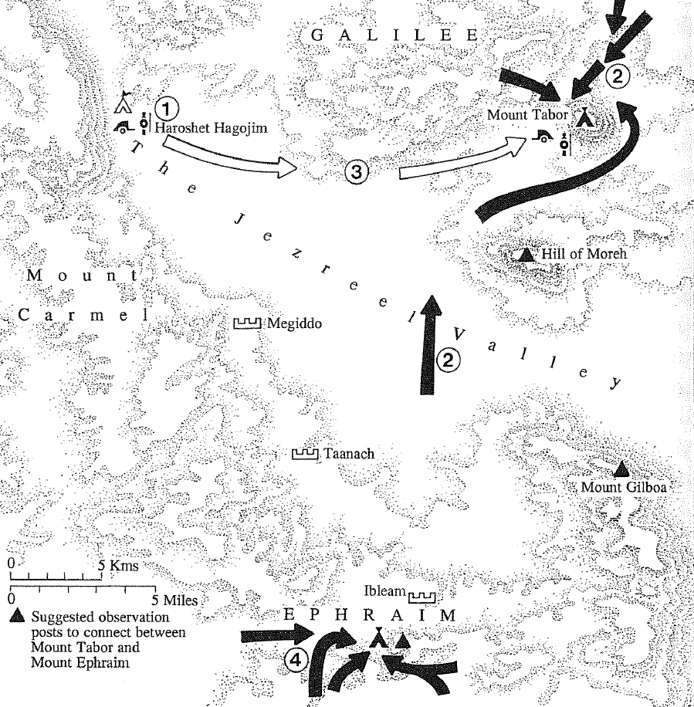

Slide 4
