Slide 1
Judges
Palm Beach Lakes
July-August 2016
Dan Jenkins

Slide 2
List of the Judges
Othniel
Ehud
Shamgar
Deborah
Gideon, Abimelech
Tola, Jair, Jephthah
Ibzan, Elon, Abdon
Samson, Eli, Samuel

Slide 3
Faithful
“Clock”
of the Judges
Repent
Judge
Idolatry
Oppressed

Slide 4
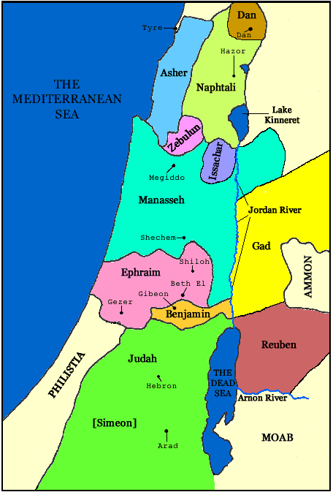
Judges—Chapter 3
1-6: Nations not driven out
7-11: Othniel
12-30: Ehud
31: Shamgar

Slide 5
O
Faithful
Othniel
Repent
judge
Idols
Oppressed

Slide 6
O
Faithful
Ehud
Name means: He that praises
Repent
judge
Idols
Oppressed

Slide 7
Ehud
Name means: He that praises
Oppressed by Moab, Eglon the king
Eighteen years of oppression
Lefthanded Ehud and his dagger
Deliver of message and dagger
Ephraim responded to call
Slew 10,000 Moabites, men of valor
Rest for 80 years

Slide 8
O
Faithful
Shamgar
Name means: named a stranger
Oppressed by Philistines
Shamgar’s weapon—an ox goad
Shamgar killed 600 Philistines
Repent
judge
Idols
Oppressed

