Slide 1
Judges
Palm Beach Lakes
July-August 2016
Dan Jenkins

Slide 2
Introduction
Moses lived 120 years; Joshua lived 110 years
Faithfulness of Joshua’s generation
Another generation—arose who left God
Fifteen Judges (13 in book of judges)
Period of judges 350-450 years (cf. 1 Kings 6:1)
Lifestyle during this time, from being nomads to becoming a unified nation with a king

Slide 3
List of the Judges
Othniel
Ehud
Shamgar
Deborah
Gideon, Abimelech
Tola, Jair, Jephthah
Ibzan, Elon, Abdon
Samson, Eli, Samuel

Slide 4
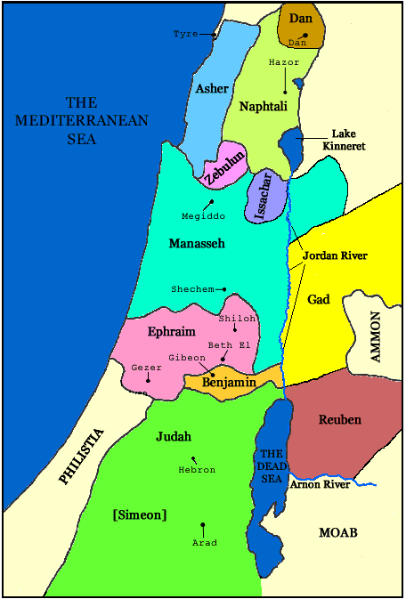
Judges—Chapter 2
1-6: Israel’s disobedience
7-10: Death of Joshua
11-23: “Clock” of Judges

Slide 5
Judges—Chapter 1
1-19: Judah, Simeon, Caleb
21-26: Benjamin
27-28: Manasseh
29: Ephraim
30; Zebulon
31-32: Asher
33: Naphtali
34-36: Dan
Cf Chapter 3:1-5

Slide 6
Faithful
“Clock”
of the Judges
Deliverer/Judge
Idolatry
Repentance

Slide 7
O
Faithful
Othniel
Deliverer/Judge
Idolatry
Repentance

