Slide 1
Joshua 21-22
Dan Jenkins
Palm Beach Lakes church of Christ

Slide 2
Outline of Joshua by Chapters
1--Charge to Joshua, Prep. to cross Jordan
2—Spies in Jericho, Rahab’s faith
3—Crossing of Jordan
4—Memorial stones @ Jordan, Gilgal
5—Circumcision, commander of God’s army
6—The fall of Jericho
7—Defeat at Ai; Achan’s sin
8—Fall of Ai
9-10—Conquering southern Palestine, Philistia
11—Northern campaign all the way to Hazor
12—List of kings defeated Moses & Joshua
13—Joshua’s charge—finish the job

Slide 3
Outline of Joshua by Chapters
1--Charge to Joshua, Prep. to cross Jordan
2—Spies in Jericho, Rahab’s faith
3—Crossing of Jordan
4—Memorial stones @ Jordan, Gilgal
5—Circumcision, commander of God’s army
6—The fall of Jericho
7—Defeat at Ai; Achan’s sin
8—Fall of Ai
9-10—Conquering southern Palestine, Philistia
11—Northern campaign all the way to Hazor
12—List of kings defeated Moses & Joshua
13—Joshua’s charge—finish the job
14-19—Division of conquered land

Slide 4
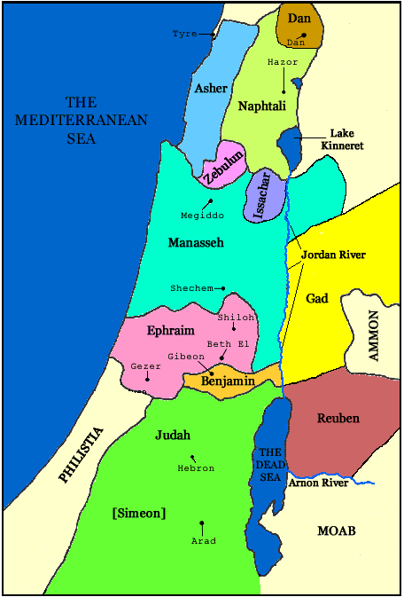
Land Divided Among Tribes
1 Now these are the territories which the sons of Israel inherited in the land of Canaan, which Eleazar the priest, and Joshua the son of Nun, and the heads of the households of the tribes of the sons of Israel apportioned to them for an inheritance,
2 by the lot of their inheritance, as the LORD commanded through Moses, for the nine tribes and the half-tribe.
Jos 14:3 For Moses had given the inheritance of the two tribes and the half-tribe beyond the Jordan; but he did not give an inheritance to the Levites among them Joshua 14:1-3
HEBRON

Slide 5
Outline of Joshua by Chapters
1--Charge to Joshua, Prep. to cross Jordan
2—Spies in Jericho, Rahab’s faith
3—Crossing of Jordan
4—Memorial stones @ Jordan, Gilgal
5—Circumcision, commander of God’s army
6—The fall of Jericho
7—Defeat at Ai; Achan’s sin
8—Fall of Ai
9-10—Conquering southern Palestine, Philistia
11—Northern campaign all the way to Hazor
12—List of kings defeated Moses & Joshua
13—Joshua’s charge—finish the job
14-19—Division of conquered land
20—Cities of refuge

Slide 6
The Cities of Refuge
Jos 20:7 So they set apart Kedesh in Galilee in the hill country of Naphtali and Shechem in the hill country of Ephraim, and Kiriath-arba (that is, Hebron) in the hill country of Judah.
Jos 20:8 Beyond the Jordan east of Jericho, they designated Bezer in the wilderness on the plain from the tribe of Reuben, and Ramoth in Gilead from the tribe of Gad, and Golan in Bashan from the tribe of Manasseh.
KEDESH
GOLAN
RAMOTH-GILEAD
SHECHEM
BEZER
HEBRON

Slide 7
Outline of Joshua by Chapters
1--Charge to Joshua, Prep. to cross Jordan
2—Spies in Jericho, Rahab’s faith
3—Crossing of Jordan
4—Memorial stones @ Jordan, Gilgal
5—Circumcision, commander of God’s army
6—The fall of Jericho
7—Defeat at Ai; Achan’s sin
8—Fall of Ai
9-10—Conquering southern Palestine, Philistia
11—Northern campaign all the way to Hazor
12—List of kings defeated Moses & Joshua
13—Joshua’s charge—finish the job
14-19—Division of conquered land
20—Cities of refuge
21—Cities of Levites (48); God kept promise

Slide 8
God Kept His Promise
43 So the LORD gave to Israel all the land of which He had sworn to give to their fathers, and they took possession of it and dwelt in it.
44 The LORD gave them rest all around, according to all that He had sworn to their fathers. And not a man of all their enemies stood against them; the LORD delivered all their enemies into their hand.
45 Not a word failed of any good thing which the LORD had spoken to the house of Israel. All came to pass. Joshua 21:43-45
HEBRON

Slide 9
Outline of Joshua by Chapters
1--Charge to Joshua, Prep. to cross Jordan
2—Spies in Jericho, Rahab’s faith
3—Crossing of Jordan
4—Memorial stones @ Jordan, Gilgal
5—Circumcision, commander of God’s army
6—The fall of Jericho
7—Defeat at Ai; Achan’s sin
8—Fall of Ai
9-10—Conquering southern Palestine, Philistia
11—Northern campaign all the way to Hazor
12—List of kings defeated Moses & Joshua
13—Joshua’s charge—finish the job
14-19—Division of conquered land
20—Cities of refuge
21—Cities of Levites (48); God kept promise
22—East armies go home; altar at Jordan

Slide 10
Trouble & Strife Among Jews
Joshua 22:10-34
HEBRON

Slide 11
Trouble & Strife Among Jews
Joshua 22:10-34
Altar built by 2 ½ tribes
HEBRON

Slide 12
Trouble & Strife Among Jews
Joshua 22:10-34
Altar built by 2 ½ tribes
Angry confrontation by 9 ½ tribes
HEBRON

Slide 13
Trouble & Strife Among Jews
Joshua 22:10-34
Altar built by 2 ½ tribes
Angry confrontation by 9 ½ tribes
Past shows dangers of disobedience
HEBRON

Slide 14
Trouble & Strife Among Jews
Joshua 22:10-34
Altar built by 2 ½ tribes
Angry confrontation by 9 ½ tribes
Past shows dangers of disobedience
Taking time to listen to other side
HEBRON

Slide 15
Trouble & Strife Among Jews
Joshua 22:10-34
Altar built by 2 ½ tribes
Angry confrontation by 9 ½ tribes
Past shows dangers of disobedience
Taking time to listen to other side
Sound reasons for the altar
HEBRON

Slide 16
Trouble & Strife Among Jews
Joshua 22:10-34
Altar built by 2 ½ tribes
Angry confrontation by 9 ½ tribes
Past shows dangers of disobedience
Taking time to listen to other side
Sound reasons for the altar
“You have misjudged us” (v. 29)
HEBRON

Slide 17
Trouble & Strife Among Jews
Joshua 22:10-34
Altar built by 2 ½ tribes
Angry confrontation by 9 ½ tribes
Past shows dangers of disobedience
Taking time to listen to other side
Sound reasons for the altar
“You have misjudged us” (v. 29)
Peace restored
HEBRON

Slide 18
Trouble & Strife Among Jews
Joshua 22:10-34
Altar built by 2 ½ tribes
Angry confrontation by 9 ½ tribes
Past shows dangers of disobedience
Taking time to listen to other side
Sound reasons for the altar
“You have misjudged us” (v. 29)
Peace restored
Applications to home & church, etc.
HEBRON

