Slide 1
Joshua 10-19
Dan Jenkins
Palm Beach Lakes church of Christ

Slide 2
Outline of Joshua by Chapters
1--Charge to Joshua, Prep. to cross Jordan
2—Spies in Jericho, Rahab’s faith
3—Crossing of Jordan
4—Memorial stones @ Jordan, Gilgal
5—Circumcision, commander of God’s army
6—The fall of Jericho
7—Defeat at Ai; Achan’s sin
8—Fall of Ai
Hivites
Girgashites
Cannanites
Location of Canaanite Nations
Ammon
Jebusites
Ai
Gilgal
•
•
Gilgal
Jericho
•
Amorites
Perizzites
Philistia
Moab
Hittites
Edom

Slide 3
Outline of Joshua by Chapters
1--Charge to Joshua, Prep. to cross Jordan
2—Spies in Jericho, Rahab’s faith
3—Crossing of Jordan
4—Memorial stones @ Jordan, Gilgal
5—Circumcision, commander of God’s army
6—The fall of Jericho
7—Defeat at Ai; Achan’s sin
8—Fall of Ai
9-10—Conquering southern Palestine, Philistia
•
Gilgal
Ai
•
•
Jericho
Philistia

Slide 4
Summary of Joshua’s Southern Campaign
40 So Joshua conquered all the land: the mountain country and the South and the lowland and the wilderness slopes, and all their kings; he left none remaining, but utterly destroyed all that breathed, as the LORD God of Israel had commanded.
41 And Joshua conquered them from Kadesh Barnea as far as Gaza, and all the country of Goshen, even as far as Gibeon.
42 All these kings and their land Joshua took at one time, because the LORD God of Israel fought for Israel.
43 Then Joshua returned, and all Israel with him, to the camp at Gilgal. Josh. 10:40-43
•
Gilgal
Ai
•
•
Jericho

Slide 5
•
Gilgal
Ai
Amorites
Jericho
•
•
Philistia
•
Gaza
Kadesh-Barnea
Goshen

Slide 6
Outline of Joshua by Chapters
1--Charge to Joshua, Prep. to cross Jordan
2—Spies in Jericho, Rahab’s faith
3—Crossing of Jordan
4—Memorial stones @ Jordan, Gilgal
5—Circumcision, commander of God’s army
6—The fall of Jericho
7—Defeat at Ai; Achan’s sin
8—Fall of Ai
9-10—Conquering southern Palestine, Philistia
11—Northern campaign all the way to Hazor
Ai
Gilgal
•
•
Gilgal
Jericho
•

Slide 7
Outline of Joshua by Chapters
1--Charge to Joshua, Prep. to cross Jordan
2—Spies in Jericho, Rahab’s faith
3—Crossing of Jordan
4—Memorial stones @ Jordan, Gilgal
5—Circumcision, commander of God’s army
6—The fall of Jericho
7—Defeat at Ai; Achan’s sin
8—Fall of Ai
9-10—Conquering southern Palestine, Philistia
11—Northern campaign all the way to Hazor
Lebanon
Ai
Gilgal
•
•
Gilgal
Jericho
•

Slide 8
Summary of Joshua’s Northern Campaign
16 Thus Joshua took all this land: the mountain country, all the South, all the land of Goshen, the lowland, and the Jordan plain—the mountains of Israel and its lowlands,
17 from Mount Halak and the ascent to Seir, even as far as Baal Gad in the Valley of Lebanon below Mount Hermon. He captured all their kings, and struck them down and killed them.
18 Joshua made war a long time with all those kings.
19 There was not a city that made peace with the children of Israel, except the Hivites, the inhabitants of Gibeon. All the others they took in battle. I
20 For it was of the LORD to harden their hearts, that they should come against Israel in battle, that He might utterly destroy them . . . Joshua 11:16-20
•
Gilgal
Ai
•
•
Jericho

Slide 9
Outline of Joshua by Chapters
1--Charge to Joshua, Prep. to cross Jordan
2—Spies in Jericho, Rahab’s faith
3—Crossing of Jordan
4—Memorial stones @ Jordan, Gilgal
5—Circumcision, commander of God’s army
6—The fall of Jericho
7—Defeat at Ai; Achan’s sin
8—Fall of Ai
9-10—Conquering southern Palestine, Philistia
11—Northern campaign all the way to Hazor
12—List of kings defeated Moses & Joshua
Ai
Gilgal
•
•
Gilgal
Jericho
•

Slide 10
Kings Conquered by Joshua (text edited)
And these are the kings of the country which Joshua and the children of Israel conquered on this side of the Jordan, on the west, from Baal Gad in the Valley of Lebanon as far as Mount Halak and the ascent to Seir, which Joshua gave to the tribes of Israel as a possession according to their divisions, in the mountain country, in the lowlands, in the Jordan plain, in the slopes, in the wilderness, and in the South—the Hittites, the Amorites, the Canaanites, the Perizzites, the Hivites, and the Jebusites: the king of Jericho, Ai, Jerusalem, Hebron, Jarmuth, Lachish, Eglon, Gezer, Debir, Geder, Hormah, Arad, Libnah, Adullam, Makkedah, Bethel, Tappuah, Hepher, Aphek, Lasharon, Madon, Hazor, Shimron Meron, Achshaph, Taanach, Megiddo, Kedesh, Jokneam in Carmel, the king of Dor in the heights of Dor, Gilgal, Tirzah—all the kings, thirty-one. Josh 12:7-24
•
Gilgal
Ai
•
•
Jericho

Slide 11
Outline of Joshua by Chapters
1--Charge to Joshua, Prep. to cross Jordan
2—Spies in Jericho, Rahab’s faith
3—Crossing of Jordan
4—Memorial stones @ Jordan, Gilgal
5—Circumcision, commander of God’s army
6—The fall of Jericho
7—Defeat at Ai; Achan’s sin
8—Fall of Ai
9-10—Conquering southern Palestine, Philistia
11—Northern campaign all the way to Hazor
12—List of kings defeated Moses & Joshua
13—Joshua’s charge—finish the job
Ai
Gilgal
•
•
Gilgal
Jericho
•

Slide 12
Outline of Joshua by Chapters
1--Charge to Joshua, Prep. to cross Jordan
2—Spies in Jericho, Rahab’s faith
3—Crossing of Jordan
4—Memorial stones @ Jordan, Gilgal
5—Circumcision, commander of God’s army
6—The fall of Jericho
7—Defeat at Ai; Achan’s sin
8—Fall of Ai
9-10—Conquering southern Palestine, Philistia
11—Northern campaign all the way to Hazor
12—List of kings defeated Moses & Joshua
13—Joshua’s charge—finish the job
14-19—Division of conquered land
Ai
Gilgal
•
•
Gilgal
Jericho
•

Slide 13
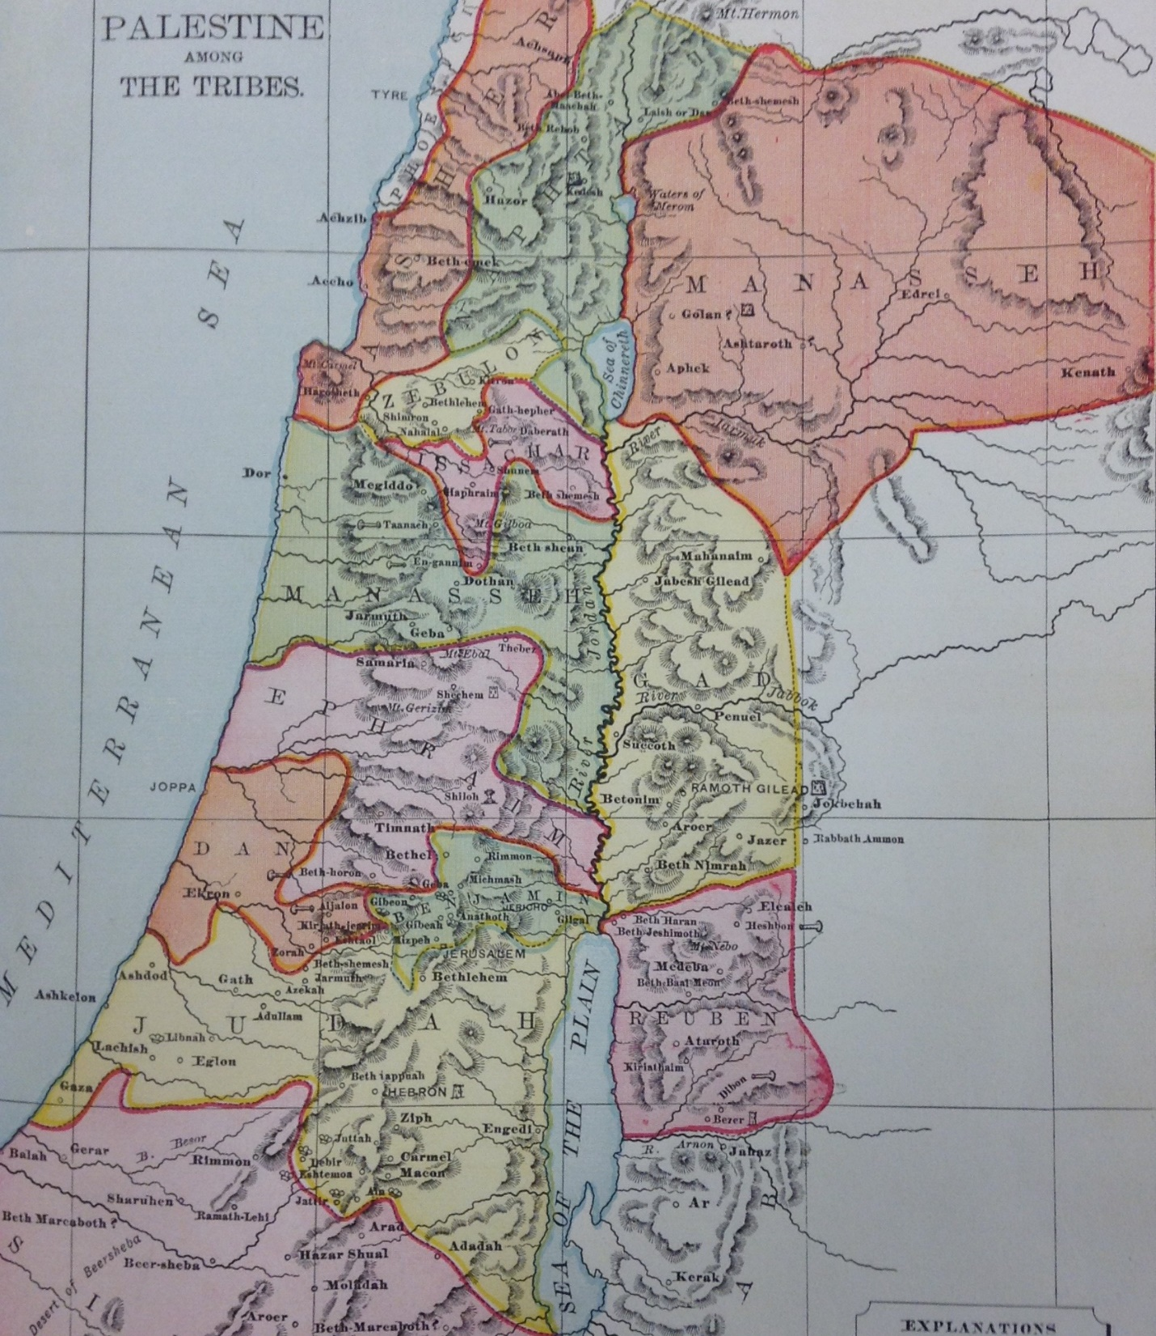
God Kept His Promise
43 So the LORD gave to Israel all the land of which He had sworn to give to their fathers, and they took possession of it and dwelt in it.
44 The LORD gave them rest all around, according to all that He had sworn to their fathers. And not a man of all their enemies stood against them; the LORD delivered all their enemies into their hand.
45 Not a word failed of any good thing which the LORD had spoken to the house of Israel. All came to pass. Joshua 21:43-45

