Slide 1
Joshua 1
Dan Jenkins
Palm Beach Lakes church of Christ

Slide 2
(Jacobites) Israelites Exit Egypt to Mt Sinai
430 Years after Move to Egypt
Mt. Sinai

Slide 3
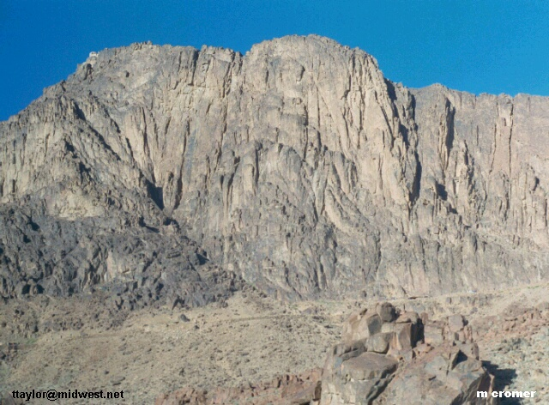
Mount Sinai

Slide 4
Israelites—From Mt. Sinai to Kadesh-Barnea
One year at Mt. Sinai
11 Days to Kadesh-Barnea
Kadesh-Barnea
Mt. Sinai

Slide 5
From Kadesh-Barnea to Kadesh-Barnea
A Forty Year Journey
Kadesh-Barnea
Mt. Sinai

Slide 6
From Kadesh-Barnea to Mt. Nebo
Mt. Nebo
Kadesh-Barnea
Mt.Hor
Mt. Sinai

Slide 7
From Kadesh-Barnea to Mt. Nebo
Miriam dies at Kadesh
Mt. Nebo
Kadesh-Barnea
Mt.Hor
Mt. Sinai

Slide 8
From Kadesh-Barnea to Mt. Nebo
Miriam dies at Kadesh
Aaron dies at Mt. Hor
Mt. Nebo
Kadesh-Barnea
Mt.Hor
Mt. Sinai

Slide 9
From Kadesh-Barnea to Mt. Nebo
Miriam dies at Kadesh
Aaron dies at Mt. Hor
Moses conquers East Bank
Mt. Nebo
Kadesh-Barnea
Mt.Hor
Mt. Sinai

Slide 10
Moses conquers the East Bank
Mt. Nebo
•

Slide 11
From Kadesh-Barnea to Mt. Nebo
Miriam dies at Kadesh
Aaron dies at Mt. Hor
Moses conquers East Bank
Moses dies at Mt. Nebo
Mt. Nebo
Kadesh-Barnea
Mt.Hor
Mt. Sinai

Slide 12
Joshua Appointed to Replace Moses
Deut. 34:7 Moses was one hundred and twenty years old when he died. His eyes were not dim nor his natural vigor diminished.
Deut. 34:8 And the children of Israel wept for Moses in the plains of Moab thirty days. So the days of weeping and mourning for Moses ended.
Deut. 34:9 Now Joshua the son of Nun was full of the spirit of wisdom, for Moses had laid his hands on him; so the children of Israel heeded him, and did as the LORD had commanded Moses.
Deut. 34:10 But since then there has not arisen in Israel a prophet like Moses, whom the LORD knew face to face . . .
Mt. Nebo
Kadesh-Barnea
Mt.Hor
Mt. Sinai

Slide 13
Key Verses on Joshua
At Mt. Sinai—Exo. 17:9-14
•
Mt. Nebo

Slide 14
Key Verses on Joshua
At Mt. Sinai—Exo. 17:9-14
Ten commandments—Exo. 24:13, 32:17
•
Mt. Nebo

Slide 15
Key Verses on Joshua
At Mt. Sinai—Exo. 17:9-14
Ten commandments—Exo. 24:13, 32:17
Kadesh-Barnea—Num. 13, 14
•
Mt. Nebo

Slide 16
Key Verses on Joshua
At Mt. Sinai—Exo. 17:9-14
Ten commandments—Exo. 24:13, 32:17
Kadesh-Barnea—Num. 13, 14
Moab, song of Moses—Deut. 31:14-19
•
Mt. Nebo

Slide 17
Key Verses on Joshua
At Mt. Sinai—Exo. 17:9-14
Ten commandments—Exo. 24:13, 32:17
Kadesh-Barnea—Num. 13, 14
Moab, song of Moses—Deut. 31:14-19
Moses is dead . . . Joshua 1:1-5
•
Mt. Nebo

Slide 18
Outline of Joshua by Chapters
•
•
Mt. Nebo

Slide 19
Outline of Joshua by Chapters
1--Charge to Joshua, Prep. to cross Jordan
•
•
Mt. Nebo

Slide 20
Outline of Joshua by Chapters
1--Charge to Joshua, Prep. to cross Jordan
2—Spies in Jericho, Rahab’s faith
•
•
Jericho
•
Mt. Nebo

