Slide 2
Introduction
Author: Anonymous, The book carries the name of the prophet that may have begun the work. Spoiler…Samuel dies in chapter 25. It is most likely a compilation. 1 Chronicles 29:29 states that Samuel, Nathan and Gad were involved in writing about the life of David.
Date Range: Roughly 1100 BC to 1010 BC, 90 years
Main theme: Transition, Eli to Samuel, Samuel to Saul, Saul to David. Also, judge/prophet to king.

Slide 3
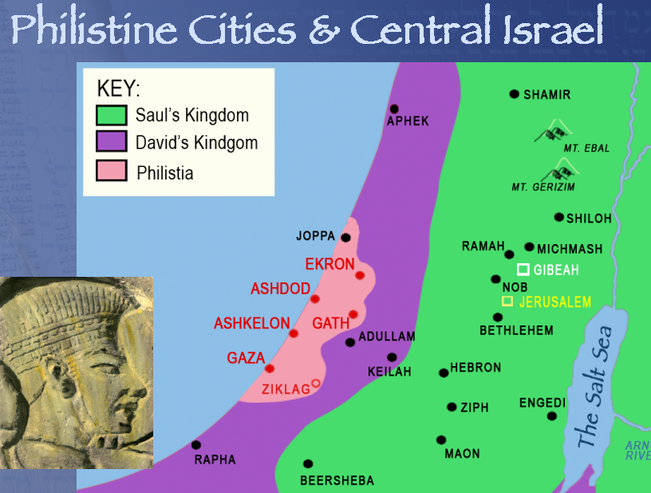
Introduction
Philistines:
Sea people (Ex 23:31)
City States
Iron workers (13:19-21)

Slide 4
Introduction
Outline:
Samuel’s judgeship (1-7)
Samuel’s birth and boyhood (1:1-2:11)
Eli’s rejection and Samuel’s call (2:12-3:21)
The ark among the Philistines (4:1-7:1)
Deliverance from Philistia (7:2-7:17)
Saul’s reign (8-31)
Rise of Saul (8-14)
Decline of Saul and rise of David (15-31)

Slide 5
Samuel’s birth and boyhood (1:1-2:11)
Hannah in Shiloh (1:1-17)
Samuel brought to Shiloh (1:18-28)
Hannah’s prayer (2:1-10)
Samuel ministers to Eli (2:11)

Slide 6
Eli’s rejection and Samuel’s call (2:12-3:21)
The sins of Eli’s sons (2:12-18)
Boyhood of Samuel (2:19-21)
Eli rebukes his sons (2:22-25)
Samuel matures (2:26)
Man of God rebukes Eli (2:27-36)
Samuel called by God (3:1-21)

Slide 7
The ark among the Philistines (4:1-7:1)
The ark is captured (4:1-10)
The word of the Lord is completed (4:11-22)
The Philistines have the ark (5:1-12)
The Philistines give it back (6:1-12)
The ark in Beth-shemesh (6:13-21)
The ark in Kiriath-jearim (7:1)

Slide 8
Deliverance from Philistia (7:2-7:17)
A call to repentance (7:2-6)
Deliverance (7:7-14)
Samuel’s ministry (7:15-17)

Slide 10
Rise of Saul (8:1-14:52)
Samuel’s ministry (7:15-8:3)
They ask for a king (8:4-22)
Saul’s Search (9:1-14)
God chooses a king (9:15-27)
The Saul as a prophet (10:1-14)
Saul publicly announced as king
(10:17-27)

Slide 11
Rise of Saul (8:1-14:52)
The defeat of the Ammonites (11:1-14)
Samuel addresses the people (12:1-25)
Saul fails to wait for Samuel (13:1-14)
Philistines defeated at Michmash (13:15-14:46)
Surrounding nations subdued (14:47-52)

Slide 12
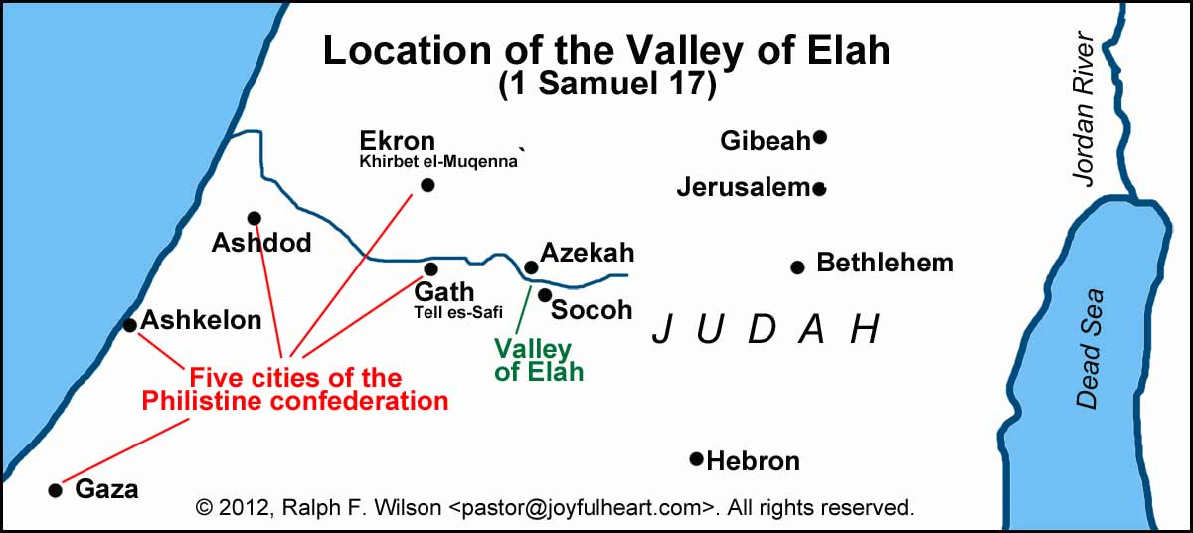
Decline of Saul and the Rise of David (15:1-31:13)
Saul’s Disobedience (15:1-34)
David is Anointed (16:1-23)
David Kills Goliath (17:1-58)

Slide 13
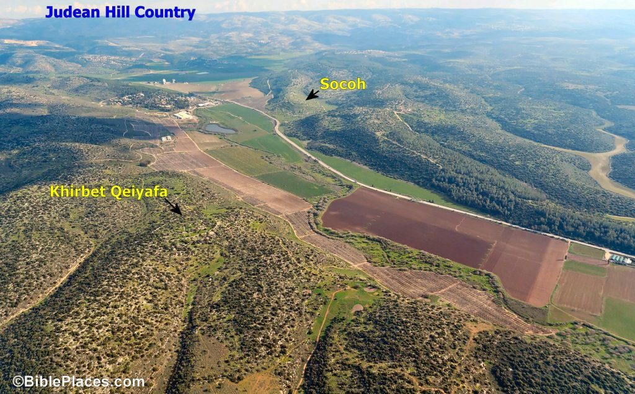
Decline of Saul and the Rise of David (15:1-31:13)

Slide 14
Decline of Saul and the Rise of David (15:1-31:13)
Saul’s Disobedience (15:1-34)
David is Anointed (16:1-23)
David Kills Goliath (17:1-58)
David in Gibeah (18:1-30)
Protection for David (19:1-24)
David flees from Saul (20:1-42)
David eats the show bread (21:1-15)
The priests are slain (22:1-23)

