Slide 2
Introduction to the Books
Thessalonica Was the Capital of Macedonia
Thessalonica was a strategically located city

Slide 3
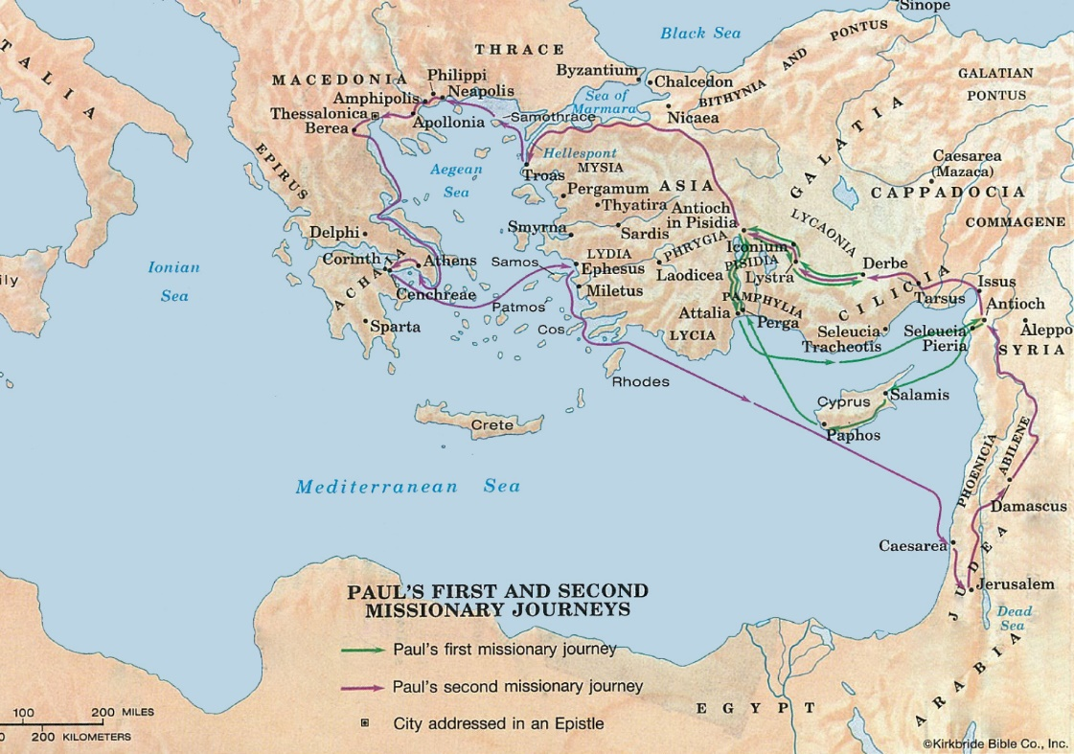

Slide 5
Introduction to the Books
Thessalonica Was the Capital of Macedonia
Thessalonica was a strategically located city
Thessalonica was a free city, governed by seven “politarchs”
City was mostly Gentiles with a sizeable Jewish population
Church Established on Paul’s Second Missionary Journey
Upon arrival in Thessalonica, Paul went to the synagogue (Acts 17:1-3)
Many were converted to the gospel that Paul as preaching, in the face of persecution (Acts 17:4-8)
The Jews of the city (who were not converted) raised up a mob and uproar against Paul (17:5-14).

Slide 7
Introduction to the Books
Paul Wrote First Thessalonians While on His Second Missionary Journey
Paul wanted to return to Thessalonica to continue teaching the brethren, but he was hindered (1 Thess. 2:17-18)
From Athens, Paul sent Timothy to teach and check on the brethren (1 Thess. 3:1-7).
Paul continued his journey to Corinth (Acts 18), where he stayed 18 months.
While in Corinth, Timothy returned to Paul with a report about Thessalonica (Acts 18:5; 1 Thess. 3:6-7).
Paul wrote First Thessalonians from Corinth, shortly after Timothy’s return and perhaps only about six months since he was forced to leave (“short time,” 1 Thess. 2:17). Around 50-51 A.D.

Slide 8
Introduction to the Books
Noteworthy Details About the Books
Only two books written by Paul on his Second Missionary Journey
Earliest epistles of Paul (written in about 51-52 A.D.)
Only James was written earlier (45-49 A.D.)
The two letters have two different tones.
First Thessalonians – positive, pleasant tone with many commendations
Second Thessalonians – more severe in tone, with some harsh censure

Slide 9
Introduction to the Books
Noteworthy Details About the Books
The themes center around the second coming of Christ
First Thessalonians: Comfort & hope for faithful Christians at the second coming of Christ
Second Thessalonians: Proper preparations for the second coming of Christ
First Thessalonians can be divided “in half”
Chapters 1-3: Praise for steadfastness in faith in midst of persecutions
Chapters 4-5: Instruction & correction regarding certain errors & misunderstandings

