Slide 1
Exodus
Palm Beach Lakes church of Christ
Sunday morning Bible class

Slide 2
A little review
a.Moses probably felt he was not a Hebrew or
a Jew.
b.We find these Biblical characters
Jethro – Moses' father
Jochebed – Moses' mother
Miriam- Moses’ sister
Aaron- Moses’ brother

Slide 3
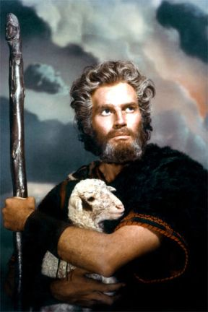
A little review
Moses gets in trouble and flees to Midian.
Moses and Israel was not ready.
God’s timing is better than ours.
Moses spent 40 years as a shepherd.
2:25 God hears the Hebrew people.

Slide 4
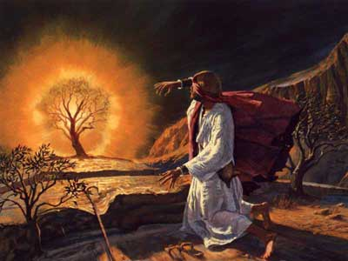
A little review
1.Moses receives his calling at the burning bush.
2.Moses is 80 years old.
3.Holy ground shows us a the degree of respect
God demands.
4. Moses was apprehensive to be a leader.

Slide 5
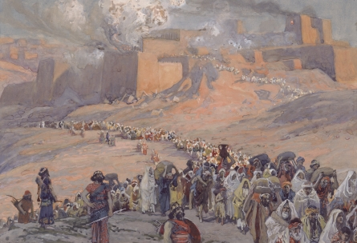
A little review
5. What is God’s name?
God says His name is “I Am Whom I Am” 3:14
6.God uses evil men to work His plan. 3:19
7. Israel did not go away empty handed.

Slide 6
A little review
8. Pharaoh said “I do not know the Lord” 5:2
9. Pharaoh decreed that the slaves would have to
get their own straw. 6:13
10. God made it very clear that the people would
leave the land of Egypt.
11. Moses and Aaron address Pharaoh and demand
that the Israelites be set free.
12. Pharaoh started a pattern going against his word.

Slide 7
The Ten Plagues
Waters become blood
Frogs
Lice
Flies
Livestock
Boils
Hail
Locusts
Darkness
First born

Slide 8
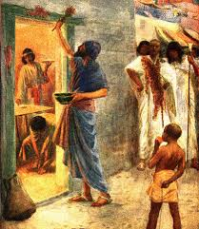
The Passover
12: 12-13 Death of the first born. Man and beast.
People were told to keep it as a feast.
They were to paint blood on the lintel and on the
two door posts so the destroyer would pass over.

Slide 9
Todays' lesson
1. God did not lead them by the way of the Philistines
lest they change their minds when they see war and
want to return to Egypt.
2. He lead them by the way of the Red Sea.
3. Moses took the bones of Joseph.
Exodus 13: 17-19

Slide 10
Todays' lesson
4. Pillar of cloud by day and pillar of fire by night 13:21
Chapter 14
5. Pharaoh chases the Israelites.
600 choice chariots
All the chariots of Egypt
Horsemen and the army
6. They grew afraid and doubted Moses. 14: 12
7. Moses said, “the Lord will fight for you”. 14:14

Slide 11
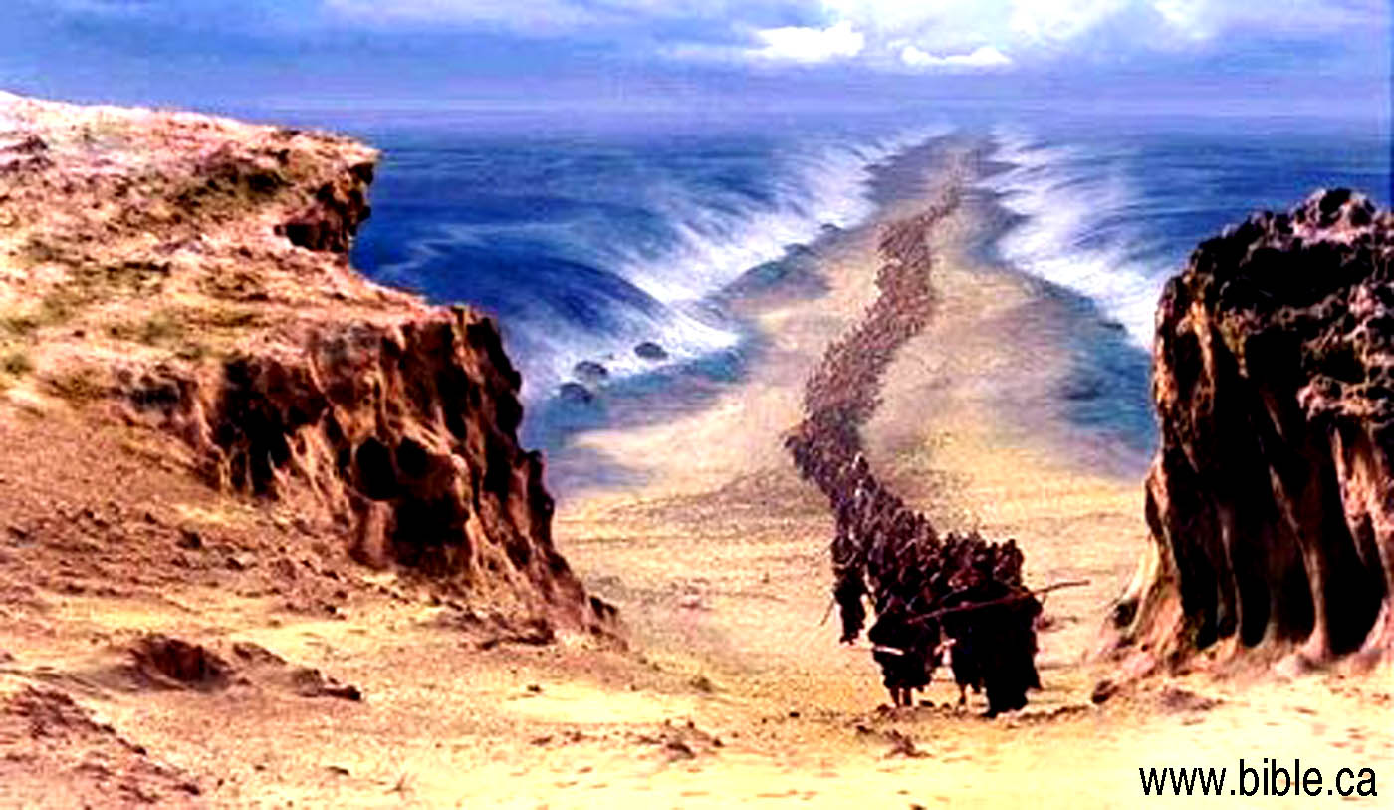
Todays' lesson
8. Moses stretched out his staff and the waters
parted. The Israel walked on dry land.
9. The sea closed and destroyed the Egyptian army.
10. The people saw the works of the Lord and believed
in the Lord and Moses. 14:31

Slide 12
Todays' lesson
The skeptics weigh in.
Accepting the biblical account as a "possible 'qualitative' description of an event," Florida State oceanographer Doron Nof set out to investigate whether the parting of the Red Sea is "plausible from a physical point of view." Using a common phenomenon called wind set-down effect.
www.slate.com

Slide 13
Today's lesson
Doubt in God’s word comes
from Post- Modernism.
Postmodernist preach the gospel of
“tolerance”.
However, Postmodernist are very “intolerant” of
those that believe in “absolute truth”.
Jesus believed and taught “absolute truth”.

Slide 14
Today's lesson
Doubt in God’s word comes
from Post- Modernism.
“Postmodern thinkers argue that one’s socio-economic, ethnic, gender, and educational statuses exert such a dominating influence on his or her interpretation of the world that there can be no abstract, universal statement of truth that applies in every circumstance, or to everyone”.
(Garry K. Brantley, Apologetics Press article)

Slide 15
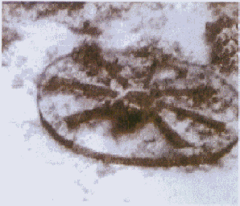
Today's lesson
Picture of a chariot wheel

Slide 16
Todays' lesson
The song of Moses & Miriam
Looking at two verses. Ex.14:13 , Psalm 78: 12-14
The songs are about the Lord, and how He
took care of Israel and His mighty works.
Moses writes two other songs:
Deuteronomy 32:1 -43
Psalm 90

Slide 17
Todays' lesson
1. vs. 22-27
a. The people complained. God fulfilled their need
b. God made a statute.
* Heed the voice of the Lord
* Do what is right
* Give ear to His commandments
* Keep all His statutes
c. The Israelites will not be afflicted with the
diseases that the Egyptians had.

Slide 18
Today's lesson
Chapter 16
1.The people complain against Moses & Aaron
2.God said He will rain bread from heaven.
and quail by night.
3. What is Manna?
* Comes from the Hebrew word Mon.
* Means “what is it?”

Slide 19
Today's lesson
The Israelites were to keep the Sabbath day.
They were to pick up manna for 6 days and
not pick it on the seventh.
They ate manna for 40 years.

Slide 20
Today's lesson
Chapter 17
The Israelites journeyed in the wilderness.
They said there was no water.
Moses struck the rock as commanded.
Once again the Lord fulfilled their need.
The Israelites had to battle the Amalekites.

Slide 21
Today's lesson
Who were the Amalekites?
1.The Amalekites has their origin within the
Edomites, being descendents of Esau.
They are associated with Edom , living in the
same area as Edom.
2.Territiory was between Babylon and the gulf of
Aquaba.
3. They are noted as enemies of the Israelites.

Slide 22
Today's lesson
Victory over the Amalekites 17:12-16
1.When Moses held up his hand,
the Israelites prevailed.
2.When the hand went down , the
Amalekites prevailed.
3.Aaron and Hur supported Moses' arms.
4. Joseph defeated Amalek and his army.

Slide 23
Today's lesson
Chapter 18
Jethro unites Moses with his family.
Jethro gives Moses advice.
*Teach them statues and laws.
* Select rulers of thousands
* Select rulers of hundreds
* Select rulers of fifties
* Select rulers of tens

Slide 24
Today's lesson
Chapter 19
1.The Jews are in the Wilderness of Sinai.
2. Moses meets God on the mountain.
3. If they follow God they will be a
kingdom of priests and a holy nation. 19:5
4. The people were not allowed to go up to
meet God.

Slide 25
Today's lesson
Chapter 20
Moses delivers the 10 commandments.
1.No other God’s before Me.
2.Do not make a graven image.
3.Do not take the name of the Lord in vain.
4.Remember the Sabbath day and keep it holy.
5.Honor your father and mother.

Slide 26
Today's lesson
Chapter 20
6. Do not murder
7. Do not commit adultery
8. Do not steal
9. Do not bear false witness
10. Do covet.

Slide 27
Today's lesson
Are Christians under the
Ten Commandments today?
1. The commandments were unique to Israel
2. They were not a complete law by themselves.
3. Christians are not required to keep the Sabbath
4. The New Testament teaches moral principles
that are found in 9 of the commandments.

