Slide 2
Dr. Philip Kitcher in his book,
Abusing Science: The Case Against Creationism
Solid evidence for the coexistence of dinosaurs and humans would “shake the foundation of evolutionary theory, because, of course, the dinosaurs are supposed to have been long extinct by the time the hominids arrived on the scene.”

Slide 3
Historical Evidence for The Coexistence of Dinosaurs & Humans Dinosaur Stories
The Ubiquity of These Stories (They’re Everywhere!)
Stories of reptiles passed down from cultures all over the world
Large reptiles were not called “dinosaurs” but “dragons”
Famed evolutionist, Carl Sagan, noted:
“The implacable mutual hostility between man and dragon…is not a Western anomaly. It is a worldwide phenomenon.”
Militant evolutionist and LiveScience.com staff writer Ker Than admitted:
“Dragons are…found in the myths and legends of cultures all around the world.”

Slide 4
Historical Evidence for The Coexistence of Dinosaurs & Humans Dinosaur Stories
The Ubiquity of These Stories (They’re Everywhere!)
Stories of reptiles passed down from cultures all over the world
Large reptiles were not called “dinosaurs” but “dragons”
“There is one creature remembered in the legends of almost every human culture that’s ever existed. A creature depicted with remarkable similarity by the Chinese, the Aztecs, even the Inuit who live in a frozen land where no reptiles are found—even they have stories of this animal: the dragon. Cultures from different continents, people who had no contact with one another yet all of them have stories describing the same mythical animal.”
(“Dragons: A Fantasy Made Real,” by Animal Planet, 2005).

Slide 5
Historical Evidence for The Coexistence of Dinosaurs & Humans Dinosaur Stories
The Antiquity of These Stories (They Go Way Back!)
“This the animal about which humankind has throughout our history been most compelled by” (“Dragons: A Fantasy Made Real,” by Animal Planet, 2005).
“The dragon-slaying theme was an important motif in the Sumerian mythology of the third millennium B.C.” (Samuel Kramer, History Begins at Sumer, 1959).
“Dragon legends have been with humanity since the dawn of recorded history” (Science Digest, 1981).

Slide 6
Historical Evidence for The Coexistence of Dinosaurs & Humans Dinosaur Stories
The Variety and yet Uniformity of These Stories
Many of these creatures sound exactly like dinosaurs or dinosaur-like (marine or flying) reptiles
Common characteristics of dragons (dinosaurs?) in legends:
Scaly, hard, elongated bodies
Long, serpentine necks
Enormous tails and stout legs
Horned, knobby, crested heads
Fearsome teeth, claws and spikes
With or without bat-like wings
With two or four legs
“No creature that ever lived looked more like dragons than dinosaurs.”
(The Greatest Monsters in the World, Daniel Cohen)

Slide 7
Historical Evidence for The Coexistence of Dinosaurs & Humans Dinosaur Stories
What real animals prompted dragon legends?
Evolutionist Mark Norell admitted: “all the mythical creatures… have real underpinnings in biology”
What rational explanation exists for why peoples in different places and times, separated by thousands of miles, all came up with stories of giant reptiles that sound more like extinct dinosaurs than any other animal on Earth?
Because many dragon legends are simply the accounts of people seeing and/or interacting with real dinosaurs.

Slide 8
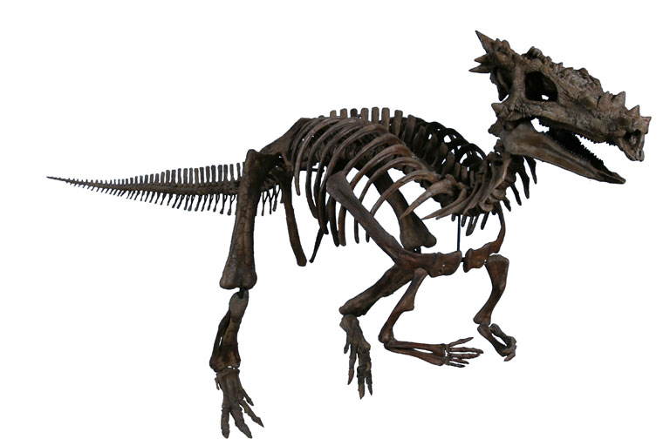
Historical Evidence for The Coexistence of Dinosaurs & Humans Dinosaur Stories
Amazing Discovery in South Dakota (2003)
Nearly complete dinosaur skull excavated in the Hell Creek Formation
The long, knobby, spiky skull appeared so similar to descriptions and paintings of certain “legendary” dragons, it actually was named Dracorex, meaning “dragon king.”
The Children’s Museum of Indianapolis, which now has the skull, referred to it as “a new type of dinosaur” that is “66-million-years-old” and “looks like a dragon.”

Slide 9
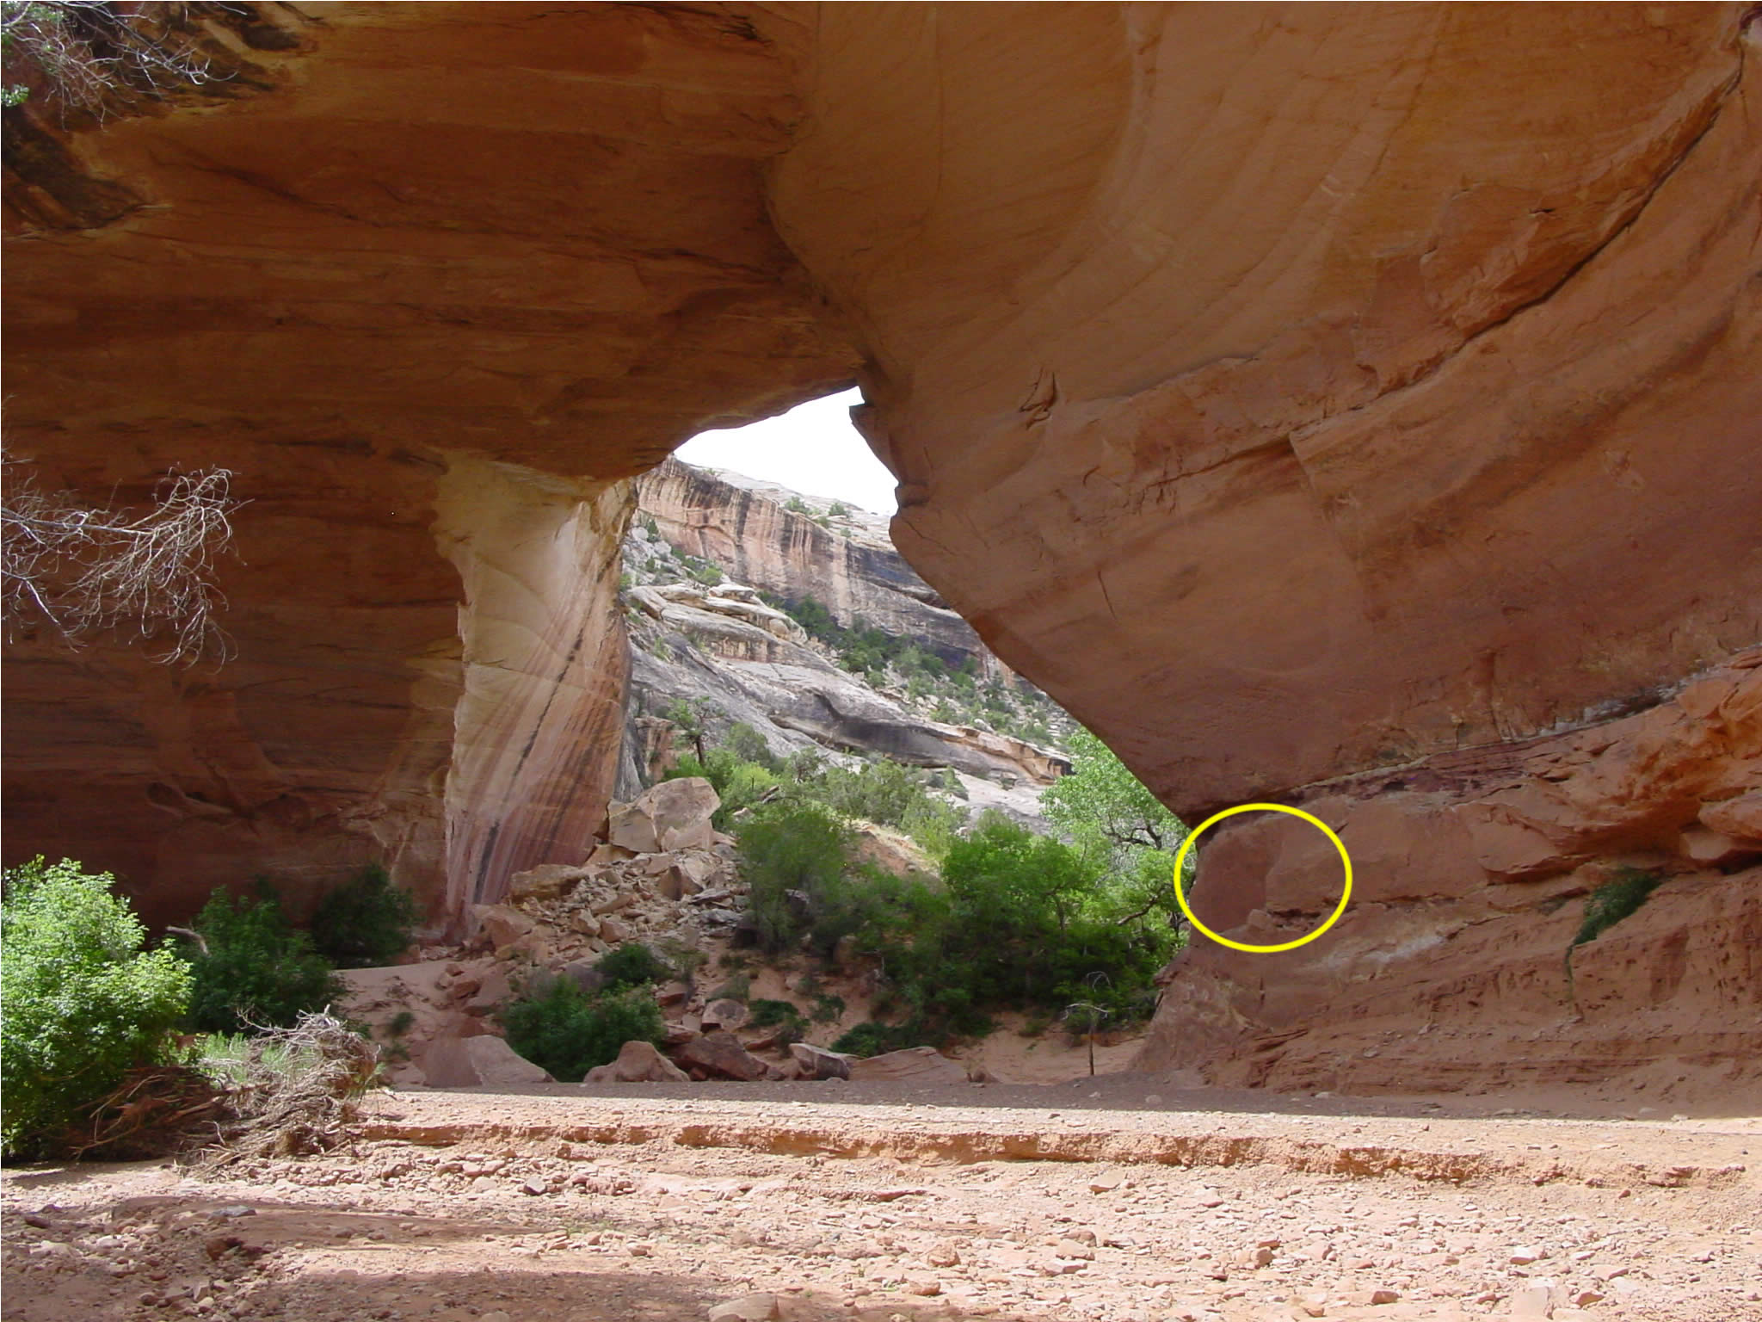
Physical Evidence for The Coexistence of Dinosaurs & Humans Dinosaur Illustrations
Petroglyph at Natural Bridges Monument (Utah)
Work of the Anasazi Indians (from 400-1400 AD)
Francis Barnes (evolutionist and authority on rock art): “There is a petroglyph in Natural Bridges National Monument that bears a startling resemblance to a dinosaur, specifically a Brontosaurus, with long tail and neck, small head and all.”

Slide 10
Physical Evidence for The Coexistence of Dinosaurs & Humans Dinosaur Illustrations
Petroglyph at Natural Bridges Monument (Utah)
Work of the Anasazi Indians (from 400-1400 AD)
45 miles away, fossils have been found of a Brontosaurus
Dennis Flifer: “One of the most curious designs is a petroglyph that resembles a dinosaur, which is apparently of Anasazi origin based on its patination.”

Slide 11
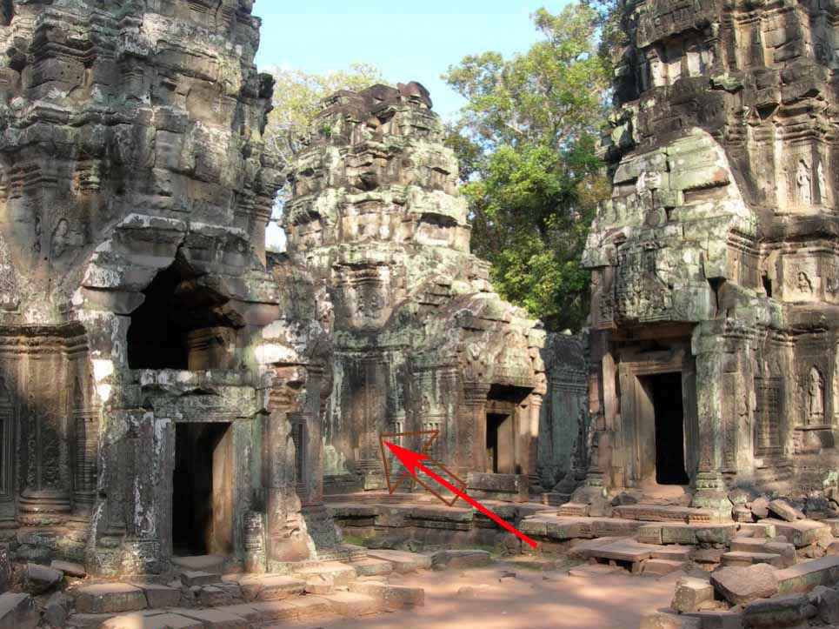
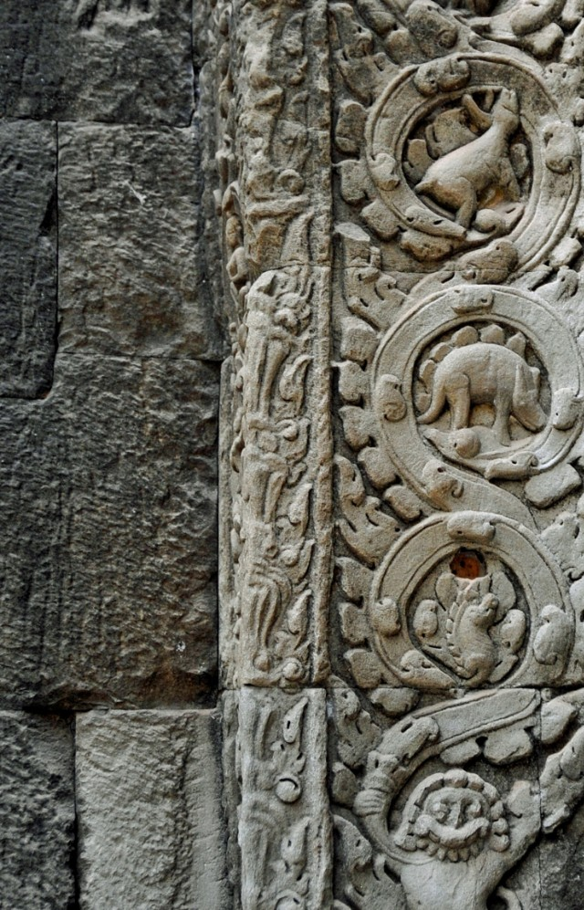
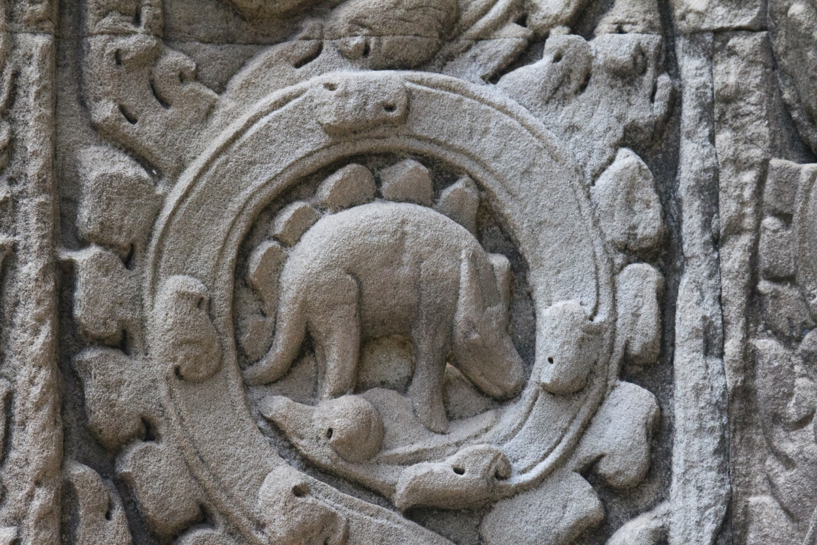
Physical Evidence for The Coexistence of Dinosaurs & Humans Dinosaur Illustrations
Rock Carving in Ancient Cambodian Temple (SE Asia)
Built by King Jayavarman VII in 1186 A.D.
600 years before we learned about dinosaurs from fossil record
Claude Jacques and Michael Freeman, Angkor: Cities and Temples: “Roundels on pilasters on the south side of the west entrance are unusual in design. IN particular…an animal which bears a striking resemblance to a stegosaurus.”

Slide 12
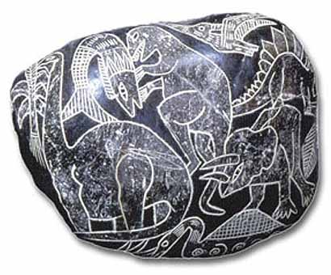
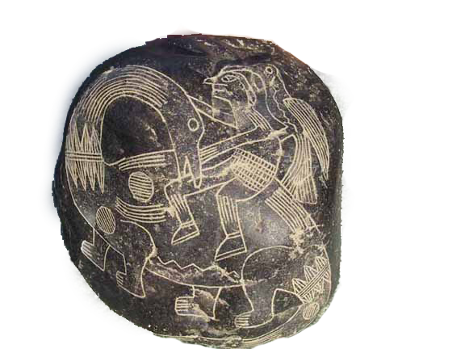
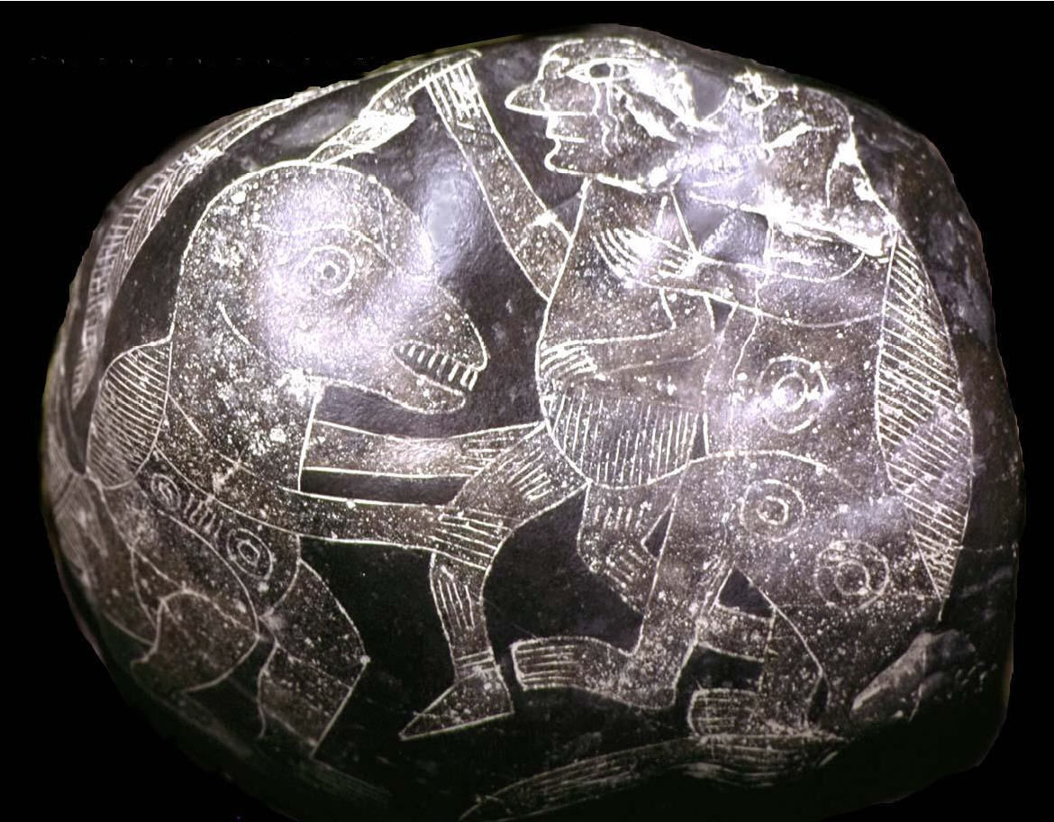
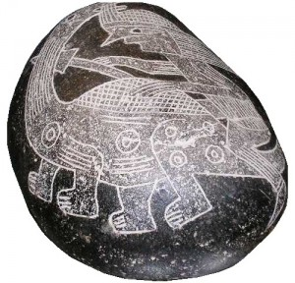
Physical Evidence for The Coexistence of Dinosaurs & Humans Dinosaur Illustrations
Ica Burial Stones (Peru)
Over 11,000 stones have been found
Nearly 1/3 specific types of dinosaurs
Dated around 500-1500 A.D.

Slide 13
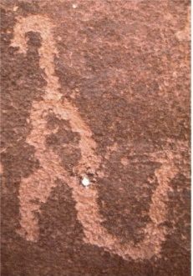
Physical Evidence for The Coexistence of Dinosaurs & Humans Dinosaur Illustrations
Rock Art in Havasupai Canyon (Arizona)
Discovered by Dr. Samuel Hubbard (a theistic evolutionist) from Oakland Museum of Natural History
From Hubbard’s book, Strange Prehistoric Animals and Their History:
“Taken all in all, the proportions are good. The huge reptile…is depicted in the attitude in which man would be most likely to see it—reared on its hind legs, balancing with the long tail, either feeding or in a fighting position, possibly defending itself against a party of men.”

Slide 14
Physical Evidence for The Coexistence of Dinosaurs & Humans Dinosaur Illustrations
Rock Art in Havasupai Canyon (Arizona)
Discovered by Dr. Samuel Hubbard (a theistic evolutionist) from Oakland Museum of Natural History
From Hubbard’s book, Discoveries Relating to Prehistoric Man: “The fact that some prehistoric man made a pictograph of a dinosaur on the walls of this canyon upsets completely all of our theories regarding the antiquity of man… The fact that the animal is upright and balanced on its tail would seem to indicate that the prehistoric artist must have seen it alive.”

Slide 15
Physical Evidence for The Coexistence of Dinosaurs & Humans Dinosaur Illustrations
The only explanation is that humans and dinosaurs lived together and humans saw dinosaurs
We have no evidence of humans finding dinosaur fossils and reconstructing their skeletons until the middle of the 19th century
So, how did someone draw or engrave such convincing pictures of dinosaurs hundreds and hundreds of years before that?
Men must have once lived with these creatures, and proof of their coexistence is found all over the world in the form of physical, historical & Biblical evidence.
TRUTH (that humans and dinosaurs once coexisted) shakes the foundations of evolution!

Slide 16
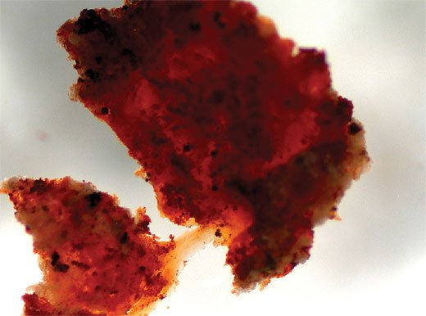
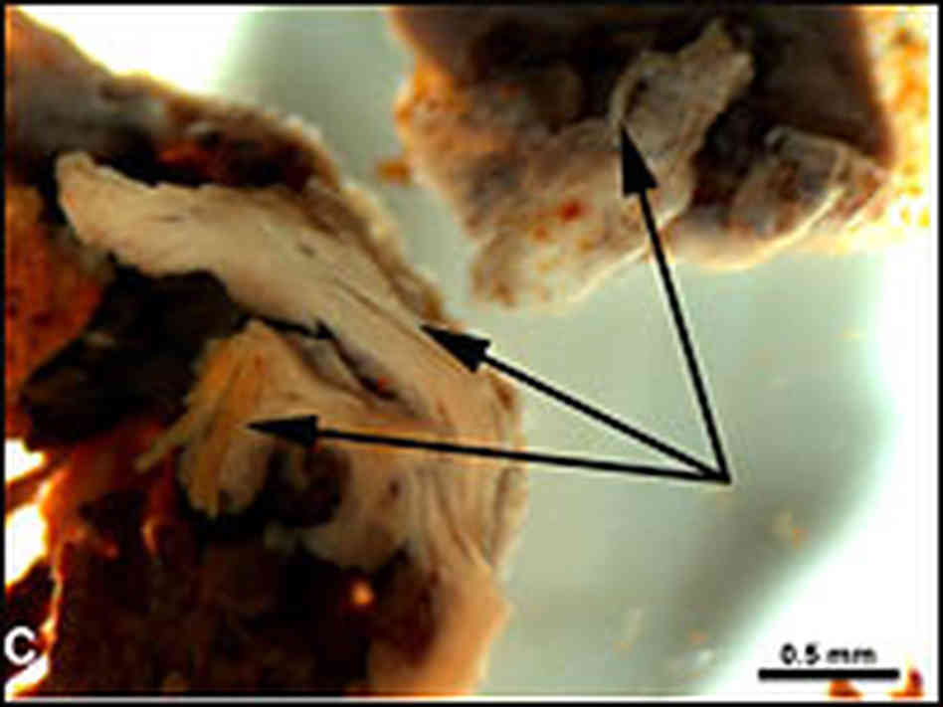
Physical Evidence for The Coexistence of Dinosaurs & Humans Dinosaur Tissue
Scientists have discovered dinosaur bones (in the last decade) that are not completely fossilized
From Science magazine (2005): “Soft tissues are preserved within hindlimb elements of Tyrannosaurus rex…Removal of the mineral phase reveals transparent, flexible, hollow blood vessels… Some regions of demineralized bone matrix are highly fibrous, and the matrix possesses elasticity and resilience… The demineralized fragment is flexible and resilient and, when stretched, returns to its original shape.”

Slide 17
Physical Evidence for The Coexistence of Dinosaurs & Humans Dinosaur Tissue
This is not an anomaly!
Alan Boyle, MSNBC Science Editor (2007): “Today, paleontologists are still stunned— not only to find material that looks like dinosaur cartilage, blood vessels, blood cells and bone cells, but to see the stuff in so many different specimens.”
There are a “growing number of tissue samples.”
“It’s not just a fluke occurrence… It’s something that’s more pervasive in the fossil record.”
They have excavated such samples in Montana, Madagascar & Mongolia

Slide 18
Biblical Evidence for The Coexistence of Dinosaurs & Humans
The whole of God’s earthly creation was brought into existence within six days.
Exodus 20:11 states: “For in six days the Lord made the heavens and the earth, the sea, and all that is in them, and rested the seventh day.”
Genesis 1 teaches that God created all animal life on days five and six of Creation and created humans on day six.
Only Conclusion: Dinosaurs once lived with humans!

Slide 19
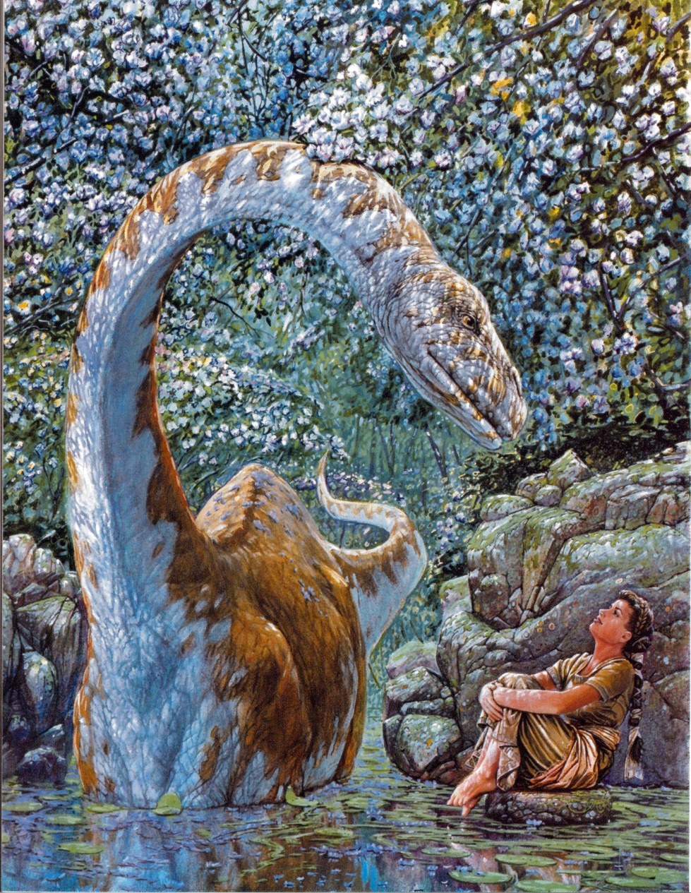
Biblical Evidence for The Coexistence of Dinosaurs & Humans Behemoth (Job 40:15-24)
“Look now at the behemoth which I made along with you…” (15)
“He eats grass like an ox” (15)
“See now, his strength is in his hips” (16)
“His power is in his stomach muscles” (16)
“He moves his tail like a cedar” (17)
“The sinews of his thighs are tightly knit”
“His bones are like beams of bronze” (18)
“His ribs like bars of iron” (18)
“He is the first [chief] of the ways of God”
“Only He who made him can bring near His sword”
Hippopotamus or Dinosaur?

Slide 20
Biblical Evidence for The Coexistence of Dinosaurs & Humans Leviathan (Job 41:1-34)
“Can you draw out Leviathan with a hook?”
“His rows of scales are his pride” (15)
“His sneezings flash forth light” (18)
“Out of his mouth go burning lights” (19)
“Sparks of fire shoot out” (19)
“Smoke goes out of his nostrils, As from a boiling pot and burning rushes” (20)
“His breath kindles coals, And a flame goes out of his mouth” (21)
“When he raises himself up…” (25)
“…the sword…cannot avail” (26)
“Nor does spear, dart, or javelin” (26)
“He regards iron as straw, And bronze as rotten wood” (27)
“Darts are regarded as straw; He laughs at the threat of javelins” (29)
Crocodile or Dinosaur?

Slide 21
Biblical Evidence for The Coexistence of Dinosaurs & Humans Leviathan (Job 41:1-34)
“His undersides are like sharp potsherds; He spreads pointed marks in the mire” (30)
“He makes the deep boil like a pot” (31)
“He makes the sea like a pot of ointment”
“He leaves a shining wake behind him; One would think the deep had white hair” (32)
“On earth there is nothing like him, Which is made without fear” (33)
“He beholds every high thing” (34)
“He is king over all the children of pride”
Crocodile or Dinosaur?

Slide 22
Biblical Evidence for The Coexistence of Dinosaurs & Humans Behemoth & Leviathan
Three possible explanations exist:
They are unreal, mythological monsters
They are real animals that exist somewhere in the world today
They are some kind of real, yet extinct creature (e.g., dinosaurs)

Slide 23
Abundant Evidence for The Coexistence of Dinosaurs & Humans
There is POWERFUL evidence for the coexistence of dinosaurs and humans:
There are rock drawings that go back hundreds or thousands of years
There are stories that go back to the beginning of time
We have the Bible that tells us that land animals and humans were both created on Day 6
And, we have our good common sense that tells us that we live with amazing creatures today.
WHY couldn’t we have lived with the dinosaurs in the past?

