Slide 2
Examining the Day-Age Theory
Theory: “Days” in Genesis 1 are not literal 24-hr periods “Days” in Genesis 1 are lengthy eons of time
“Day” (yom) can have different meanings in the O.T.
Can refer to the opposite of night (Genesis 1:5, 15, 16, 18)
Can refer to a specific day – like Sabbath Day, snowy day
Can refer to a time in the future (e.g., “day of judgment”)
In Genesis 2:4, it has reference to the total days of Creation.
But, it most often means a literal twenty-four hour day.

Slide 3
Examining the Day-Age Theory
The context defines “day” – “the evening and the morning were the first day” (Gen. 1:5)
When used with “evening and morning” in O.T., “day” (yom) always means 24-hour day (Ex. 27:21; 1 Sam. 17:16; 1 Kg. 17:6)
If “days” were years, what were the “years” (Gen. 1:14)?
When Hebrew yom is preceded by a numeral, it always carried the meaning of a 24-hour day (Gen. 7:14; 30:36; Josh. 6:3; Jonah 1:17).
When Hebrew yom occurs in the plural (yamim), it always refers to a literal 24-hour day (Ex. 20:11).

Slide 4
Examining the Day-Age Theory
If “days” are millions/billions of years, there’s a significant problem in the field of botany.
There is another Hebrew word for long eons of time (dor), which Moses could have used, but he used every means possible to emphasize literal 24-hour periods.
God’s explicit command to the Israelites about the Sabbath Day observance demands 24-hour days (Ex. 20:8-11). Creation week is the basis for our week.
Read the plain statements in the Bible and see if it sounds like God spent millions or billions of years in creation (Ex. 20:11; 31:17; Psa. 33:6, 9; 148:5).

Slide 5
Examining the Day-Age Theory
What about 2 Peter 3:8?
Look at the context – the promise of God is not set by time
The verse says “as” not “is”
It does indicate God knows the diff between a day and year
If God wanted man to know that He created the world in six literal days, what words would He use (if different than the words He used in Genesis 1)?
God could have created the Universe in any way, order, and time of His choosing. The question is not what He could have done but what He said He did!

Slide 6
Examining the New Testament Evidence
Evolution teaches that the Universe is 14 billion years old and that man has only been around about 2 million years.
Study carefully the words of the Creator Himself:
“The foundation of the world”
“You loved Me before the foundation of the world” (Jn. 17:24)
Jesus “was foreordained before the foundation of the world” (1 Pt 1:20)
God “chose us in Him before the foundation of the world” (Eph. 1:4)
When did man come on the scene? READ Luke 11:49-51
“The beginning of the creation”
When did man come on the scene? READ Mark 10:6
“Since the creation of the world”
When did man come on the scene? READ Romans 1:20

Slide 7
Examining the Age of the Earth
If the Earth is only a few thousand years old, evolution never could have happened!
And, historical and biblical data prove that the Earth is only a few thousand years old.
Secular, historical documents reveal that from the present back to the time of Jesus is approx. 2,000 years
From Jesus back to Abraham is about 2,000 years
From Abraham back to Adam was about 2,000 years
The Earth is only five days older than man
The age of the earth, from actual documentation, is around 6,000-10,000 years old.

Slide 8
Examining the Fossil Record
Fossils are the remains of once-living organisms that are now buried in the rocks of the Earth
Evolution requires Transitional Forms
A transitional form is an organism that exhibits characteristics of two separate groups
Even Darwin claimed that the fossil record should show “innumerable transitional links”
Reality Check: Not one fossil has ever been proven to be an authentic transitional form
The Fossil Record does show millions of organisms suddenly arriving on the scene fully formed and functional, without any transitional forms preceding

Slide 9
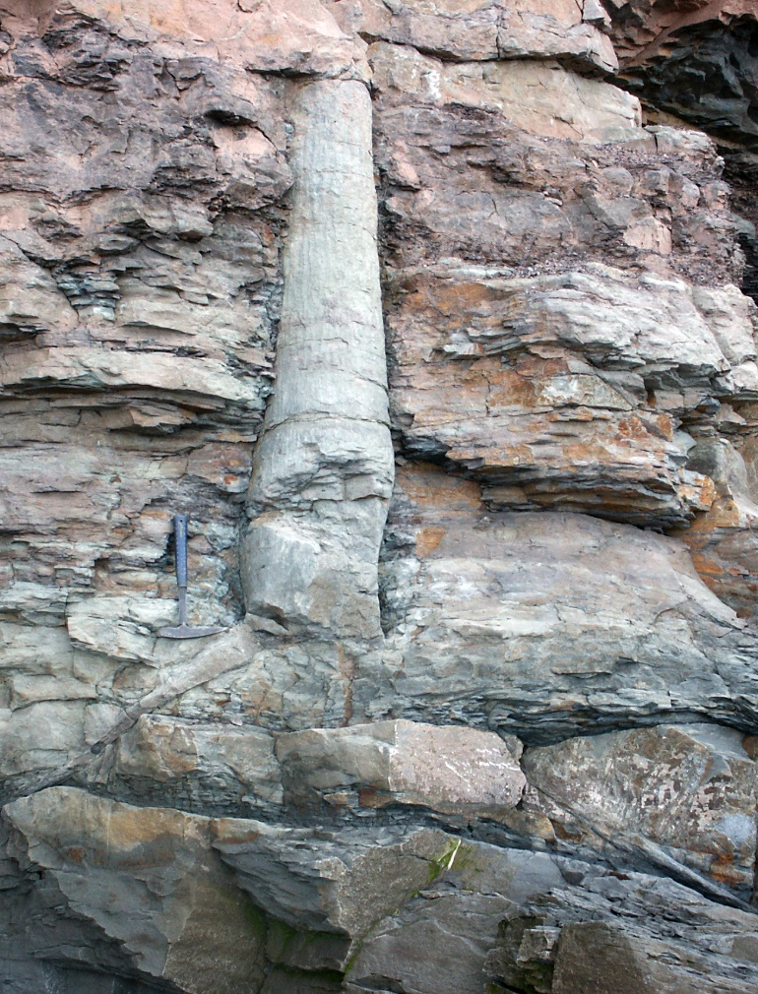
Examining the Fossil Record
Evolutionists point to sedimentary-rock layers as strong evidence for vast amounts of geologic time
Embedded in sedimentary rocks are polystrate (“many layers”) fossils
Cut thru at least two layers
Organic material exposed to the elements will rot (not fossilize)
Fossilization would require quick preservation (with surrounding rock layers being rapidly deposited)

Slide 10
Examining the Biblical Record
“For in six days the LORD made the heavens and the earth, the sea, and all that is in them, and rested the seventh day” (Ex. 20:11).
“He spoke, and it was done; He commanded, and it stood fast” (Psa. 33:9).
“All things were made through Him, and without Him nothing was made that was made” (John 1:3)

