Slide 1
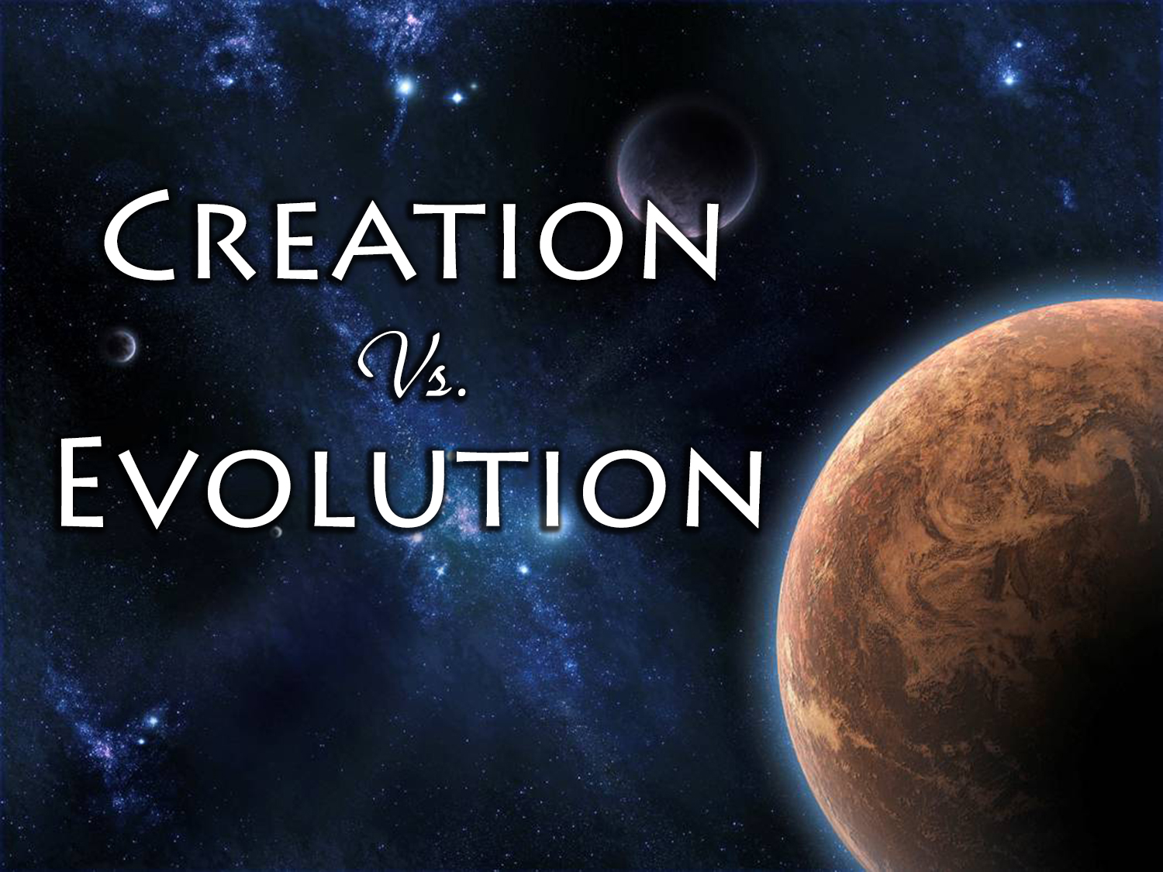

Slide 2
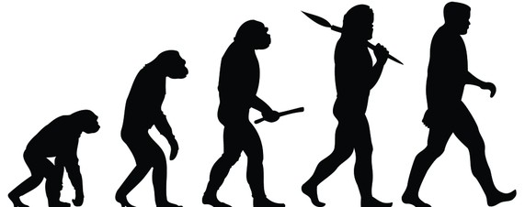
or
Creation
Evolution
“In the beginning God created the heavens and the earth.”
“In the beginning was matter, which begat the amoeba, which begat the worm, which begat the fish, which begat the amphibian, which begat the reptile, which begat the lower mammal, which begat the lemur, which begat the monkey, which begat man, who imagined God.”
Which Is Correct? Only one can be!

Slide 3
or
Creation
Evolution
The Universe is not self-contained
All things originated thru supernatural processes
A supernatural being is responsible for the origin and design of the Universe
All living things originated from the One and Only God, life from Life
The Universe is self-contained
All things originated through natural processes
No supernatural being had any part in the origin or development of life
All living things originated from a one-cell organism, which arose from non-living
Which Is Correct? Only one can be!

Slide 4
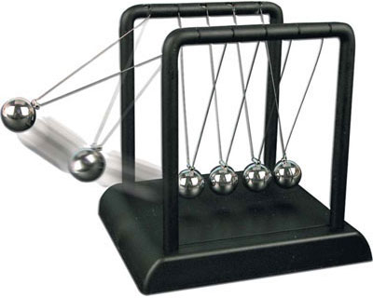
The Law of Cause and Effect
“Every material effect must have an adequate cause that existed before the effect.”
The Effect: Massive, intricately complex universe
What would be an adequate cause?
What would be a cause before the material?
A miniscule ball of matter that came from nothing and then exploded in a “Big Bang”?

Slide 5
The Law of Cause and Effect
The
Universe
Our Universe has over 100 billion galaxies
Each galaxy has an estimated 100 billion stars
Our Universe has over 25 sextillion stars (21 zeroes)
The Milky Way Galaxy has 300 billion stars (Sun=one)
The Milky Way is 100,000 light years across
The Andromeda Galaxy is 750,000 light years away
Crossing the Universe would take >20 billion light yrs
WHAT WAS THE FIRST CAUSE?
Must have been adequate & have come before
Could not have been material

Slide 6
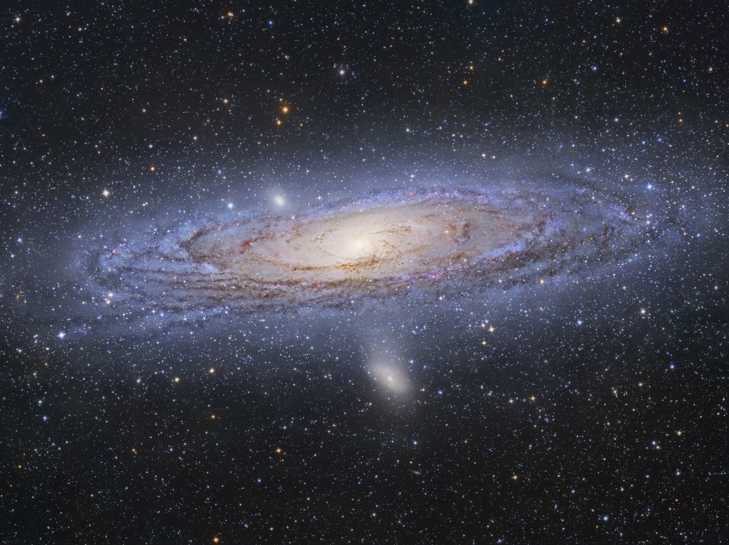
The Law of Cause and Effect
The Bible &
The Cause
“In the beginning God created the heavens and the earth” (Gen. 1:1)
“God, who made the world and everything in it…He is Lord of heaven and earth” (Acts 17:24)
“For in six days the LORD made the heavens and the earth, the sea, and all that is in them” (Ex. 20:11)
God is undoubtedly:
An adequate cause (Gen. 1:1; 17:1)
Before the material world (Psa. 90:2)

Slide 7
The Law of Biogenesis
“Life in the material Universe comes from previous life of its own kind.”
Living things always come from living things
Living things produce only more living things like themselves
There has never been or observed a single exception to this basic law of science
Evolution contradicts the Law of Biogenesis
Evolution says living things came from nonliving matter
Evolution says one kind of animal gave rise to a different kind of animal

Slide 8
The Bible &
Biogenesis
The Law of Biogenesis
Genesis 1:11 Then God said, "Let the earth bring forth grass, the herb that yields seed, and the fruit tree that yields fruit according to its kind, whose seed is in itself, on the earth"; and it was so.
12 And the earth brought forth grass, the herb that yields seed according to its kind, and the tree that yields fruit, whose seed is in itself according to its kind. And God saw that it was good. …
21 So God created great sea creatures and every living thing that moves, with which the waters abounded, according to their kind, and every winged bird according to its kind. And God saw that it was good.
22 And God blessed them, saying, "Be fruitful and multiply, and fill the waters in the seas, and let birds multiply on the earth.“ …
24 Then God said, "Let the earth bring forth the living creature according to its kind: cattle and creeping thing and beast of the earth, each according to its kind"; and it was so.
25 And God made the beast of the earth according to its kind, cattle according to its kind, and everything that creeps on the earth according to its kind. And God saw that it was good.

Slide 9
The Fossil Record
Fossils are the remains of once-living organisms that are now buried in the rocks of the Earth
Evolution requires Transitional Forms
A transitional form is an organism that exhibits characteristics of two separate groups
Even Darwin claimed that the fossil record should show “innumerable transitional links”
Reality Check: Not one fossil has ever been proven to be an authentic transitional form
The Fossil Record does show millions of organisms suddenly arriving on the scene fully formed and functional, without any transitional forms preceding

Slide 10
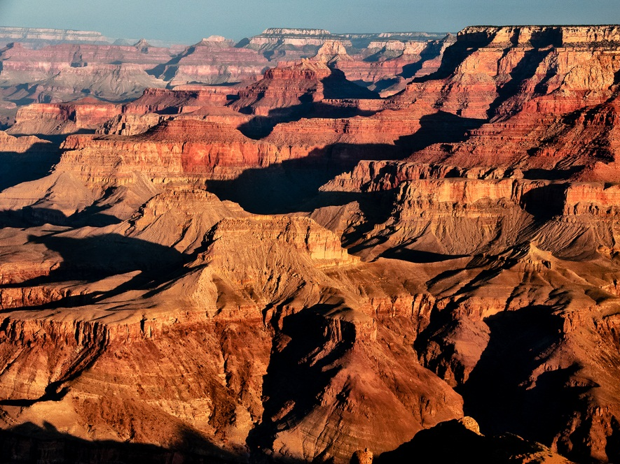
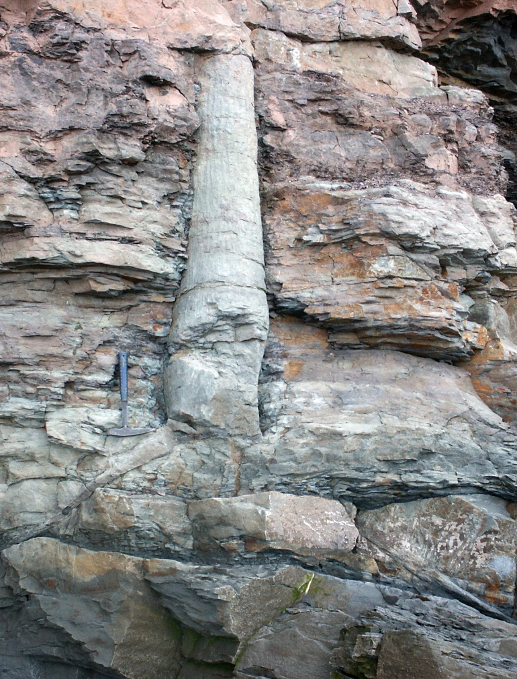
The Fossil Record
Evolutionists point to sedimentary-rock layers as strong evidence for vast amounts of geologic time
Embedded in sedimentary rocks are polystrate (“many layers”) fossils
Cut thru at least two layers
Organic material exposed to the elements will rot (not fossilize)
Fossilization would require quick preservation (with surrounding rock layers being rapidly deposited)

Slide 11
Facts of
A material effect requires an adequate cause
The adequate cause must come before the effect
Living things always (and only) come from living things
Living things produce only more living things like themselves
No transitional fossils of half-and-half organisms exist
Facts are stubborn, impartial things that refuse to budge
All the facts (i.e., evidence) stand behind Creation!

Slide 12
or
Creation
Evolution
“In the beginning God created….”
- Only possible, honest, reasonable explanation
“In the beginning was matter…”
- Scientifically untenable

