Slide 2
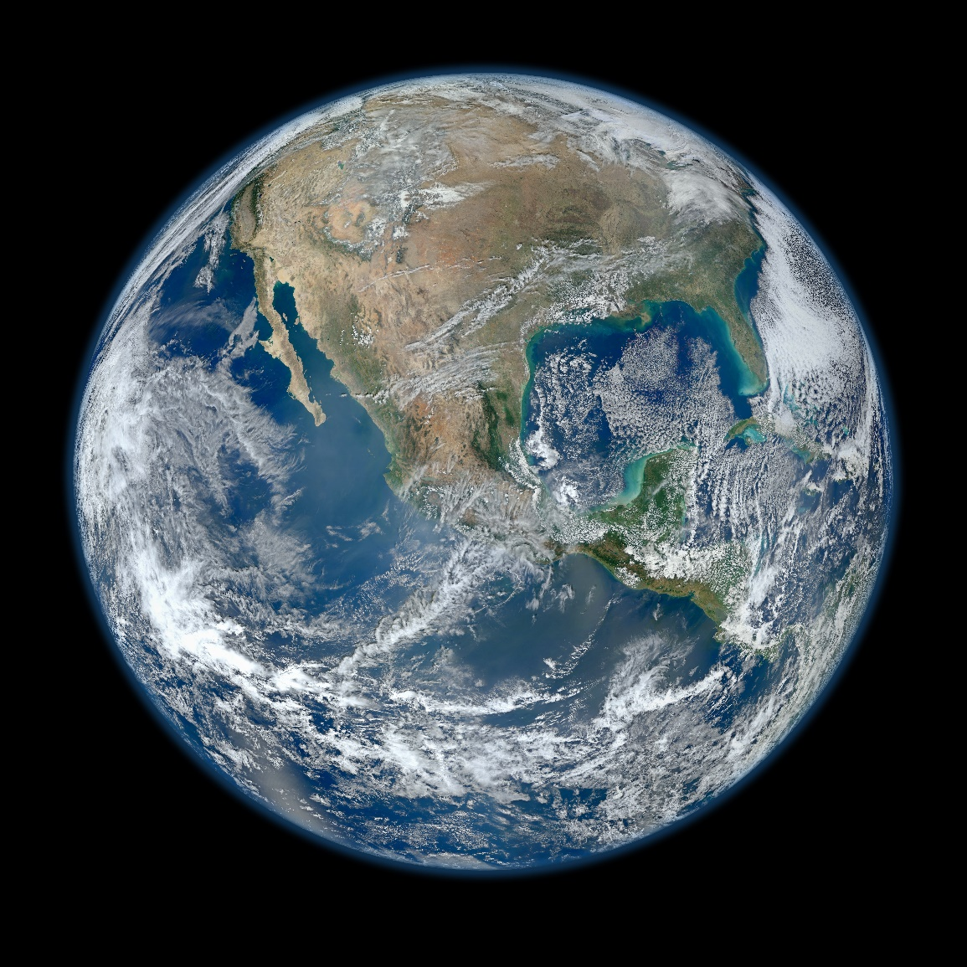
Does the Earth evince design?
If the Earth evinces purposeful design, there must have been a designer.
The Earth does evince purposeful design.
Therefore, the Earth must have had a designer.
Is it more reasonable to believe the design of the earth was PLANNED or that it happened JUST BY ACCIDENT?

Slide 3
The Location of the Earth
93 million miles from the Sun
A 12,000,000°F heat source with an interior temperature of more than 20 million degrees Celsius
Like a giant nuclear engine—giving off more energy in a single second (8 million tons) than mankind has produced since the Creation
The EXACT distance to receive the proper amount of heat and radiation to sustain life as we know it.
The location of the Earth is JUST RIGHT!

Slide 4
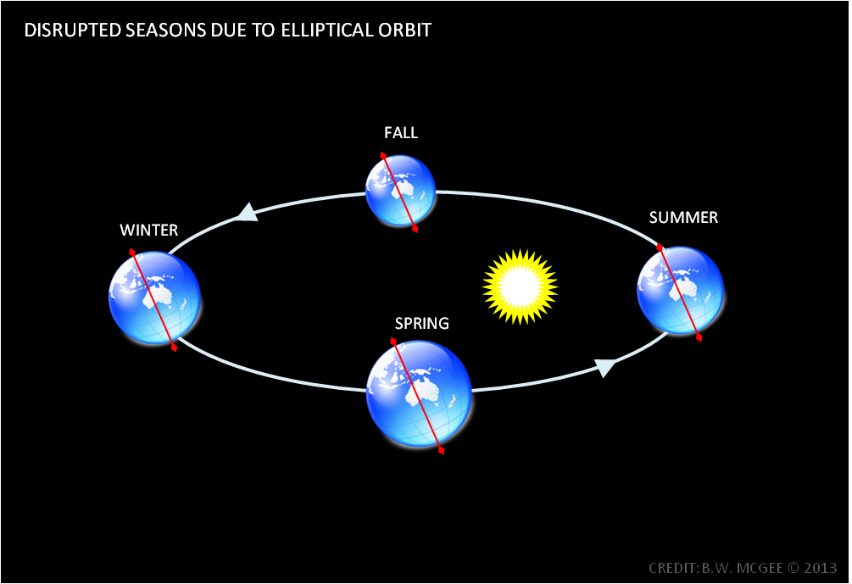
The Orbit of the Earth
Elliptical—not perfect circle
Sometimes closer to Sun
Sometimes farther from Sun
Orbit not at a constant rate
When closer, moves faster
When farther away, moves slower
Departs from a straight line by only one-ninth of an inch every eighteen miles
The EXACT orbit to keep a proper and safe distance and allow for our seasons.
The orbit of the Earth is JUST RIGHT!

Slide 5
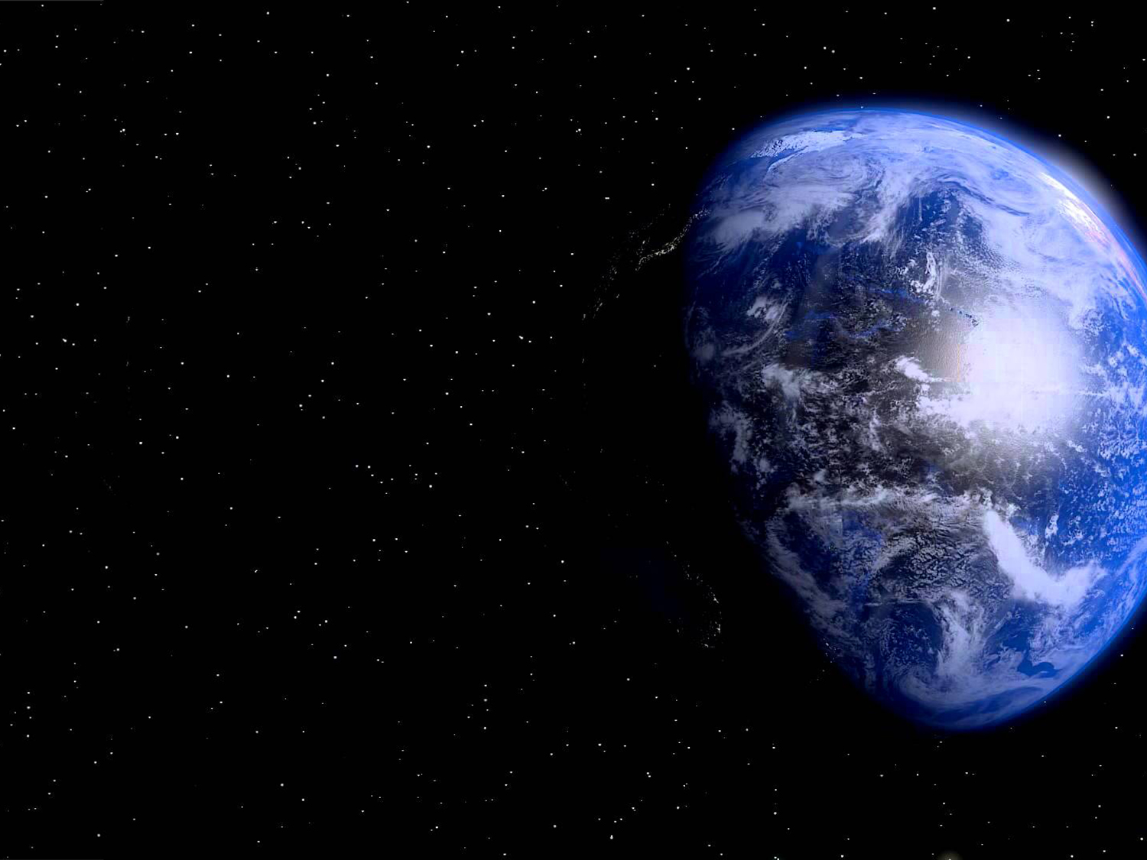
The Rotation of the Earth
Rotates at ~1,000 mph at equator
While Earth orbits at 67,000 mph around Sun
While solar system travels at 600,000 mph
Provides periods of light & darkness necessary for sustaining life
If faster—fierce cyclones would be stirred up over the Earth & be difficult to grow crops
If slower—days and nights would be impossibly hot or cold
The EXACT rotation speed to maintain proper balance of temperatures & seasons
The rotation of the Earth is JUST RIGHT!

Slide 6
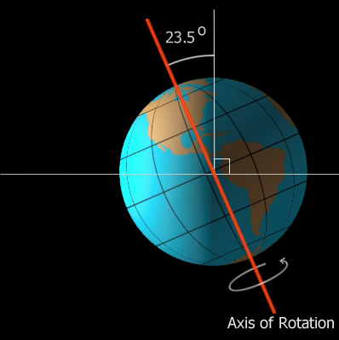
The Tilt of the Earth
Tilted on its axis at exactly 23.5 degrees
If it were straight up:
Water would accumulate at the poles, leaving vast deserts in between.
There would be no seasons.
If it were tilted 90 degrees:
The Earth would alternate between very cold winters and very hot summers
The EXACT tilt to sustain moderate water levels, seasons & temperatures.
The tilt of the Earth is JUST RIGHT!

Slide 7
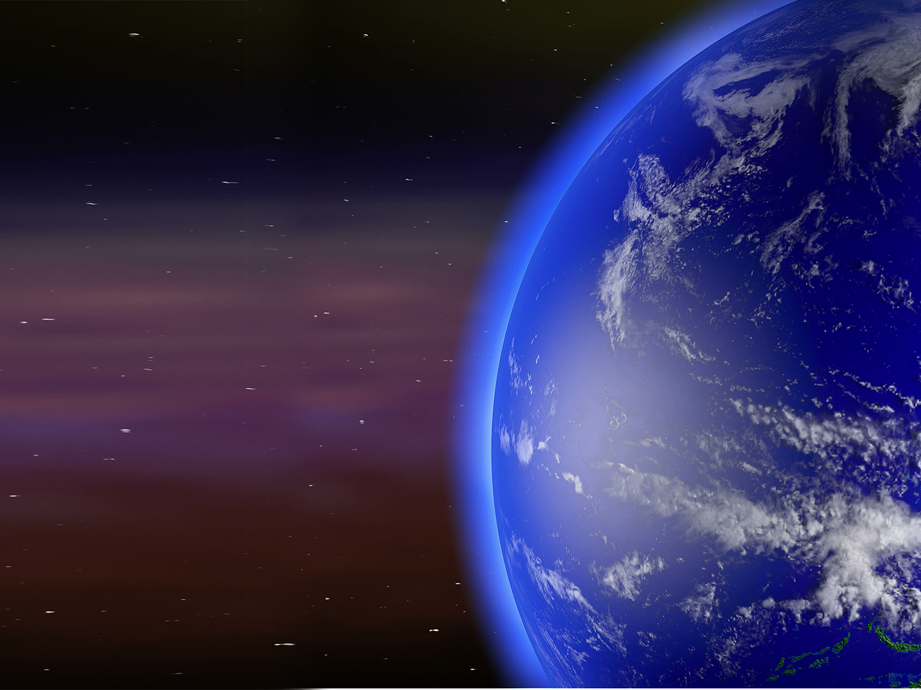
The Waters of the Earth
Water covers 72% of Earth’s surface
Provides a reservoir of moisture constantly evaporating & condensing and falling as rain
Holds its temperature longer, providing a natural heating/AC system for land areas
Human dependence on plant life
Plants give off oxygen which we need
90% of our oxygen from plants in the seas
The EXACT water coverage for providing us with ideal moisture, temperature & oxygen
The waters of the Earth are JUST RIGHT!

Slide 8
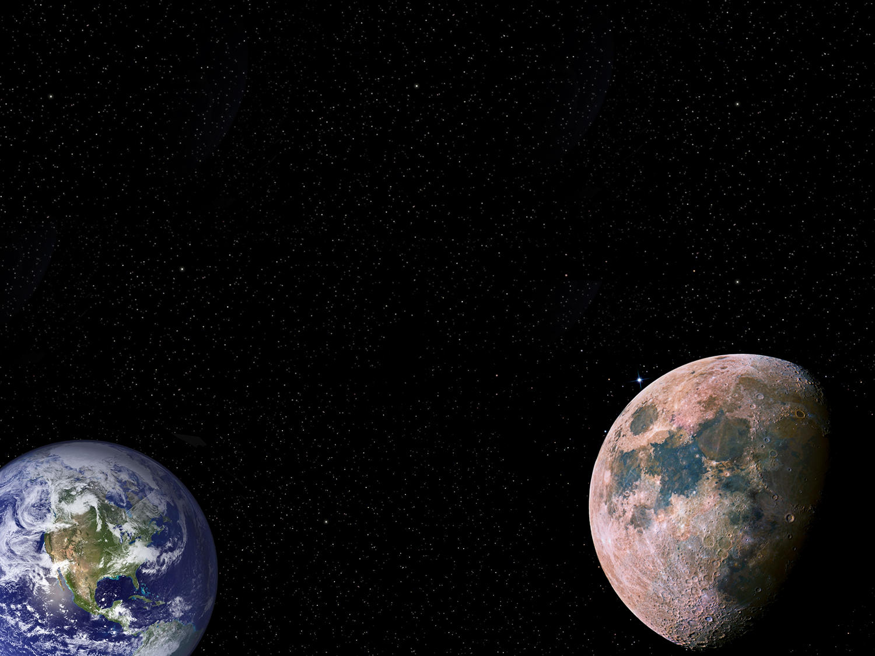
Relation of the Earth to the Moon
The Moon is 240,000 miles from the Earth
The Moon helps control the oceans/tides
Tides provide cleansing of shorelines & help ocean life to prosper
Without tides, the oceans would stagnate and the animals and plants living in the oceans and seas would soon perish
If moved closer by just a fifth, twice a day the tides would reach 35-50 feet high
The EXACT relation of moon to earth to maintain tide levels & ocean life
The relation of moon to Earth is JUST RIGHT!

Slide 9
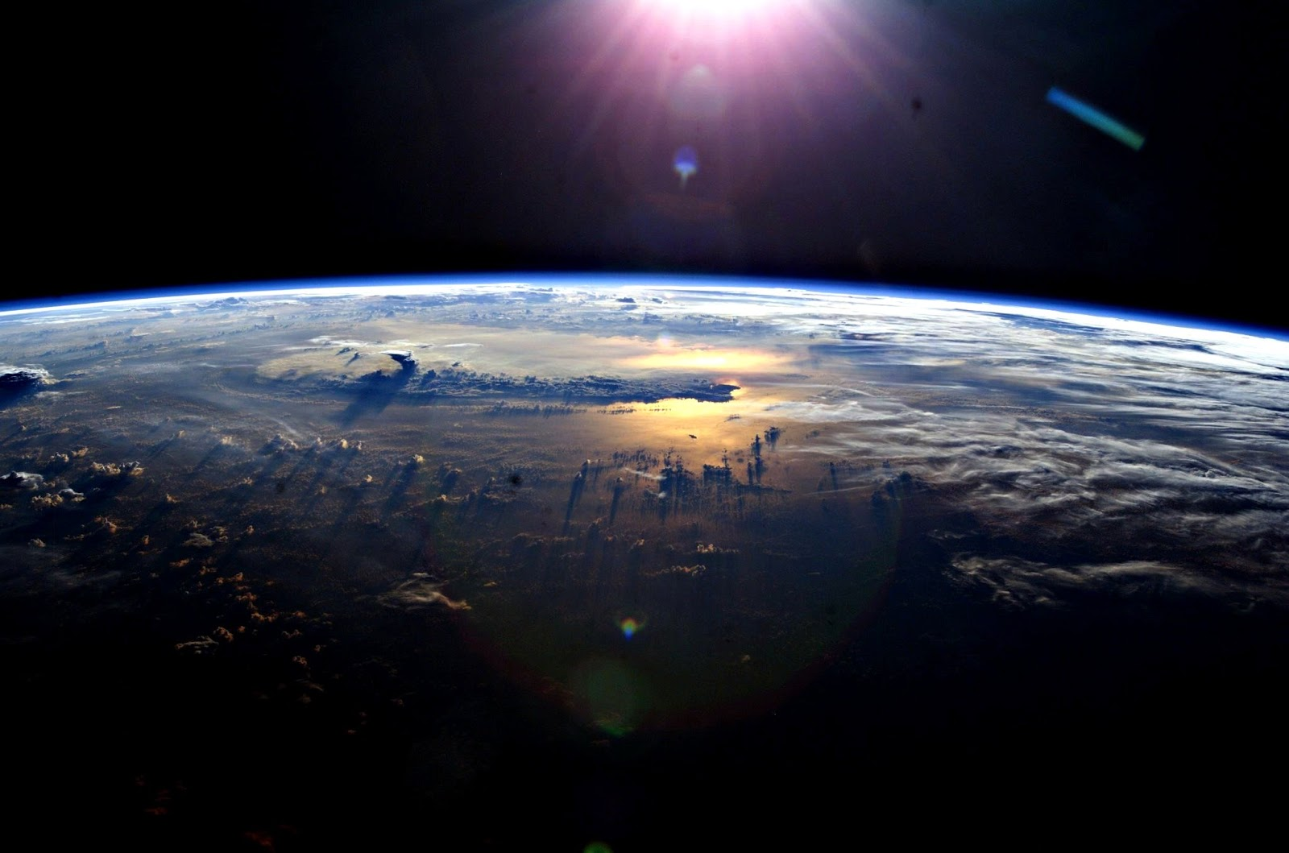
The Atmosphere of the Earth
Contains proper balance of gases essential to life
Scatters light & captures solar heat
Protects the Earth & its inhabitants
From meteors falling from space
From dangerous levels of ultraviolet rays
From protons & electrons from the Sun
Exerts a pressure of ~15 lbs/sq inch (~15-20 tons on the entire human body)
The EXACT atmospheric contents, protection & pressure essential to sustain life
The atmosphere of the Earth is JUST RIGHT!

Slide 10
Does the Earth evince design?
Exactly the right distance from the Sun
Exactly the right orbit around the Sun
Exactly the right rotation on its axis
Exactly the right tilt on its axis
Exactly the right amount of water coverage
Exactly the right distance from the Moon
Exactly the right atmospheric contents
Exactly the right atmospheric pressure
Is it more reasonable to believe the design of the earth was PLANNED or that it happened JUST BY ACCIDENT?

Slide 11
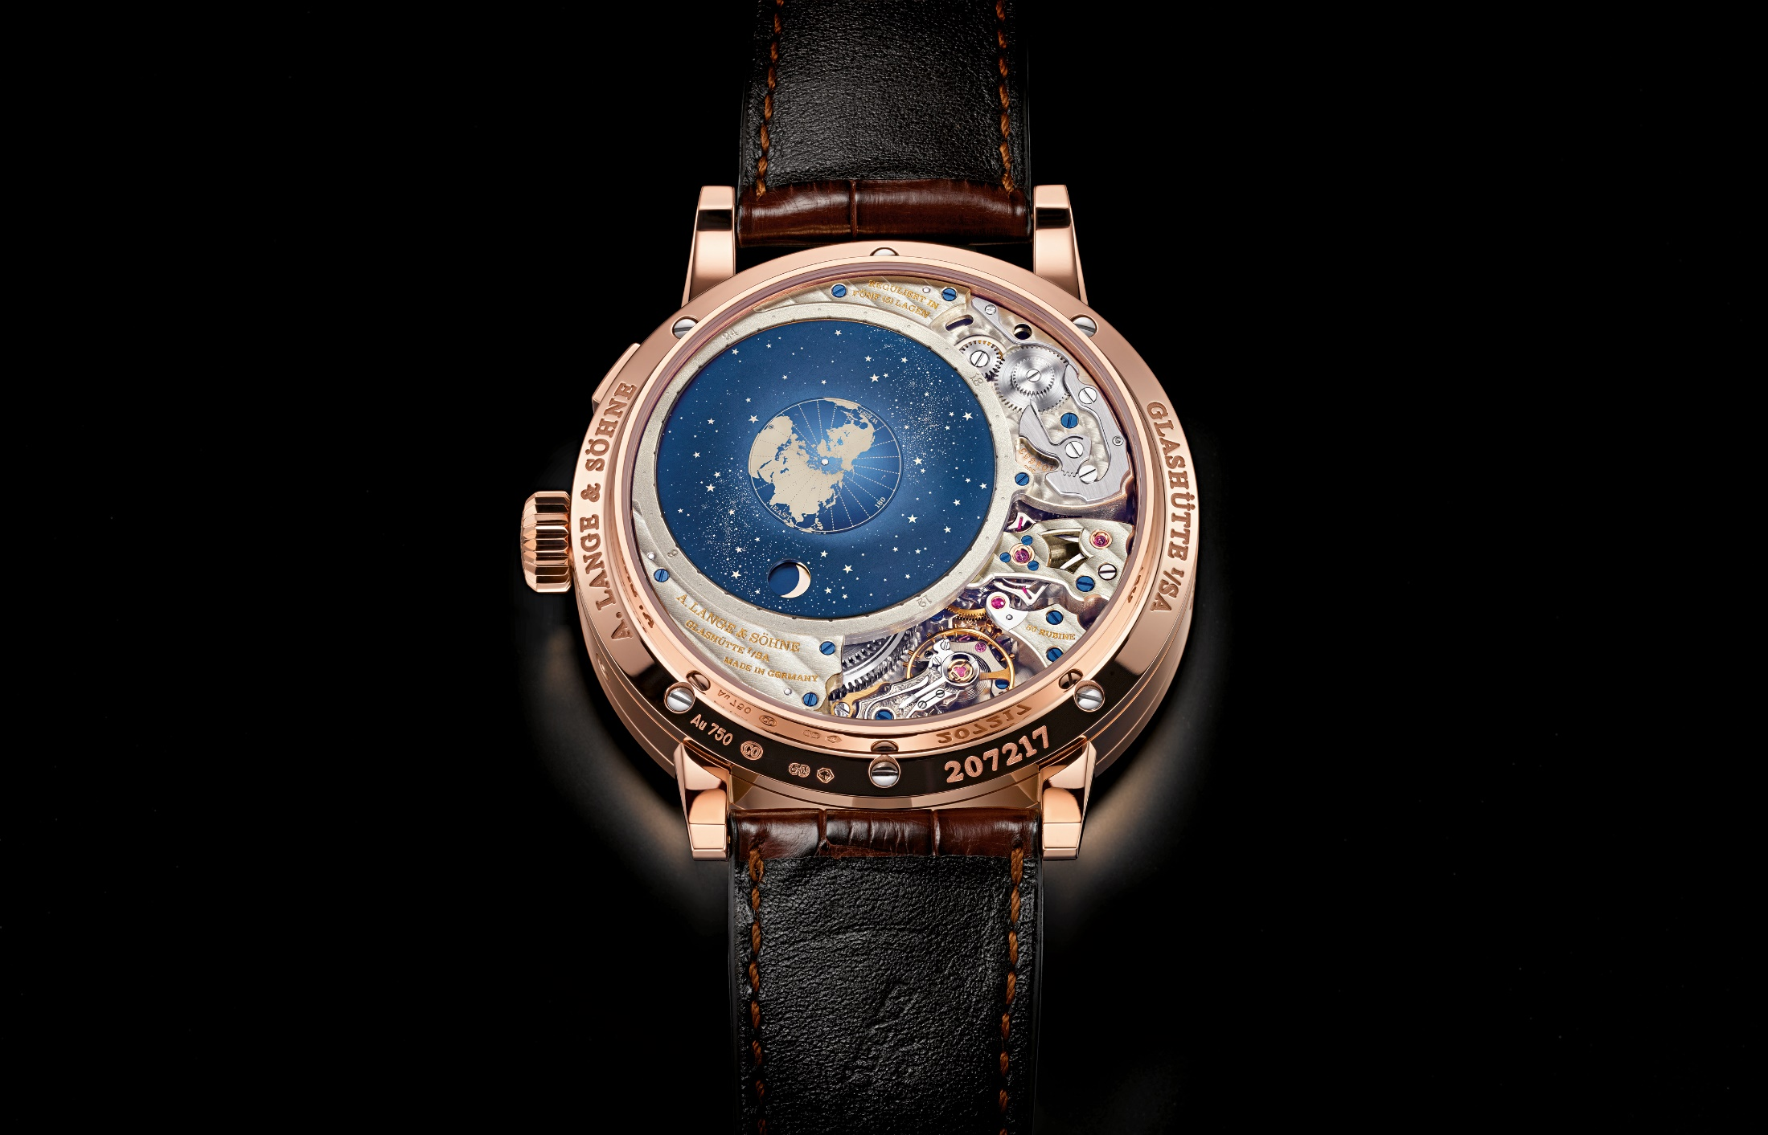
Design? or Accident?

Slide 12
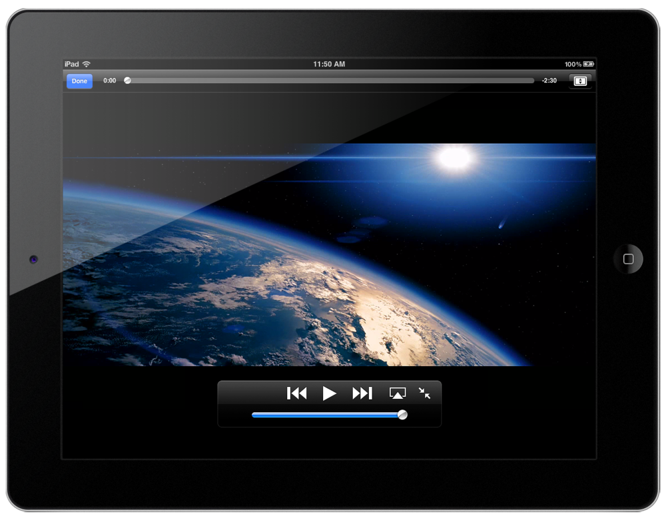
Design? or Accident?

Slide 13
Design? or Accident?

Slide 14
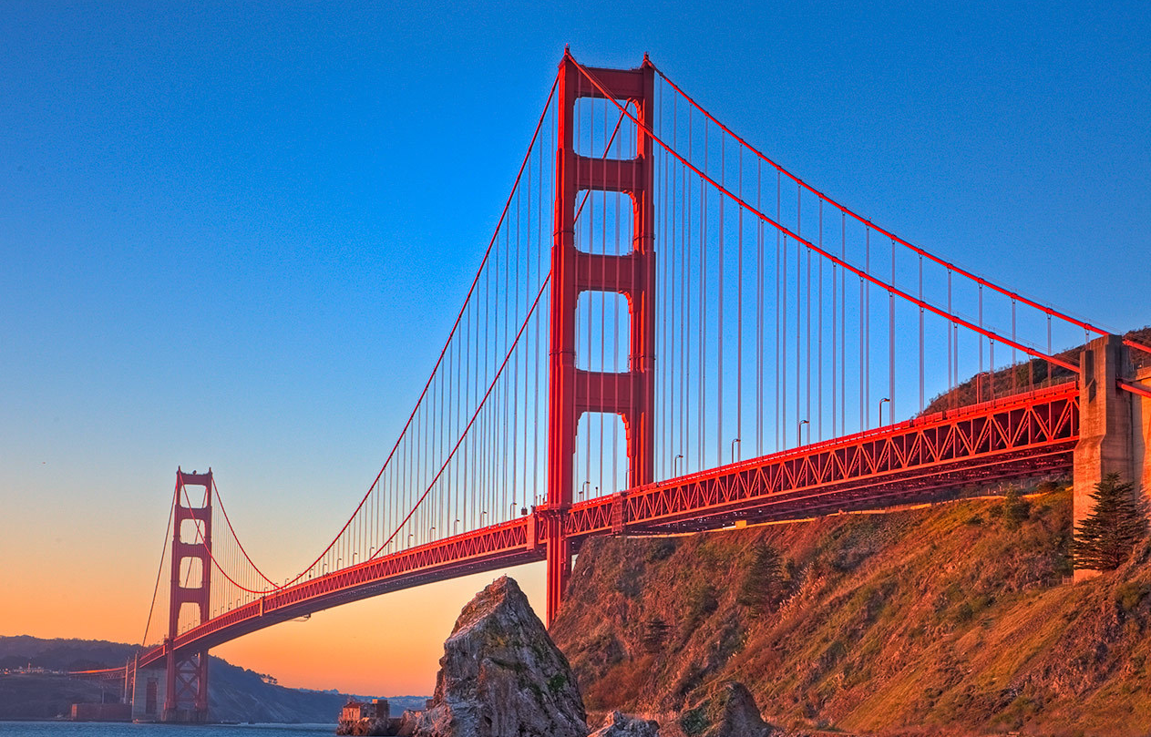
Design? or Accident?

Slide 15
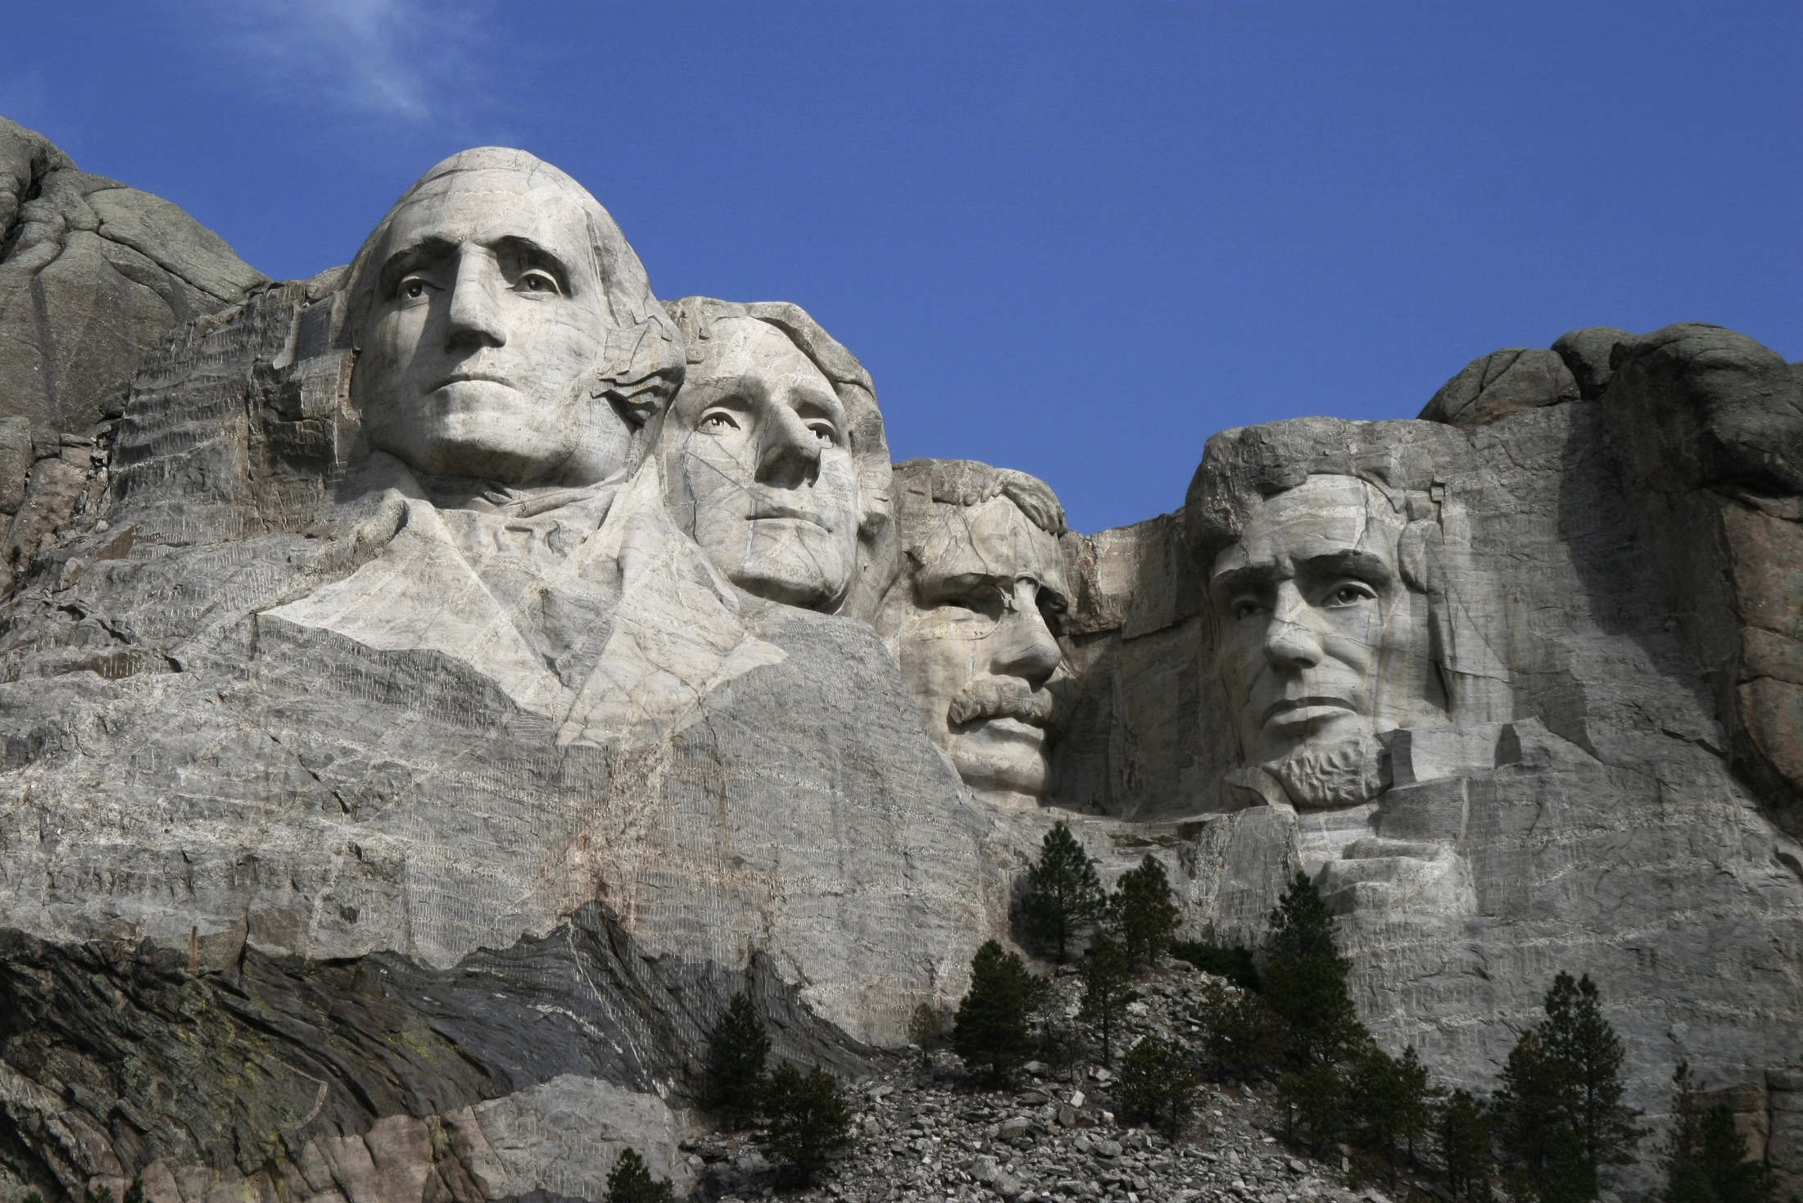
Design? or Accident?

Slide 16
ABCDEFGHIJKLMNOPQRSTUVWXYZ
If the letters of the alphabet were tossed into the air by chance force, they might fall in the present order of ABC’s once in more than five hundred million, million, million, million (1 in 503,291,461,116,595,535,584, 000,000) times that they were thus tossed up and allowed to come down without guidance.
If there is that much chance of the ABC’s falling into their present order, how much possibility is there that the countless combinations in nature and this world would have come together in the wonderful, perfect, precise order that they have if they were tossed about by blind chance?
Design? or Accident?

Slide 17
“The heavens declare the glory of God; And the firmament shows His handiwork.” (Psa. 19:1)
“For every house is built by someone, but He who built all things is God.” (Heb. 3:4)
“For since the creation of the world His invisible attributes are clearly seen, being understood by the things that are made, even His eternal power and Godhead, so that they are without excuse.” (Rom. 1:20)

