Slide 1
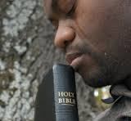
Selected Psalms Lesson 6 Practical Lessons From Psalm 73
From Doubt to Assurance

Slide 2
Asaph’s Inner Conflict is the Same One You and I Face Now Days
It was caused by an outward contradiction

Slide 3
The ungodly are prosperous (Psalm 73:3-5).
³For I was envious of the boastful, When I saw the prosperity of the wicked.
⁴For there are no pangs in their death, But their strength is firm.
⁵They are not in trouble as other men, Nor are they plagued like other men.

Slide 4
The ungodly are prideful

Slide 5
The ungodly are Profane

Slide 6
The ungodly are Popular

Slide 7
Asaph’s Resolution Can Help Us See Life From God’s Perspective
Asaph Resolved to:

Slide 8
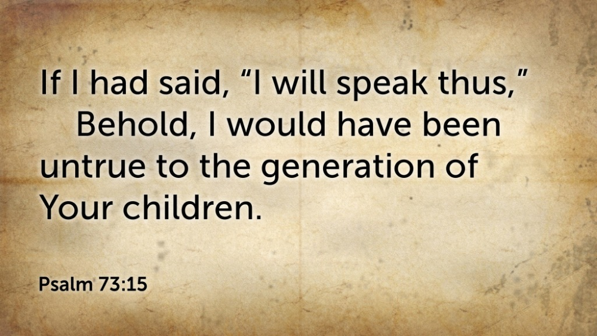
Resist the urge to voice doubts

Slide 9
Return to the Presence of God

Slide 10
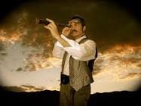
Review the Rest of the Story
See the Big Picture!

Slide 11
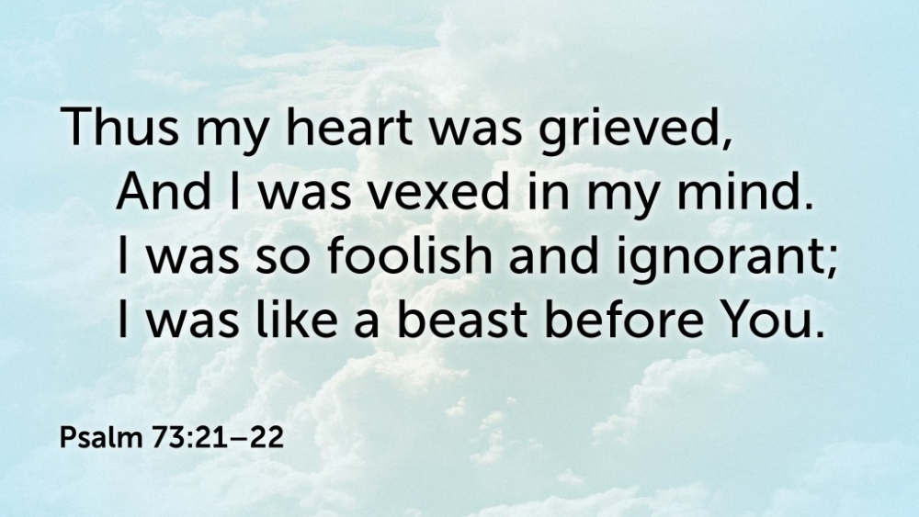
Reevaluate Your Own Life

Slide 12
Reassure your heart of God’s love and goodness

Slide 13
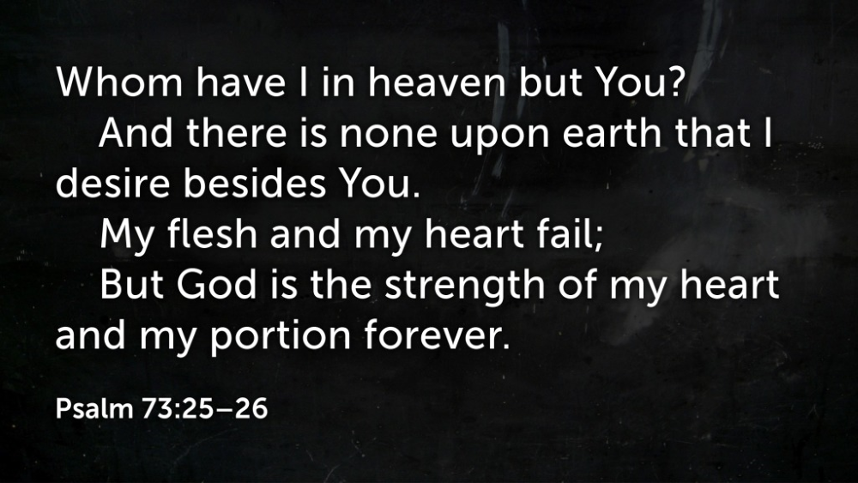
Reestablish your faith in God

Slide 14
Resolve to stay near God (cf. James 4:8)

Slide 15
Conclusion
Learn to Count Your Blessings!

