Slide 1
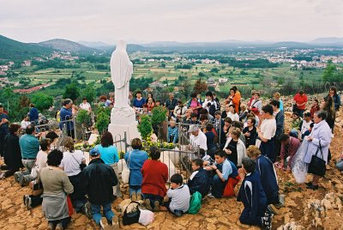
Selected Psalms Lesson 5 Idolatry: The Greatest Deception of All Time Psalm 115:1-8

Slide 2
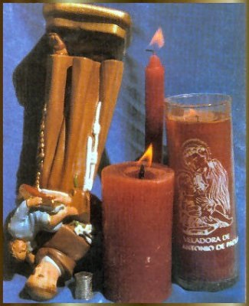
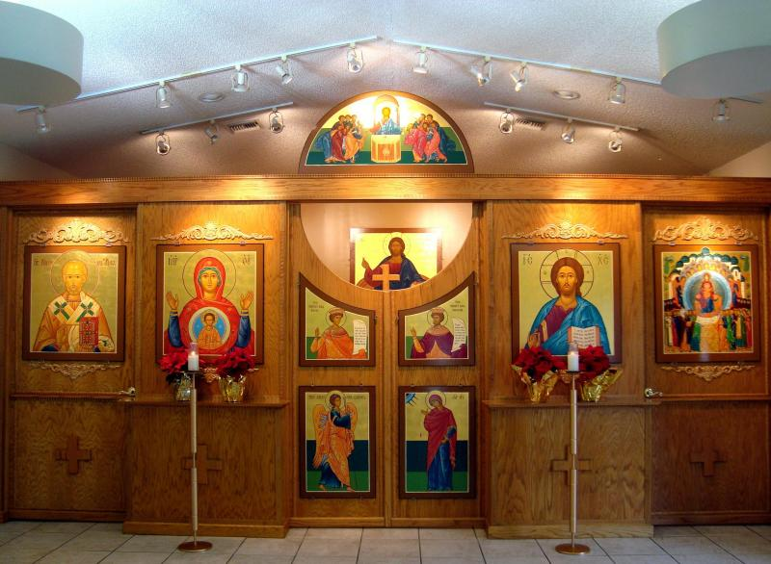
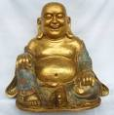
Worshipping Images

Slide 3
Why is it a sin to worship images?
God forbids it (Ex. 20:1-6).
Images cannot do anything for us (Psalm 115:1-8).
Images cannot do anything on their own; they need men (Jer. 10:1-5).
Man is the creator of images (Jer. 10:8-10).
We should worship God and God alone (Matt. 4:10).
They take the first place God should have in our lives (Matt. 6:33).
It’s stupid, foolish, worthless doctrine, lie, futile, work of errors, useless, non-profitable, deception and vanity (Jer. 10:8, 14-15; Isa. 44:9-20).

Slide 4
What are the consequences of worshipping images?
You will be put to shame (Isa. 44:9-10).
You will remain an ignorant (Isa. 44:18-19).
You will live in deception (Isa. 44:20).
You will be condemned (Ex. 20:5; cf. Rev. 14:9-11).

Slide 5
Worshipping Idols of the Heart (cf. Ezekiel 14:3).

Slide 6
What are some of the idols men have in their hearts?

Slide 7
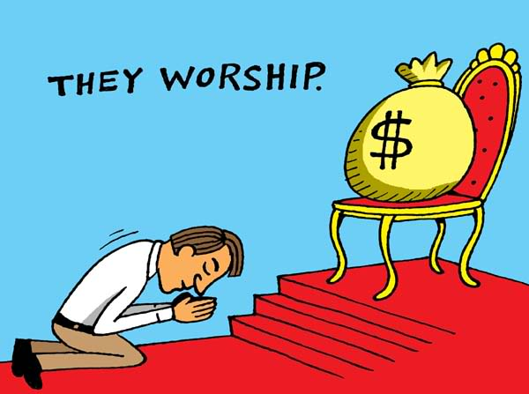
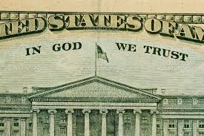
What are some of the idols men have in their hearts?
Money – “In God We Trust”
1 Tim. 6:10
Heb. 13:5
Gen. 1:1
Psalm 24:1

Slide 8
What are some of the idols men have in their hearts?
Sex, drugs and alcohol (1 Cor. 6:18, Gal. 5:20, Prov. 23:29-35; cf. 20:1; Ti. 2:11-12, 1 Pet. 2:11).

Slide 9
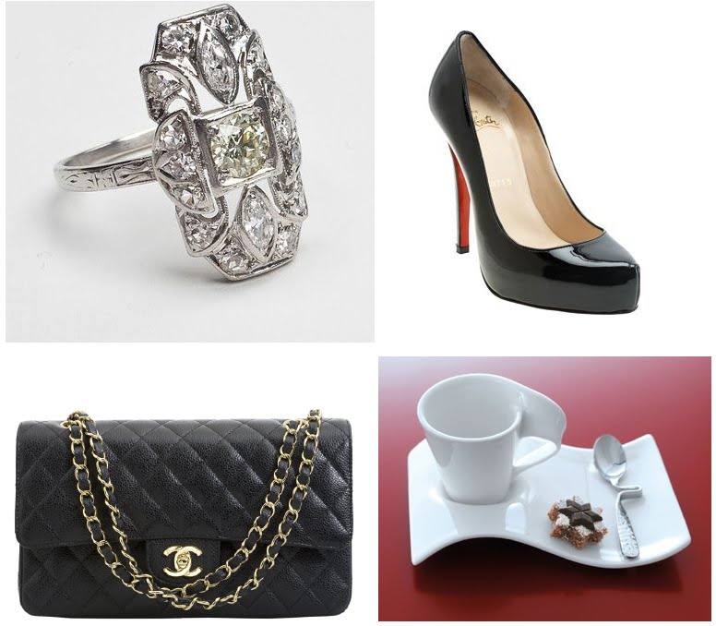
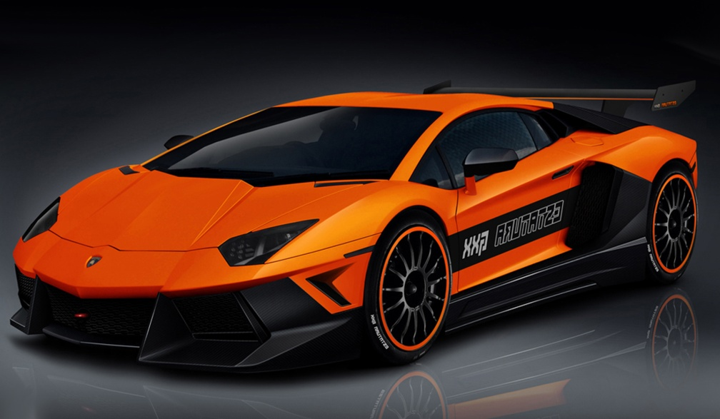
What are some of the idols men have in their hearts?
Material things (Matt. 6:19-21).

Slide 10
What are some of the idols men have in their hearts?
Religious leaders (Matt. 15:14)
José Luis de Jesús Miranda

Slide 11
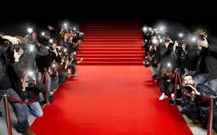
What are some of the idols men have in their hearts?
Celebrities
Remember 3 John 1:11.
The Red Carpet →

Slide 12
Only God is worthy of honor and praise!
Conclusion:

