Slide 1
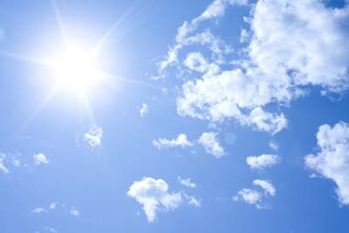
Heaven
Wednesday Night Bible Study
Palm Beach Lakes church of Christ

Slide 2
Lesson 12
Searching For Truth

Slide 3
What We Have Learned
- Heaven is a real place.
- It is possible for people to lose their salvation.
- Hell is a real place.
- Repentance is important.
- After we are baptized we are put on the road to heaven.

Slide 4
What We Have Learned
- Your good is not good enough.
- Your “good” might not be “good” to God.
- When we die our soul goes to Hades.
- Sometimes the best road is the hard road.

Slide 5
The Truth Will Set You Free
Truth follows a straight logical path. It needs little or no statements to support itself.

Slide 6
The Bible Game

Slide 7
1.
Who built a 90 foot statue and told everyone to worship it?
King Josiah
King Nebuchadnezzar
King Jeroboam
Bobbo Lupo

Slide 8
2.
Elijah duels the prophets of Baal at
_____________________.
Mt. Rushmore
Mt. Carmel
Gishon
Lake Park, Florida

Slide 9
3.
Who was Jezebel’s husband?
I don’t know, get me out of here
Ahab
Noah
Menezzar

Slide 10
4.
Who had to serve Laban for a total of 14
years to get a wife?
Lot
Adam Seal
Jacob
Joseph

Slide 11
5.
How many shekels did Abraham pay for the field of Machpelah?
300
100
1,000
400

Slide 12
6.
What was King David’s father’s name?
Joseph
Pottipher
Jesse
Saint Joe

Slide 13
7.
What is the shortest book in the Bible?
Esther
Amos
3 John
1 Thessalonians

Slide 14
8.
What is the longest chapter in the Bible?
Psalm 119
Psalm 51
Revelation 21
Leviticus 1

Slide 15
9.
What is the name of the Apostle Peter’s
wife?
We don’t know
Jasmine
Esther
Tabitha

Slide 16
10.
Jonah’s dad’s name was __________.
Amos
Ananaiah
Amittai
Belshazzar

Slide 17
11.
What was Jacob doing all night just before
God changed his name to Israel?
Running
Air boating
Hunting
Wrestling

Slide 18
12.
What did Ishmael become good at while
living in the desert?
Catching snakes
Archery
Glass blowing
Soccer

Slide 19
13.
Whose hair grew like feathers , and nails
like bird claws ?
Ahab
Pottipher
Nebuchadnezzar
Josiah

Slide 20
14.
Before John was an apostle he was a
___________________________.
Soldier
Medical doctor
Tax collector
Theologian

Slide 21
15.
How old was Adam when he died?
600 years old
200 years old
78 years old
930 years old

Slide 22
16.
Peter once worked in the _______________ industry.
Music
Idol
Fishing
Farming

Slide 23
17.
Who was the king of the Medes/Persians
when they took Babylon?
King Calif
King Darius
King Nero
King Brad Shelt

Slide 24
18
King David’s son __________________
brought bloodshed and grief.
Abadad
Medessa
Joseph
Absalom

Slide 25
19.
King David’s home town was ________.
Bethlehem
Jerusalem
Edom
Goshen

Slide 26
20.
Where did the Cedar trees come from that
were used in Solomon’s temple.
Syria
Russia
Lebanon
Egypt

