Slide 1
Heaven
Wednesday Night Bible Study
Palm Beach Lakes church of Christ

Slide 2
Lesson 11
Once Saved Always Saved and Heaven

Slide 3
What We Have Learned
-Learn to be content
-Materialism is bad
-Lay up treasures in heaven
-Being a good person is not enough
-A good person will go to heaven is the
most common belief in America.
-Repentance should be very big part of our life.

Slide 4
What We Have Learned
We have a starting point and
we have an ending point.

Slide 5
Is it possible to step off the road to heaven and lose your way?

Slide 6
Once saved always saved
Background of this teaching
Originated in the mid- 1500’s by John Calvin.
“Once persons are truly born of God or regenerated, nothing in heaven or earth shall be able to separate them from the love of God.”
Also associated with the teaching of “predestination.”

Slide 7
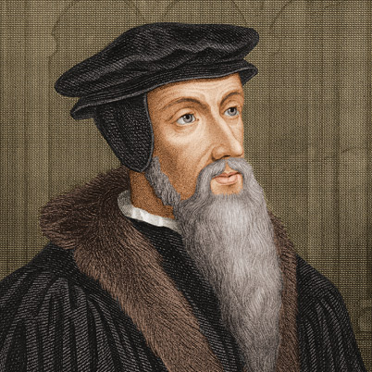
Background of John Calvin
Born July 10, 1509
Theologian, Journalist, Official
Executed 58 people
Did not believe in instrumental music

Slide 8
Is it Biblical?
Be careful what you teach and what you believe
2 Peter 2:1 False teachers are real
2 Peter 3:16 Twisting the scripture
1 Timothy 4: 1 Deceiving doctrines
Galatians 1:6-9 A different gospel

Slide 9
Is it Biblical?
Look at Genesis 3:1-4
Satan will tell us a bold face lie.
Now the serpent was more cunning than any beast of the field which the Lord God had made. And he said to the woman, “Has God indeed said, ‘You shall not eat of every tree of the garden’?”
And the woman said to the serpent, “We may eat the fruit of the trees of the garden; ³ but of the fruit of the tree which is in the midst of the garden, God has said, ‘You shall not eat it, nor shall you touch it, lest you die.’”
Then the serpent said to the woman, “You will not surely die.

Slide 10
Is it Biblical?
Looking at what others believe
Sam Morris, a Baptist preacher in Stamford, Texas wrote a little tract explaining that all the sins one may commit cannot harm the soul or cause the person to be lost. Look at the quote: “We take the position that a Christian's sins do not damn his soul. The way a Christian lives, what he says, his character, his conduct, or his attitude toward other people have nothing whatever to do with the salvation of his soul... All the prayers a man may pray, all the Bibles he may read, all the churches he may belong to, all the services he may attend, all the sermons he may practice, all the debts he may pay, all the or-dinances he may observe, all the laws he may keep, all the benevolent acts he may per-form will not make his soul one whit safer; and all the sins he may commit from idolatry to murder will not make his soul in any more danger... The way a man lives has nothing whatever to do with the salvation of his soul... The way I live has nothing whatsoever to do with the salvation of my soul" [Do a Christian’s Sins Damn His Soul?].

Slide 11
Is it Biblical?
Looking at what others believe
The Arminian/Wesleyan/Holiness tradition, and the Assemblies of God that grew out of it, have both historically rejected the belief in eternal security. The official AG Web site states, “The Assemblies of God has taken a stand against the teaching that God’s sovereign will completely overrides man’s free will to accept and serve Him. In view of this we believe it is possible for a person once saved to turn from God and be lost again.”
(Enrichment Journal- Assemblies of God)

Slide 12
Is it Biblical?
Looking at what others believe
During one Sunday School hour this topic came up and I want to give the class scriptural reference why the Church of Our Lord Jesus Christ does not subscribe to this creed. This doctrine can be damnable, by giving one a sense of false hope while living a sinful life. One must keep their vessel holy in order to make the rapture (I Thess. 4:7). Believers must continue in holiness and mortify the deeds of the flesh daily (Gal. 5:24). Believers can not practice sin (I Jo. 3:4-8); this is living the life of the old man and expect to be saved (Ro. 6:1-2). Believers are saved by faith through the grace of God and are to work out their own salvation.
( Apostolic Oneness Pentecostals)

Slide 13
Is it Biblical?
Looking at what others believe
“...we believe it is possible for a person once saved to turn from God and be lost again…”
(United Pentecostal Churches)

Slide 14
Is it Biblical?
Looking at what others believe
Conclusion
Some religious groups have
openly called “once saved always
saved” a false teaching.

Slide 15
Is it Biblical?
Looking at what others believe
The Westminster Confession of Faith, Chapter XIX, “ Of The Perseverance of the Saints,” claims: “They whom God hath accepted in his Beloved, effectually called and sanctified by his Spirit, can neither totally nor finally fall away from the state of grace; but shall certainly persevere therein to the end, and be eternally saved” [pgs. 102, 103].

Slide 16
Where did that come from?
John 10:28 Ephesians 1:3, 2:6
Ephesians 4:20 Romans 8:23
Colossians 3:1-3 1 Corinthians 3:10-15
1 Thess. 1:9,10, 5:8-10 1 Peter 1:1-5
1 John 1:7-9 Romans 8:38-39
John 10:28-30 Ephesians 2:8,9

Slide 17
Why is it wrong?
Taking a look at Old Testament scriptures
Exodus 32:30-35, 39:42-43
Numbers 9:15-23, 14:1-12
Deuteronomy 4:25-26
Deuteronomy 8:18-20

Slide 18
Why is it wrong?
-Those that have known the Lord, but
then forget Him, will perish.
-Perish- Hebrew word “abad”.
Utterly destroyed by divine judgment.
-The fate of an unfaithful Christian
is the same fate as someone that never
knew God.

Slide 19
Why is it wrong?
Biblical principle …
God is the same now as He
always has been.

Slide 20
Why is it wrong?
Taking a look at the New Testament
John 8:31, 32
-We can be His disciples.
-What is the flip side?
-We can “no longer” be His disciples.

Slide 21
Why is it wrong?
Taking a look at the New Testament
John 15:1-9
Abide means... to remain, sojourn, not to
depart, tarry, to continue to be present.
Romans 11:20-23
- Do not be conceited.

Slide 22
Why is it wrong?
Taking a look at the New Testament
1 Corinthians 9:27
Paul says that it is possible that he
could be disqualified.

Slide 23
Why is it wrong?
Taking a look at the New Testament
Philippians 2:12
Why would we have to work out our
salvation, if there was no risk of losing it?

Slide 24
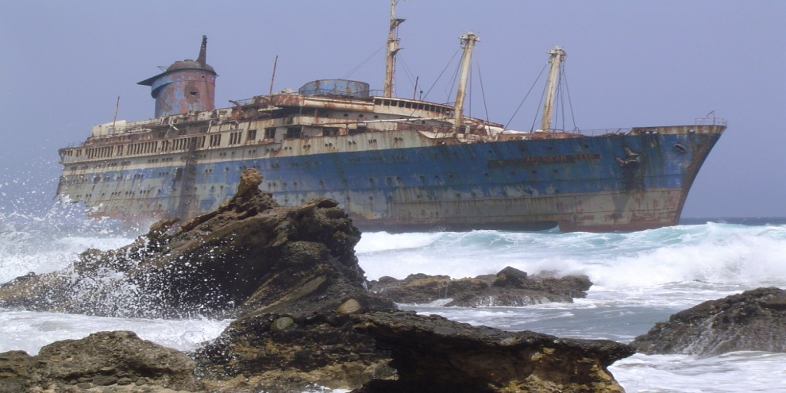
Why is it wrong?
Taking a look at the New Testament
1 Timothy 1: 18-20
Shipwrecked faith
Names were given as an example

Slide 25
Why is it wrong?
Taking a look at the New Testament
2 Peter 3:17
We can be taken away by error
Fall from our steadfastness

Slide 26
Those lists
Galatians 5:16-21
Adultery Hatred Heresies
Fornication Contentions Envy
Uncleanness Jealousies Murders
Lewdness Our bursts of wrath Drunkenness
Idolatry Selfish ambitions Revelries
Sorcery Dissentions

Slide 27
Those lists
1 Corinthians 6:9-10
Fornicators Drunkards
Idolaters Revilers
Adulterers Extortioners
Homosexuals
Sodomites
Thieves

Slide 28
What’s the connection?
What does this false doctrine have to
do with heaven?
- Someone could think they are
right with God, and yet be found
unfaithful, unrighteous, and not be
allowed into heaven.
Matthew 7:21

Slide 29
Looking At The End
1 Corinthians 9:24-27
Hebrews 12:1-4
The Christian life is not a sprint,
it’s an endurance race.

Slide 30
Awesome discussion questions and interesting remarks
Can someone be saved, and lose their salvation?
How is “once saved always saved”
a dangerous doctrine?

