Slide 1
Heaven
Wednesday Night Bible Study
Palm Beach Lakes church of Christ

Slide 2
Lesson 10
The Road To Heaven

Slide 3
What We Have Learned
Apathy is a destroyer
Materialism is bad
Lay up treasures in heaven
Being a good person is not enough
A good person will go to heaven in the
most common belief in America.
The kingdom of God is the church
There is only one kingdom, church

Slide 4
What We Have Learned
At Palm Beach Lakes

Slide 5
Revive My Longing to Go to Heaven
Going to S.E.W
Spiritual Enrichment Weekend
October 2014
Singing
Getting to know each other
Learning
Spiritual setting outside of the world

Slide 6
The Road To Heaven
We have a starting point and
we have an ending point.

Slide 7
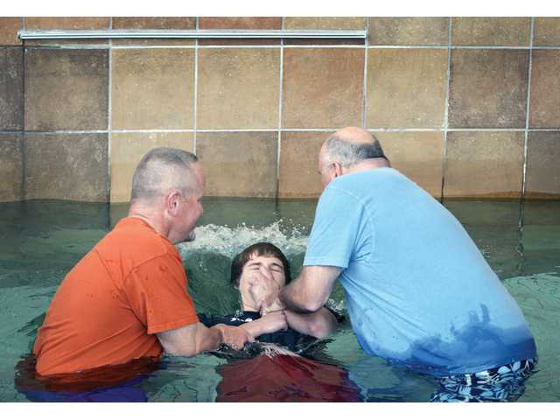
The Road To Heaven
When we are baptized we are a new creature and set on the road.
Romans 6: 1-4

Slide 8
The Road To Heaven
TWO roads diverged in a yellow wood, And sorry I could not travel both And be one traveler, long I stood And looked down one as far as I could To where it bent in the undergrowth; 5 Then took the other, as just as fair, And having perhaps the better claim, Because it was grassy and wanted wear; Though as for that the passing there Had worn them really about the same, 10 And both that morning equally lay In leaves no step had trodden black. Oh, I kept the first for another day! Yet knowing how way leads on to way, I doubted if I should ever come back. 15 I shall be telling this with a sigh Somewhere ages and ages hence: Two roads diverged in a wood, and I—I took the one less traveled by, And that has made all the difference.
(The Road Not Taken by Robert Frost)

Slide 9
The Two Roads
Satan has a road, and God has road
The devil has a road Matt. 7:13
God has a road Matt. 7:14, John 14:6
The devil’s road leads to
a lake. Rev. 20:10-15
God’s road leads to a river. Rev.22:1-2

Slide 10
The Two Roads
“ The safest road to hell is the gradual one- the gentle slope, soft underfoot, without sudden turnings, without milestones, without signposts”
C.S. Lewis

Slide 11
The Two Roads
God’s road might seem more difficult
Matthew 7:13, Psalm 15:1
But leads to a most wonderful
destination.

Slide 12
The Road to Heaven
Heaven is a place John 14:2
We should be able to find
directions to it.
God is not the author of confusion
1 Corinthians 14:33
The directions should not be too hard

Slide 13
The Road to Heaven
The first step is to go to the
“Stop Sign” and repent.
John 8:24
Luke 13:5
Acts 2:37
Acts 2:38 - First thing mentioned is
repentance.

Slide 14
The Road to Heaven
The first step is to go to the
“Stop Sign” and repent.
Repent is found 66 times in the
New Testament.
Repentance means to make a decision to
stop doing anything that displeases
God.

Slide 15
The Road to Heaven
The first step is to go to the
“Stop Sign” and repent.
It is not just being sorry for
sin’s consequences, but being sorry
the sin displeased and dishonored God.
2 Corinthians 7:10

Slide 16
The Road to Heaven
The first step is to go to the
“Stop Sign” and repent.
The rich young ruler went away
sorrowful, but he did not repent.
Matthew 19: 16-22

Slide 17
The Road to Heaven
King David understood
repentance.
Psalm 51
“Create in me a clean heart”

Slide 18
The Road to Heaven
The first step is to go to the
“Stop Sign” and repent.
Obedience to the point of
repentance leads to..
Acts 3:19 - Times of refreshing
2 Timothy 2:26 – Freedom
Acts 2:38 - Remission of sins

Slide 19
The Road to Heaven
The apostles were to preach repentance
and remission of sins. Luke 24:47
God commands all men everywhere
to repent. Acts 17:30

Slide 20
Universal Principles
Sin is a universal problem Romans 3:23
Forgiveness is a universal opportunity
Matthew 11: 28-30
Christ is the universal answer John 14:6
Repentance is the universal command Acts 17:30
Obedience is the universal remedy
Hebrews 5: 8-9
“Come” is the universal invitation Rev. 22:17

Slide 21
Universal Principles
Stop Sin Immediately
Isaiah 1: 16-17 Proverbs 16:17
Proverbs 19:27 2 Timothy 2:19
Proverbs 23:4
Ephesians 1:16
Psalm 34:14
Proverbs 3:7

Slide 22
God’s Road Isaiah 35:8
God’s road is not a twisty, turning,
uneven dirt road. It is a highway.
A highway shall be there, and a road, And it shall be called the Highway of Holiness. The unclean shall not pass over it, But it shall be for others. Whoever walks the road, although a fool, Shall not go astray.

Slide 23
The Path from Earth to Heaven Is Straight
Proverbs 4:27
Deuteronomy 28:14
Joshua 1:7

Slide 24
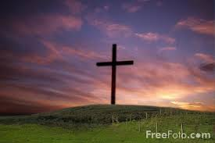
Look for the Cross
The single greatest “landmark” that we
can look for is the cross.
“For the message of the cross is foolishness
to those who are perishing, but to us who
are being saved, it is the power of God.”
1 Corinthians 1:18

Slide 25
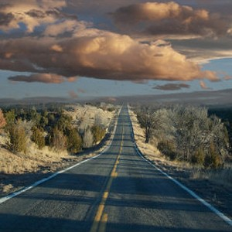
The Journey Can Be Long
Revelation 2:10
Romans 2:7
Hebrews 3:6
2 Timothy 4:6-8

Slide 26
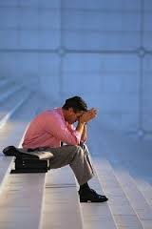
Getting Lost
It is possible to step off the road to
heaven, and lose your way.
2 Peter 2: 20,21

Slide 27
Looking at the End
1 Corinthians 9:24-27
Hebrews 12:1-4
The Christian life is not a sprint,
it is an endurance race.

Slide 28
Awesome Discussion Questions and Interesting Remarks
What does it mean to repent?
Does God expect us to be perfect?
How can we keep our focus on the
cross of Jesus?
How has this lesson benefited you?
What is the connection between
Laborers Together With God and
heaven?

