Slide 1
Victory Over Trials
Wednesday Night Bible Class
Dan Fuller

Slide 2
Victory Over Trials
Lesson 12
Better Than Gold

Slide 3
Lesson 12 Better Than Gold
This Quarter
The nature of God.
The nature of Satan.
Spiritual warfare.
There will be storms in your life. Guaranteed.
Jesus is waiting for us in every storm.

Slide 4
Lesson 12 Better Than Gold
This Quarter
Storms go away.
Life goes in cycles.
8. Life has ups and downs. Don’t judge
your life on the downs.
9. Is God fair? God is just.
10. Job had an anchor. We need an anchor.

Slide 5
Lesson 12 Better Than Gold
This Quarter
Take Action
1. Watch what you look at. Psalm 119:37
2. Watch your mouth. Prov. 4:24
3. Watch your path. Prov. 4:26

Slide 6
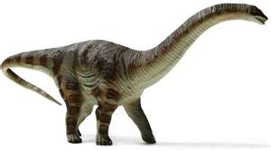
Lesson 12 Better Than Gold
This Quarter
We looked at Creation Science
The Behemoth & Leviathan Job 40 & 41

Slide 7
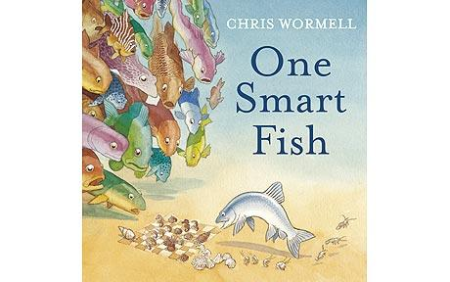
Lesson 12 Better Than Gold
Why is it important to
teach Creation Science?
Because Evolution is a lie that
cripples people’s faith. Especially
the faith of young people.

Slide 8
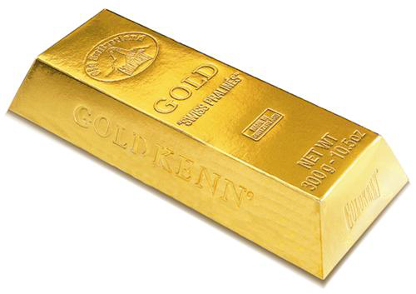
Lesson 12 Better Than Gold
How does God feel about our trials?
They are more precious than gold.
1 Peter 1:6-7

Slide 9
Lesson 12 Better Than Gold From Lesson 11
Adversity Is For Our Profit
God allows us to struggle. For our benefit.
Deuteronomy 32:11,12

Slide 10
Lesson 12 Better Than Gold From Lesson 11
Adversity Is For Our Profit
Wrong attitude: Receive adversity with
contempt and indignation railing against God.
Right attitude: Understand that trials
promote our spiritual growth.
Hebrews 12:5-10

Slide 11
Lesson 12 Better Than Gold From lesson 11
Rejoice In Our Persecutions
Matthew 5:11,12
Difficult? Yes. Paul did. 2 Corinthians 12:7-10

Slide 12
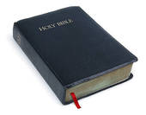
Lesson 12 Better Than Gold
For Your Tool Box
Don’t let circumstances dictate your
faithfulness.
“Be faithful until death”. Revelations 2:10

Slide 13
Lesson 12 Better Than Gold
For Your Tool Box
Paul said that he learned to be content.
“ Not that I speak in regard to need, for I
have learned in whatever state I am, to be
content.”
Philippians 4:11

Slide 14
Lesson 12 Better Than Gold
For Your Tool Box
The Principle of Sowing and Reaping
2 Corinthians 9:6 – sparingly, bountifully
Galatians 6:8 – corruption, eternal life
Galatians 6:7 – sowing , reaping

Slide 15
Lesson 12 Better Than Gold
For Your Tool Box
Galatians 5:22,23
Concentrate on the Fruit of the Spirit
Love Goodness
Joy Faithfulness
Peace Gentleness
Longsuffering Self-control
Kindness

Slide 16
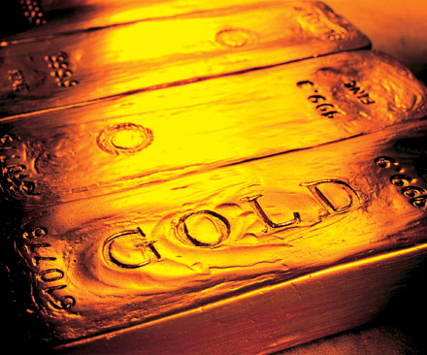
Lesson 12 Better Than Gold
Look at Job 23:10
“ But He knows the way that I take;
When He has tested me, I shall come
forth as gold”.

Slide 17
Lesson 12 Better Than Gold
Why do we make wrong choices?
Two major reasons.
1. Our own desires – 1 Timothy 5:11, James 1:13-15
2. Temptations of the devil.

Slide 18
Lesson 12 Better Than Gold
God Is Never Wrong
2 Samuel 22:31
“As for God, His way is perfect;
The word of the Lord is proven;
He is a shield to all who trust Him”.
** The king and his servant story.

Slide 19
Lesson 12 Better Than Gold
God Will Not Fail Us
Because God cannot lie.
Look at Hebrews 6:18

