Slide 1
Victory Over Trials
Wednesday Night Bible Class
Dan Fuller

Slide 2
Victory Over Trials
Lesson 11
Our Journey

Slide 3
Lesson 11 Our Journey

Slide 4
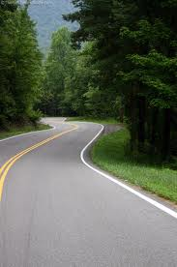
Lesson 11 Our Journey
Psalm 30:5
“For His anger is but for a moment, His
favor is for life;
Weeping may endure for a night,
But joy comes in the morning.”

Slide 5
Lesson 11 Our Journey
Tools to Equip Us
1. Keep a prayer list.
2. Keep a prayer journal.
“Please bless PBL and our May 23, 2012
Missionaries”

Slide 6
Lesson 11 Our Journey
Tools to Equip Us
Don’t play with the devil.
Build strong relationships with
faithful Christians.
Keep the kingdom of God first
in your life. Matt. 6:33

Slide 7
Lesson 11 Our Journey
Why are we here?
“Created in Christ Jesus
for good works”.
Ephesians 2:10

Slide 8
Lesson 11 Our Journey
From lesson 10
What course do we take?
Some problems can be avoided.
Others can be cured.
The rest can be endured.
All can be used for our profit.

Slide 9
Lesson 11 Our Journey From lesson 10
Sin, Suffering and Satan
In a basic sense, sin is the root of
all suffering.
God made all things good – Genesis 1:31
Anger and agonizing heartache should be
against Satan, not God.

Slide 10
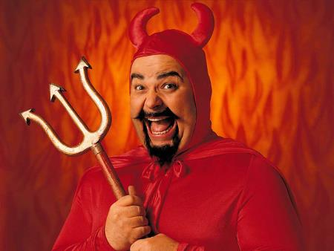
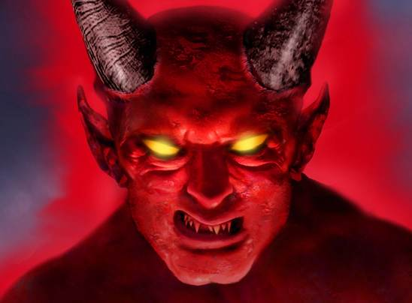
Lesson 11 Our Journey
What is your perception of Satan?
Don’t think of Satan as Hollywood
portrays him.

Slide 11
Lesson 11 Our Journey From lesson 10
The Chastening of the Lord
God’s love. Hebrews 12:6
Why? – For our profit.
How? – Direct like Abraham
Indirectly like Job & Paul.
2 Corinthians 12:7
What? – The most important question.

Slide 12
Lesson 11 Our Journey From lesson 10
God’s will
God’s will can be categorized into 2 parts.
God’s intentional will.
God’s permissive will.

Slide 13
Lesson 11 Our Journey
The Road Ahead
God’s word teaches us that tribulations are:
Certain
Uncertain
Painful
Temporary
Beneficial

Slide 14
Lesson 11 Our Journey
Adversity is Certain
Job 5:7, 14:1
Paul’s journey was one hard long fight.
Moses chose the hard road. Hebrews 11:25

Slide 15
Lesson 11 Our Journey
Adversity is Certain
1 Peter 2:20
1 Peter 3:14,17
Philippians 1:29
John 16:20-22
2 Timothy 3:12

Slide 16
Lesson 11 Our Journey
Adversity is Uncertain
James 4:14,15
Uncertain as to time
Uncertain as to kind
Uncertain as to length
“Run with patience” Hebrews 12:1

Slide 17
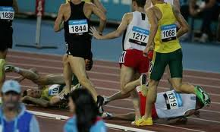
Lesson 11 Our Journey
Adversity is Painful
1 Peter 1:6
Hebrews 12:11
Matthew 26:37,38

Slide 18
Lesson 11 Our Journey
Adversity is Temporary
Christian vs. Humanist
What does a humanist have to offer
a suffering soul?
Romans 8:17,18 1 Peter 1:6

Slide 19
Lesson 11 Our Journey
Adversity is for Our Profit
Wrong attitude: Receive adversity with
contempt and indignation railing against God.
Right attitude: Understand that trials promote
our spiritual growth.
Hebrews 12:5-10

Slide 20
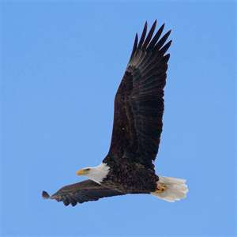
Lesson 11 Our Journey
Adversity is for Our Profit
God allows us to struggle. For our benefit.
Deuteronomy 32:11,12

Slide 21
Lesson 11 Our Journey
Rejoice in Your Persecutions
Matthew 5: 11,12
Difficult? Yes. Paul did. 2 Corinthians 12:7-10

