Slide 1
Victory Over Trials
Wednesday Night Bible Class
Dan Fuller

Slide 2
Victory Over Trials
Lesson 9
Storms Go Away

Slide 3

Lesson 9
Storms Go Away
We can have peace after the storm

Slide 4
Lesson 9
Storms Go Away
A little review
1. Everyone has trials.
2. God knows our trials.
3. We all have the same God.
4. We all have the ability to experience
victories in our lives.

Slide 5
Lesson 9
Storms Go Away
A little review
God knows what you are going through.
God will put a limit to what you are
going through.
3. God has a reason for what you are going through.

Slide 6
Lesson 9
Storms Go Away
A little review
1. We can walk with God.
2. We are created for good works.
3. The principle of sowing and reaping.
4. Our trials are more precious than gold.

Slide 7
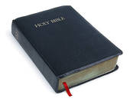
Lesson 9
Storms Go Away
From lesson 8
“No excuse verses”
Romans 1:20
Acts 17:22-30

Slide 8
Lesson 9
Storms Go Away
From lesson 8
The Bible fits nicely with science
Some scientists discredit evolution.
There is true science in the Bible.
Look at Job 38 & 39

Slide 9
Lesson 9
Storms Go Away
From lesson 8
God is superior
Superior power – 40:9
Superior insight – 40:11-14

Slide 10
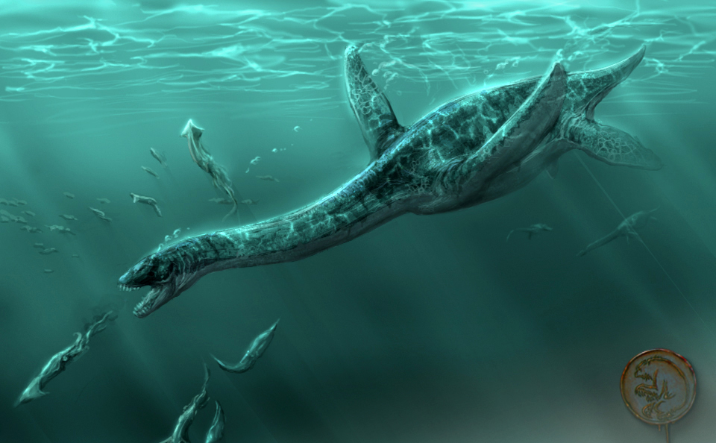
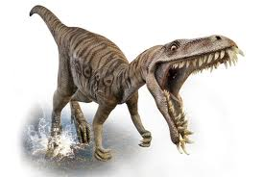
Lesson 9
Storms Go Away
From lesson 8
The Leviathan & Behemoth
Could man live with such beasts?

Slide 11
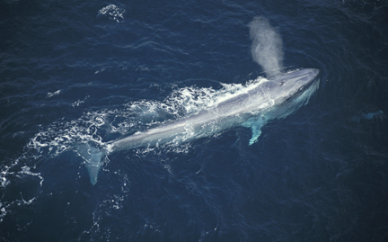
Lesson 9
Storms Go Away
From lesson 8
The Leviathan & Behemoth
Could man live with such beasts?
The mighty Blue Whale

Slide 12
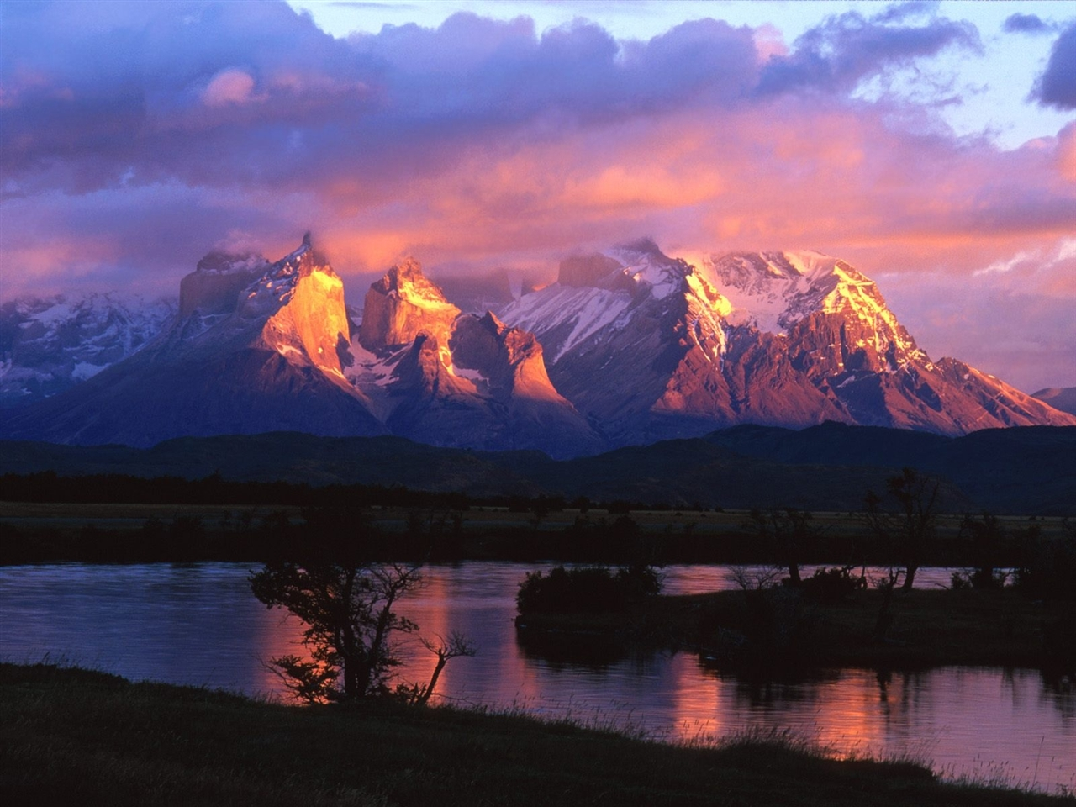
Lesson 9
Storms Go Away
Creation

Slide 13
Lesson 9
Storms Go Away
From Lesson 8
Job’s eyes were open
42:5-6
“ I have heard of You by the hearing of the ear,
But now my eye sees You. Therefore I abhor
myself, And repent in dust and ashes”

Slide 14

Lesson 9
Storms Go Away
After all the trauma in Job’s life, he
was able to say he had hope.
Look at 19:25,26
Job had an anchor. Hebrews 6:19

Slide 15
Lesson 9
Storms Go Away
The steadfastness of Job
“I will trust Him”. 13:15
“ I will hold fast my righteousness”. 27:6
“ I will come forth as gold”. 23:10

Slide 16
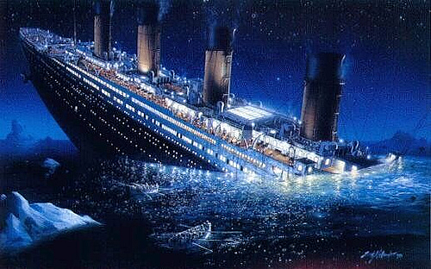
Lesson 9
Storms Go Away
What not to anchor your life on:
People
Possessions
Profession

Slide 17
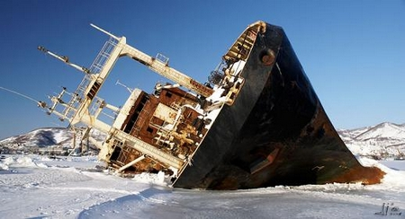
Lesson 9
Storms Go Away
A ship wrecked faith
Look at 1 Timothy 1:18-20
No one wakes up and says, “I think I will
ship wreck my faith today”.

Slide 18
Lesson 9
Storms Go Away
Complete Vindication
Job’s enemies & Job’s approval – 42:7,8
God accepts Job - 42:9
Job is blessed – 42:10-17

Slide 19
Lesson 9
Storms Go Away
Many misunderstand God and feel there
should be rewards of faith like earthly joy
and comfort this side of eternity.
But look at the life of Paul.
2 Timothy 4:6-8
2 Corinth. 11

Slide 20
Lesson 9
Storms Go Away
Life goes in cycles.
There are ups and downs.
Don’t judge your life on the downs.

Slide 21
Lesson 9
Storms Go Away
Victory
Victory is important for us.
Victory is important for those around us.

Slide 22
Lesson 9
Storms Go Away
Victory
Victory over sin. Acts 26:18
Victory over despair.
Numbers 13 & 14
2 Corinthians 4:16-18
1 Peter 5:7
Psalm 27:13

Slide 23
Lesson 9
Storms Go Away
Victory
Gratitude is powerful.
How much time do we spend in thanksgiving?
“The brook would lose its song if you
remove the rocks.”
Wisdom from a little boy.

