Slide 1
Victory Over Trials
Wednesday Night Bible Class
Dan Fuller

Slide 2
Victory Over Trials
Lesson 8
God’s Questions

Slide 3
Lesson 8 God’s Questions From lesson 7
Joseph is an example of someone
who might have a reason to be bitter.
Yet he was able to overcome that.
He saw God’s sovereign plan.
Genesis 50:20

Slide 4
Lesson 8 God’s Questions From lesson 7
There will be hardship
2 Timothy 2:3-6
Three different occupations
A soldier
An athlete
A farmer

Slide 5
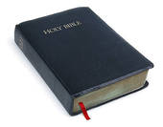
Lesson 8 God’s Questions From lesson 7
There is a time for everything.
Look at Ecclesiastes 3

Slide 6
Lesson 8 God’s Questions From lesson 7
Tools to Equip Ourselves
5 Habits of Successful Christians
1. Put a bridle on your tongue. (James 3)
2. Be honest, live with integrity.
3. Make a decision to do right.
4. Live each day conscious of God’s
providence.
5. Make Bible class and worship a priority.

Slide 7
Lesson 8 God’s Questions
The Bible & Science
1st Law of Thermodynamics
Matter/Energy is neither created nor
destroyed.
2nd Law of Thermodynamics
The quality of Matter/Energy gradually
diminishes over a period of time.

Slide 8
Lesson 8 God’s Questions
The Bible & Science
“Nine – tenths of the talk of evolutionists is
sheer nonsense, not founded on observation
and wholly unsupported by facts. This museum
is full of proofs of the utter falsity of their
views.”
- Dr. Etheridge, Paleontologist of the British Museum

Slide 9
Lesson 8 God’s Questions
The Bible & Science
“The fossil record with all its abrupt transitions
offers no support for gradual change”
- Dr. Stephen Jay Gould, Harvard University Paleontologist

Slide 10
Lesson 8 God’s Questions
Creation
Psalm 104:24
“O Lord, how manifold are all Your works!
In wisdom You have made them all.
The earth is full of Your possessions.”

Slide 11
Lesson 8 God’s Questions
Creation
Psalm 104:3
“Praise Him, sun and moon;
Praise Him, all you stars of light!”

Slide 12
Lesson 8 God’s Questions
Creation
Psalm 69:34
“Let heaven and earth praise Him,
The seas and everything that moves in
them.”

Slide 13
Lesson 8 God’s Questions
Creation
Psalm 19:1
“The heavens declare the glory of God;
And the firmament shows His
handiwork.”

Slide 14
Lesson 8 God’s Questions
Creation
Psalm 150:6
“Let everything that has breath praise
the Lord. Praise the Lord.”

Slide 15
Lesson 8 God’s Questions
Creation

Slide 16
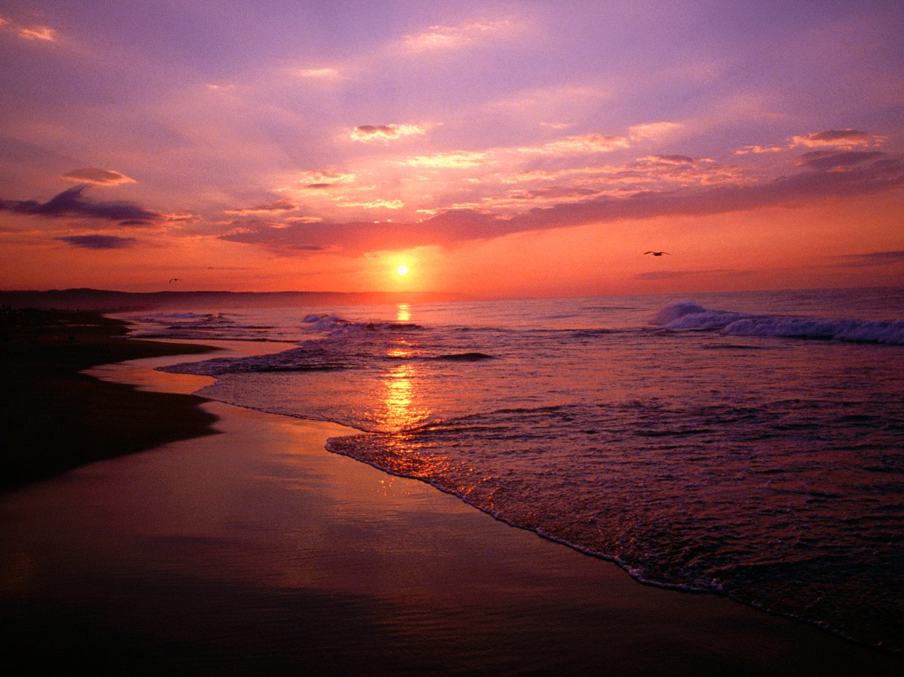
Lesson 8 God’s Questions
Creation

Slide 17
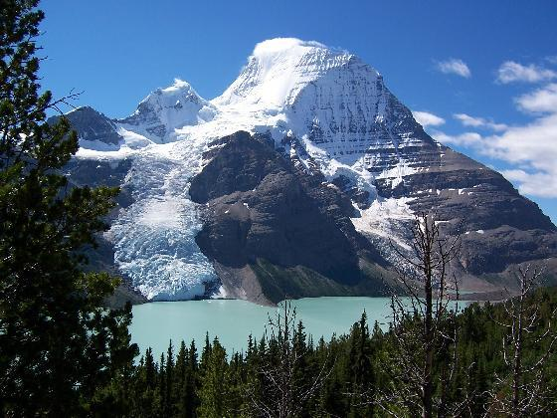
Lesson 8 God’s Questions
Creation

Slide 18
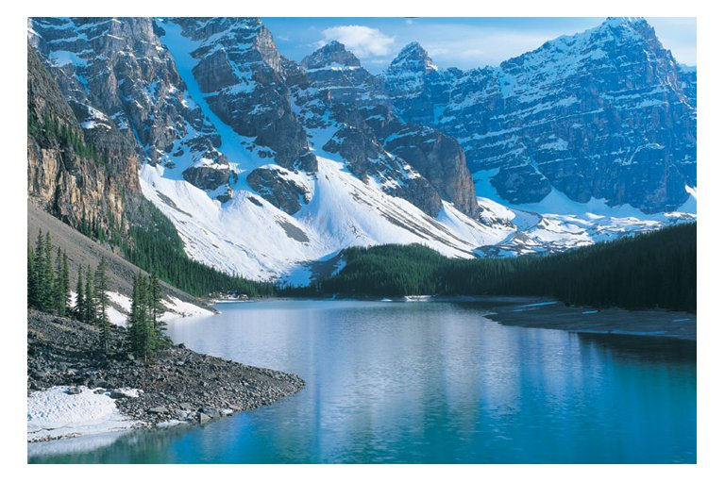
Lesson 8 God’s Questions
Creation

Slide 19
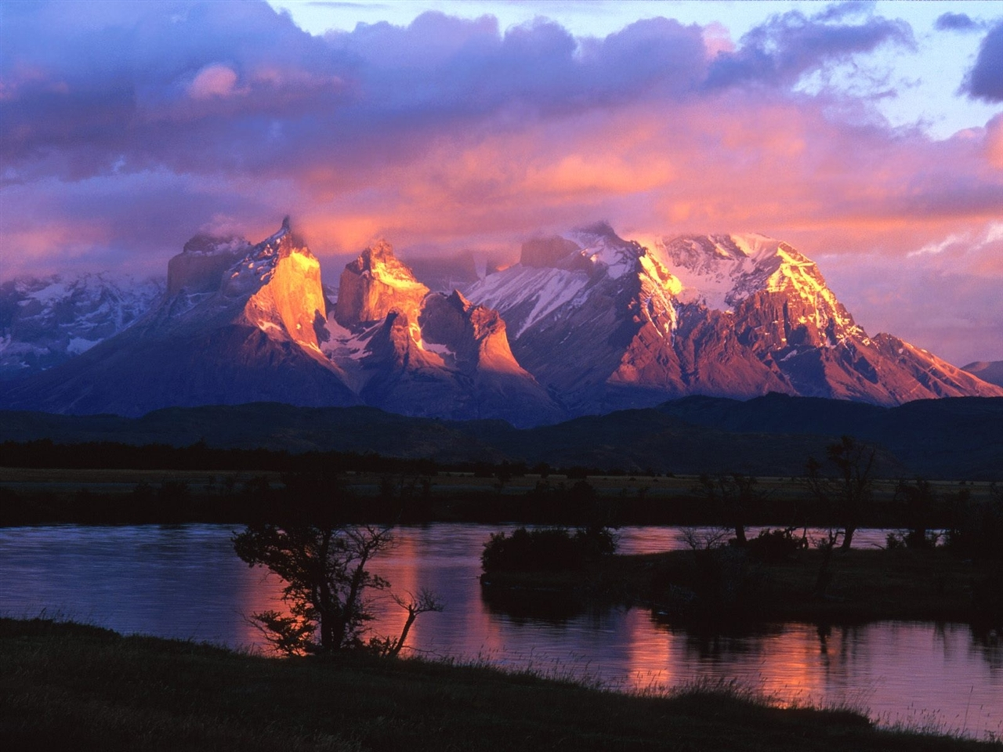
Lesson 8 God’s Questions
Creation

Slide 20
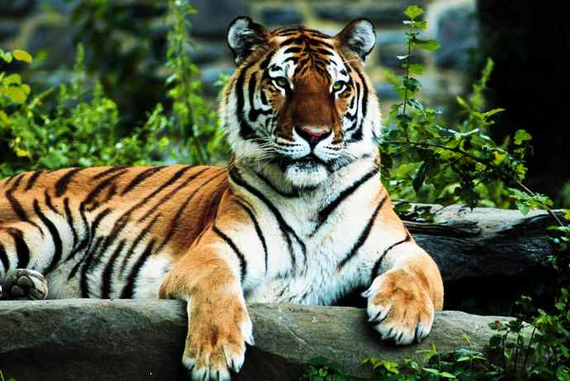
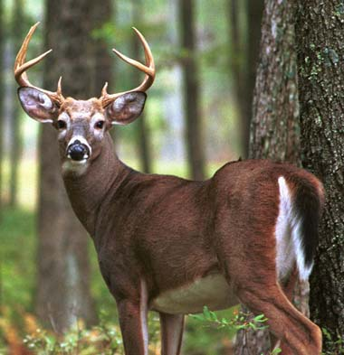
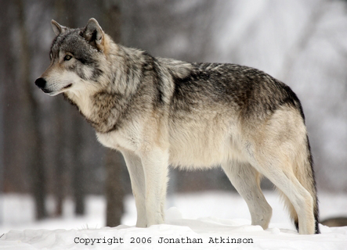
Lesson 8 God’s Questions
Creation

Slide 21
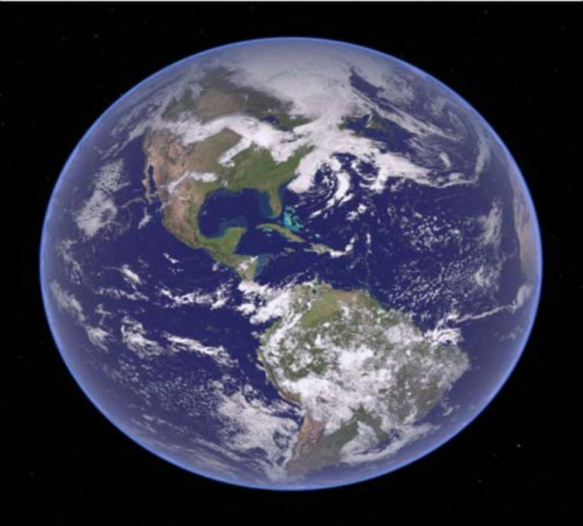
Lesson 8 God’s Questions
“Then the Lord answered Job out of the
whirlwind, and said ……”
Job 38:1

Slide 22
Lesson 8 God’s Questions
God is clearly seen
Romans 1:20

Slide 23
Lesson 8 God’s Questions
Our World
Foundations of the Earth 38:4-7
The sea 38:8-11
Light 38:12-15 , 19-21
Springs in the sea 38:16
Rain 38:25-28

Slide 24
Lesson 8 God’s Questions
Man
Our intellect, emotions 38:36
Animals
God provides 38:39- 41
Take a look at Chapter 39

Slide 25
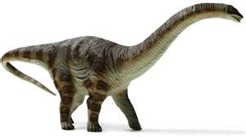
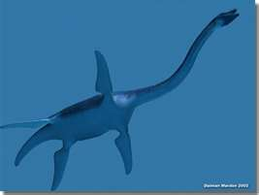
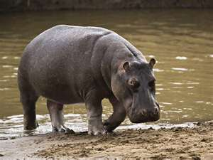
Lesson 8 God’s Questions
The Behemoth – 40:15-24
The Leviathan – 41:1

Slide 26
Lesson 8 God’s Questions
God is Superior
Superior Power – 40:9
Superior Insight – 40:11-14

Slide 27
Lesson 8 God’s Questions
Job’s eyes were opened
42:5-6
“ I have heard of You by the hearing of
the ear, But now my eye sees You.
Therefore I abhor myself, And repent in
dust and ashes.”

