Slide 1
Victory Over Trials
Wednesday Night Bible Class
Dan Fuller

Slide 2
Victory Over Trials
Lesson 7
Silence ?

Slide 3
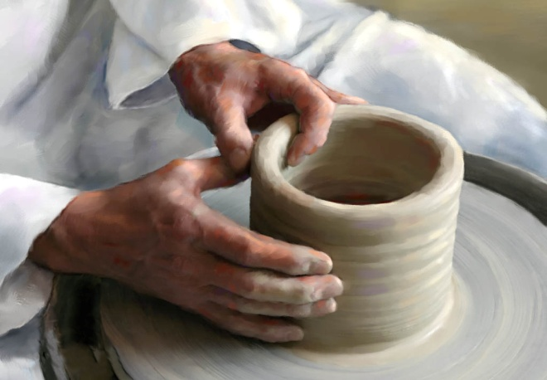
Lesson 7
Silence ?
From lesson 6
The Clay/Potter Principle
Isaiah 64:8 (Jeremiah 18:1-8)
“ But now, O Lord, You are our Father;
We are the clay, and You our potter;
And all we are the work of Your hand.”

Slide 4
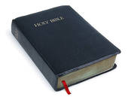
Lesson 7
Silence ?
From lesson 6
God’s Expectations of Us
God expects us to be just.
God expects us to be merciful.
God expects us to be faithful.

Slide 5
Lesson 7
Silence ?
From lesson 6
Why do the wicked prosper?
It rains on the just and the unjust. Matt. 5:45
Our sense of justice can be wrong.
The wicked’s prosperity is fleeting. Psalm 37:2,13
The wicked will be judged. Matthew 25: 30,46
Some charge God foolishly.

Slide 6
Lesson 7
Silence ?
From lesson 6
Joseph is an example of someone
we might think has a reason to be bitter.
Yet he was able to overcome that.
He saw God’s sovereign plan.
Genesis 50:20

Slide 7

Lesson 7
Silence ?
From lesson 6
Is God fair?
God is just.

Slide 8
Lesson 7
Silence ?
From lesson 6
There Will Be Hardship
2 Timothy 2: 3-6
Three different occupations
A soldier
An athlete
A farmer

Slide 9

Lesson 7
Silence?
Is this silence to you?

Slide 10

Lesson 7
Silence ?
Is this silence to you?

Slide 11
Lesson 7
Silence ?
Quotes About Computers
“Computers in the future may weigh no more
than 1.5 tons.” Popular Mechanics, 1949
“I think there is a world market for maybe five
computers.” Thomas Watson, IBM, 1943
“But what is it good for?” IBM engineer
commenting on the microchip, 1977

Slide 12
Lesson 7
Silence ?
Quotes About Computers
“There is no reason anyone would want a
computer in their home.” Ken Olson,
Digital Equipment Corp. 1977
“Everything that can be invented has been
invented.” Charles H. Duell,
U.S. Office of Patents, 1899

Slide 13
Lesson 7
Silence ?
Have you ever had the feeling you
just had to say something?
Jeremiah - Jeremiah 20:9
Elihu - Job 32:19

Slide 14
Lesson 7
Silence ?
Have you ever had the feeling you
just had to say something?
There is a time for everything……
Read Ecclesiastes 3

Slide 15
Lesson 7
Silence ?
Elihu – A look at Job 32
Elihu has his appraisal. 32:21,22
Wrong analysis. 32:12
People are not always wise. 32:9
Wise people listen to God. 32:8

Slide 16
Lesson 7
Silence ?
Elihu – A look at Job 33
Elihu believed he was right. 33:3, 36:2,3
God does not have to give us a reason.
33:12-14.
God disciplines. 33:17-30

Slide 17
Lesson 7
Silence ?
Elihu – A look at Job 34
God is just. 34:12
We can trust God’s judgments. 34:14,15
The bad will not escape. 34:21-29

Slide 18
Lesson 7
Silence ?
Can man be just in God’s eyes? 9:2
We can walk acceptably before
our God. Galatians 2:16, 1 John 1:7-9

Slide 19
Lesson 7
Silence ?
Speaking without knowledge.
Did Job speak without knowledge?
34:35, 35:16, 38:2
He said he did. 42:3-6

Slide 20
Lesson 7
Silence ?
Speaking without knowledge.
In religion – 1 Tim. 1:7, 1 Peter 4:11
In science
In morality
In human relationships

Slide 21
Lesson 7
Silence ?
Tools to equip ourselves
5 Habits of Successful Christians
Put a bridle on your tongue. (James 3)
Be honest; live with integrity.
Make a decision to live right.
Live everyday conscious of God’s
providence.
5. Make Bible class and worship a priority.

